Slide 1
Applying for an Individual
I-CARE User Account

Slide 2
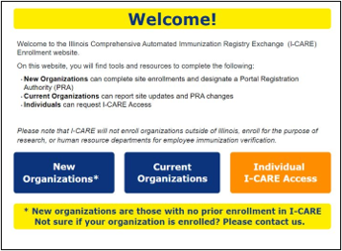
Individual I-CARE Access​
Navigate to the Site:
I-CARE Enrollment - Smartsheet.com
Select Individual I-CARE Access

Slide 3
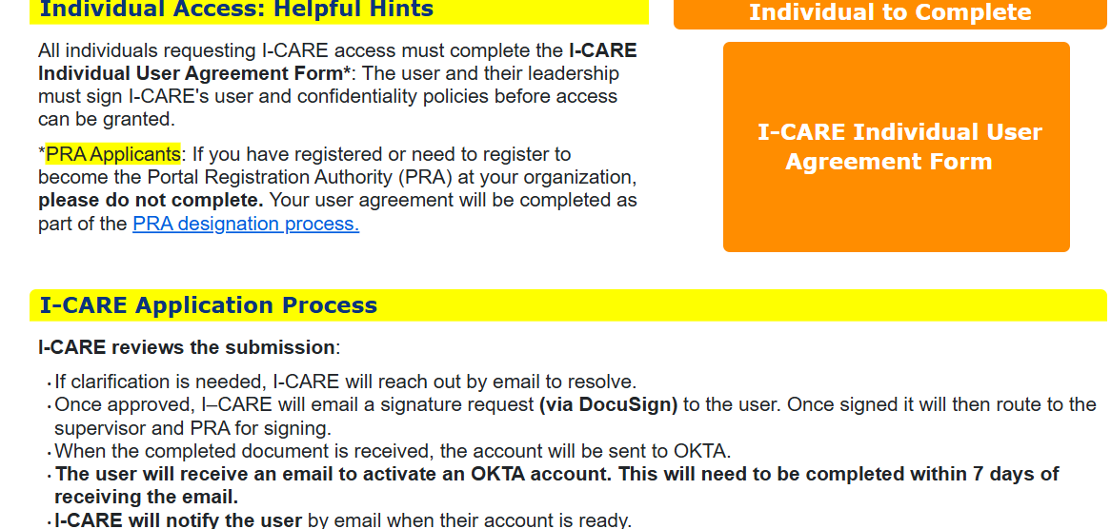
I-CARE Individual User Agreement Form
Select I-CARE Individual User Agreement Form

Slide 4
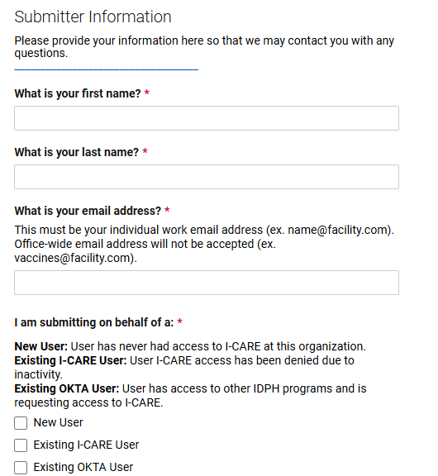
Submitter Information
*Complete all fields with red asterisks.
If submitting for someone else, provide their first and last name, work email address, and phone number.

Slide 5
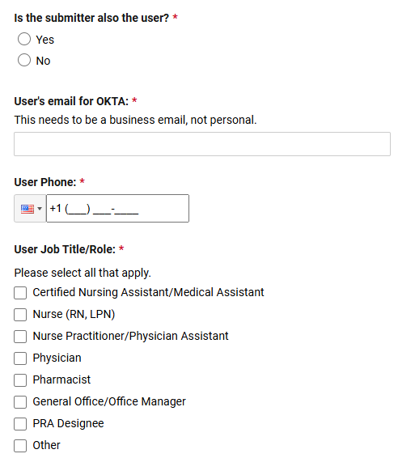
User Information
*Complete all fields with red asterisks.

Slide 6
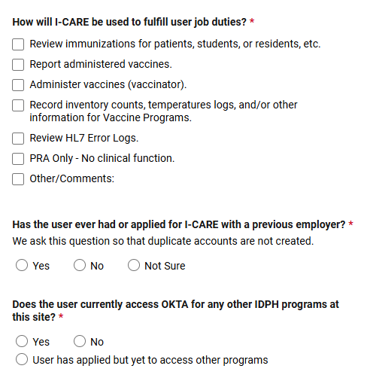
User Information
*Complete all fields with red asterisks.

Slide 7
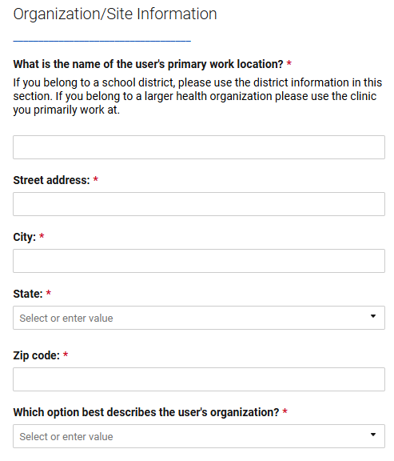
Organization/Site Information
*Complete all fields with red asterisks.

Slide 8
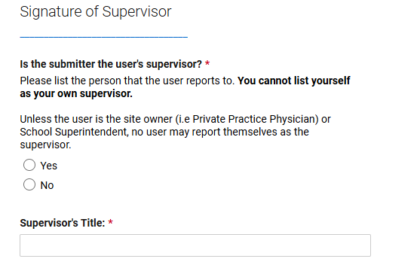
Signature of Supervisor
*Complete all fields with red asterisks.

Slide 9
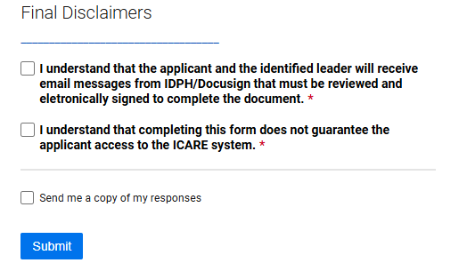
Final Disclaimers
Final Disclaimers: Review the disclaimers, check the boxes to indicate that you understand, and click Submit. You will also have the option to have responses email to you.

Slide 10
Next Steps
The user will receive a DocuSign. This should be signed and then it will be routed to supervisor and then PRA for approvals.
We will process and reach out if there are any questions.
The user will receive an email with login information when it is complete.

Slide 11

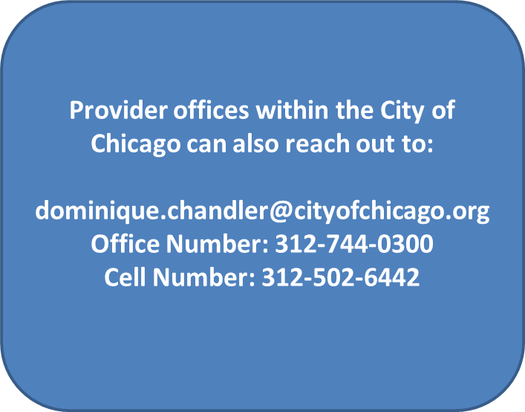
Congratulations!
Your Individual I-CARE Account Has Been Submitted

Slide 12
Thank You!

