Slide 1
Measles Reminder Recall Provider Training
April 30, 2025

Slide 2
Vaccination Recommendations and Schedules
It is essential to understand vaccine recommendations and schedules for patients who are due or overdue for vaccinations.
Updated vaccination schedules can be found on the CDC's website.
Examples of routine and catch-up immunization schedules are included on slides 3, 4, and 5.
It is important to stay up-to-date with recommended immunization schedules, including additional considerations such as medication conditions or other indications.
Some people should not get the MMR vaccine, or they should wait. People should check with their healthcare provider about whether they should get the vaccine, please consult this link for more details:
    https://www.cdc.gov/measles/vaccines/index.html

Slide 3
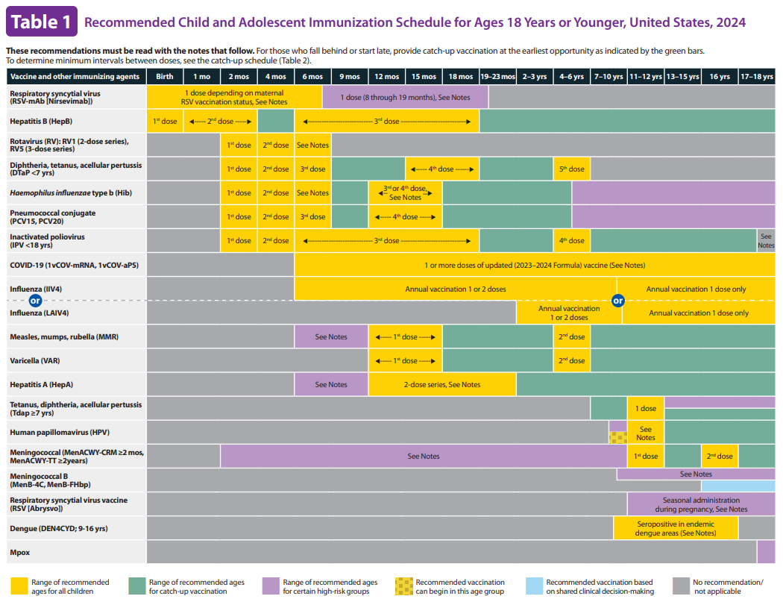
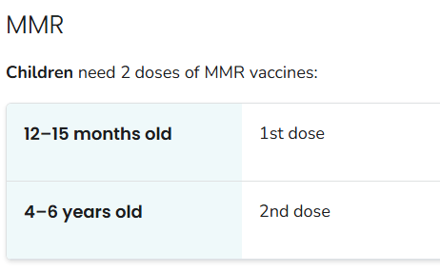
Child and Adolescent Immunization Schedule

Slide 4
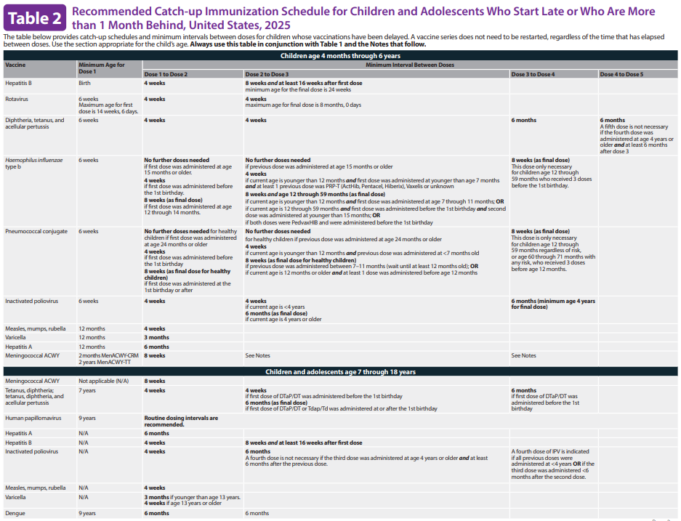
Child and Adolescent Catch-up Immunization Schedule

Slide 5
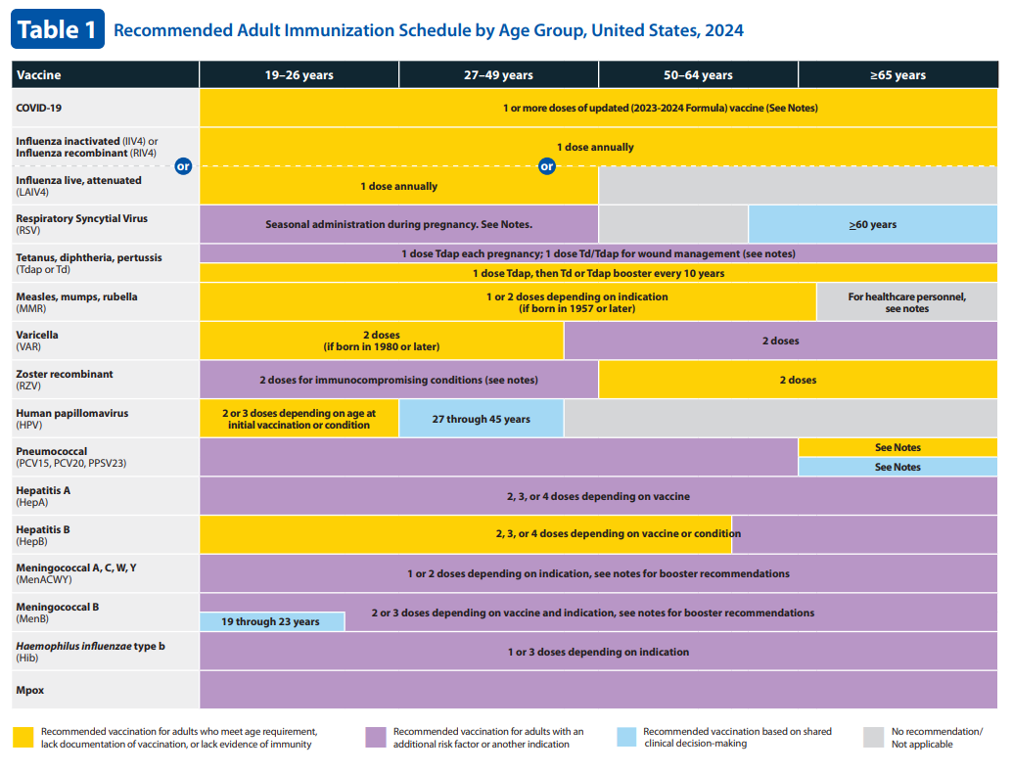
Adult Immunization Schedule

Slide 6
Measles International Travel Recommendations
Protect yourself against measles
The best way to protect yourself and your loved ones is by getting the measles, mumps, and rubella (MMR) vaccine. You should plan to be fully vaccinated against measles at least 2 weeks before you depart.
  Two doses of MMR vaccine provide 97% protection against measles.
  One dose provides 93% protection.
Infants under 12 months old traveling
  Get an early infant dose at 6 through 11 months.
  Follow the recommended schedule and get:
    Another dose at 12 through 15 months.
    A final dose at 4 through 6 years
Children over 12 months old
  Get first dose immediately.
  Get second dose 28 days after first dose
Teens & adults with no evidence of immunity*
  Get first dose immediately.
  Get second dose 28 days after first dose.
    *Acceptable evidence of immunity against measles includes at least one of the following:
  Written documentation of adequate vaccination
  Laboratory evidence of immunity
  Laboratory confirmation of measles
  Birth in the United States before 1957

Slide 7
Measles in 2025
As of April 24, 2025, a total of 884 confirmed* measles cases were reported by 30 jurisdictions in the US in 2025. 97% of cases have been unvaccinated or have unknown vaccine status.
CDPH is encouraging all eligible children ages 12 months and older to get their measles, mumps, and rubella (MMR) vaccinations using routine or catch-up schedules in order to be protected from the measles virus.
Thus far, there have been a total of 2 pediatric deaths in unvaccinated patients in 2025, making it ever more important to ensure our children get vaccinated.

Slide 8
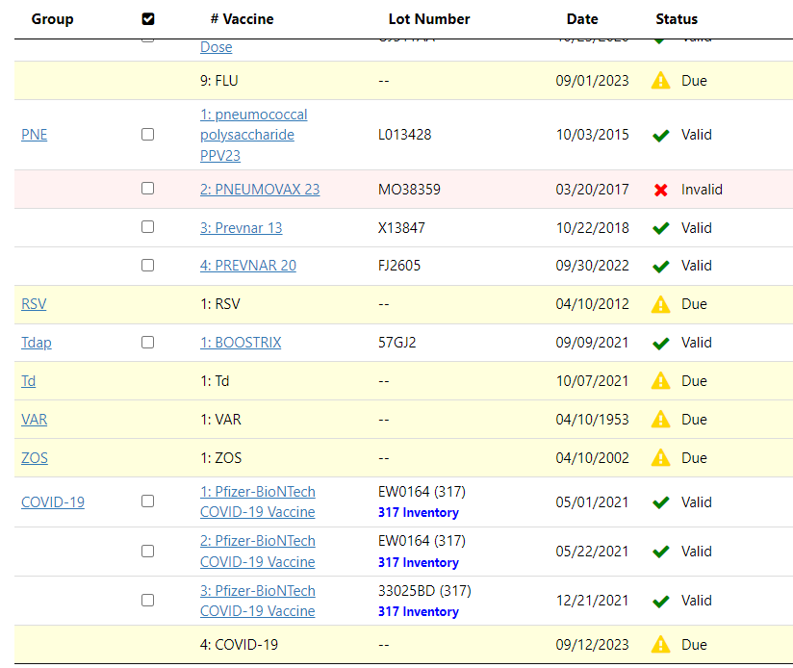
Reminder Recall
Reminder recall is a helpful tool for ensuring that patients who are due or overdue for vaccinations are notified
  Reminder: immunizations are coming due
  Recall: immunizations are past due
I-CARE can be utilized to see which patients are due/overdue for their
MMR vaccination
There are two reports in I-CARE that can be utilized to generate vaccination reminder recall letters:
  Customize Letters
  Reminder Recall

Slide 9
What is the difference between customize letters and reminder recall?
Customize letters lets providers design their own letters in I-CARE that they want to send out to patients
Reminder Recall allows providers to generate letters and postcards that match a specific search criteria

Slide 10

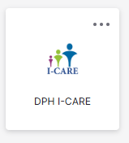
Accessing I-CARE
1. Navigate to the https://ilpartner.illinois.gov/
2. Log in using your username and password
3. Select the “DPH I-CARE”
Icon under the My apps section> I-CARE

Slide 11
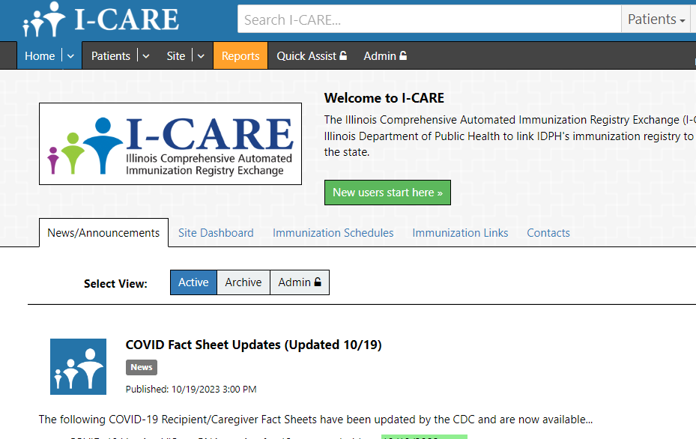
Navigate to Reports
On the I-CARE landing page, navigate to the “Reports” tab on the menu in the upper left-hand corner

Slide 12
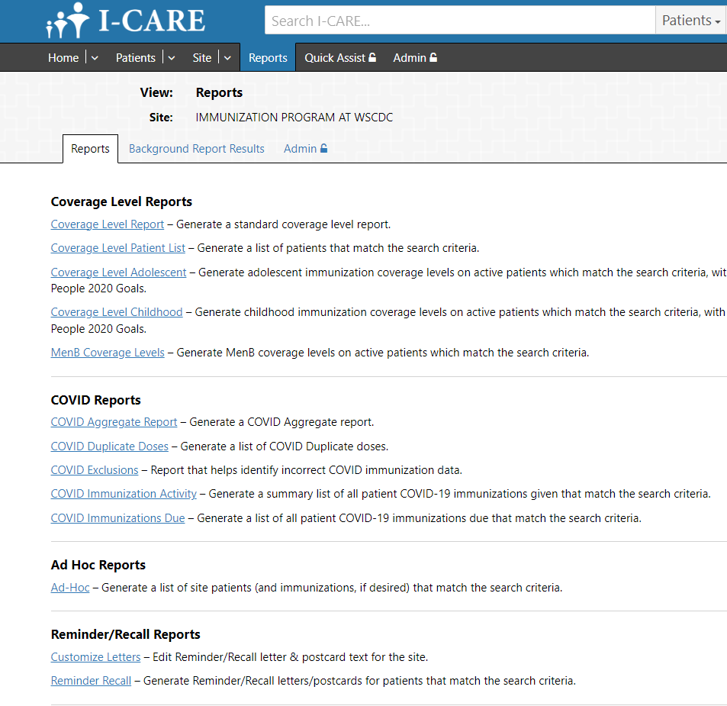

Find Reminder Recall Reports – Customize Letters
Once on the “Reports” page, navigate to the Reminder/Recall section to find the two reports we want to run
Customize Letters
Reminder Recall

Slide 13
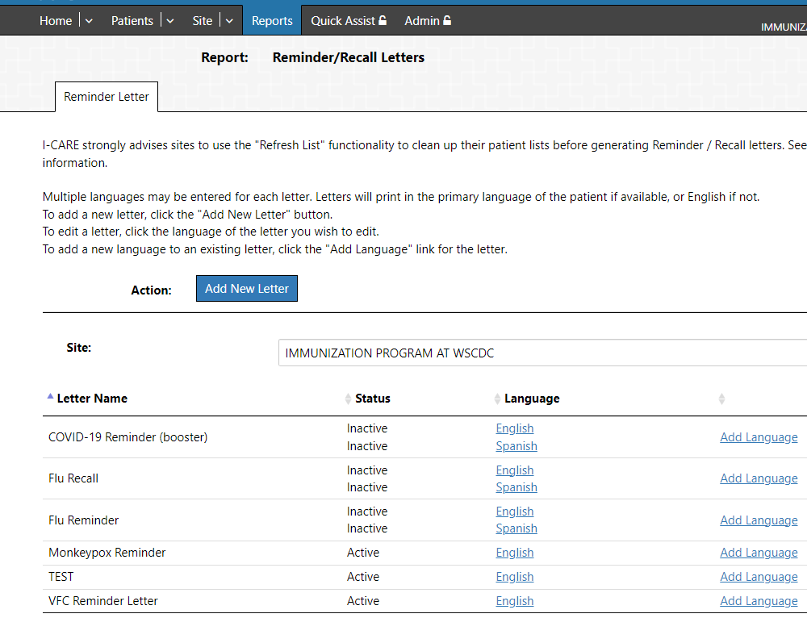
Customized Letter Report
This report lets providers design their own letters to send to patients
Letters can be used to provide a reminder for patients who are due or overdue for a vaccine
New letters can be added here OR existing letters can be edited or added in a new language
*ADD NEW LETTER HERE
*EDIT EXISTING LETTER HERE
*ADD LANGUAGE HERE

Slide 14
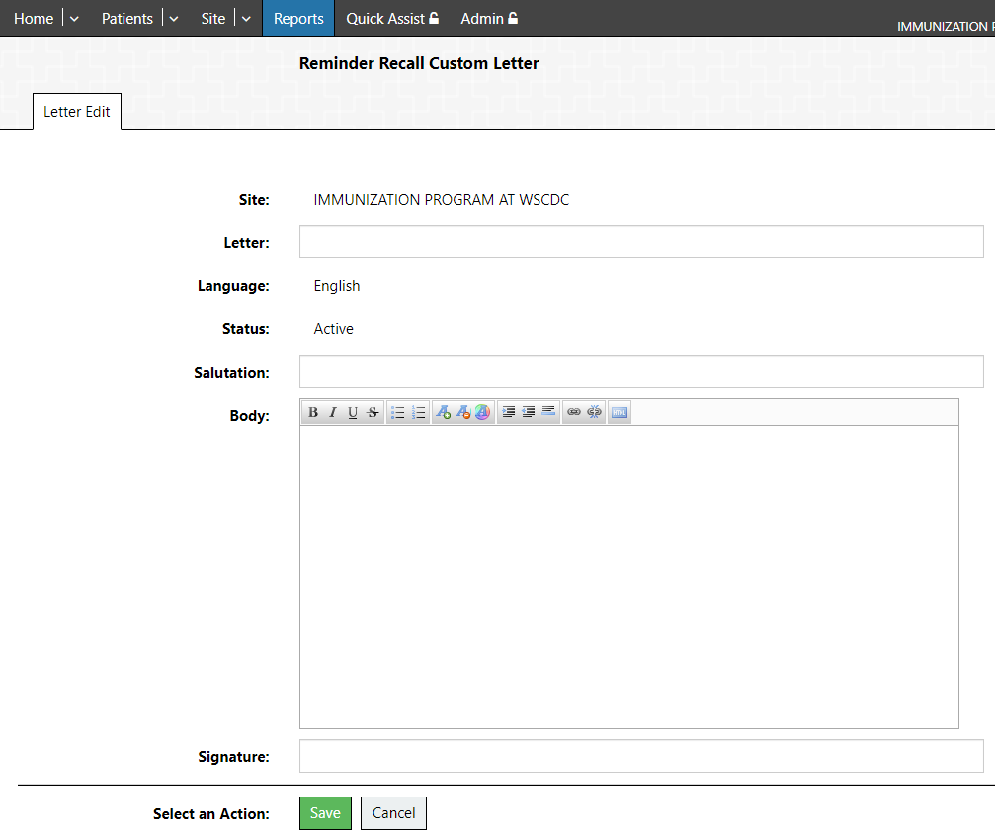
Customized Letter Report
Letter: Title of your letter (e.g. Pediatric Flu Vaccine Reminder)
Salutation: Greeting (e.g. Hello, Dear Resident, Dear Parent/Guardian)
Body: Unique content that site wants to share with patients or parents/guardians
Signature: Site or Provider Name
Save letter once complete

Slide 15
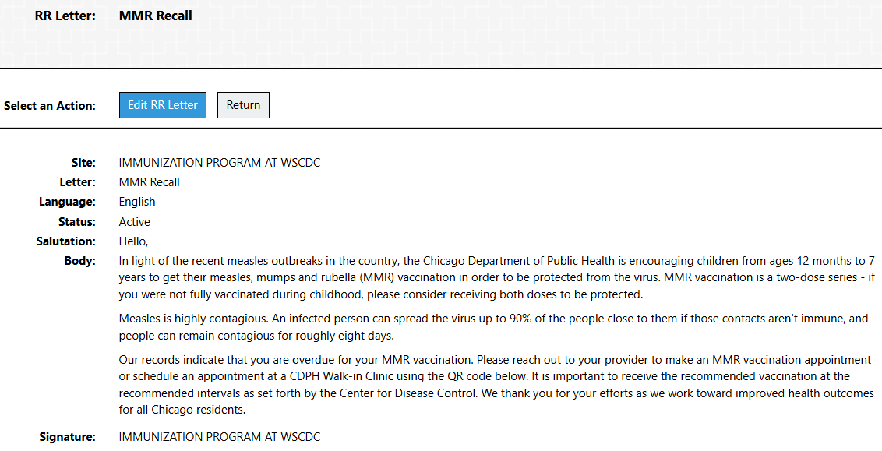
Customized Letter Report
Once you hit save, a preview of your letter will be generated in the next page

Slide 16

Find Reminder Recall Reports – Reminder Recall
Once on the “Reports” page, navigate to the Reminder/Recall section to find the two reports we want to run
Customize Letters
Reminder Recall

Slide 17
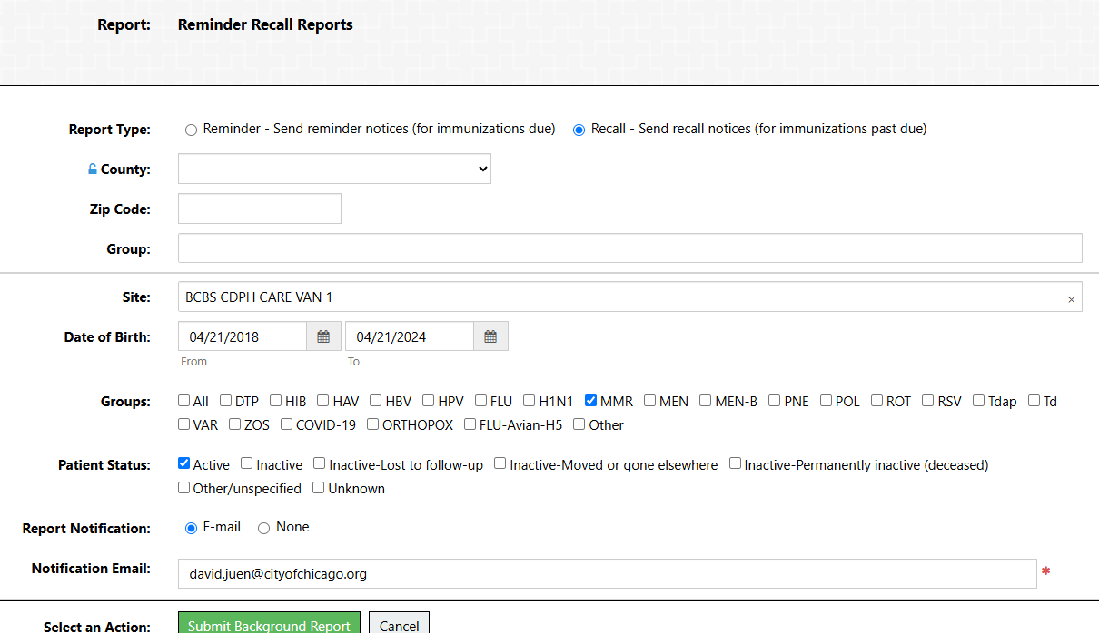
Reminder Recall Report
The reminder/recall report lets providers generate letters that match a specific search criteria
*Note: ensure that you are choosing the correct type of report (Reminder or Recall)
Select the Recall option for immunizations past due
Input the patient date of birth range desired (12 months to 7 years old)
Select MMR in the vaccine group
Ensure that you fill out all relevant fields
Select “Submit Background Report” once finished

Slide 18
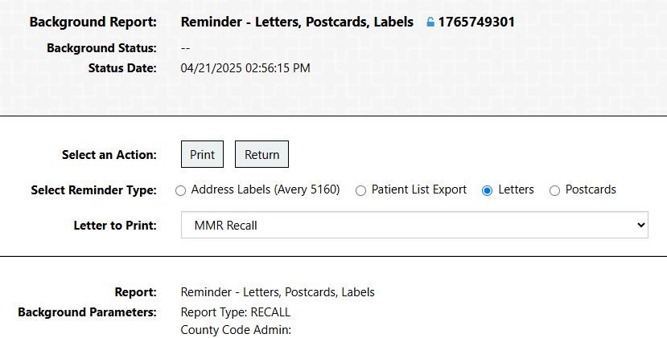



Reminder Recall Background Report
You will receive an email when the report is completed. This will generate options for providers to send out reminder types such as letters and postcards
Select which reminder type you would like to send
Select which letter you would like to send from the drop-down
You also will have the option to include immunization due dates
Select “Print” when finished to generate letters

Slide 19
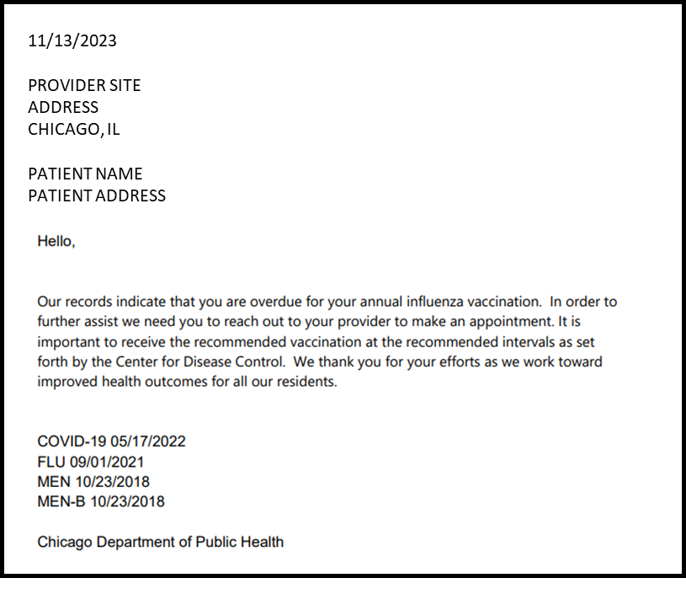
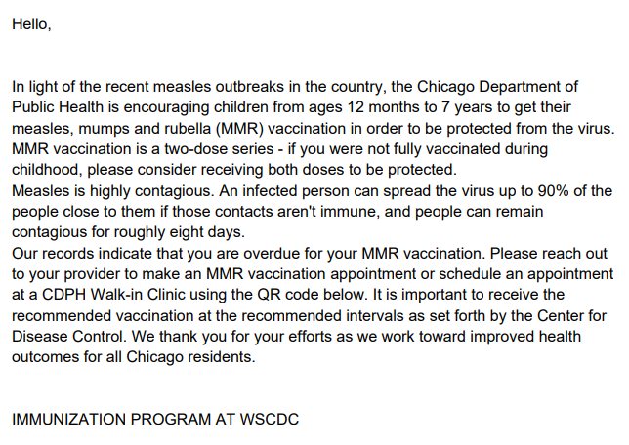
Reminder Recall Letters
A PDF of unique reminder/recall letters will be generated after selecting “Print”
You now have a list of personalized letters to send out to patients who have upcoming vaccines or who are overdue for vaccines (Perform the vaccination reminder or recall)

Slide 20
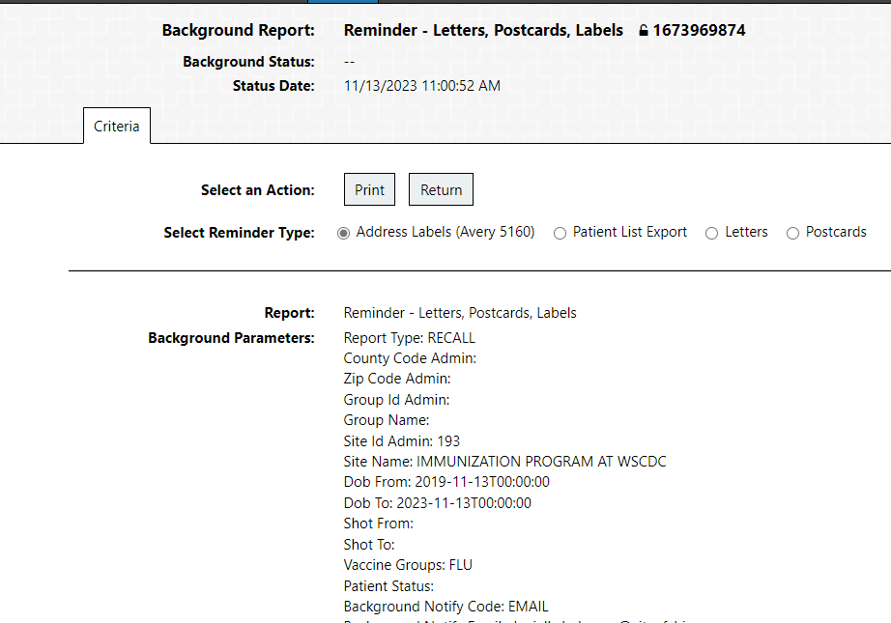

Reminder Recall Address Labels
Address labels to mail the personalized reminder/recall letters can also be created in I-CARE
Using the same background report, you can select the option for “Address Labels” and then hit “Print”
This will create a PDF document of labels with patient Name and Address that can be printed onto labels

Slide 21
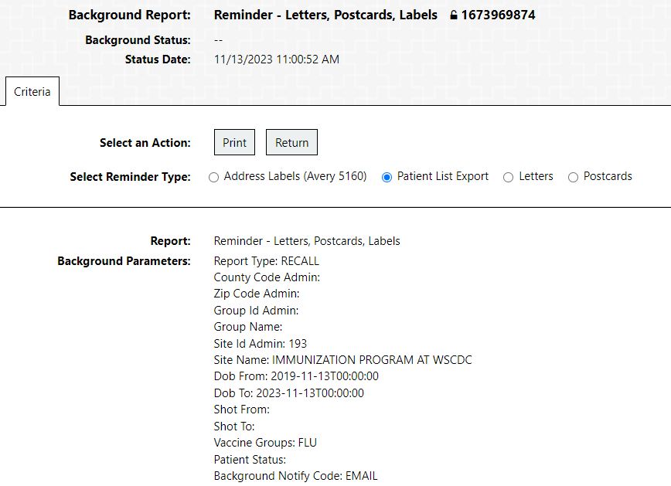

Generate and Export Patient List
Navigate to the same Reminder/Recall Background report
A list of patients who are due/overdue for vaccinations can be generated using this same report
On the background report, select “Patient List Export” and then “Print”
This will generate an Excel file with relevant patient information that can be downloaded and used in a mail merge to create unique letters

Slide 22
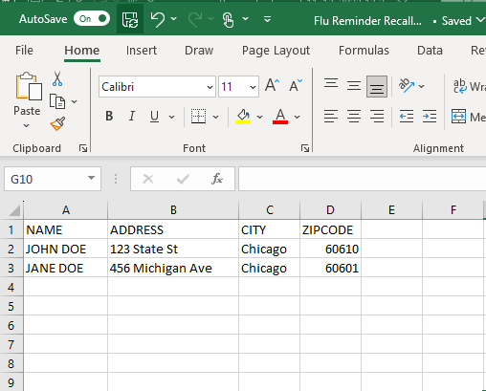
Edit and Save Spreadsheet File
The exported spreadsheet file will act as the list of individuals you are sending letters to
Open the spreadsheet file
Add column names to relevant fields such as Name, Address, Email, Zip code, etc.
Save spreadsheet file
This file can be used for mail merge, outreach to patients, send text reminders, etc.

Slide 23
Recap of Reminder Recall
Reminder recall is a helpful tool for ensuring that patients who are due or overdue for vaccinations are notified
You can customize letters to send out to patients
You can generate letters and postcards that match a specific search criteria
You can generate address labels and export a patient list
It is important for patients to stay up-to-date with recommended immunization schedules

Slide 24
Thank you for doing your part in protecting Chicago children from Measles

