Slide 1
Chicago Long Term Care
Roundtable
7.31.25

Slide 2
Agenda
Surveillance Updates
IDPH XDRO Memo
Nebulizer IPC
LTC Resident Vaccination Requirements
Heat Mitigation Toolkit for Long Term Care
Upcoming Events
Questions & Answers

Slide 3
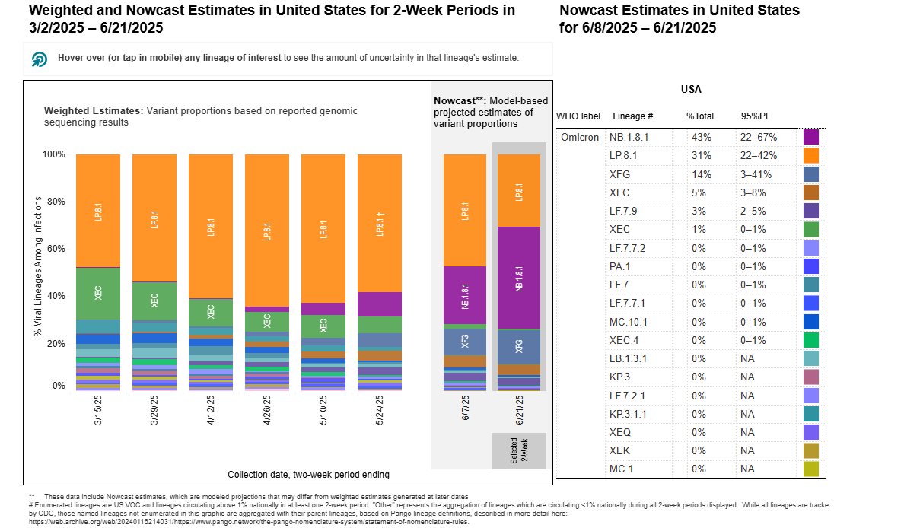
COVID-19 Variant Proportions
Source: https://covid.cdc.gov/covid-data-tracker/#variant-proportions

Slide 4
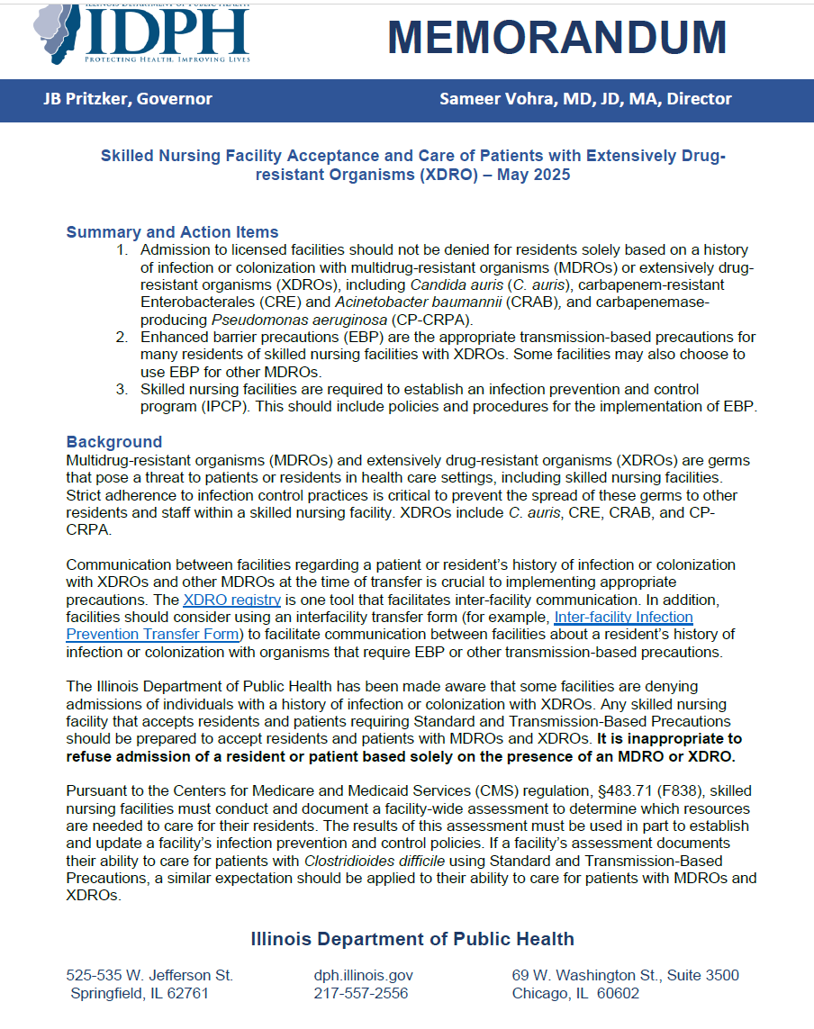
New IDPH Memo: Residents with XDROs
Admission to SNFs should not be denied based solely on a resident’s XDRO status
  Example: You should not deny a resident admission to your facility just because they have C. auris, CRAB, CRE, and/or CP-CRPA
Use enhanced barrier precautions (EBP) for residents with XDRO colonization/infection

Slide 5
Reminder: XDRO Registry
An approved user from your facility should check the XDRO registry for all new admissions
Residents admitted to your facility with XDRO colonization or infection must be placed on EBP and cohorted appropriately (e.g., do not put a resident with C. auris in a room with other residents who do not have C. auris)
  Reminder that residents with XDRO colonization or infection, even if currently receiving treatment, do not need to be placed on contact precautions unless otherwise indicated. As always, please make sure your policies align with your practices.
If you need assistance with XDRO registration, please contact Shaunette Neal at Shaunette.Neal@cityofchicago.org

Slide 6
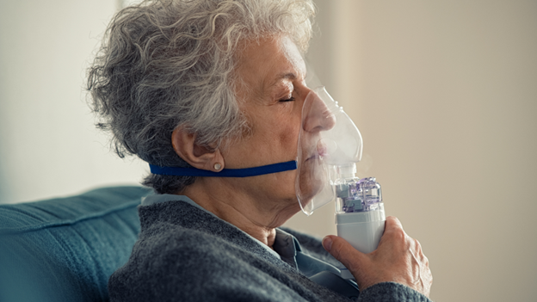
Nebulizers
Device that turns liquid medications into a mist that can be inhaled
Can deliver medication deep into the lungs
Often used for conditions such as:
  Asthma
  COPD
  Cystic Fibrosis
  Bronchiectasis
Source: https://www.lung.org/getmedia/3124fe1d-abc5-4741-8c17-bc8a449ea67b/ABCs-Nebulizer-V2-4-6-2020_new-branding.pdf?ext=.pdf; https://www.citymd.com/health-and-wellness/inhaling-relief-how-nebulizer-treatments-help-respiratory-conditions

Slide 7
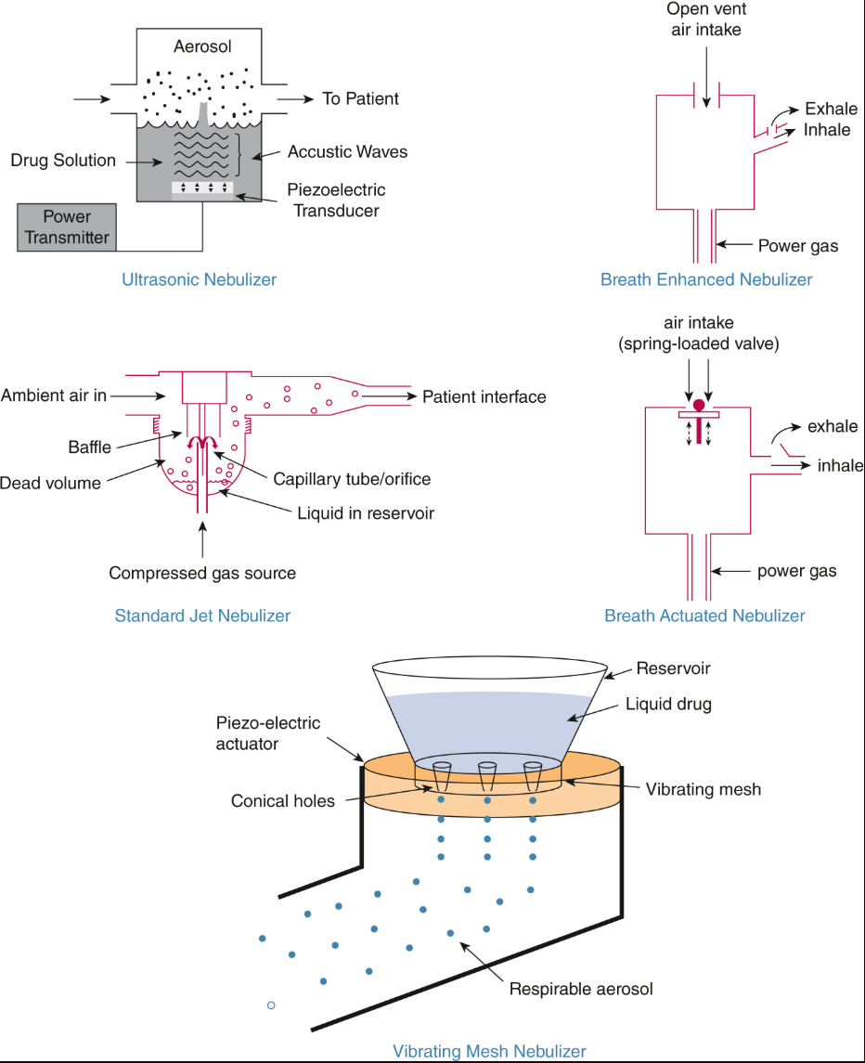
Types of Nebulizers
Jet nebulizer
  Uses compressed gas to create a fine mist
Ultrasonic nebulizer
  Uses high-frequency vibrations (instead of air/gas) to break down the liquid into tiny particles
Vibrating mesh nebulizer
  Uses the energy of ultrasonic frequencies to vibrate mesh to generate aerosols
Source: https://pmc.ncbi.nlm.nih.gov/articles/PMC8108015/; https://nebology.com/blogs/education/what-are-the-different-types-of-nebulizers?srsltid=AfmBOoq3BI2U1dygT7aNjmKXUoVIoeW9oTg9NrO93Hr9mVmeC58cD1aN; https://www.sciencedirect.com/science/article/pii/S0012369223057082; https://nebology.com/blogs/education/what-are-the-different-types-of-nebulizers?srsltid=AfmBOoq3BI2U1dygT7aNjmKXUoVIoeW9oTg9NrO93Hr9mVmeC58cD1aN

Slide 8
Risks
Nebulizers can be contaminated with pathogens if not cleaned and disinfected appropriately, which can lead to nosocomial pneumonia
Outbreaks associated with nebulizers in healthcare settings have been caused by:
  Acinetobacter spp.
  MRSA
  Pseudomonas aeruginosa
  Burkholderia cepacian
Source: https://pmc.ncbi.nlm.nih.gov/articles/PMC8108015/

Slide 9
Best Practices
Perform hand hygiene to avoid contamination
Do not share nebulizers between multiple residents
Between treatments for reusable nebulizers:
  Take apart the nebulizer
  Clean and disinfect the components (e.g., reservoirs, masks, tubing) according to the manufacturer’s instructions for use
  Rinse with sterile water (not tap water)
Allow to dry and store in a manner that prevents contamination
Use only sterile fluid and medication and dispense into the nebulizer aseptically
  When filling nebulizers with medication, the dropper tip should not touch the nebulizer reservoir
Source: https://pmc.ncbi.nlm.nih.gov/articles/PMC8108015/; Schweon, S. J., & Danko, J. (2023). Respiratory care services. In Infection prevention for practice settings and service-specific patient care areas. Association for Professionals in Infection Control and Epidemiology. https://text.apic.org/toc/infection-prevention-for-practice-settings-and-service-specific-patient-care-areas/respiratory-care-services/

Slide 10
Resident Vaccination Requirements: Influenza
As per the Illinois Administrative Code:
  A facility should administer/arrange for annual administration of the influenza vaccination for each resident according to ACIP recommendations unless the resident has already received the annual vaccination, the vaccine is medically contraindicated, or the resident refuses
  Influenza vaccinations for residents should be completed by November 30th of each year (or as soon as possible if vaccines aren’t available before November 1st)
  Residents who are admitted during flu season but after November 30th should receive an influenza vaccination as soon as possible
  The facility must document in the resident’s medical record whether the influenza vaccination was:
    Administered or
    Refused or
    Medically Contraindicated
Source: https://www.ilga.gov/agencies/JCAR/EntirePart?titlepart=07700300

Slide 11
Resident Vaccination Requirements: Pneumococcal
As per the Illinois Administrative Code:
  A facility should administer/arrange for administration of a pneumococcal vaccination for each resident according to ACIP recommendations unless the resident has already received it, it is medically contraindicated, or the resident refuses
  The facility should document in the resident’s medical record whether the pneumococcal vaccination was:
    Administered or
    Refused or
    Medically Contraindicated
Source: https://www.ilga.gov/agencies/JCAR/EntirePart?titlepart=07700300

Slide 12
Resident Vaccination Requirements: Hepatitis B
As per the Illinois Administrative Code:
  Facilities must document within the resident’s medical record whether the resident has been immunized against Hepatitis B
  Susceptible (i.e., unvaccinated) residents shall be offered Hepatitis B immunization within 10 days of admission
    Note that Hepatitis B is a multiple dose vaccine series (either 2 or 3 doses depending on the type of vaccine)
Source: https://www.ilga.gov/agencies/JCAR/EntirePart?titlepart=07700300; https://www.cdc.gov/hepatitis-b/vaccination/index.html

Slide 13
Resident Vaccination Requirements: Education
As per the Illinois Administrative Code:
  A facility shall distribute educational information on all vaccines recommended by the ACIP including, but not limited to, the risks associated with shingles and how to protect oneself against the varicella zoster virus
  The facility shall provide this information to each newly admitted resident and all residents who request this information
  The facility may distribute the information to residents electronically
CDC’s Recommended Adult Immunization Schedule can be found here
Information about shingles, including prevention/protection, can be found here
Source: https://www.ilga.gov/agencies/JCAR/EntirePart?titlepart=07700300; https://www.cdc.gov/vaccines/hcp/imz-schedules/downloads/adult/adult-combined-schedule.pdf; https://www.cdc.gov/shingles/about/index.html

Slide 14


Emergency Preparedness
Heat Mitigation

Slide 15
CMS Regulations for Skilled Nursing Homes
Appendix PP (SNF federal regulation) includes:
  F584 –Safe Environment
  483.10(i)(6) Comfortable and safe temperature levels. Facilities initially certified after October 1, 1990, must maintain a temperature range of 71°F to 81°F.

Slide 16
Illinois Skilled Nursing Regulations for Heat Management
Ill. Admin. Code tit. 77, §330.3170 – Heating and Cooling
  “Areas of a nursing home used by residents of the nursing home shall be airconditioned and heated by means of operable air-conditioning and heating equipment. The areas subject to this air-conditioning and heating requirement include, without limitation, bedrooms or common areas such as sitting rooms, activity rooms, living rooms, community rooms, and dining rooms.”
Illinois Administrative Code title 77 §330.770(j)
  The air-conditioning system shall be capable of maintaining an ambient temperature of between 75° and 80° F.

Slide 17
Heat Related Illness In Older Adults
As we age, our ability to adequately respond to heat and regulate our internal body temperature can become a serious problem during heat emergencies. This is especially true in long term care facilities. Older residents are at significant increased risk of heat related illnesses. Heat related illnesses include heat cramps, heat syncope (passing out from heat), heat exhaustion, and heat stroke.
(Source: CDPH Heat Preparedness)
Experts at the National Institute on Aging, part of the National Institutes of Health, report key risk factors (Source: NIH News/Events)

Slide 18
Key Risk Factors for Older Adults in Long Term Care Facilities
Age-related changes to the skin- as poor blood circulation, inefﬁcient sweat glands.
Heart, lung, and kidney diseases, as well as any illness that causes general weakness or fever.
  High blood pressure or other conditions that require changes in diet, such as salt- restricted diets.
  Reduced sweating, caused by medications such as diuretics, sedatives, tranquilizers, and certain heart and blood pressure drugs.
Taking several drugs for various conditions.
Multiple chronic or complex medical conditions; co-morbidities
Being substantially overweight or underweight.
Being dehydrated.
(Source: NIH News/Events)

Slide 19
Types of Heat Related Illness
Heat Rash: A skin irritation caused by blocked sweat glands.
Heat Cramps: Painful muscle spasms caused by dehydration and electrolyte loss.
Heat Exhaustion: A more serious condition characterized by symptoms such as weakness, dizziness, nausea, vomiting, and heavy sweating.
Heat Stroke: The most severe form of heat related illness, where the body’s core temperature rises above 104°F (40°C) and includes symptoms such as confusion, slurred speech, seizures, decrease consciousness. This is a serious life-threatening medical emergency.
  (Source: CDPH Heat Preparedness)

Slide 20
Common Signs of Heat Related Illness
Sweating (excessive or none at all)
Headache
Nausea and vomiting
Dizziness and lightheadedness
Confusion and disorientation
Rapid heart rate
High body temperature
(Source: CDPH Heat Preparedness)

Slide 21
Take Necessary Precautions to Prevent Serious Health Effects
Keep residents cool: Keep residents in air-conditioned areas. If there is no back up power to shelter in place in a power outage in your facility, consult your Emergency Plan for evacuation procedures. If evacuation is necessary, please call 311 or the CDPH PHEOC.
Keep residents hydrated: Provide residents with two to four cups of water every hour if possible. Monitor fluid intake throughout any power outage.
Stay informed: Check your local news for extreme heat warnings and safety tips. Visit the Chicago OEMC web page at Chicago.gov/OEMC to find local information and tips for preventing heat sickness and to sign up for free alerts to your phone. Locations of cooling centers can be found here, cooling centers.

Slide 22
Tips to Prepare for Power Outage in a Long-Term Care Facility for Heat Related Illness
Be familiar with your facility’s plan for managing cooling, utilizing backup power, mobilizing supplies and communication with utility partners and the CDPH PHEOC if you can shelter in place.
You should also have an evacuation location planned in advance with transportation support, should the situation require moving or transferring residents.

Slide 23
Develop a Comprehensive Emergency Plan
Emergency Planning is Critical
All facilities, including assisted living, should have a clear, updated emergency plan.
Even if not required, assisted living centers need a disaster framework to protect resident health and safety.
Plans must address power outages, that include:
Contact information for local utility companies and emergency services.
Clear instructions on how to use backup power sources.
Evacuation routes and procedures and an agreed upon location. Transportation to an evacuation location should also be considered

Slide 24
Stock Up on Essential Supplies
Ensure that the facility is well-stocked with essential supplies such as:
  Non-perishable food and bottled water.
  Battery-operated flashlights and lanterns.
  Extra batteries and portable chargers.
  Inventory your Emergency Kit (See recommendations for an Emergency Kit to follow).

Slide 25
Emergency Kit Inventory List for Heat Related Disaster
(This list courtesy of the Arizona Department of Health Services and the Arizona Health Care Associations)
Cooling tools and ice packs
Sun block and lip balm
Coral rehydration salts
Coolers
Bottled water
Emergency contact list for family members, guardians, responsible parties
2-Port Ultra-Portable Charger, charged cell phones
Fans, battery operated, and power based
Hand sanitizer
8 LED flashlights
2 Emergency Hand Crank Self-Powered AM/FM NOAA Solar Weather Radio with LED flashlight, 1000mAh Power Bank
Every Read First Aid Fully Stocked First Responder
A collection of essential gear to treat a wide variety of injuries and emergencies
Double Bandage Kit
Dual tube stethoscope
Blood pressure cuff
Adult CPR mask

Slide 26
Emergency Kit Inventory List for Heat Related Disaster (cont.)
(This list courtesy of the Arizona Department of Health Services and the Arizona Health Care Associations)
16/3 Vinyl 50-foot extension cord
2-6 Outlet Surge Protector Power Strips
Handheld bullhorn loudspeaker
Basic tool kit
ICS vests
!D bracelets/nametags
Blankets, lightweight clothing
Survival snacks, Cliff bars/ protein bars, emergency meals, protein drinks
Sweet snacks, candy (no hard candy due to choking risk)
Cereal, crackers
Games, puzzles, card, iPad, electronic games, paper and writing tools, coloring books, crayons
Music and headphones

Slide 27
Assess Back Up Power
Generators can provide critical electricity during a power outage. Ensure that they are:
  Regularly maintained and tested.
  Fuel supplies are ample and safely stored

Slide 28
Develop a Communication Plan
Establish a communication plan to keep residents, staff, and families informed. This should include:
  A list of emergency contacts, local first responders, evacuation site partners
  Methods for regular updates for all stakeholders (e.g., text messages, phone calls).
  A list of payer partners to contact, along with regulatory agencies.

Slide 29
Staff Training on Heat Impact on Long-Term Care Residents
Extreme heat poses serious risks to elderly residents in long-term care, making staff training essential. Training should cover signs of heat-related illness, hydration practices, and emergency response protocols.
Recognizing Heat Related Illnesses
  Common Symptoms
    Staff must be able to identify the early signs of heat related illnesses, which can include dizziness, nausea, excessive sweating, headache, rapid heartbeat, and confusion. Awareness of these symptoms allows for swift intervention and treatment.
  Monitoring and Assessment
    Regular monitoring of residents’ body temperatures and overall condition is crucial. Staff should conduct frequent checks, especially during heatwaves, to detect any abnormal changes promptly. Keeping detailed records of each resident’s health status can aid in early detection and response

Slide 30
Hydration Techniques
Encouraging Fluid Intake
  Ensuring that residents stay hydrated is a key preventive measure. Staff should encourage and assist residents in drinking fluids regularly, offering water and electrolyte solutions throughout the day. Special attention should be given to residents with conditions that may limit their fluid intake.
Monitoring Fluid Intake
  Documenting and monitoring fluid intake can help prevent dehydration. Staff should note the amount and frequency of fluids consumed by each resident and be vigilant for signs of dehydration such as confusion, dry mouth, sunken eyes, and decreased urine output.

Slide 31
Emergency Response Protocols
Immediate Actions
  In the event of a heat related emergency, staff should follow established protocols in the facility Emergency Plan to provide immediate care. This includes moving the resident to a cooler area, providing fluids, and using cooling techniques such as wet towels or fans.
Calling for Medical Assistance
  If a resident exhibits severe symptoms of heat related illness, such as fainting or unconsciousness, staff should seek medical assistance immediately. Knowing when to escalate the situation to health care professionals, including medical directors, nurses and first responders is critical for the resident’s safety.

Slide 32
Emergency Response Protocols
Resident Care Training Tips
  In training sessions, supplies and cooling resources should be discussed as part of the curriculum.
  Ensure cooling supplies are available for your patients and residents (e.g. cooling jackets, ice water baths) and appropriate support to avoid injury.
  Provide cooling options/areas, available for several hours each day, (designated cool room, cool showers, fan, sponging with cool water).
  Keep medications cool (storage below 78°F for room temperature is typical).
  Ensure meals with high water content are prepared and spoiled food is discarded

Slide 33
Contact Phone Numbers
ComEd Customer Service 1/800-334-7661
Chicago City Services 311
OEMC 312/746-9111
CDPH PHEOC 312/742-7921

Slide 34


Questions?
Mark.McCarville@cityofchicago.org
A special thanks to the Arizona Health Care Association and the Arizona Department of Health Services for allowing us to use the original document.

Slide 35

One more thing…Site Visits
I am back on the road and back to visiting Chicago’s, Long-Term Care Facilities
For those facilities that I haven’t visited yet, please follow the link below to schedule an appointment for me to stop by
All I’m asking for is 2-hours of your busy schedules to go over Emergency Operations Plan, with a fresh set of eyes
You have nothing to lose and everything to gain from this visit
Questions? Mark.mccarville@cityofchicago.org or 312/747-9581

Slide 36
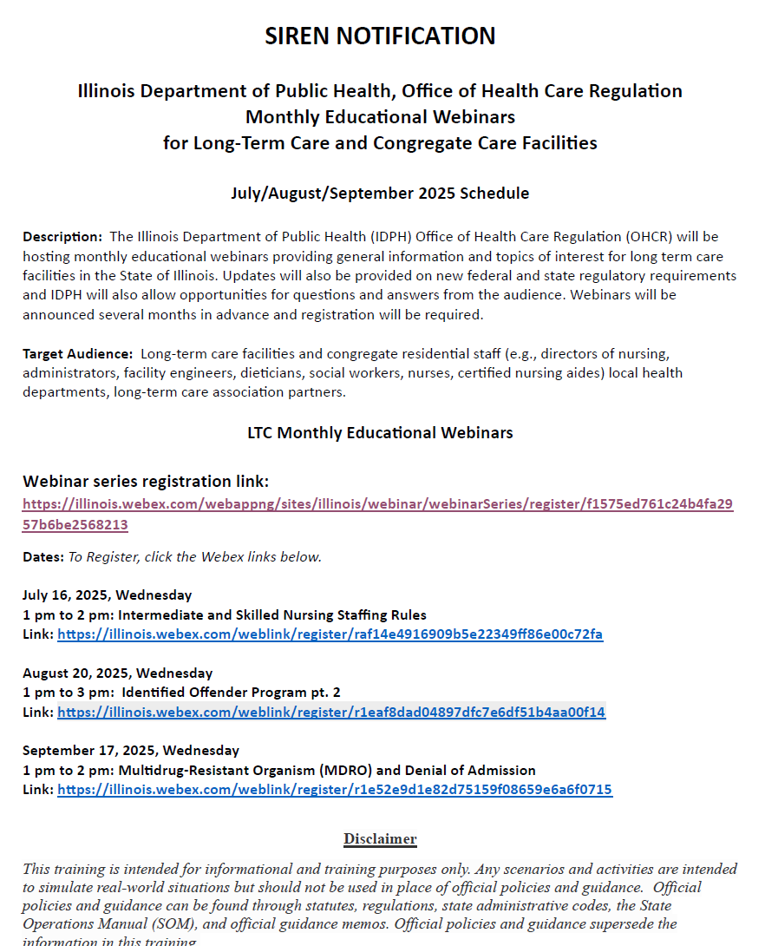
Upcoming Webinars
IDPH Office of Health Care Regulation (OHCR) has a series of webinars for long-term care facilities
Upcoming webinars are on the identified offenders program and denial of admission due to MDROs
To participate, register here

Slide 37
Questions & Answers
For additional resources and upcoming events, please visit the CDPH LTCF HAN page at: https://www.chicagohan.org/covid-19/LTCF

