Slide 1
COVID-19
Chicago Long Term Care
Roundtable
1.30.25

Slide 2
Agenda
Respiratory Disease Epi & Surveillance
New IDPH Guidance & Resources
Acute Gastroenteritis/Norovirus 101
H5N1 Update
Updated NHSN Requirements for LTCFs
Questions & Answers

Slide 3
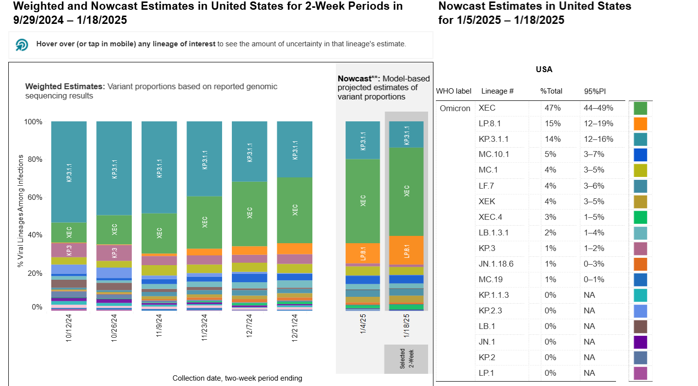
COVID-19 Variant Proportions
Source: https://covid.cdc.gov/covid-data-tracker/#variant-proportions

Slide 4
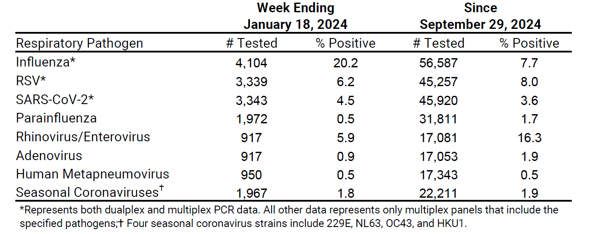
Chicago Respiratory Virus Surveillance Report – Current Week & Cumulative
Source: Chicago Respiratory Virus Weekly Surveillance Report

Slide 5
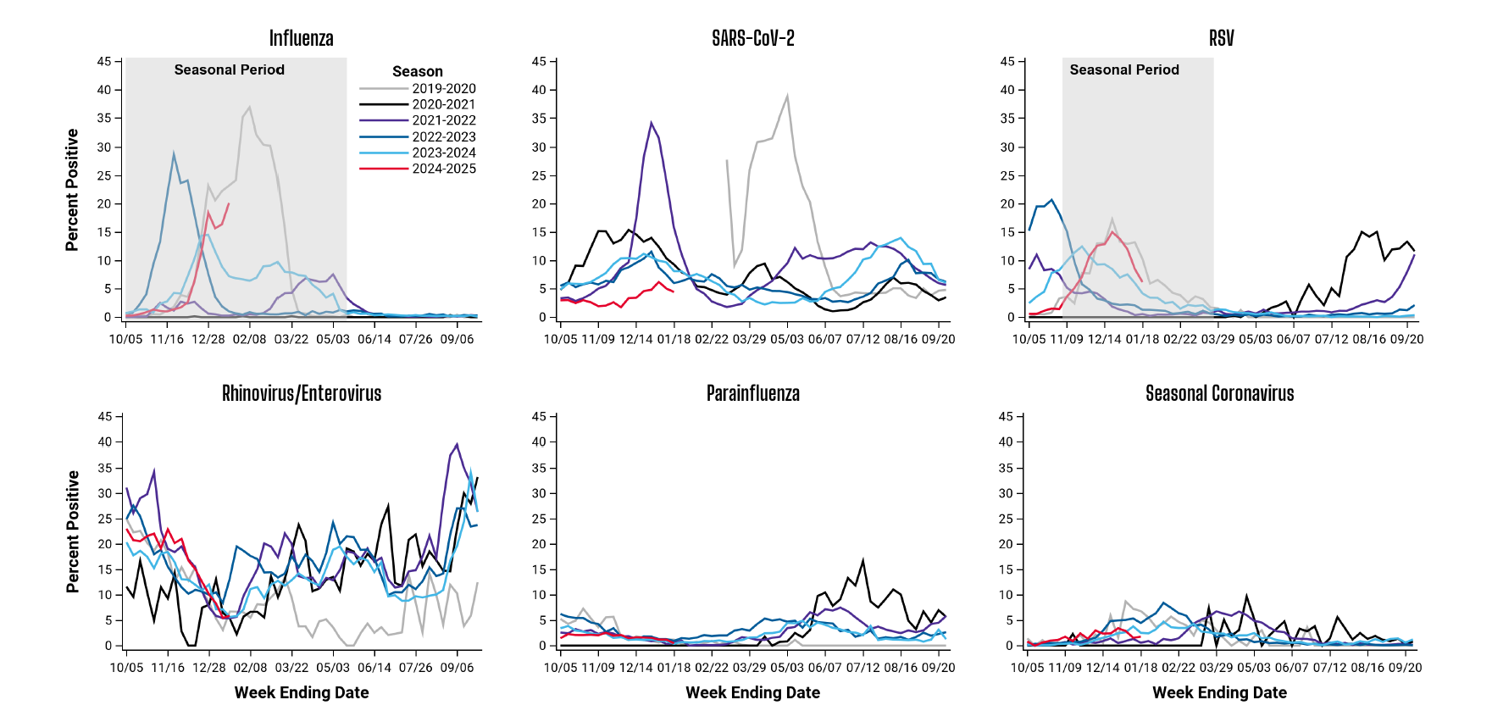
Chicago Respiratory Virus Surveillance Report – Seasonal Trends
Source: Chicago Respiratory Virus Weekly Surveillance Report

Slide 6
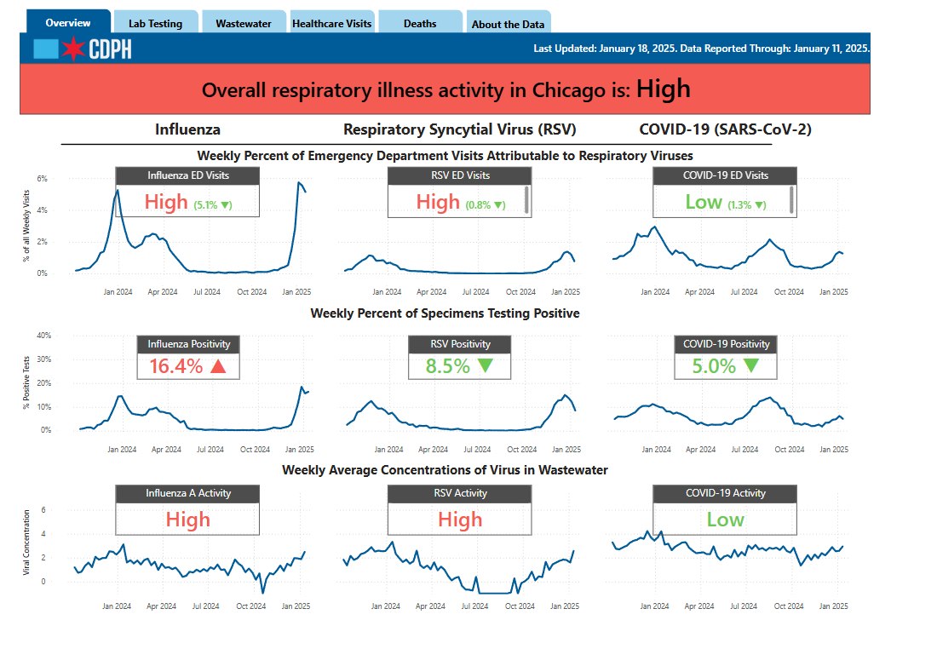
New: CDPH Respiratory Illness Dashboard
Source: City of Chicago : Respiratory Illness Data

Slide 7
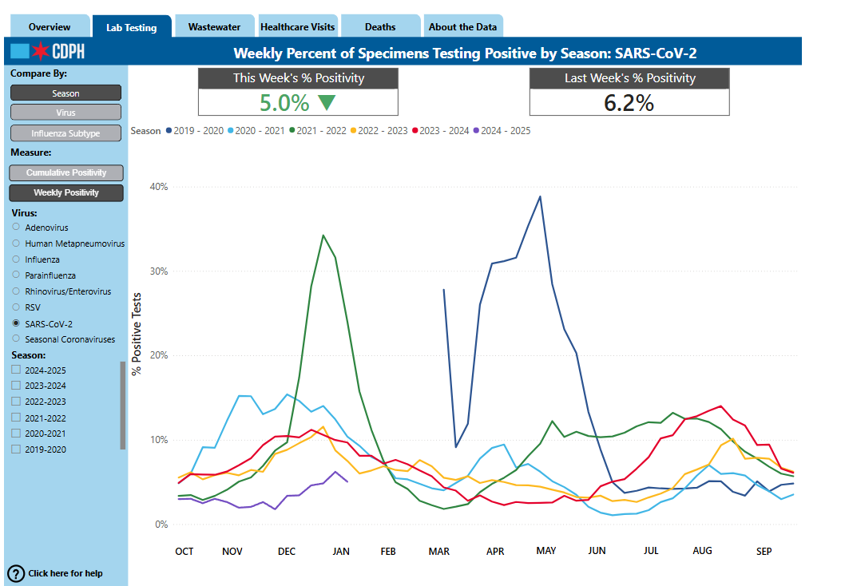
New: CDPH Respiratory Illness Dashboard
Source: City of Chicago : Respiratory Illness Data

Slide 8
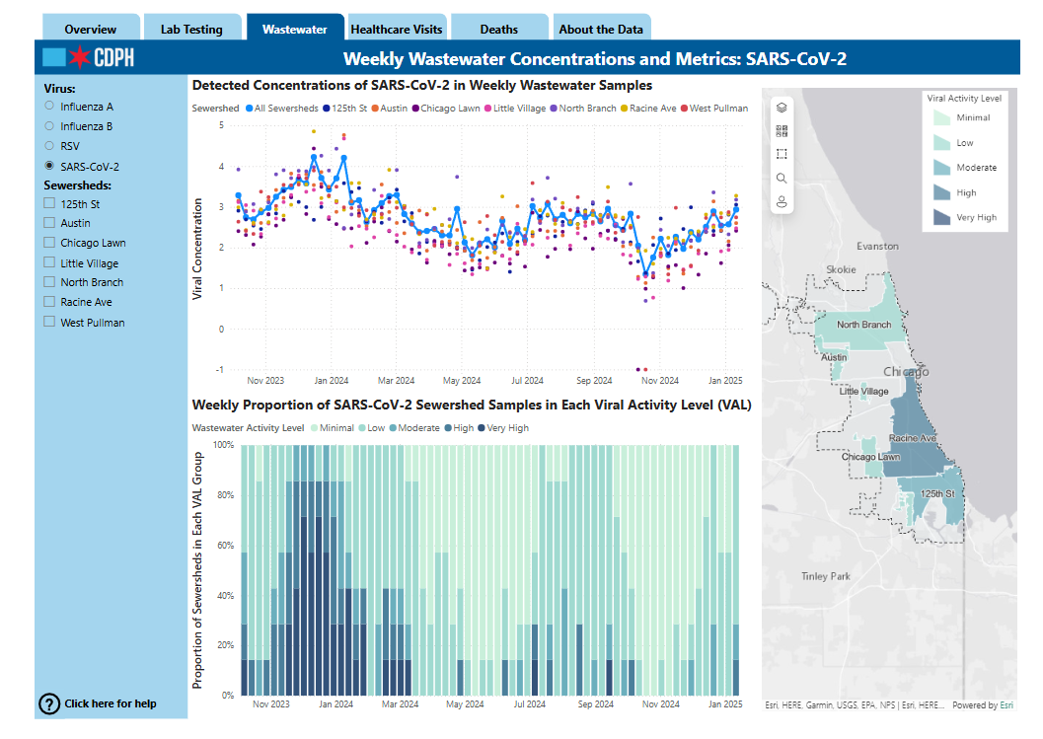
New: CDPH Respiratory Illness Dashboard
Source: City of Chicago : Respiratory Illness Data

Slide 9
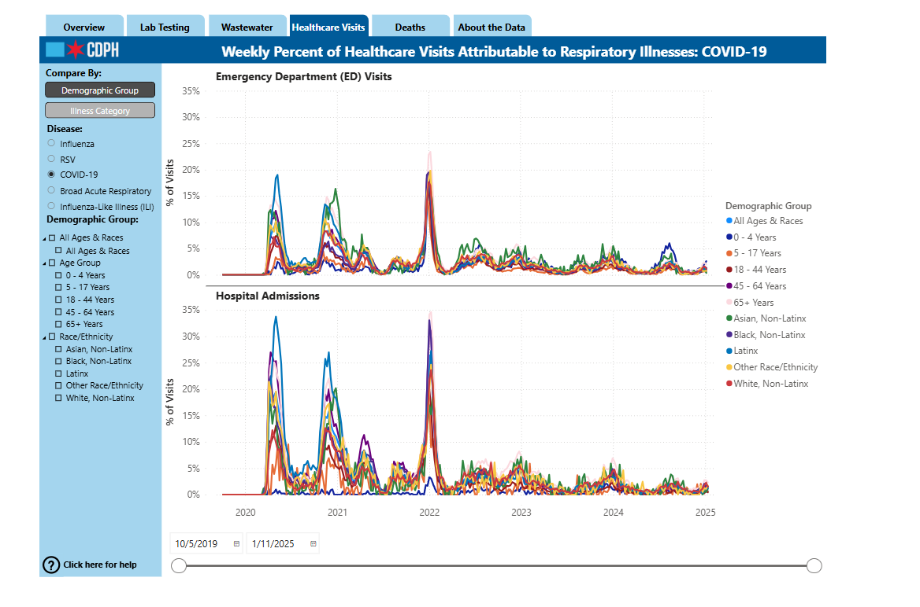
New: CDPH Respiratory Illness Dashboard
Source: City of Chicago : Respiratory Illness Data

Slide 10
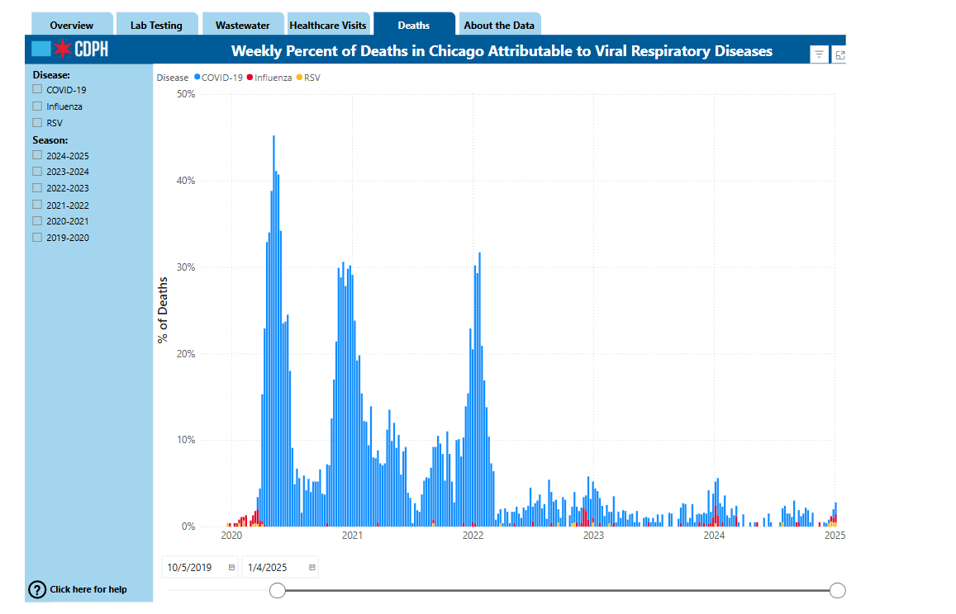
New: CDPH Respiratory Illness Dashboard
Source: City of Chicago : Respiratory Illness Data

Slide 11
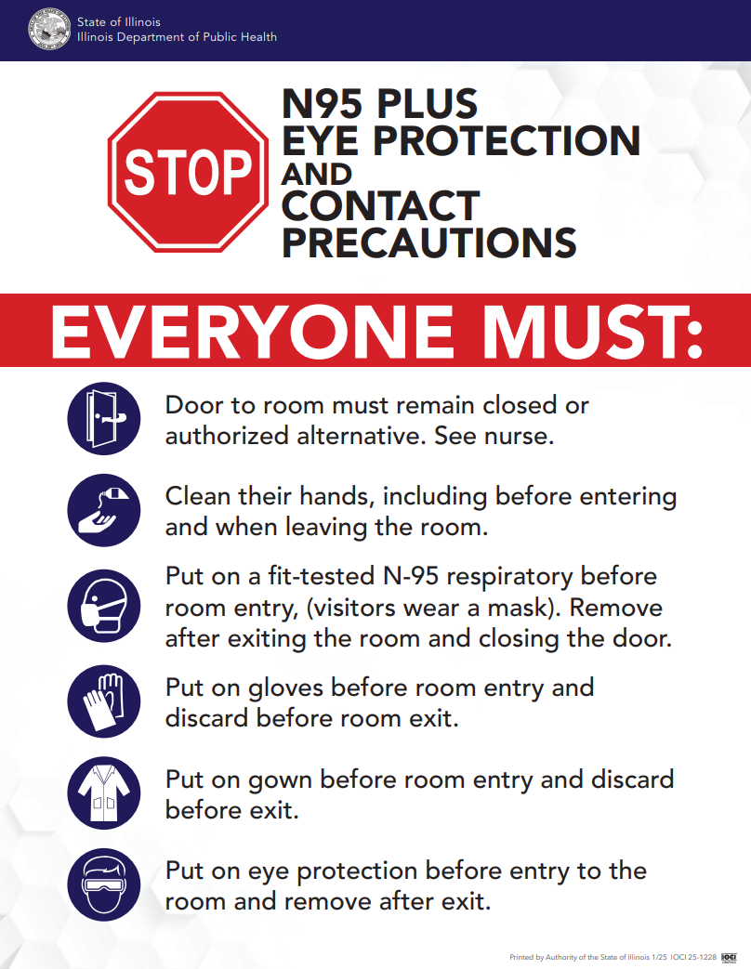
New IDPH Signage
IDPH created a sign that facilities can use for respiratory infections that require full PPE (i.e., gloves, gown, eye protection, N95 respirator)
Facilities can use this sign for residents on transmission-based precautions for COVID and for residents with respiratory symptoms of unknown etiology
If you use this sign, ensure that you in-service your staff and that it’s reflected in your policies
Source: https://dph.illinois.gov/content/dam/soi/en/web/idph/publications/idph/topics-and-services/diseases-and-conditions/respiratory-disease/guidance/respiratory-isolation-sign-2025.pdf

Slide 12
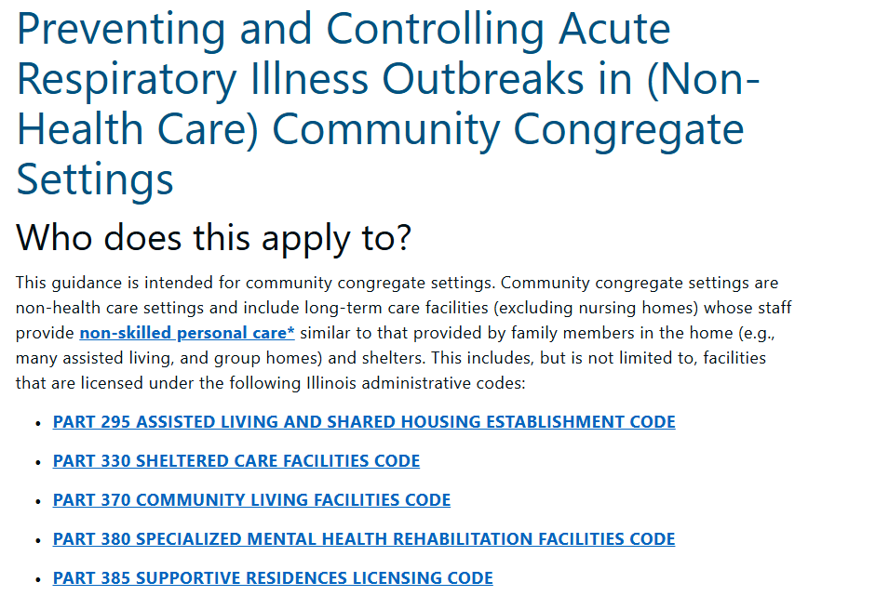
New IDPH Guidance for Non-Healthcare Community Congregate Settings
“Facilities that provide a spectrum of care (e.g., skilled nursing, assisted living, and independent living) should follow the appropriate guidance for each setting; personnel who serve across settings should be held to the most conservative guidance. Health care providers should follow guidance for health care personnel across all setting types.”
Source: https://dph.illinois.gov/topics-services/diseases-and-conditions/respiratory-disease/guidance/community-congregate-settings.html

Slide 13
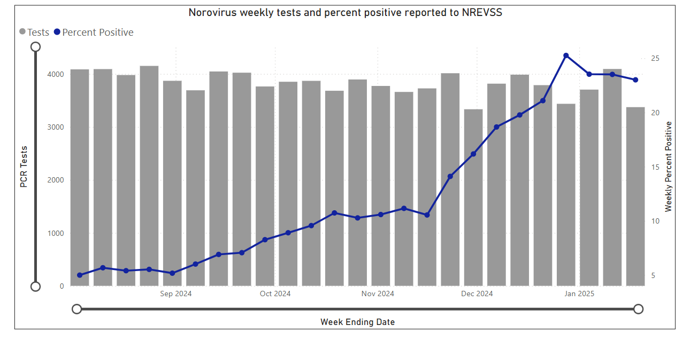
National Norovirus Situation
Source: Interactive Dashboard | NREVSS | CDC

Slide 14

Local Situation
Since the beginning of December 2024, our team has responded to many norovirus/GI Illness outbreaks:
  10 outbreaks in SNFs - 7 confirmed as norovirus
  4 outbreaks in Assisted Living facilities - 1 confirmed as norovirus
  Several facilities with one or two cases not meeting outbreak criteria
On January 7th, 2025, IDPH released a Health Alert titled Increased Norovirus Statewide

Slide 15

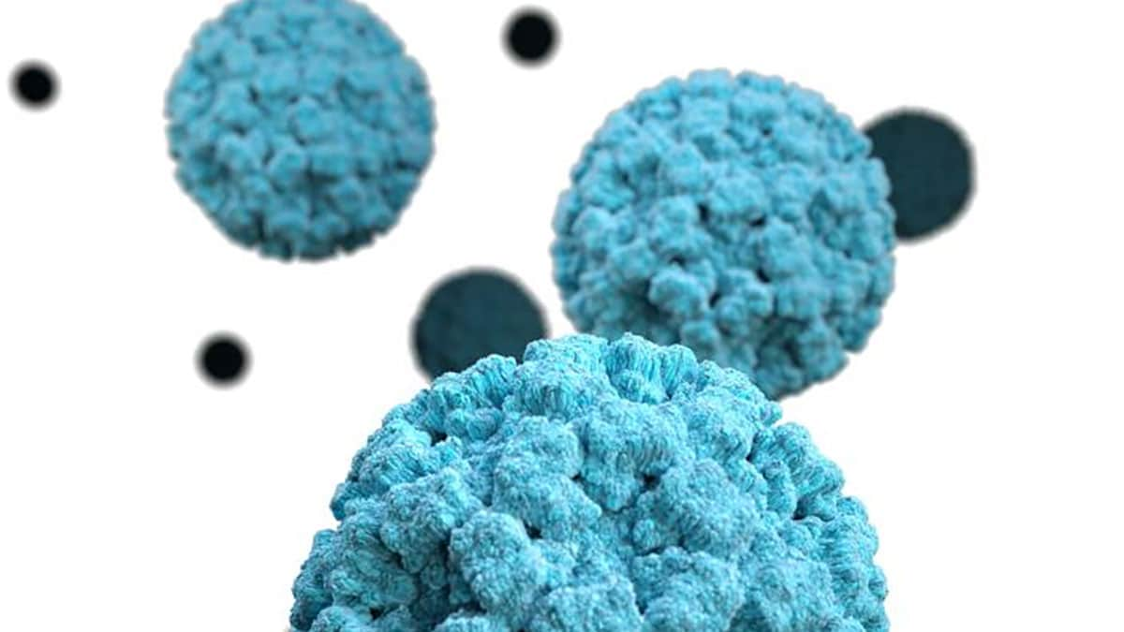
Signs and Symptoms
Most Common Symptoms
Diarrhea
Vomiting
Nausea
Stomach Pain
Other Symptoms
Fever
Headache
Body aches
These symptoms can lead to dehydration, which can manifest as:
Decreased urination
Dry mouth and throat
Dizziness upon standing
Unusual sleepiness
Source: About Norovirus | Norovirus | CDC

Slide 16
How Norovirus Spreads
You can get norovirus by accidentally getting tiny particles of feces or vomit in your mouth from an infected individual
Contaminated Surfaces
A person with norovirus touches surfaces with bare hands
Food, water, or objects that are contaminated are placed on other surfaces
Tiny drops of vomit from a person with norovirus spray in the air, landing on surfaces or entering another person’s mouth
Contaminated Food
A person with norovirus touches food with their bare hands
Food is placed on a counter that has bodily fluids/virus particles on it
Tiny drops of vomit spray through the air and land on food
Source: How Norovirus Spreads | Norovirus | CDC

Slide 17
When to Report
Acute Gastroenteritis (AGE) Outbreak Definition
Two or more AGE cases occurring in a unit with onset dates within 48 hours of each other
Source: https://ilgov.sharepoint.com/sites/DPH-CD/CDAZ/Pages/Norovirus.aspx
Notes:
Double check case definitions for AGE/noro

Slide 18
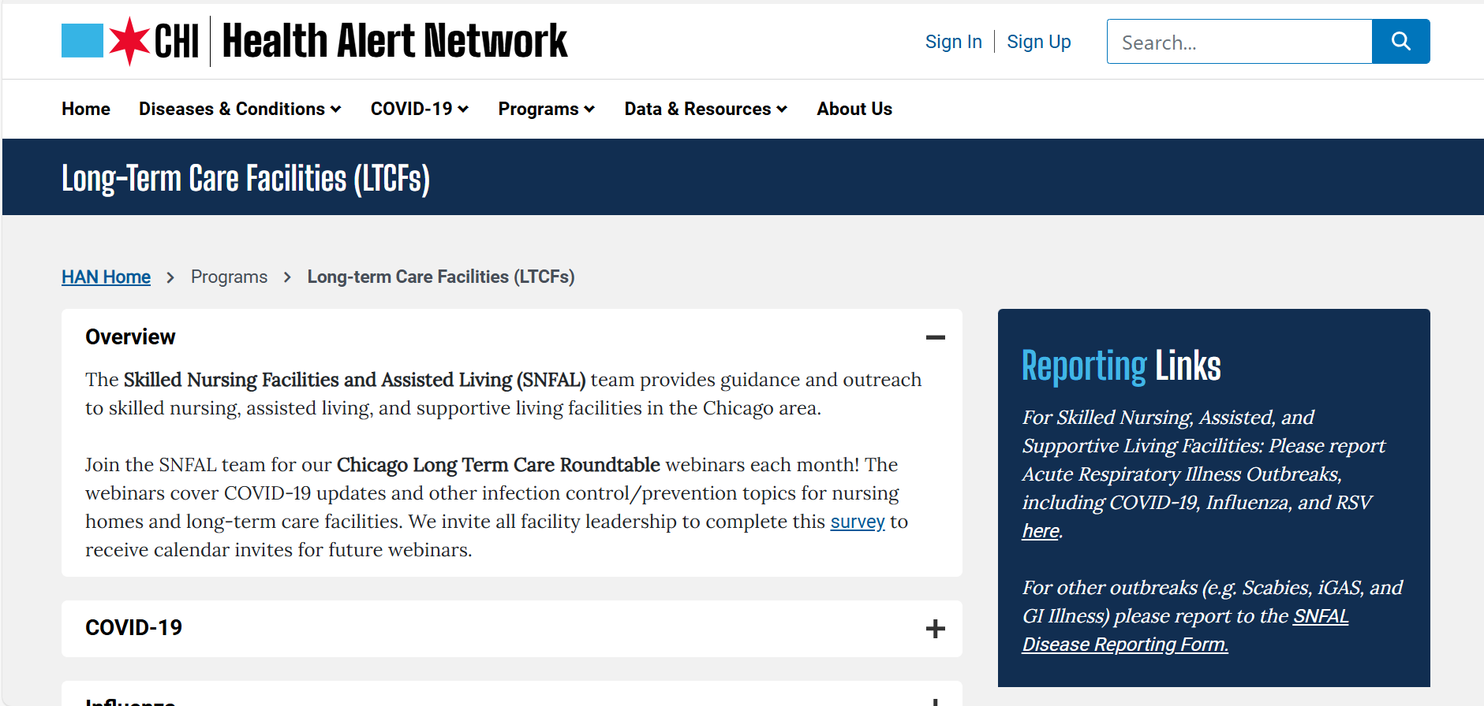
How to Report
Visit: www.chicagohan.org/ltcf

Slide 19
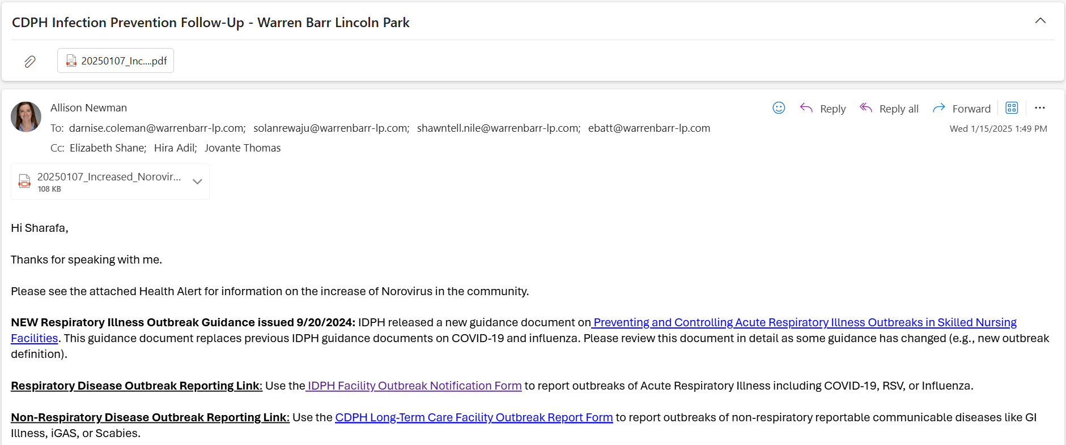
How to Report
Search Email Subject: CDPH Infection Prevention Follow Up

Slide 20
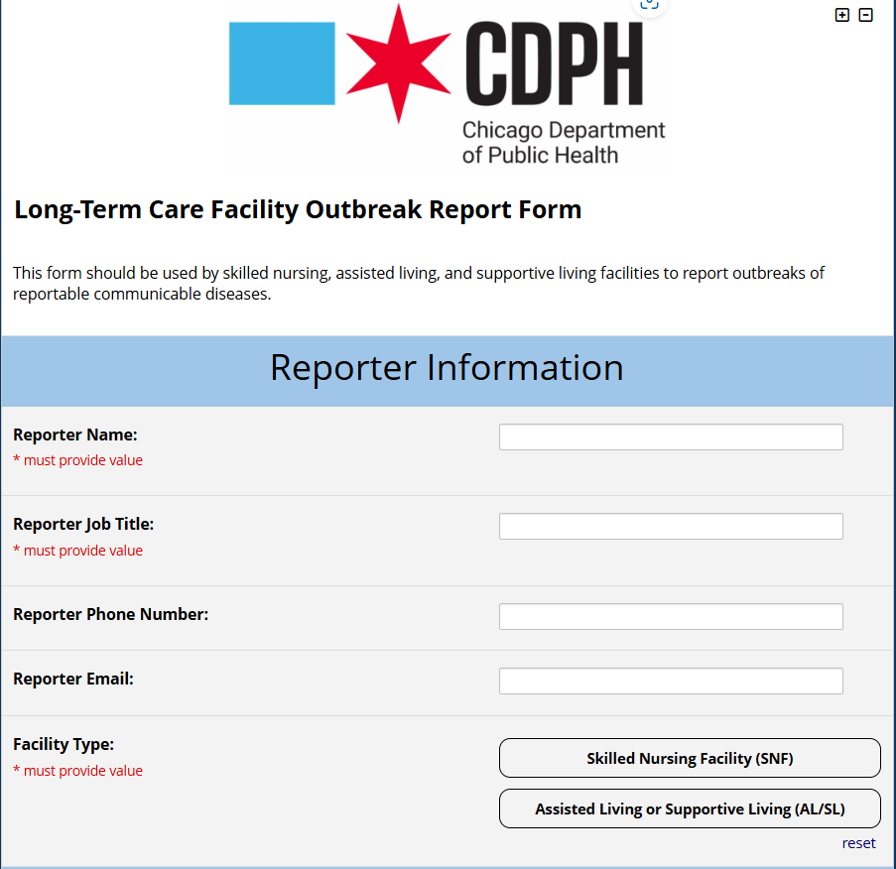

Slide 21
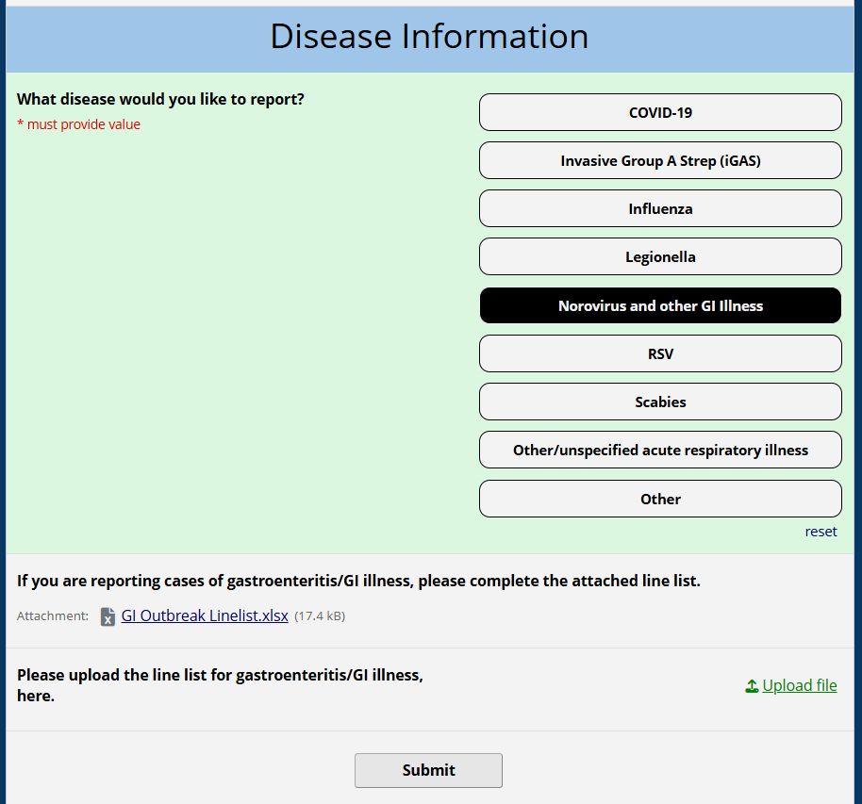
*If you continue to have new cases after you submit your initial report, please continue to send updated line lists directly to your CDPH IP contact

Slide 22
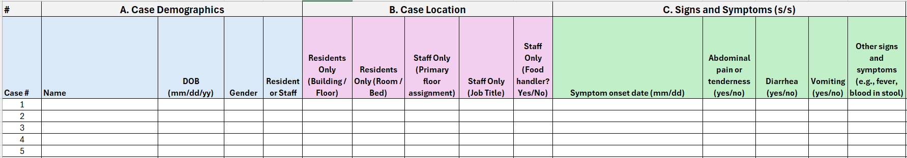
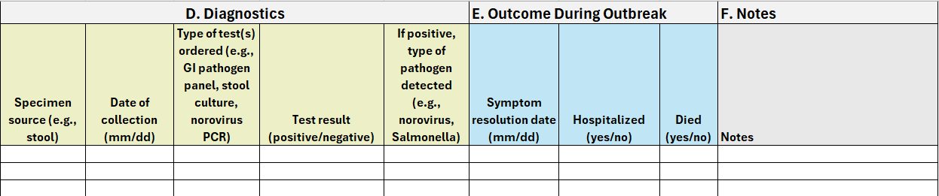
Line list for Norovirus/GI Illness

Slide 23
Key IP&C Recommendations for the Control of Norovirus Outbreaks
Place residents with norovirus on Contact Precautions for a minimum of 48 hours after the resolution of symptoms
Suspend group activities (e.g., dining events and group therapies) for the duration of outbreak
Minimize resident movements with the facility during norovirus outbreaks
Use only soap and water for hand hygiene
If etiology isn’t yet known, order GI pathogen panels for all symptomatic residents
Increase frequency of cleaning and disinfection of patient care areas using a product on List G: EPA’s Registered Antimicrobial Products Effective Against Norovirus
Ill staff members should stay home for a minimum of 48 hours after resolution of symptoms. Upon return, the importance of performing frequent hand hygiene should be enforced
Conduct additional in-service trainings to ensure staff members are up to date with recommendations and precautions

Slide 24
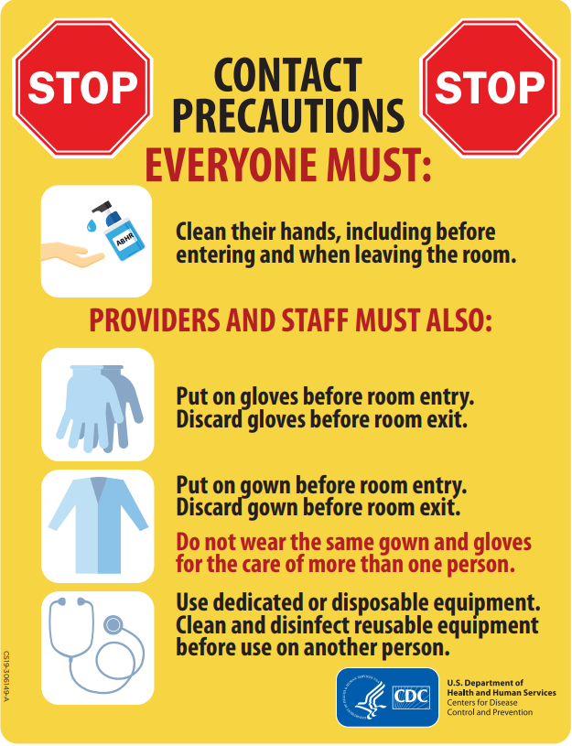
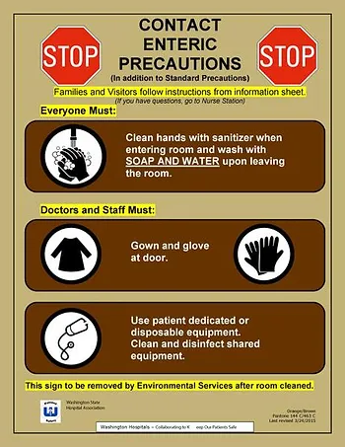
Contact Precautions
https://www.cdc.gov/infection-control/media/pdfs/contact-precautions-sign-P.pdf
https://www.chicagohan.org/documents/d/han/image-1-png?download=true

Slide 25
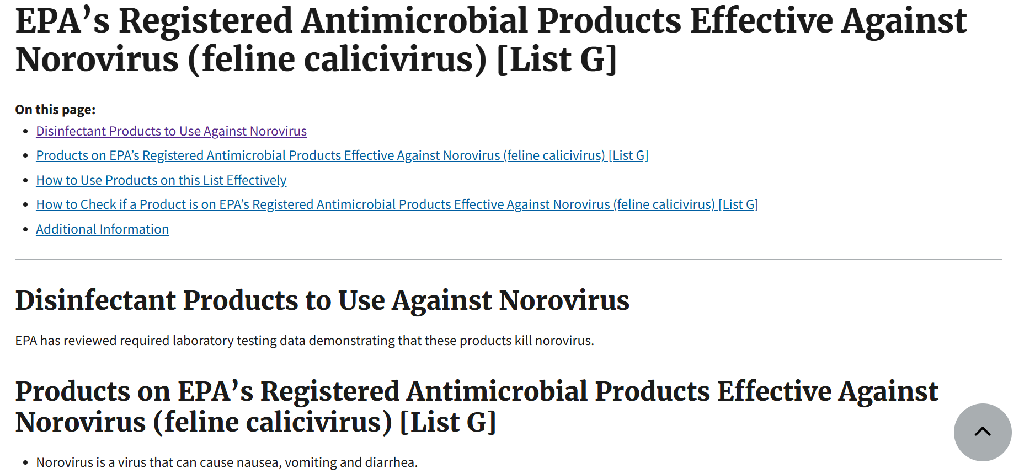
EPA’s List G Products

Slide 26
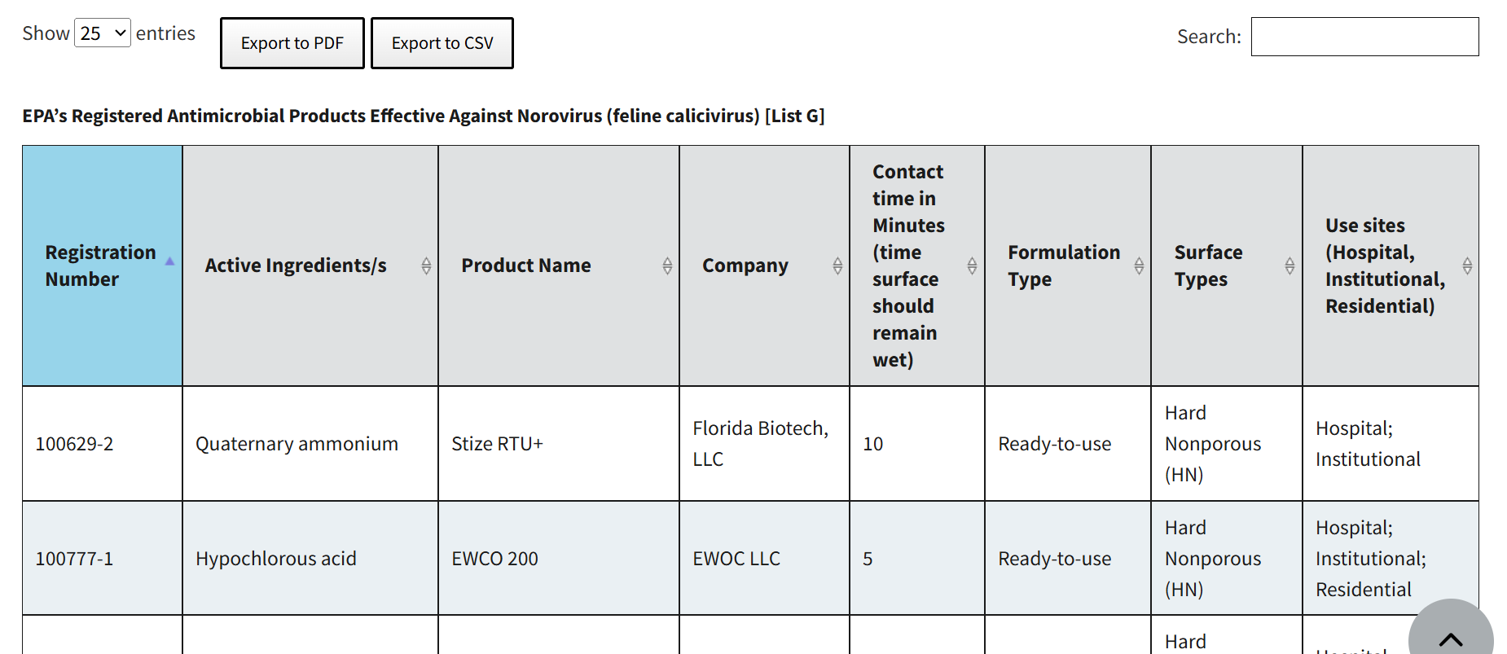
*Supplemental distributer products are not included in the lists. For example, if EPA Reg. No. 12345-12 is on the lists, you can buy EPA Reg. No. 12345-12-2567 and know you’re getting an equivalent product.
EPA’s Registered Antimicrobial Products Effective Against Norovirus (feline calicivirus) [List G] | US EPA
Notes:
Find the EPA registration number on the product label. Look for “EPA Reg. No.” followed by two, as described on the List Landing Page.
Supplemental distributer products are not included in the lists. For example, if EPA Reg. No. 12345-12 is on the lists, you can buy EPA Reg. No. 12345-12-2567 and know you’re getting an equivalent product.
On the product list, search the registration number exactly as it appears on the label.
Once you see the results on the product list, make sure to check that the product's label includes directions for use as a disinfectant product against norovirus under Use Directions for Disinfection.
Regardless of whether you are using a primary registration product or a supplemental distributor product, always check the label has the corresponding directions for use for the relevant pathogen.

Slide 27
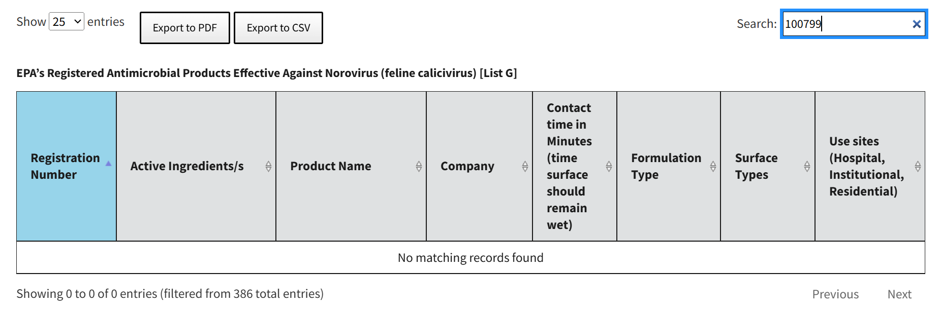

EPA’s Registered Antimicrobial Products Effective Against Norovirus (feline calicivirus) [List G] | US EPA

Slide 28
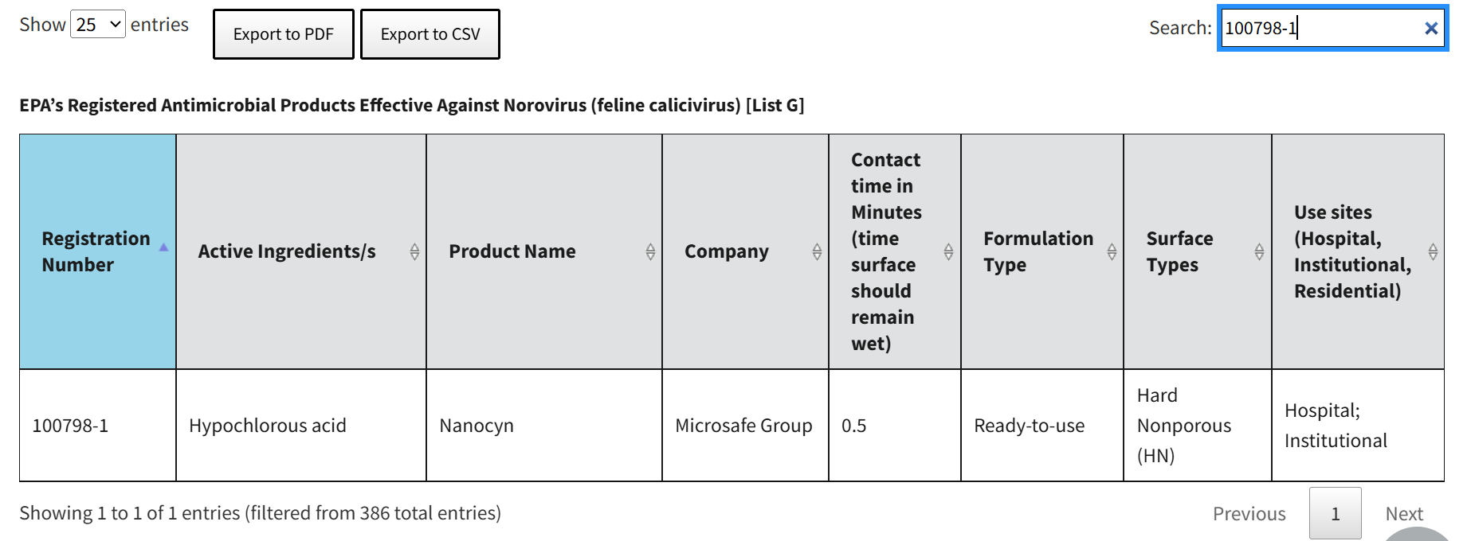

EPA’s Registered Antimicrobial Products Effective Against Norovirus (feline calicivirus) [List G] | US EPA

Slide 29
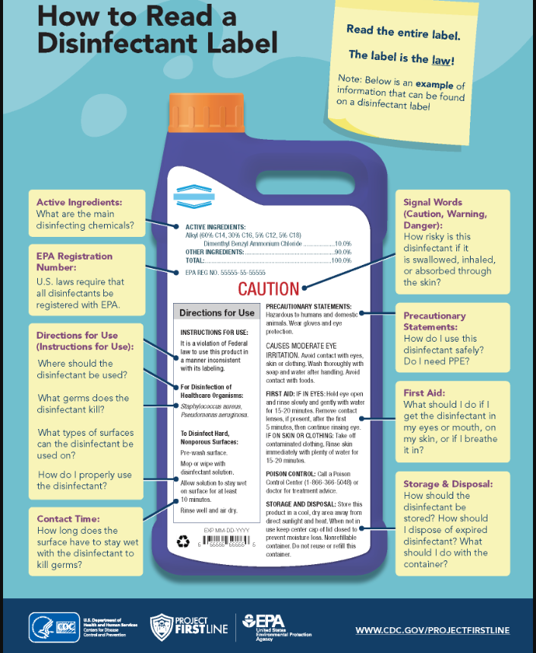
English: HowToReadALabel-508c-Final-2022-08-30 (005)_1.png (1700×2200)
Spanish: How to Read a Cleaning Label - Spanish

Slide 30
Questions to Consider
Are there ill food handlers?
Are visitors bringing in food for residents or staff to share?
Have staff and residents shared food at an event recently?
Are you encouraging hand hygiene with soap and water for visitors and residents?
Are staff members encouraged to stay home when ill?
Have staff on all shifts in all departments received training on GI outbreaks?

Slide 31
What to Expect from CDPH
What CDPH Will Ask You For
Regularly updated line lists of all ill staff and residents
Food menu from the past week
Name and EPA Numbers of your cleaning and disinfecting products
What CDPH Will Send to You
Guidance email with resources, including:
  EPA List G
  IDPH Webinar on Norovirus
  HAN Alert on Norovirus
  Food Handler Employee Illness Reporting Form
Please be aware that CDPH will reach out semi-regularly until 96 hours after the last case

Slide 32
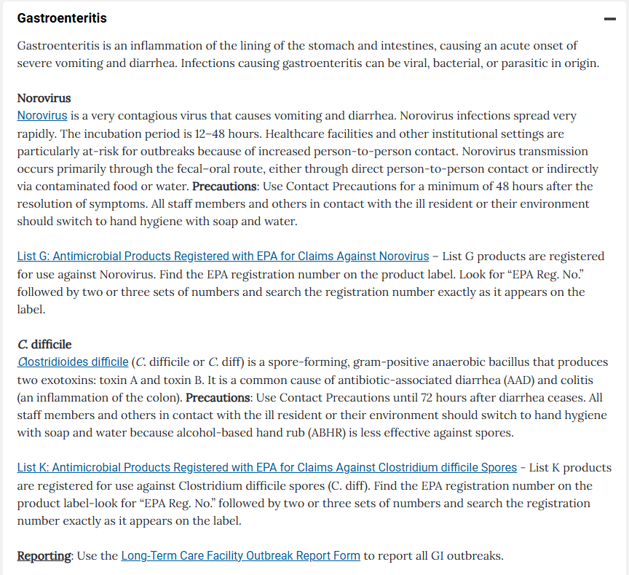
Source: Long-term Care Facilities (LTCFs) - HAN

Slide 33
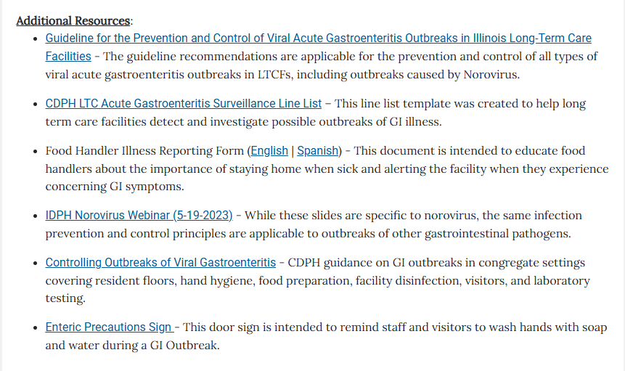
Source: Long-term Care Facilities (LTCFs) - HAN

Slide 34
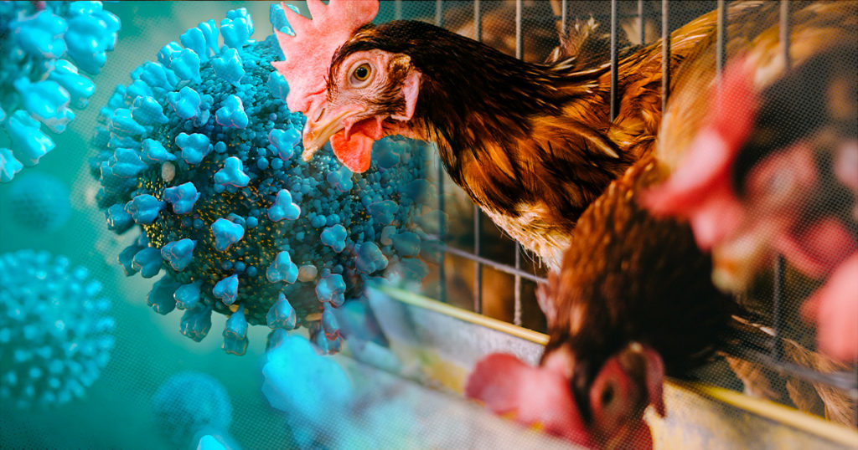
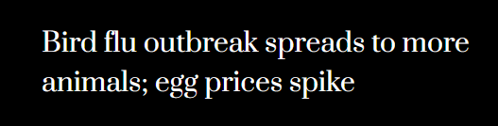
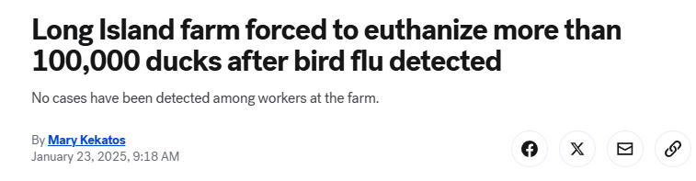

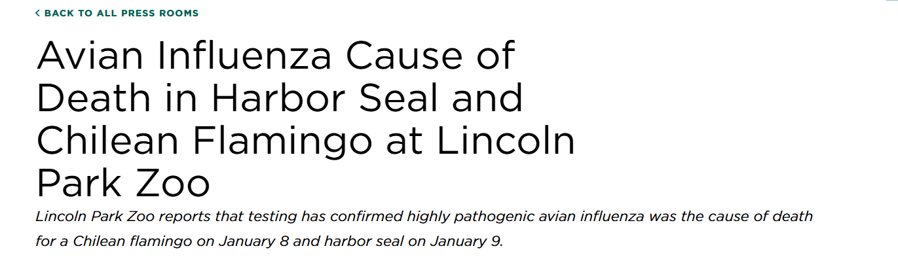
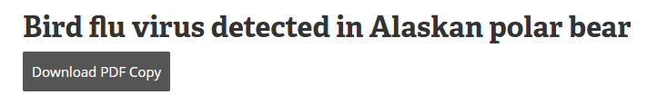
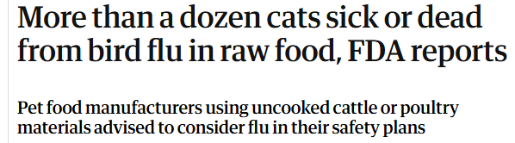
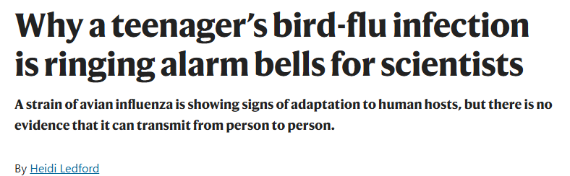


Avian Influenza
Overview
Source: https://abcnews.go.com/US/long-island-farm-forced-euthanize-100000-ducks-after/story?id=118015774; https://www.lpzoo.org/pressroom/avian-influenza-cause-of-death-in-harbor-seal-and-chilean-flamingo-at-lincoln-park-zoo/; https://www.nola.com/news/healthcare_hospitals/new-orleans-cat-infected-bird-flu/article_341cffbe-d9d5-11ef-b49e-5b73c5f90bef.html; https://www.theguardian.com/us-news/2025/jan/22/cats-bird-flu-food; https://www.promegaconnections.com/avian-influenza-h5n1/; https://6abc.com/post/first-suspected-case-bird-flu-philadelphia-detected-snow-goose-carroll-park/15826309/; https://www.cnn.com/2025/01/06/health/bird-flu-death-louisiana/index.html; https://www.nature.com/articles/d41586-024-03805-4; https://www.cbsnews.com/chicago/news/south-suburban-chicago-loses-hens-bird-flu/; https://www.today.com/video/bird-flu-outbreak-spreads-to-more-animals-egg-prices-spike-230162501879; https://investigatemidwest.org/2025/01/21/134m-poultry-and-counting-interactive-charts-show-hardest-hit-counties-in-bird-flu-crisis/; https://www.news-medical.net/news/20240702/Bird-flu-virus-detected-in-Alaskan-polar-bear.aspx

Slide 35
Avian Influenza Overview
Avian Influenza
(also known as “bird flu”)
Highly Pathogenic Avian Influenza
(HPAI)
Low Pathogenicity Avian Influenza
(LPAI)
H5N1

Slide 36
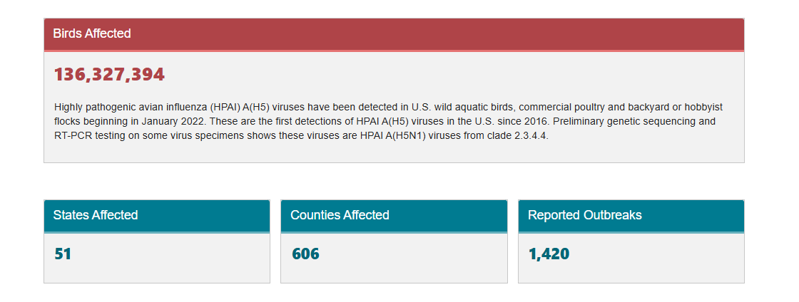
Avian Influenza Overview
Source: https://www.cdc.gov/bird-flu/situation-summary/data-map-commercial.html

Slide 37
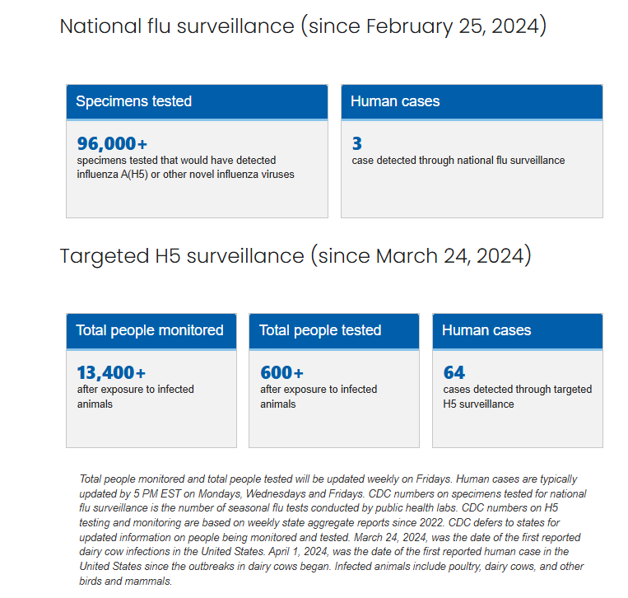
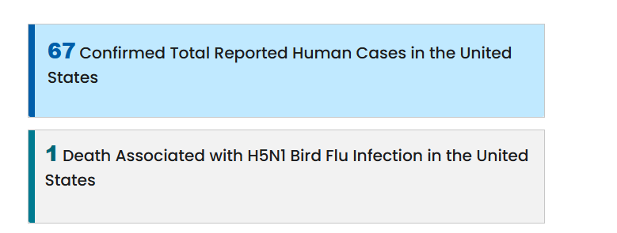
Avian Influenza Overview
There has been no evidence of human-to-human transmission of H5N1
To date, no human cases of H5N1 have been reported in Illinois
As per CDC, the current risk to the general public is low
Source: https://www.cdc.gov/bird-flu/situation-summary/index.html; https://www.cdc.gov/bird-flu/situation-summary/inhumans.html

Slide 38
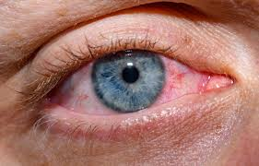
H5N1 Signs and Symptoms in Humans
Of the human cases, common symptoms include:
  Fever
  Cough
  Runny nose or nasal congestion
  Sore throat
  Muscle or body aches
  Headache
  Fatigue
  Conjunctivitis (red irritated eyes)
Incubation period typically around 3 days (range 2-7 days)
Source: https://www.cdc.gov/bird-flu/signs-symptoms/index.html; https://www.cidrap.umn.edu/avian-influenza-bird-flu/cdc-sequencing-h5n1-avian-flu-samples-patient-yields-new-clinical-clues

Slide 39

H5N1 Risk Factors for Humans
Direct contact with birds, livestock, or other animals with H5N1
Preparing or consuming certain foods including raw milk or other unpasteurized dairy products from infected animals
Direct contact with surfaces contaminated with feces from infected animals
Source: https://www.cdc.gov/bird-flu/prevention/hpai-interim-recommendations.html; https://agriculture.ny.gov/dairy/raw-milk

Slide 40
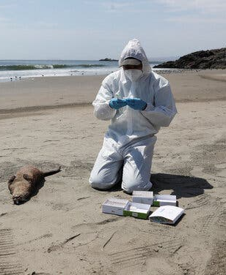
H5N1 in Animals
Ducks and wild birds can be infected without symptoms
Mortality rate in infected chickens is ~90-100%, typically within 48 hours
  Depopulation/culling of remaining chickens usually occurs when H5N1 is detected in a poultry flock
H5N1 has also been identified in non-bird species, including polar bears, dolphins, bobcats, mountain lions, cats, seals, and squirrels
  Often causes significant morbidity or mortality
Can become infected through direct contact with infected animals or through contact with surfaces, food, or water contaminated with the virus
Sources: https://www.aphis.usda.gov/livestock-poultry-disease/avian/avian-influenza/hpai-detections/mammalsl; https://www.cdc.gov/bird-flu/virus-transmission/avian-in-birds.html; https://www.nytimes.com/2024/04/22/health/birdflu-marine-mammals.html

Slide 41
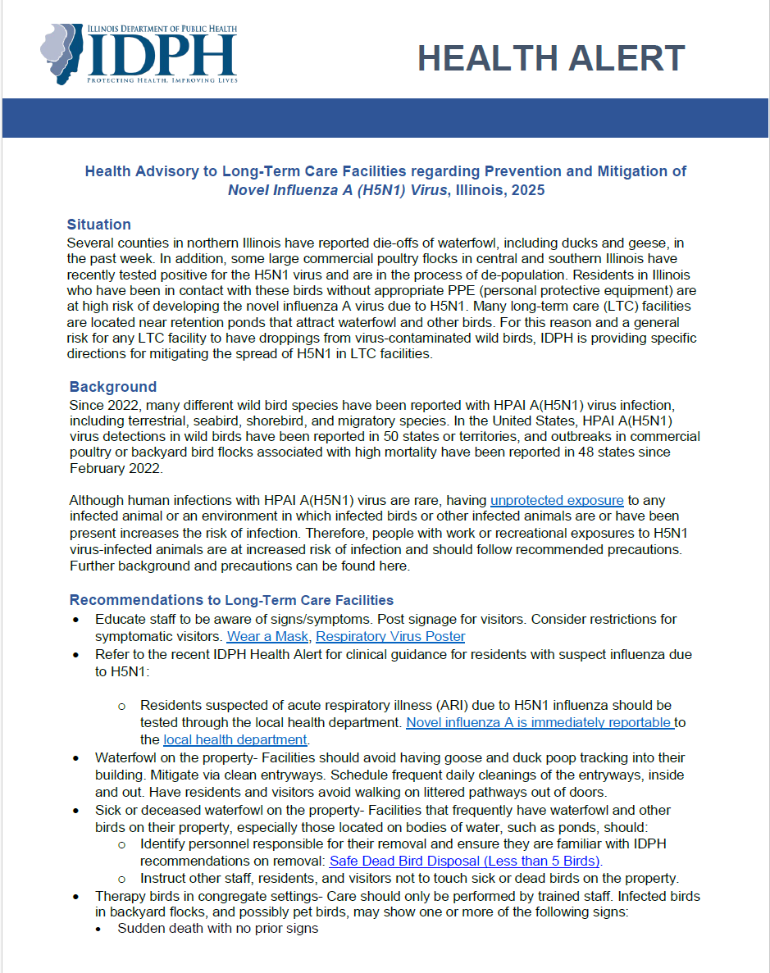
IDPH Health Alert to LTCs on H5N1
On January 15, 2025, IDPH released a Health Alert with guidance to long-term care facilities around preventing and mitigating H5N1 virus
Source: Illinois Department of Public Health

Slide 42
H5N1 Guidance for LTC Facilities
Facilities should:
  Continue educating staff, residents, and visitors about flu signs & symptoms, exclude ill staff, isolate ill residents, and recommend visitors defer non-urgent visitation if symptomatic
  Schedule frequent cleanings of entryways to limit goose and duck poop that may be tracked into the building
  Avoid having pets that live in/on the property and therapy animals that come to the property interact with wild and/or dead birds
  Ensure that animals that live in the facility are not fed food containing raw meat
  Educate staff and residents not to touch dead birds
  Identify personnel responsible for removal of dead birds/waterfowl on the property and ensure that they are familiar with IDPH recommendations on removal.
    If you notice a large die off of birds/waterfowl on your grounds or in a place that residents/staff frequent, please alert CDPH & the Illinois Department of Natural Resources (IDNR) as soon as possible:
      IDNR – please contact Nicky Strahl (847-608-3122 or Nicky.Strahl@illinois.gov)
      CDPH – please email me (Elizabeth.Shane@cityofchicago.org)

Slide 43
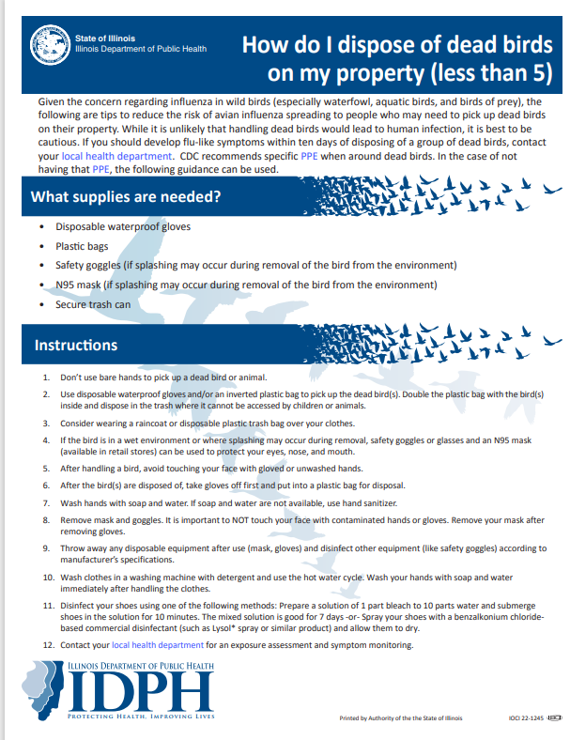
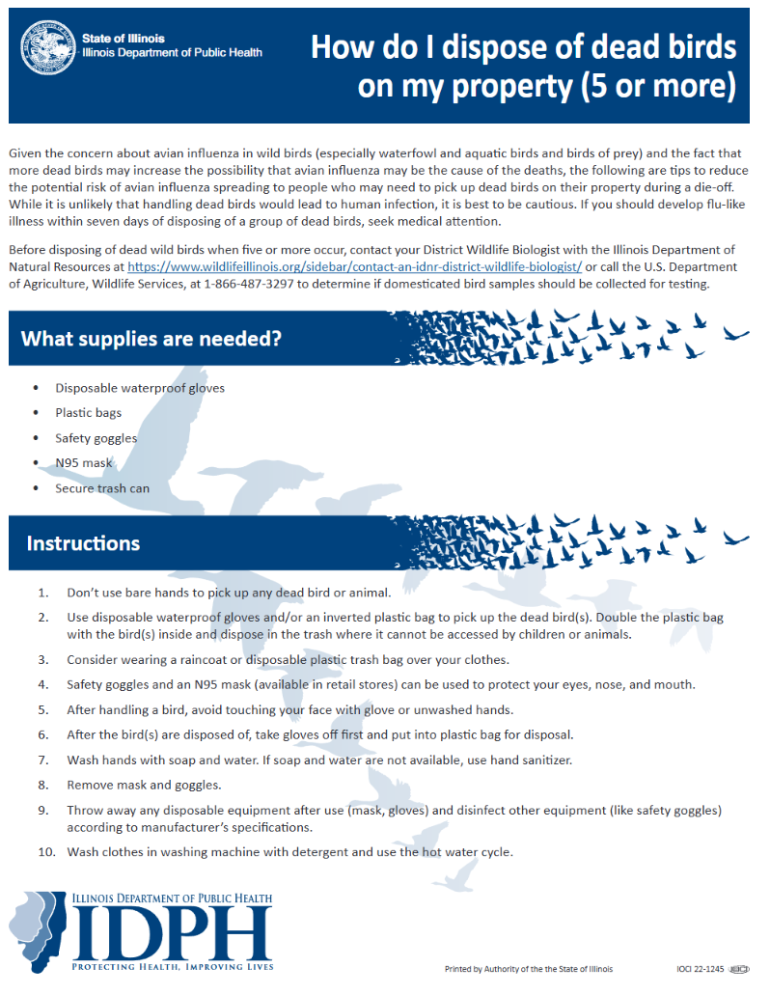
Dead Bird Disposal Guidance
Source: Safe Dead Bird Disposal (Less than 5 Birds)

Slide 44
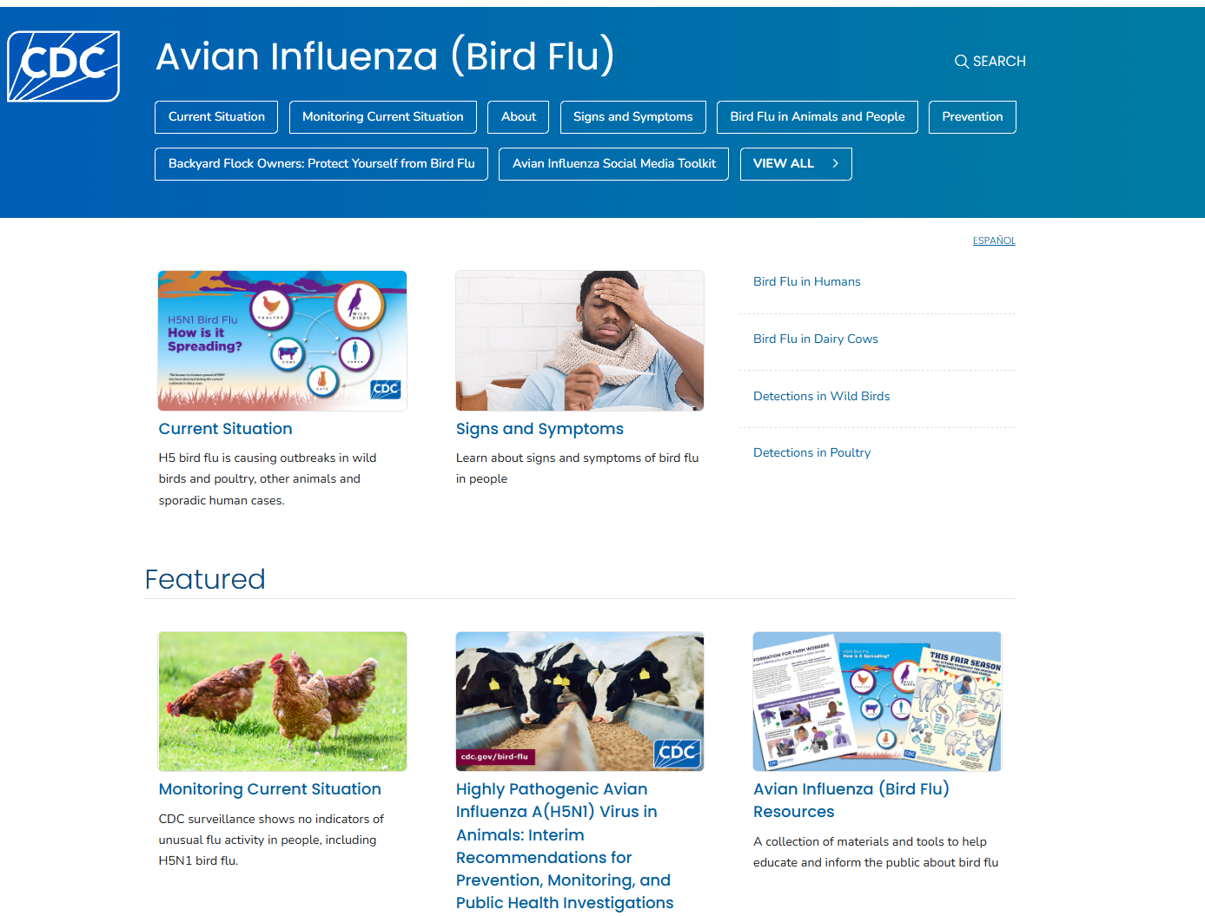
CDC Avian Influenza Webpage
Source: https://www.cdc.gov/bird-flu/index.html

Slide 45
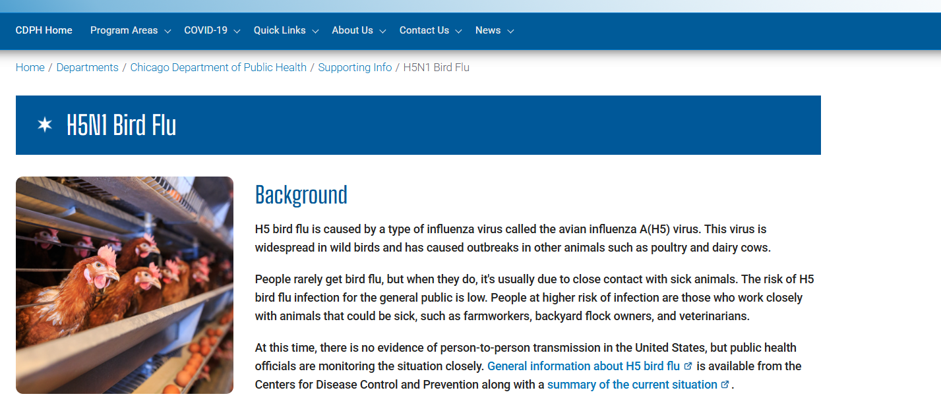
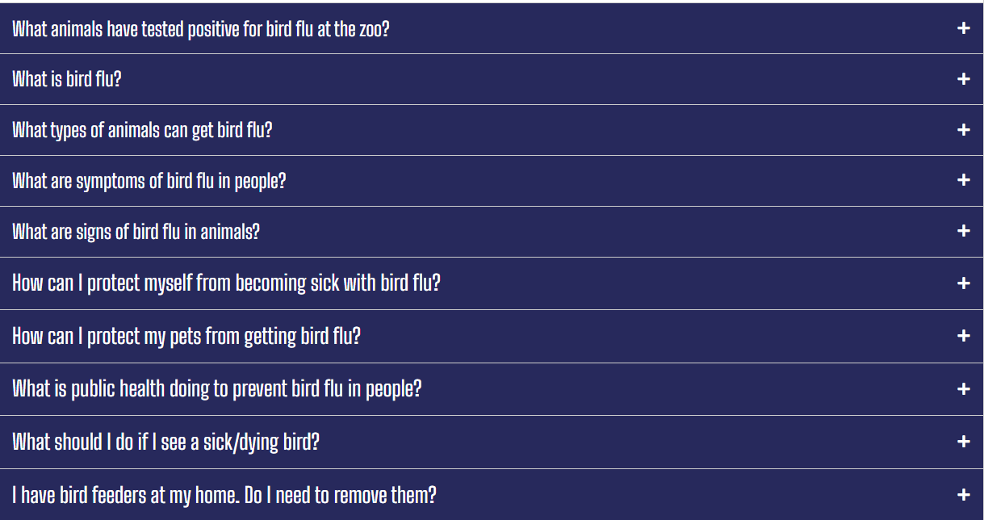
CDPH H5N1 Webpage
Source: https://www.chicago.gov/city/en/depts/cdph/supp_info/infectious/h5n1-bird-flu.html

Slide 46
FAQ: Does the seasonal flu vaccine protect against H5N1
No, the seasonal flu vaccine does not provide protection against H5N1
The risk of H5N1 to the general public is very low, while the risk of seasonal influenza is high
  Please continue to encourage residents, staff, and visitors to get the seasonal flu vaccine
  Prioritize early detection and treatment of flu
  Follow current isolation and work exclusion guidance for residents and staff with the flu
  Ensure exposed residents receive prophylactic antivirals when indicated
  Reminder to report all flu outbreaks to the IDPH Outbreak Reporting Form

Slide 47

QSO-25-11-NH: Updates to LTCF NHSN Reporting
1/30/2025
Thomas C. Roome MPH CIC EMT
Infection Prevention Specialist,
Chicago Department of Public Health ,
Bureau of Disease Control | Healthcare Settings
Thomas.Roome@CityofChicago.org

Slide 48
NHSN Reporting Requirements
This update applies to: Skilled Nursing Facilities, Nursing Homes, Intermediate Care, and ICF/IDs. (i.e. Long-Term Care Facilities)
Previously, Long Term Care Facilities (LTCFs) were required by CMS to report resident COVID-19 vaccination rates to the NHSN COVID-19 Module.
  This requirement expired on December 31st, 2024.
On 12/31/24, CMS issued QSO-25-11-NH, to replace the expired LTCF regulations for NHSN COVID-19 reporting.
QSO-25-11-NH contains significant changes to what LTCFs need to report for viral Acute Respiratory Illness (ARIs)
QSO-25-11-NH: Long-Term Care (LTC) Facility Acute Respiratory Illness Reporting Requirements
CDC: NHSN Long-Term Care Facilities (LTCF) Component
Notes:
This update to the NHSN reporting requirement applies to Skilled Nursing Facilities nursing homes, Intermediate Care and ICF/IDs; which CMS calls LTCFs. Please note that this does not apply to Long-Term Acute Care Hospitals, which report to different modules.
Before, LTCFs were required to report resident COVID-19 vaccination rates to NHSN (weekly). However, on 12/31/24 the QSO requiring this reporting expired.
That same day, CMS released a new regulation QSO-25-11-NH to replace it. This new QSO contains significant changes to

Slide 49
What are the Changes?
LTC Facilities are now required to report the following information about COVID-19, Influenza and RSV to NHSN:
  Resident vaccination status,
  Confirmed resident cases,
  And hospitalizations with confirmed cases.
Facilities are also now required to report their current census.
The cadence of reporting will remain unchanged.
QSO-25-11-NH: Long-Term Care (LTC) Facility Acute Respiratory Illness Reporting Requirements
NHSN: Long-Term Care Facility Reporting Requirements and Guidance

Slide 50
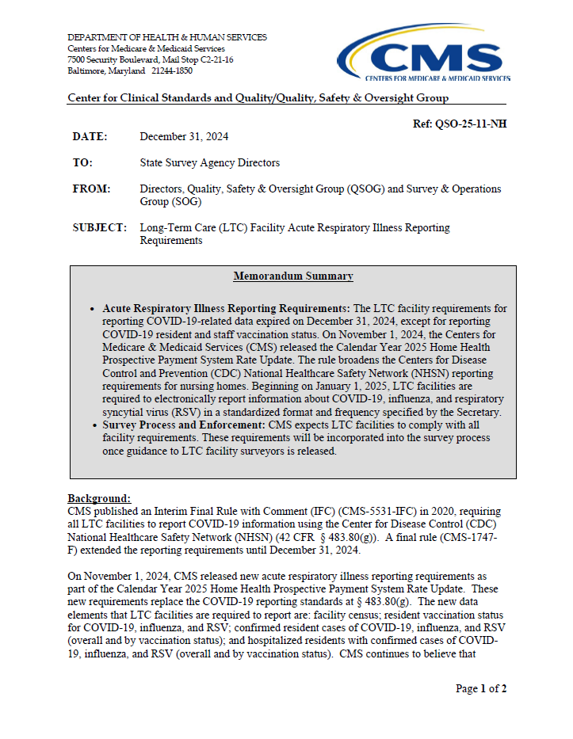
QSO-25-11-NH
These regulations went into effect on January 1st, 2025.
The LTC Module in NHSN has been updated to include these new data elements.
Enforcement of QSO-25-22-NH will begin once CMS issues enforcement guidelines.
QSO-25-11-NH: Long-Term Care (LTC) Facility Acute Respiratory Illness Reporting Requirements

Slide 51
Questions & Answers
For additional resources and upcoming events, please visit the CDPH LTCF HAN page at: https://www.chicagohan.org/covid-19/LTCF

