Slide 1

How to report temperature in I-CARE

Slide 2
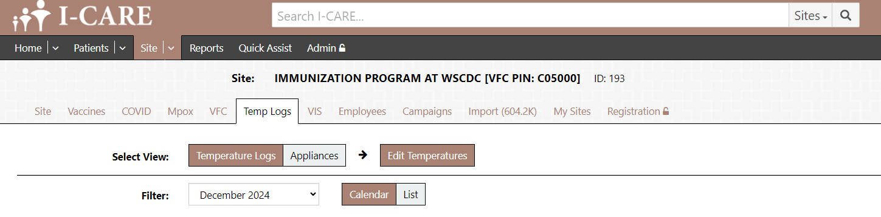
How to report temperature in I-CARE

Slide 3
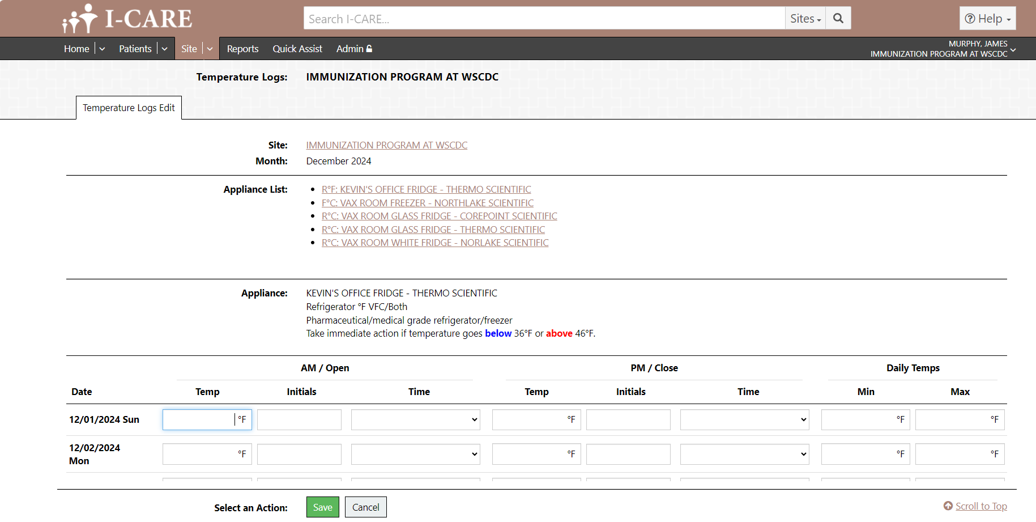
How to report temperature in I-CARE

