Slide 1

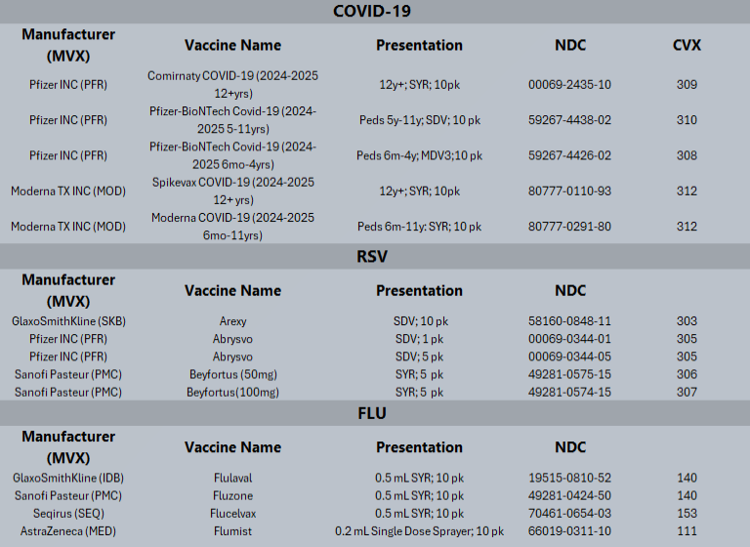

2024-2025 Respiratory Virus Season Vaccine Code Updates
Provider sites should work with their EMR and IT teams to ensure that their vaccine charting details reflect the new seasonal formulas for COVID, Flu, and RSV. Double check the CVX and MVX codes as well as the NDC numbers. This will ensure that patient records reflect the 2024-25 updates and will contribute to high data quality for the respiratory virus season.

