Slide 1
COVID-19
Chicago Long Term Care
Roundtable
06-24-21

Slide 2
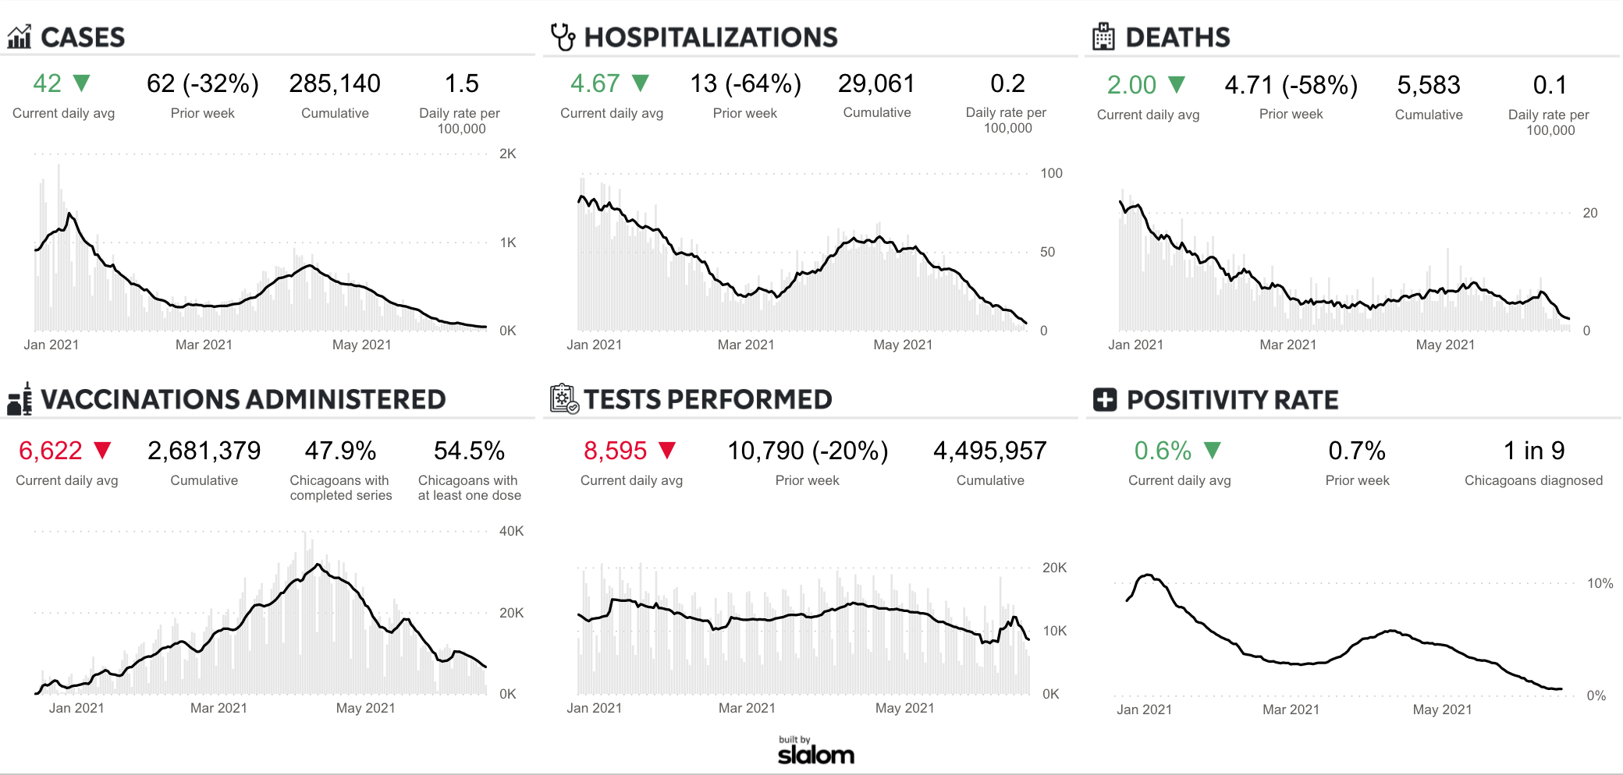
Chicago Dashboard
Source: https://www.chicago.gov/city/en/sites/covid-19/home/covid-dashboard.html

Slide 3
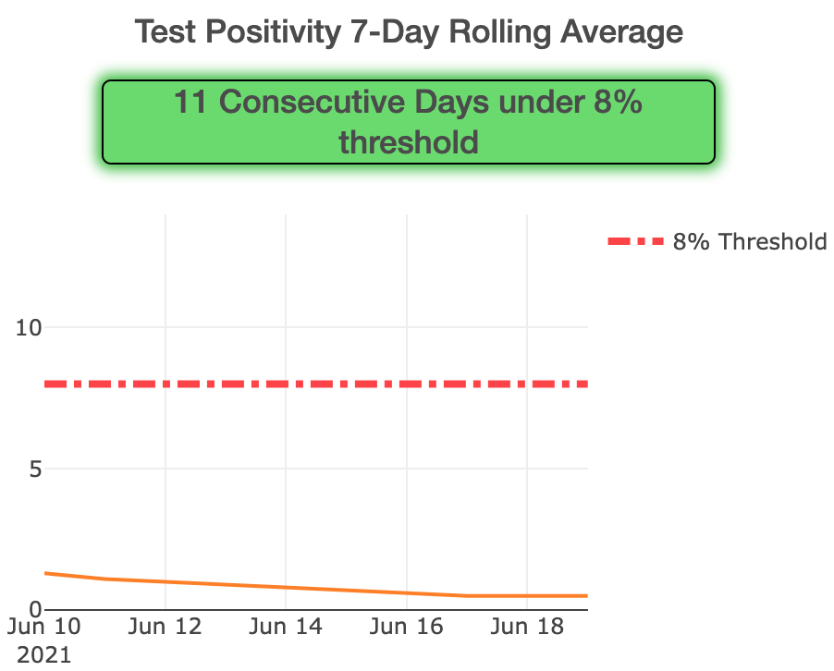
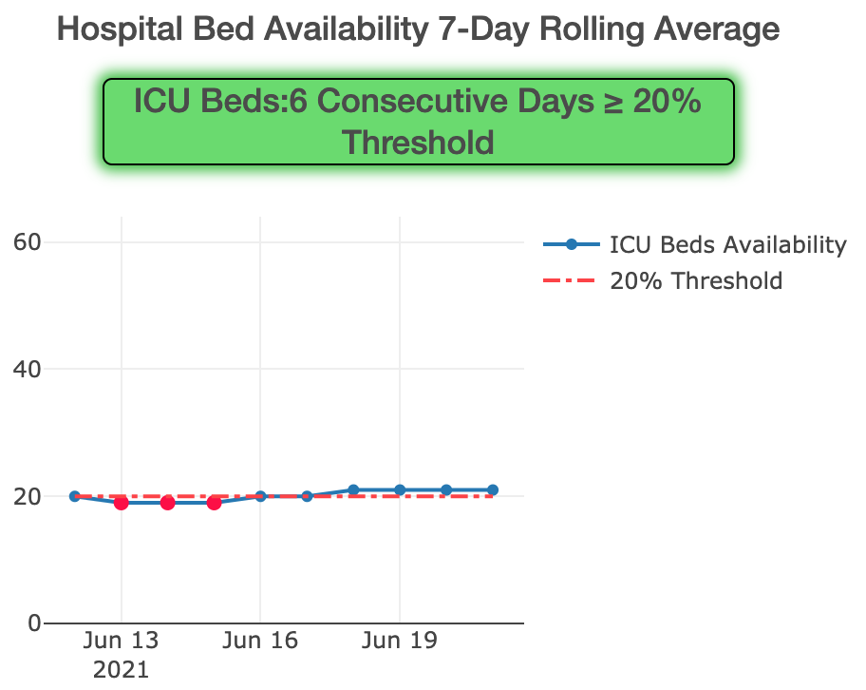
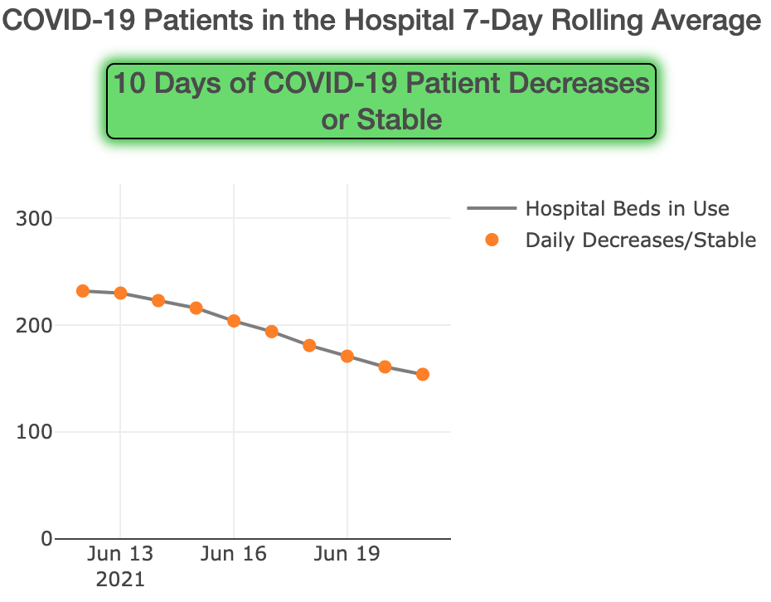
IDPH Regional Resurgence Metrics: Region 11
Source: https://www.dph.illinois.gov/regionmetrics?regionID=11

Slide 4

Chicago Emergency Travel Order
Source: https://www.chicago.gov/city/en/sites/covid-19/home/emergency-travel-order.html

Slide 5
Skilled Nursing Facility COVID-19 Cases
First round
vaccine clinics began
Second round vaccine clinics began
65 (83%) SNFs are out of outbreak
13 (17%) SNFs have active outbreaks
Third round vaccine clinics began
*Epi curve depicts lab-confirmed (PCR or antigen positive) cases since 12/1/2020
Data as of 6/15/2021

Slide 6
The majority of new SNF-associated COVID-19 cases are not fully vaccinated
Data as of 6/15/2021

Slide 7
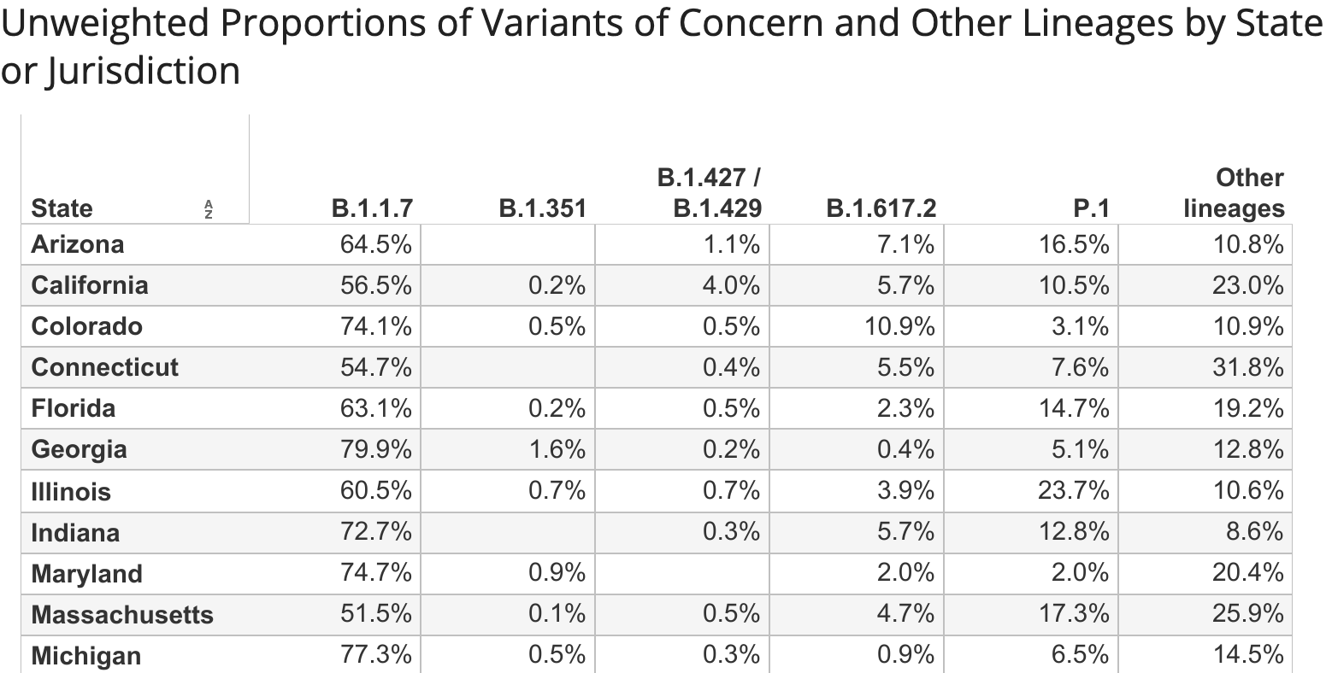
COVID Variants of Concern in Illinois
Proportions in Illinois:
  B.1.1.7 (U.K.) – 60.5%
  B.1.351 (South Africa) – 0.7%
  B.1.427/1.429 (California) – 0.7%
  B.1.617.2 (Delta) – 3.9%
  P.1 (Brazil) – 23.7%
  Other lineages – 10.6%
Source: https://covid.cdc.gov/covid-data-tracker/#variant-proportions

Slide 8
Reminder: Use of Eye Protection
Eye protection must be worn:
  For the care of any resident under quarantine or isolation for COVID (e.g., unvaccinated new and readmitted residents, exposed residents, symptomatic residents, and COVID+ residents)
  For the care of all residents if a facility has had a case within the past 14 days and/or if the Cook County positivity rate is >5% as per CMS.
If a facility has not had a case in >14 days* and the Cook County positivity rate is <5% as per CMS:
  Eye protection does not need to be worn for the care of residents who are not under quarantine or isolation for COVID (i.e., no eye protection would be needed in the green or gray zones).
*with the final round of outbreak testing occurring no sooner than the 14th day following the specimen collection date from the most recent case

Slide 9
Reminder: PPE Requirements for Staff Providing Care to Residents
If your facility has not had a case within the last 14 days*:
  If a resident is not under quarantine or isolation for COVID, staff must wear a surgical mask.
  If a resident is under quarantine or isolation for COVID, staff must wear eye protection, a N95 respirator, a gown, and gloves.
If your facility has had a case within the last 14 days*:
  If a resident is not under quarantine or isolation for COVID, staff must wear eye protection and a N95 respirator.
  If a resident is under quarantine or isolation for COVID, staff must wear eye protection, a N95 respirator, a gown, and gloves.
  Just a reminder: staff universal masking requirements are still effective irrespective of the vaccination status (with certain exceptions in the break room areas).
*with the final round of outbreak testing occurring no sooner than the 14th day following the specimen collection date from the most recent case

Slide 10
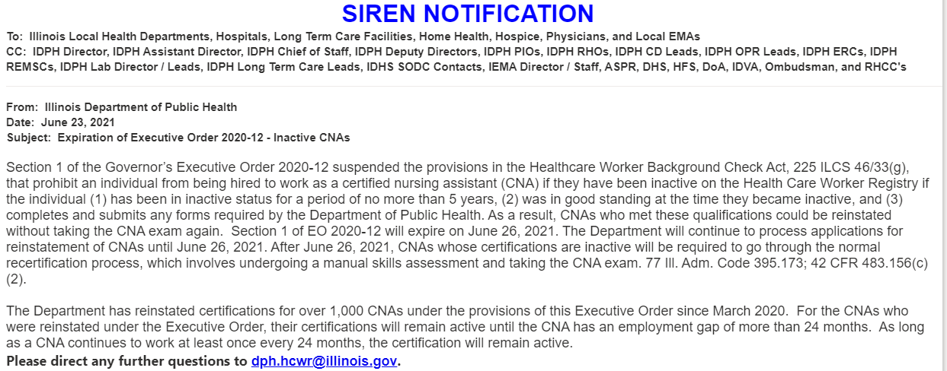
IDPH: Expiration of Executive Order 2020-12- Inactive CNA’s

Slide 11
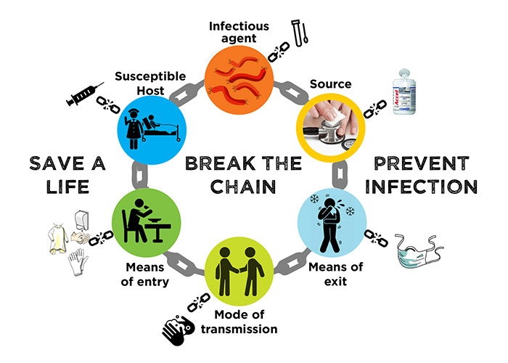
Environmental Services Overview

Slide 12
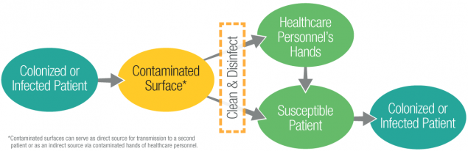
Cleaning and Disinfection
Healthcare environment contains a diverse population of microorganisms that can serve as reservoirs of potential pathogens.
These microorganisms are continuously shed or spread by direct skin contact onto surrounding environment surfaces.
https://www.cdc.gov/hai/prevent/environment/surfaces.html

Slide 13

Core Components of Environmental Cleaning and Disinfection
https://www.cdc.gov/hai/prevent/environment/surfaces.html

Slide 14
1. Integrate environmental services into facility’s culture:
Establish an EVS program with defined management structure and multidisciplinary participation
Hold regular meetings to review EVS practices and quality measures and to go over EVS goals
Define program responsibilities
Incorporate considerations for effective cleaning and disinfection into the design, structure, and layout of patient care areas.

Slide 15
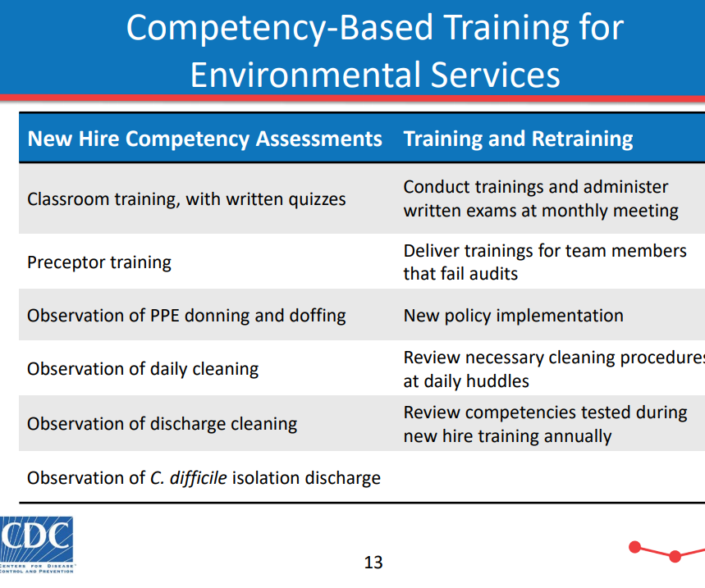
2. Educate and train all health care providers Responsible for Cleaning and Disinfecting Resident Care Areas
Focus training on:
  Learning and following the correct practices of cleaning and disinfection
  Understanding the concepts of pathogen transmission
  Recognizing the impact of their work on infection control and protecting residents
  Proper PPE use by the EVS staff
Train all EVS upon hire and at least annually and keep a record of training completion
Retrain to address weaknesses discovered during routine monitoring and audits
Update EVS staff on trends in facility infection rates and prevention priorities

Slide 16

3. Select appropriate cleaning and disinfecting products
Ideal Disinfectant:
One step cleaner/disinfectant
Non-toxic and non-irritating
Low toxicity rating
Not damage surfaces
Easy to use
Acceptable odor
Economical

Slide 17
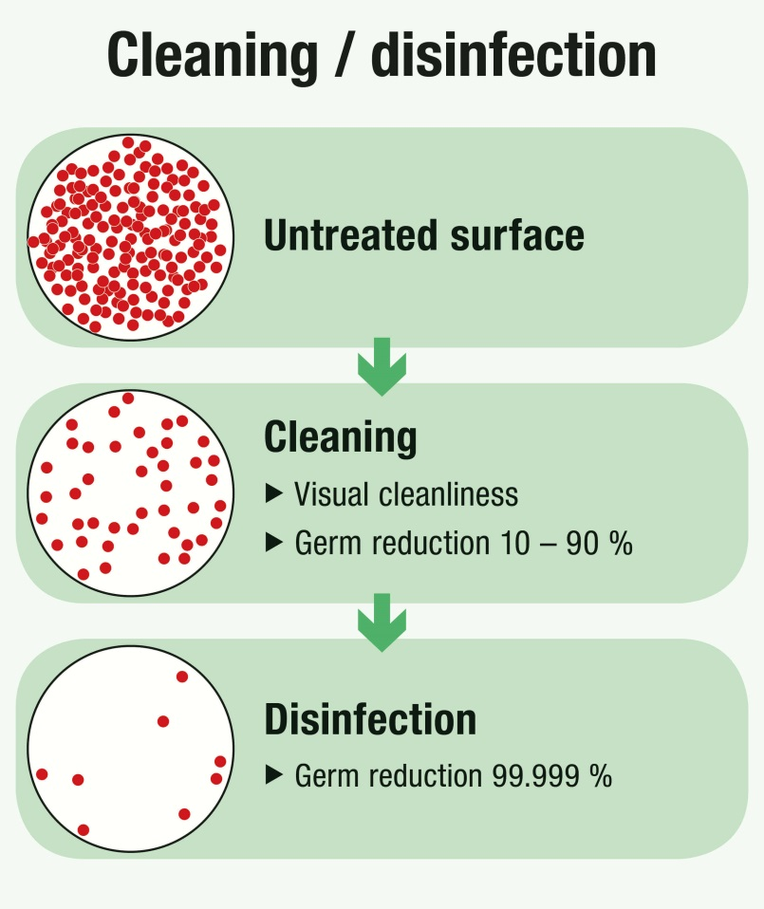
Questions to help in selection:
Cleaner/ disinfector or both?
premixed or mixed via chemical mixing dispenser (i.e J-Fill)/ requires dilution (ratio for dilution)
EPA registration number (check for List N, List K agents)
Contact time
Kill claim (bactericidal, viricidal, tuberculocidal)
Toxicity
Economical
Required PPE

Slide 18
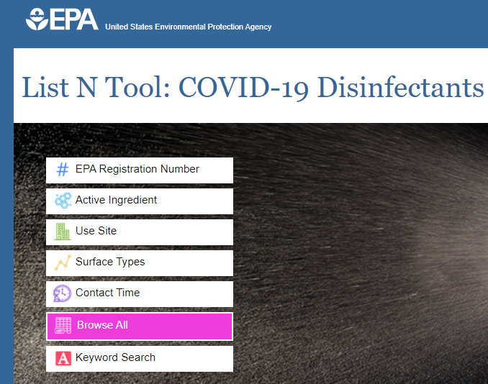
List N agents
  EPA expects all products on List N to be effective against coronavirus SARS-CoV-2 (COVID-19) when used according to the label directions.
  To find a product, locate the EPA Reg. No. on the product label, then enter the first two sets of numbers into the tool.
List K agents:
  EPA's Registered Antimicrobial Products Effective against Clostridium difficile Spores
List P agents
  registered for use with Candida auris (C. auris).

Slide 19
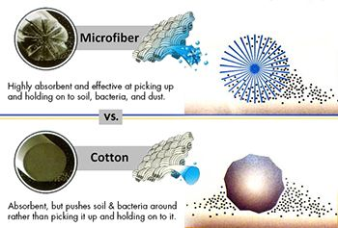
Microfiber vs Cloth/cotton mops
Absorbs seven times its weight in water
With water, removes 98.9% of bacteria from smooth surfaces
Dries 3 times faster than traditional cloth mops
Reduces chemical usage significantly than cotton mops
Change microfiber mop after each patient area, after isolation room and after cleaning blood and bodily fluid spills

Slide 20
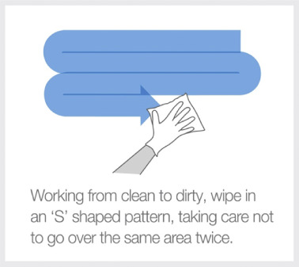
4. Standardize Setting-Specific Cleaning and Disinfection Protocols
Identify responsibilities for cleaning and disinfecting
Develop standardized protocols for routine (e.g., daily) and discharge/transfer(terminal) cleaning
Create and post cleaning schedules for common areas and bathrooms
Consider having staff document the time that cleaning is completed on a posted tracking sheet.
Follow guidelines for an optimal cleaning path – For example: clockwise, top to bottom – Cleanest to dirtiest

Slide 21


Surface types:
High-touch surfaces are surfaces that are frequently touched throughout the day. These include doorknobs, elevator buttons, light switches and computer keyboards. High-touch surfaces require cleaning and disinfection at least daily, and more frequently where the risk of contamination is higher than usual (e.g. during an outbreak).
Low-touch surfaces are surfaces that are touched less frequently throughout the day. These include floors and walls. Low-touch surfaces require cleaning on a regularly scheduled basis. However, they should be cleaned immediately when visibly soiled.

Slide 22
5. Monitor Effectiveness and Adherence to Cleaning and Disinfection Protocols
Include in the protocols for monitoring:
    Who should do the monitoring?
    What type of monitoring will be used (e.g., direct observation, fluorescent gel, adenosine triphosphate (ATP))?
    How frequently the monitoring will occur?
    How monitoring data will be validated?
    Which rooms will be monitored?
    Which surfaces will be assessed?
Perform routine audits of adherence to cleaning and disinfection procedures.

Slide 23
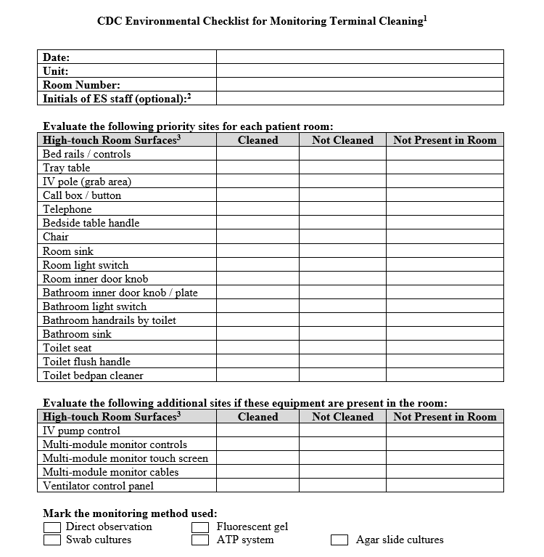
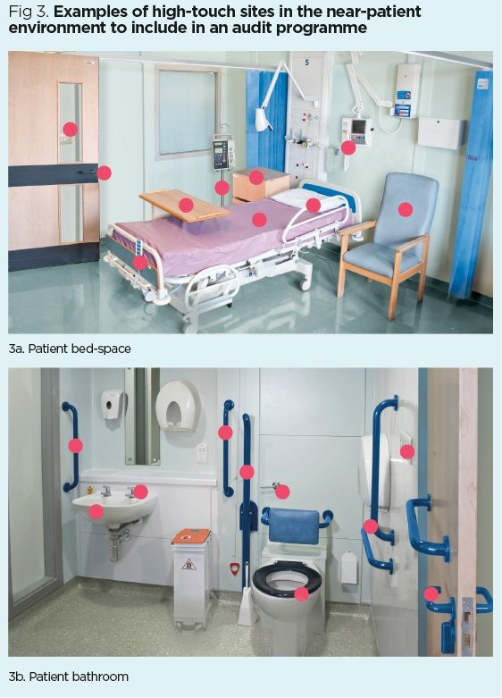
Evaluating Environmental Cleaning
https://www.cdc.gov/hai/toolkits/evaluating-environmental-cleaning.html

Slide 24
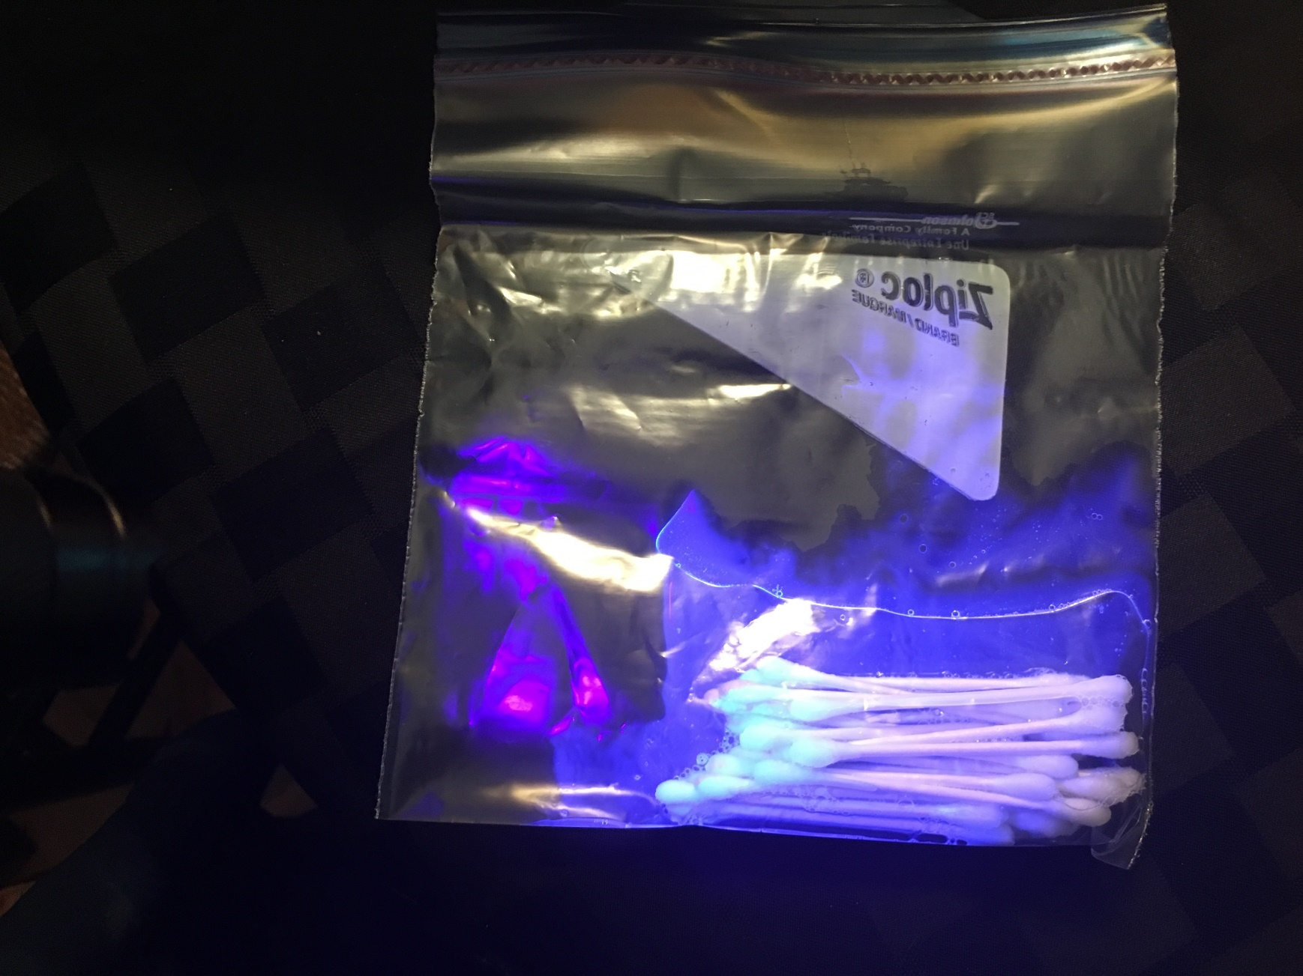
Mark surfaces in each room using separate plastic bag with individual applicators saturated with Tide Free and Gentle

Slide 25
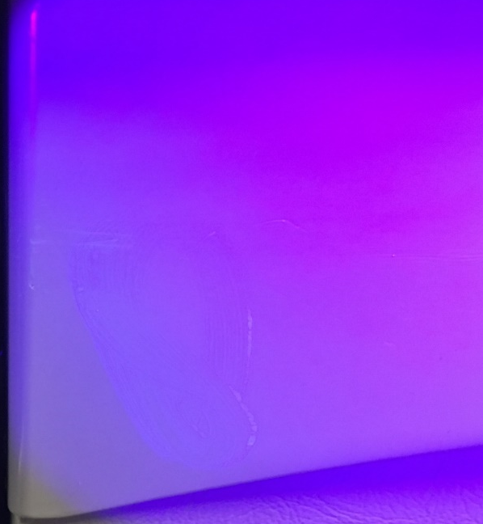
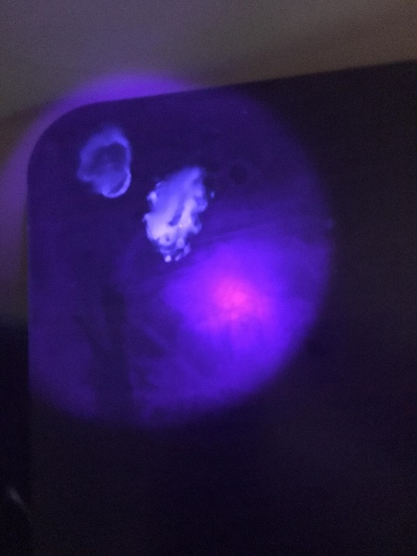
Example: Wiped and Missed

Slide 26
6. Provide feedback on adequacy and effectiveness of cleaning and disinfection to all responsible HCP as well as relevant stakeholders (e.g., infection control, hospital leadership)
Present audit data to EVS personnel regarding their adherence to cleaning and disinfection procedures.
Present audit data to leadership to:
  Identify active issues and strategies to mitigate these issues.
  Validate the effectiveness of the overall cleaning strategy.

Slide 27



Recognize EVS team members and their role in infection prevention:
EVS recognition week
Top performers
Meal tickets
Uniform badges
Thankyou cards

Slide 28
Antimicrobial Stewardship Programs in Chicago SNFs
Amy Hanson, PharmD, BCPS AQ-ID
Project Administrator, Antimicrobial Stewardship
Chicago Department of Public Health
Notes:
Good afternoon, I’m Amy Hanson, an Infectious Disease Pharmacist, and I’ve been intermittently providing clinical pearls to initiate and/or enhance your antimicrobial stewardship programs, or ASPs, on these webinars.

Slide 29





CDPH Roundtables on
Antimicrobial Stewardship Topics
Date | Antimicrobial Stewardship for SNFs Topic
1.28.21 | COVID and Antimicrobial Resistance (AMR): Antibiotics are Indicated to Treat a Virus
2.4.21 | Clarify Penicillin (and Beta-lactam) Allergies; Reduce Use of Fluoroquinolones
2.18.21 | Urinary Tract Infection Education and Get Your #ShotofHope Reminder
3.11.21 | IDPH Survey’s Assessment of SNF ASPs
4.1.21 | Baseline Survey Review of Chicago SNF ASP Compliance
5.13.21 | GAIN Collaborative Pilot Results – Pre- vs- Post- ASP
6.10.21 | Tour of Resources Available on the Chicago HAN
6.24.21 | Focus on Core Element One: Leadership Commitment
Notes:
Here is an overview of the antimicrobial stewardship pearls that have been provided on these webinars. Today we are going to focus on the CDC Core Element 1 for antimicrobial stewardship programs, or ASPs in nursing homes, Leadership Commitment.

Slide 30
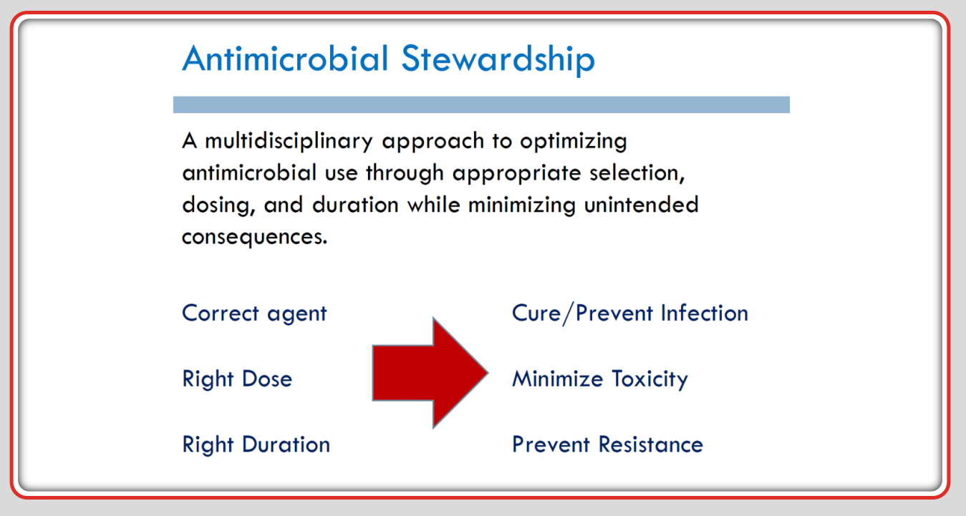
https://mena-ams.com/wp-content/uploads/2020/02/BSAC-MENAAMS2020-AMS-EngagingLeadership-MushiraEnani.pdf
Notes:
Overall, Antimicrobial Stewardship refers to a multi-disciplinary approach to optimizing antimicrobial use. We use the term antimicrobial over antibiotic stewardship in order to encompass antifungals, antiviral and antiparasitic agents as well. Being mindful of the 3 D’s, or choosing the correct drug at the right dose for the right duration, can improve patient outcomes, which is the goal of a comprehensive ASP. Programs are designed to improve clinical outcomes, minimize risk of adverse drug events, and prevent the development of antimicrobial resistant pathogens.

Slide 31

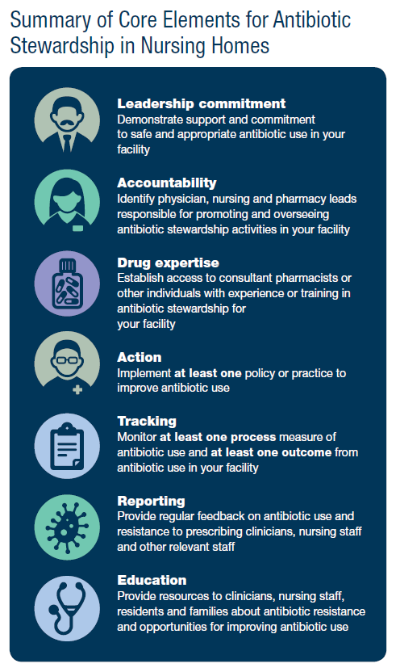

7 CDC Core Elements for Antimicrobial Stewardship Programs in Nursing Homes
https://www.cdc.gov/longtermcare/prevention/antibiotic-stewardship.html#anchor_1557415462
Notes:
The CDC has 7 core elements for SNF ASPs, and as mentioned, today we will hone in on core element 1, leadership commitment. Facilities should demonstrate support and commitment to safe and appropriate use of antimicrobials at their facilities.

Slide 32
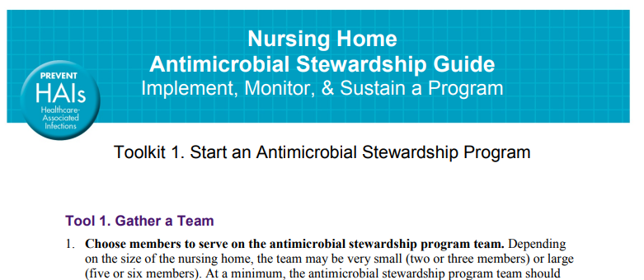
AHRQ for Core Element 1:
Leadership Commitment
https://www.ahrq.gov/sites/default/files/wysiwyg/nhguide/3_TK1_T1-Gather_a_Team_final.pdf
Notes:
As reviewed on the last webinar from June 10th, there are many resources that are helpful when you are starting and/or enhancing your ASP. AHRQ, or the Agency for Healthcare Research and Quality, has an extensive list of tools on their website, and many helpful references to demonstrate a strong leadership commitment to the facilities ASP.

Slide 33

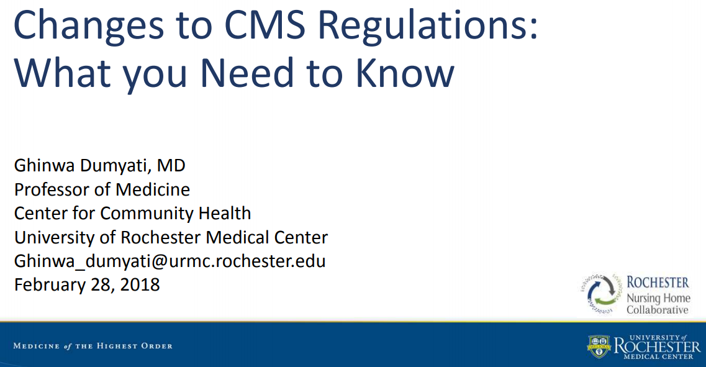
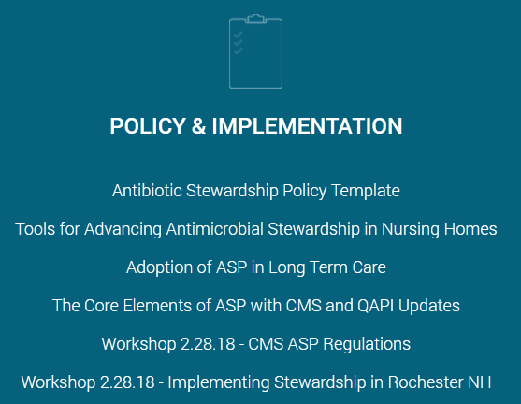
Core Element 1: Leadership Commitment
Rochester Nursing Home Collaborative
https://www.rochesterpatientsafety.com/index.cfm?Page=For%20Nursing%20Homes
Notes:
I like these Rochester Nursing Home resources. I’ve found that pointing out this is a required program, and there was mandated by CMS that all LTCFs needed to have a comprehensive ASP since 2017.
There is a nice slide deck that explains that exact changes to the CMS Megarule that requires ASPs available on this site by Dr. Dumyati, a prominent physician in the SNF ASP realm.

Slide 34
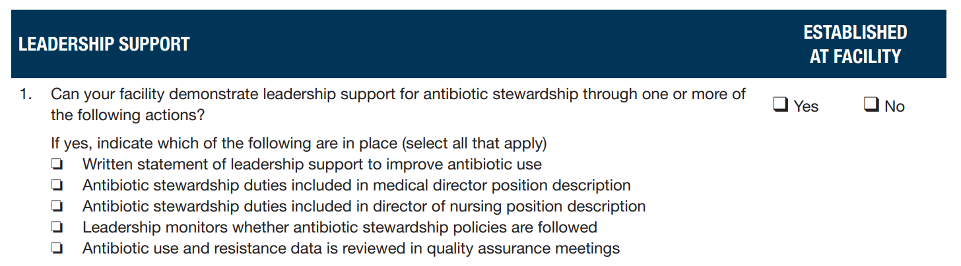
Core Element 1: Leadership Commitment
CDC Checklist
https://www.cdc.gov/longtermcare/pdfs/core-elements-antibiotic-stewardship-checklist.pdf
Notes:
Now we’ll walk through the CDC Core Elements Checklist with exactly what activities are recommended for Leadership Commitment, and how to achieve each milestones. First, we’ll start with having a written statement of leadership support to improve antimicrobial use. Now, under the core element 4 action, your ASP should also include having an antimicrobial stewardship policy outlining specific procedures and guidelines in place to ensure appropriate use of antimicrobials in detail. This leadership commitment statement is a separate, broader in scope, and typically shorter than your policies and procedures document.

Slide 35



Sample Written Statement of Leadership Support
We, the administration and/or corporation, are committed to supporting efforts that improve antimicrobial use in our facility.
https://health.ri.gov/healthcare/about/antimicrobialstewardship/#commitment
Notes:
The leadership commitment should represent how leadership is committed to supporting aspects of each of the 7 CDC core elements. I’ll provide a sample statement for each core element. Here, we find a general statement of leadership commitment to the facility’s ASP. (Read statement)

Slide 36



Sample Written Statement of Leadership Support
We will ensure antimicrobial stewardship related duties are included in job descriptions for the medical director, clinical nurse lead(s), and consultant pharmacist(s).
https://health.ri.gov/healthcare/about/antimicrobialstewardship/#commitment
Notes:
Next, the 2nd core element is accountability. An example statement here reads: (read statement)

Slide 37



Sample Written Statement of Leadership Support
We will assist our prescribers, nurses and
consultant pharmacists in developing
antimicrobial use protocols and guidelines that ensure the appropriateness of any antimicrobial agent ordered for our residents.
https://health.ri.gov/healthcare/about/antimicrobialstewardship/#commitment
Notes:
For the 3rd core element, drug expertise, you could include: (read statement)

Slide 38



Sample Written Statement of Leadership Support
We will reassess the use of antimicrobials after they are initiated. When culture results become available, action(s) will be taken including discontinuation, continuation, or a change in antimicrobials with adequate chart documentation including signs/symptoms.
https://health.ri.gov/healthcare/about/antimicrobialstewardship/#commitment
Notes:
For the 4th core element action, there are many different directions you can go with this, and as the figure on the left shows, it’s sometimes trial and error and more of a meandering than direct route to success, and that’s okay! You know your staff and residents the best, and you know what types of tools, tricks and motivating factors will be best to have successful implementation for different aspects of your ASP.
An example of leadership commitment to action may read: (read statement) The act of re-assessing antimicrobials at about 48 hours when culture results become available is often also referred to as an “antimicrobial time-out”.

Slide 39
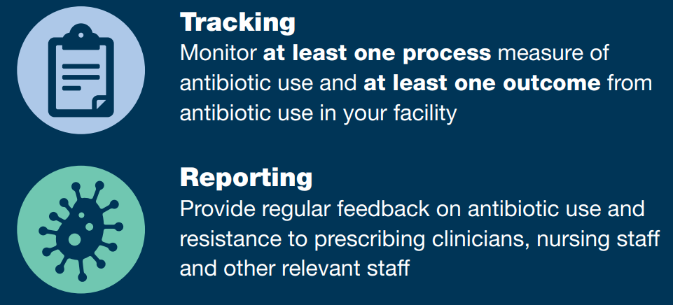


Sample Written Statement of Leadership Support
We will work with our prescribers, nurses and consultant pharmacists to create a system that monitors and shares reports regarding antimicrobial use in the facility.
https://health.ri.gov/healthcare/about/antimicrobialstewardship/#commitment
Notes:
Core elements 5 and 6 often go hand-in-hand. Tracking and Reporting both antimicrobial use and clinical outcomes are important to observe trends and make modifications to improve prescribing and outcomes based on these quality and process improvement reports. A sample statement of leadership commitment for tracking and reporting may read: (read statement)

Slide 40



Sample Written Statement of Leadership Support
We commit to creating a culture focused on messaging, education and celebrating improvement, which promotes antimicrobial stewardship with staff, residents and their families at our facility.
https://health.ri.gov/healthcare/about/antimicrobialstewardship/#commitment
Notes:
The 7th and last core element is education. In-services should be provided at least annually and for new hires on key components of the ASP, and information on appropriate prescribing for common infections in elderly residents such as urinary tract infections, skin and soft tissue infections, and respiratory tract infections, especially emphasizing that antibiotics should not be routinely started for patients diagnosed with COVID-19, as an antibiotic will not treat a virus, only bacteria. Educational flyers should also be provided to patients and their families when antimicrobials are prescribed outlining the risks and benefits of antimicrobial therapy so they are also making informed decisions with their care teams. An example includes: (read statement)

Slide 41

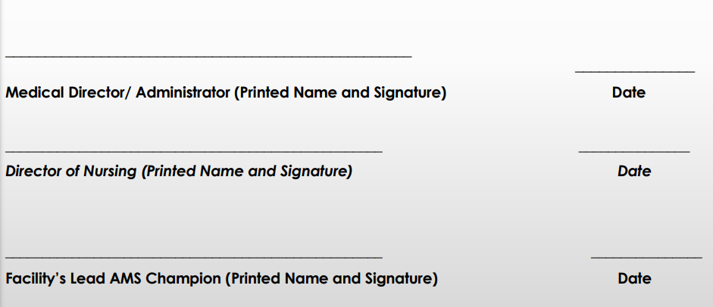
Sample Written Statement of Leadership Support
https://health.ri.gov/healthcare/about/antimicrobialstewardship/#commitment
Notes:
And finally, the leadership commitment statement should include names, positions and signatures that are dated. Revisions and re-commitments may need to be made as needed, or as a key member of the leadership or corporate team changes.

Slide 42
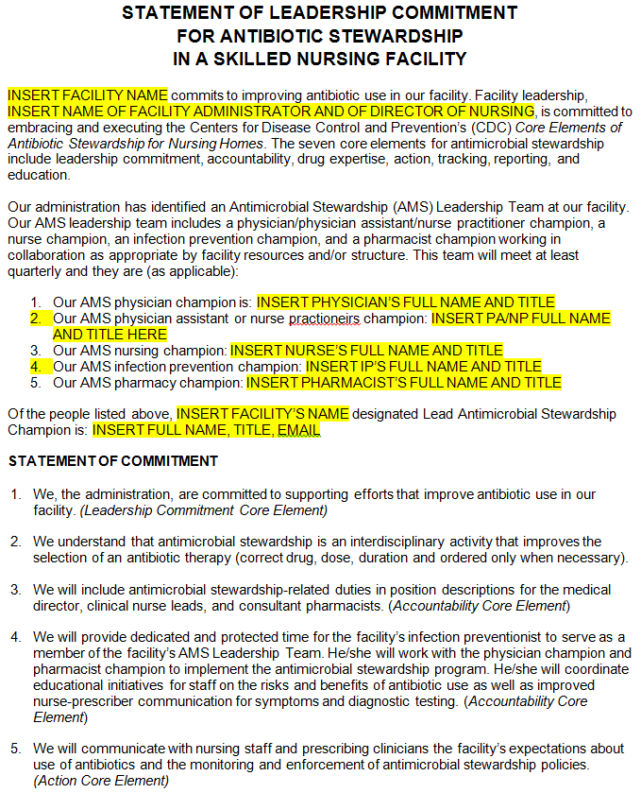
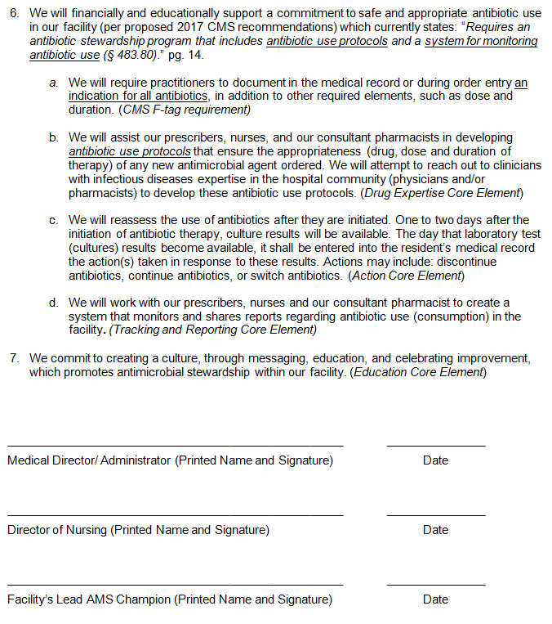
https://health.ri.gov/healthcare/about/antimicrobialstewardship/#commitment
Notes:
The same Rhode Island Health Department website I’ve been referencing at the bottom of the slides also provides a sample statement of leadership commitment for antimicrobial stewardship in a SNF. Feel free to not reinvent the wheel, we know you are all extremely busy still and wearing so many different hats, so please use sample policies when you’re able!

Slide 43
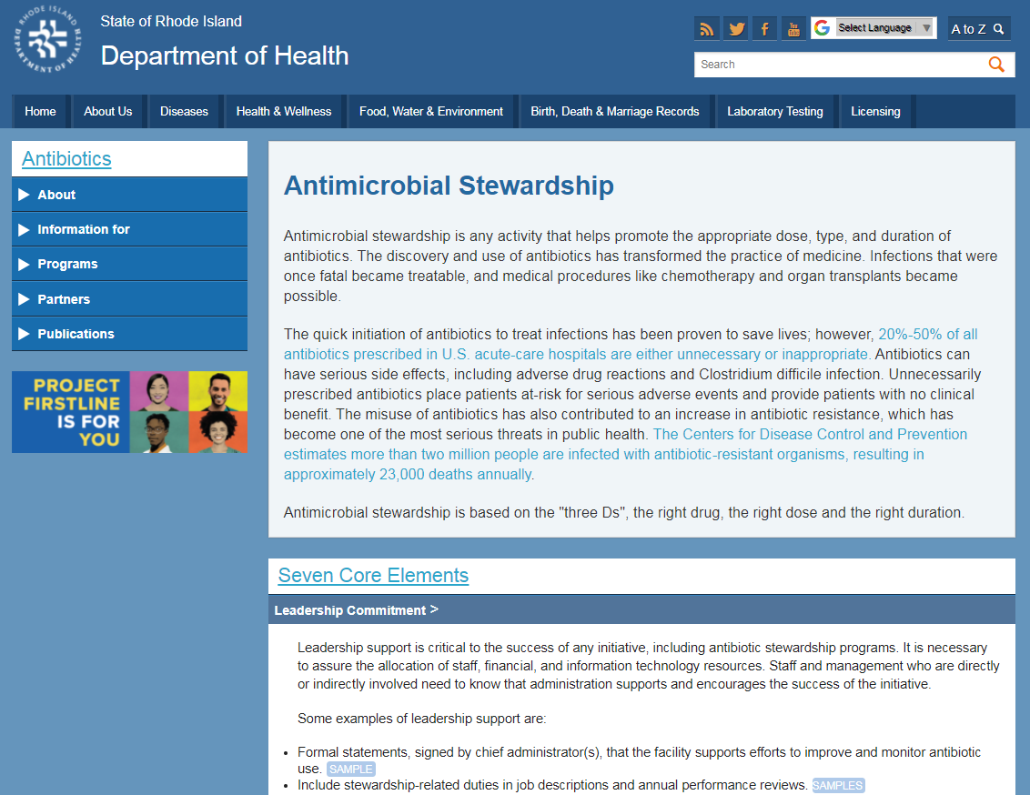
https://health.ri.gov/healthcare/about/antimicrobialstewardship/#commitment
Notes:
The arrow is pointing at both where the sample leadership commitment statement resides, and also sample job descriptions for key members of the ASP team, which we will discuss next.

Slide 44

Core Element 1: Leadership Commitment
CDC Checklist
https://www.cdc.gov/longtermcare/pdfs/core-elements-antibiotic-stewardship-checklist.pdf
Notes:
We will review 3 job descriptions for inclusion of antimicrobial stewardship duties: the medical director, director of nursing, and I added in the pharmacy consultants, since they are often your designated drug expert.

Slide 45
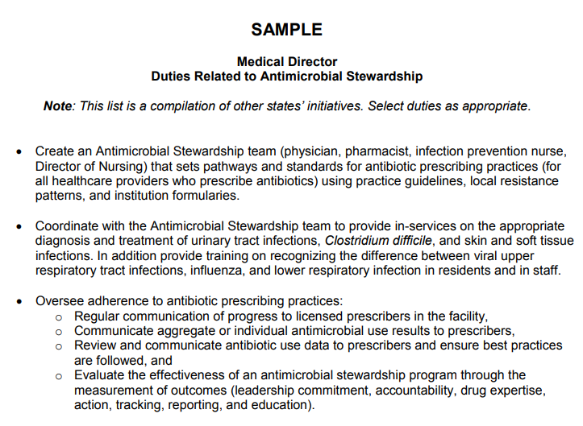
https://health.ri.gov/publications/guidelines/DutiesRelatedToAntimicrobialStewardship.pdf
Notes:
The same Rhode Island Health Department website provides sample job descriptions for these roles. I won’t read through all of them, and as it’s noted at the top, the list is meant to select duties as appropriate and adopt for what the practice models looks like at your facility. Often the Medical Director is the organizer of the antimicrobial stewardship inter-disciplinary team, an educator for staff providing in-services on appropriate diagnosis and management of common infections in nursing home residents, and may oversee adherence to various antimicrobial prescribing practices.

Slide 46
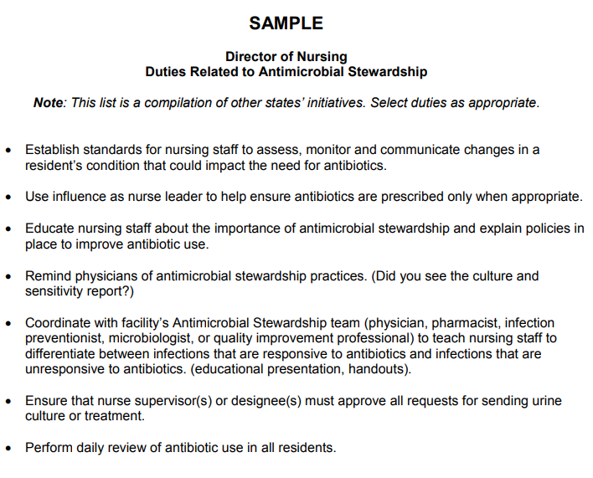

https://health.ri.gov/publications/guidelines/DutiesRelatedToAntimicrobialStewardship.pdf
Notes:
The Director of Nursing or DON may have antimicrobial stewardship related activities integrated into their job description and responsibilities. This may be a co-lead role with the medical director and/or pharmacy consultant. This may also be shared, cross-trained position of responsibilities with other members of the nursing leadership team. This could include the DON, assistant director or nursing or ADON, the infection prevention or IP nurse, a corporate nurse consultant, and/or a corporate VP of clinical operations and/or services. Administrators may also be involved in writing the leadership commitment. The lead stewardship nurse or nurses may also provide in-services on appropriate antimicrobial use to clinical frontline nurse and other clinical providers and staff, and ideally would co-perform with a stewardship or infectious disease provider daily reviews of all residents on antimicrobials to ensure appropriate and judicious use.

Slide 47
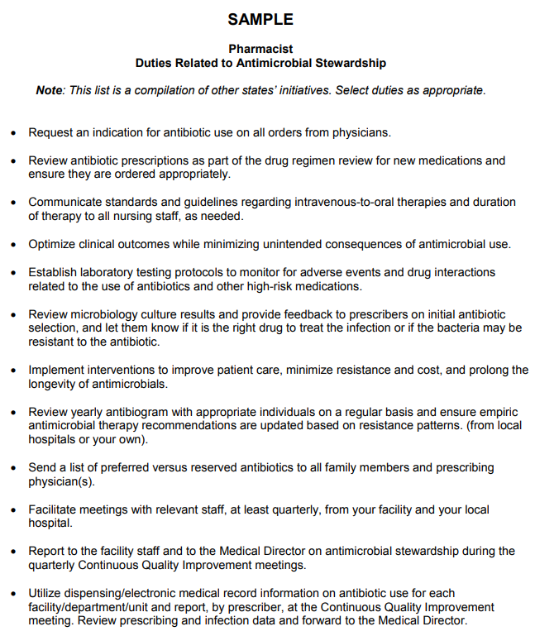
https://health.ri.gov/publications/guidelines/DutiesRelatedToAntimicrobialStewardship.pdf
Notes:
The pharmacist list is longest, as it should be, in my opinion, as a pharmacist myself. This list could also serve as brain storming for how to get the pharmacy consultant more involved in taking the lead of antimicrobial stewardship initiatives at your facility. The pharmacy consultant companies I’ve worked with in Chicago have been great. I’ve presented on antimicrobial stewardship at each of their clinical meetings in the past in 2019, and each member of pharmacy leadership servicing the 78 Chicago SNFs has been very enthusiastic in getting their consultants to be more involved in championing new initiatives, so don’t be afraid to ask them to take a leadership role and craft new interventions to improve antibiotic prescribing at your facility. Pharmacists should be doing more than renal adjustments of a fluoroquinolone antibiotic, for example, such as levofloxacin or ciprofloxacin when ordered. Especially if it’s for a urinary tract infection, they should be verifying it’s indicated by matching signs and symptoms with the Loeb criteria, recommending an alternative agent based on local and recent antibiogram susceptibility data, and making sure a short and appropriate duration of therapy has been selected if indicated.

Slide 48
Core Element 1: Leadership Commitment
CDC Checklist
Also recommend in the consultant pharmacist job description.
https://www.cdc.gov/longtermcare/pdfs/core-elements-antibiotic-stewardship-checklist.pdf
Notes:
Now that we’ve reviewed the written statement of leadership commitment and job duties depending on position, let’s discuss how leadership can monitor whether antimicrobial stewardship policies are being followed.

Slide 49


Leadership Monitors for Compliance
Review of Inter-disciplinary Quality Assurance Meetings were Antimicrobial Stewardship Program activities are discussed.
Compliance with job responsibilities for antimicrobial stewardship are factored into performance evaluations.
High prescribers are given feedback on prescribing rates compared to peer providers.
Notes:
I couldn’t find this outlined in detail in several references, so here’s my top 3 in this department. Leadership can attend inter-disciplinary quality assurance meetings proactively, and/or review the meeting minutes and provide suggestions retrospectively. They can also ensure compliance with the job responsibilities outlined, and assess these aspects in performance evaluations. There is also opportunity to give high prescribers feedback on prescribing rates compared to peer providers, as this is often a surrogate marker that correlates with inappropriate prescribing and can also be included in performance evaluation metrics.

Slide 50
Core Element 1: Leadership Commitment
CDC Checklist
https://www.cdc.gov/longtermcare/pdfs/core-elements-antibiotic-stewardship-checklist.pdf
Notes:
And last but not least, as discussed, we can review in more detail how leadership can show support of facility ASPs by reviewing antibiotic use and resistance data at quality assurance meetings.

Slide 51
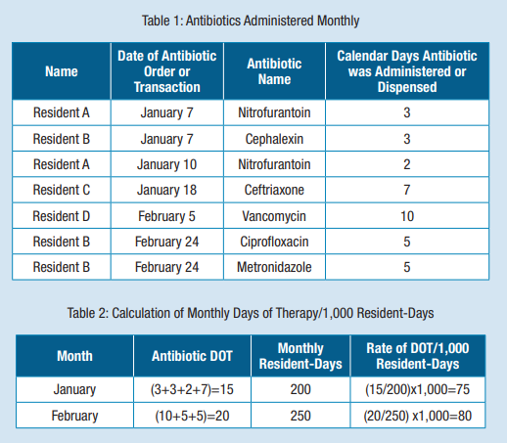

https://www.cdc.gov/longtermcare/pdfs/Nursing-Homes-Core-Elements-C-508.pdf
Notes:
The CDC has this appendix C of their core elements resources that provides valuable samples for how to format and present data on measure and reporting antimicrobial use in nursing homes. Table One shows an example of antimicrobial administration by month. As you can see, the data collection does not need to be extensive. However ,you may want to include a little more detail, such as: the resident name, a second identifier such as date of birth, the room number, the date of antibiotic start date, the antibiotic, the indication, the stop date (for total days duration of therapy), prescribing provider to look for trends, and comments on appropriateness of therapy, or any recommendations made and if it was accepted by the provider or not. Table Two is a sample calculation of monthly days of therapy, or DOT, per 1,000 resident days, which will normalize the prescribing data for a fluctuating census, and is the gold standard for tracking and reporting antimicrobial use data for action.

Slide 52

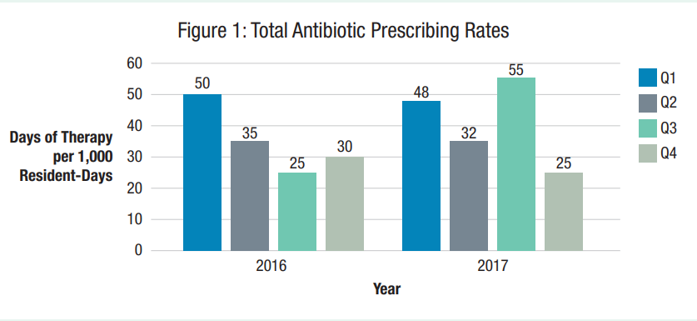
https://www.cdc.gov/longtermcare/pdfs/Nursing-Homes-Core-Elements-C-508.pdf
Notes:
This appendix also includes this Figure One, which gives an example of how to graphically represent the DOT per 1,000 resident days data from quarter to quarter, and year to year.

Slide 53
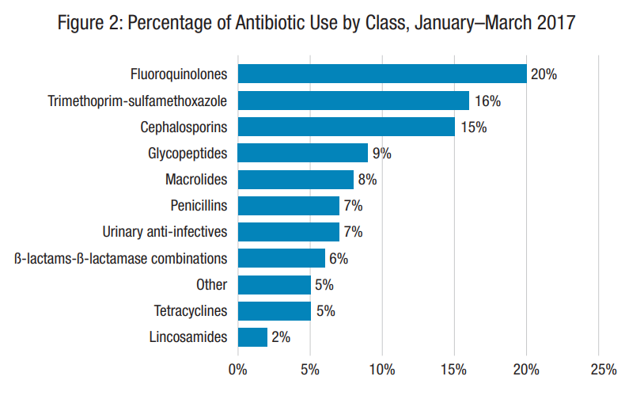
https://www.cdc.gov/longtermcare/pdfs/Nursing-Homes-Core-Elements-C-508.pdf
Notes:
Figure Two gives an example of how to report and review percentages of antibiotic use by class over time.

Slide 54

Core Element 1: Leadership Commitment
CDC Checklist
https://www.cdc.gov/longtermcare/pdfs/core-elements-antibiotic-stewardship-checklist.pdf
Notes:
Now that we’ve reviewed how to check off that final mark that you’ve established leadership support for antimicrobial stewardship at your facility, let’s look at where you can go for additional resources on the subject.

Slide 55
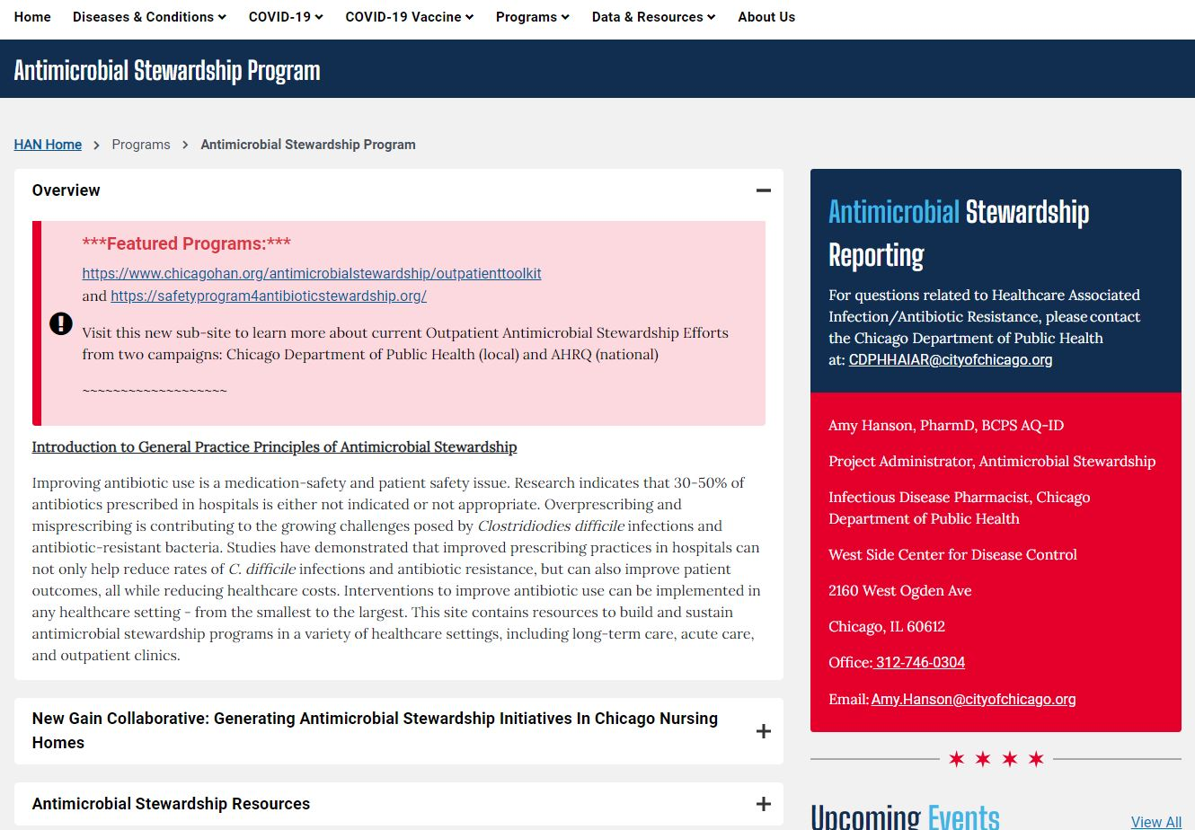
New Chicago HAN Antimicrobial Stewardship Website
https://www.chicagohan.org/antimicrobial-stewardship-program
Notes:
Here’s a look at the new HAN page dedicated to stewardship. ASP resources are now found under the Programs tab. Note that under the GAIN Collaborative Tab, which stands for Generating Antimicrobial Stewardship Initiatives in Chicago Skilled Nursing Facilities, you have an “Antimicrobial Stewardship Resources” tab.

Slide 56
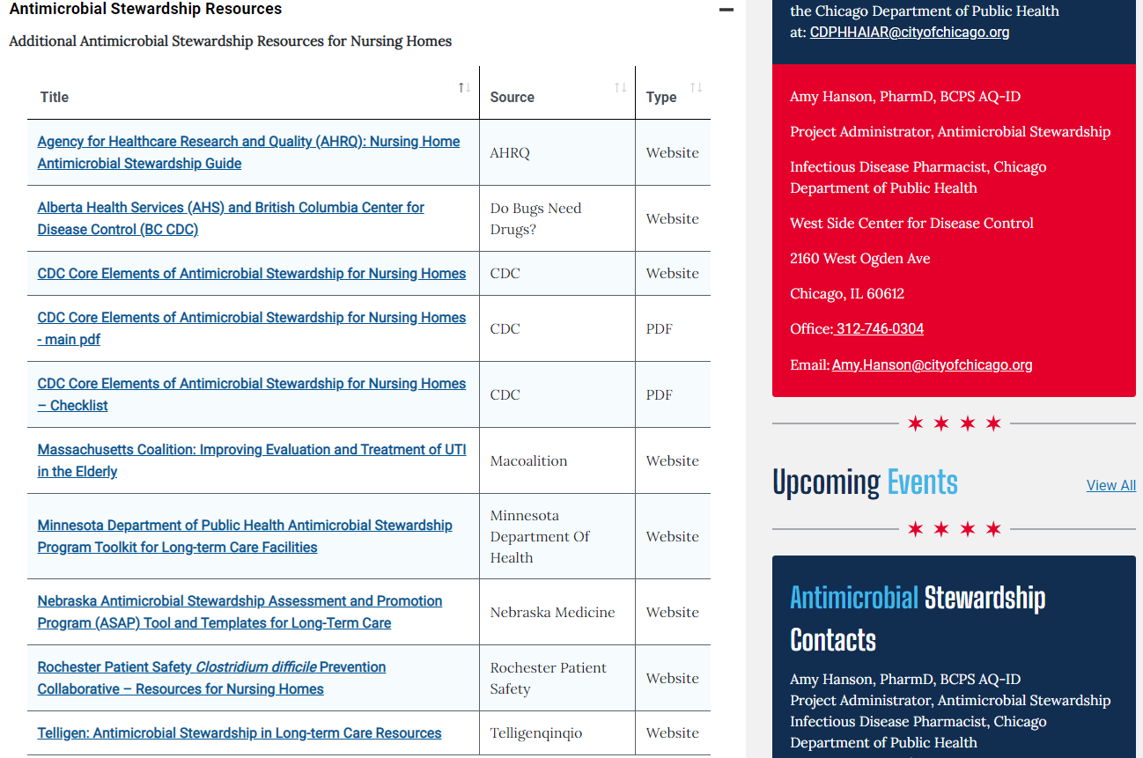

https://www.chicagohan.org/antimicrobial-stewardship-program
Notes:
Again, on the last webinar June 10th, we reviewed these 10 key website for aiding SNF ASPs in more detail, and which are most helpful for each core element, in my opinion. And now I think we can turn the floor back over and open up to any questions.

Slide 57
Thank You!
What Questions Do You Have?
Amy Hanson, PharmD, BCPS AQ-ID
Chicago Department of Public Health
Amy.Hanson@cityofchicago.org
Notes:
And I thank you for your attention during today’s presentations!

Slide 58
Questions & Answers
A special thanks to:
CDPH HAI Team:
Hira Adil
Dr. Stephanie Black
Dan Galanto
Dr. Amy Hanson
Adebola Hassan
Liz Shane
Winter Viverette
Kelly Walblay
Shannon Xydis
Shane Zelencik
Christy Zelinski
For additional resources and upcoming events, please visit the CDPH LTCF HAN page at: https://www.chicagohan.org/covid-19/LTCF

