Slide 1
COVID-19 Question and Answer Session for Long-Term Care and Congregate Residential Settings
June 11th , 2021

Slide 2
Housekeeping
All attendees in listen-only mode
Submit questions via Q&A pod to All Panelists
Slides and recording will be made available later

Slide 3
Agenda
Upcoming Webinars
NHSN Reminders
Illinois COVID-19 Cases and Vaccination Update
OSHA COVID-19 Healthcare Emergency Temporary Standard (ETS)
Long-Term Care Guidance Updates: N95 Respirators & Facemasks
Previous FAQ
Open Q & A
Slides and recording will be made available after the session.

Slide 4
IDPH webinars
​
Upcoming Friday Brief Updates and Open Q&A
1:00 pm - 2:00 pm
Friday, June 25th | https://illinois.webex.com/illinois/onstage/g.php?MTID=e157623284204828c8960c7c3687017bb
Previously recorded webinars can be viewed on the IDPH Portal
Slides and recordings will be made available after the sessions.
Notes:
HH webinar originally part of the monthly HAI series. Keeping this as a placeholder because it’s been scheduled. Most likely change to COVID-related topics and postpone HH for another time.

Slide 5
Reminder - NHSN COVID-19 Vaccination Reporting Requirement
Enforcement of the CMS interim final rule that requires LTC facilities to report vaccine data to NHSN begins June 13, 2021.
Only 432 CMS-certified SNFs have entered data since May.
Telligen is available to provide support: Nursinghome@Telligen.com
Data quality issues to avoid:
Entering 0 or underreporting the total weekly number of staff
Entering data for either residents or staff alone
Notes:
ICF/IID are not required to report to NHSN at this time, but they may voluntarily report

Slide 6
Telligen Update: Upgrade SAMs access from Level 1 to Leve 3
CDC is offering to help!
Telligen is collecting information for the CDC
Submit contact info to Telligen HERE by June 17th
Full legal name (as shown on IDs) and email used for Level 1 login
Look for an email from SAMS (after June 18th) that will initiate the upgrade process
Questions: nursinghome@telligen.com
This material was prepared by Telligen, the Medicare Quality Innovation Network Quality Improvement Organization, under contract with the Centers for Medicare & Medicaid Services (CMS), an agency of the U.S. Department of Health and Human Services. The contents presented do not necessarily reflect CMS policy. This material is for informational purposes only and does not constitute medical advice; it is not intended to be a substitute for professional medical advice, diagnosis or treatment. 12SOW-IL-06/11/21-4124
Notes:
The CDC is offering to help users upgrade SAMS access from Level 1 to Level 3, for your NHSN reporting.
CMS has reached out to Telligen to submit a list of Illinois Level one users who want to upgrade their access to level 3
The slide includes a hyperlink to a smartsheet page, where you can submit your contact information and facility information. There are only 5 questions.
Please complete this online form by June 17 and on June 18 Telligen will share this with CMS and the CDC.
Thank you
Post in chat: Link for submitting contact Info: https://app.smartsheet.com/b/form/fa43f1bf83094d348f25ac3b18c8596f

Slide 7
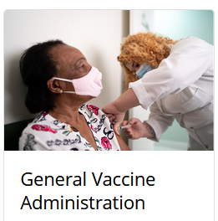
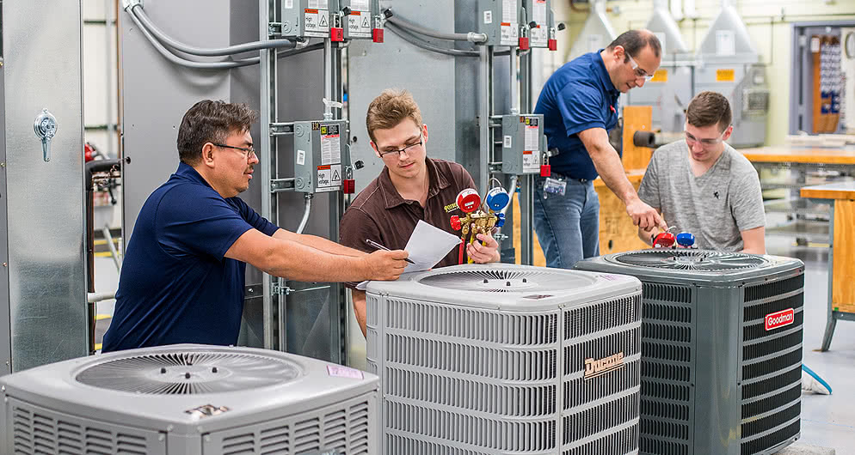
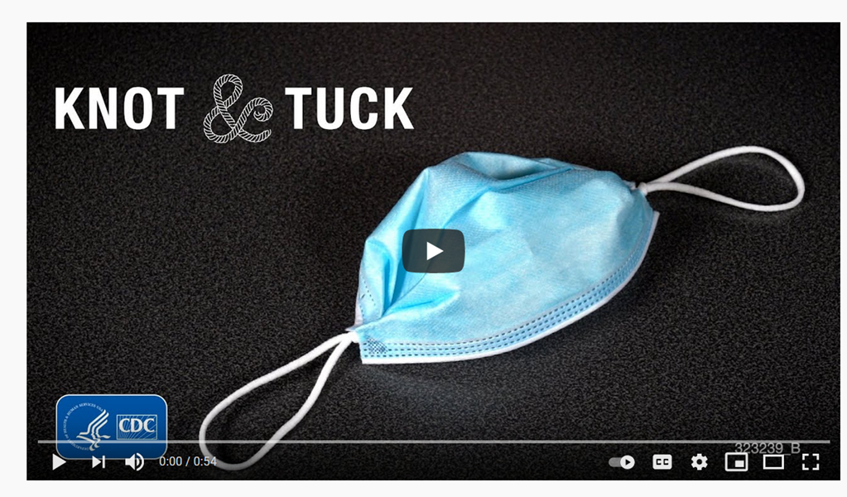
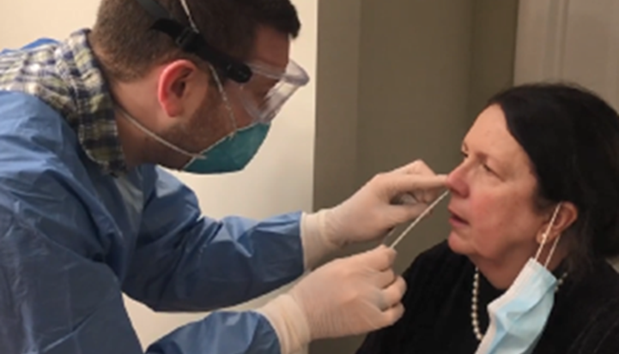
Image: Harper College
Ventilation
Screening and Surveillance
Hand Hygiene
Source Control
Surface Cleaning / Disinfecting
Detection, Isolation
Core Infection Prevention Practices
Notes:
Vaccination
Screening of all who enter the rehearsal space
Testing of unvaccinated and symptomatic persons
Hand hygiene (use of alcohol-based hand rub is preferred)
Face covering or mask (covering mouth and nose)
Physical distancing at least six feet between persons for unvaccinated persons
Instructional signage
Cleaning and disinfecting
Effective cohorting

Slide 8
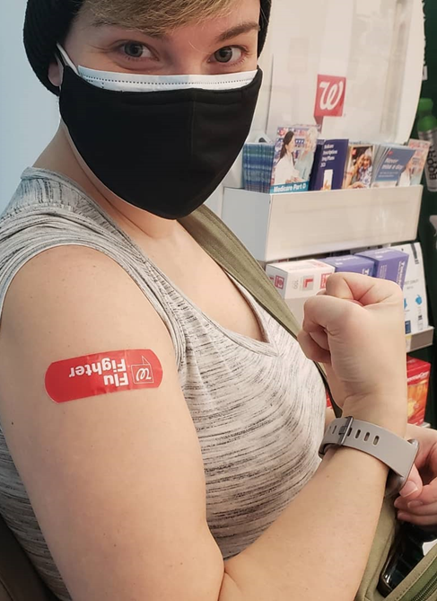
Definition: Fully Vaccinated
The CDC defines people who are fully vaccinated as those who are two weeks past their second dose of the Moderna and Pfizer COVID-19 vaccine or two weeks past a single dose of the Johnson & Johnson vaccine.

Slide 9
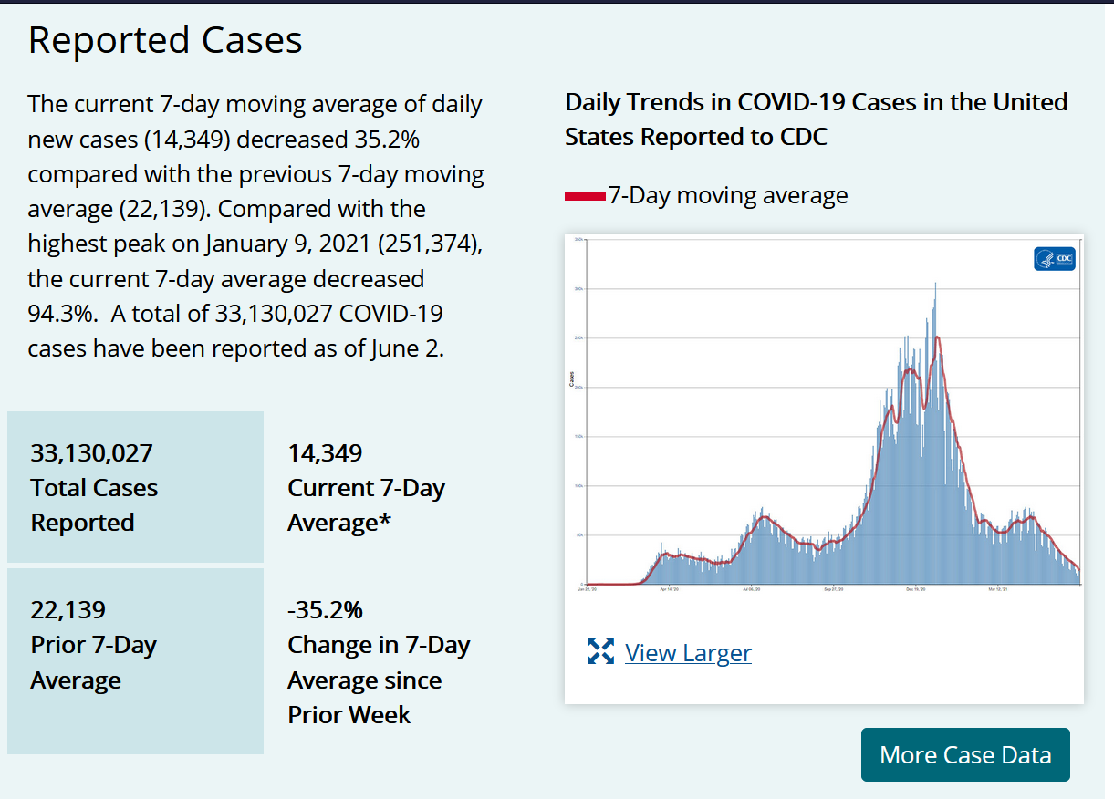

Slide 10
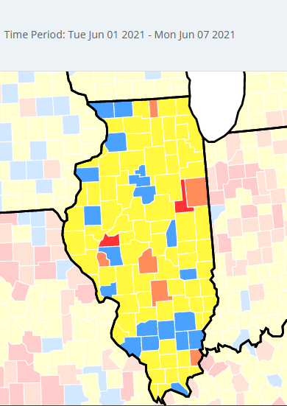
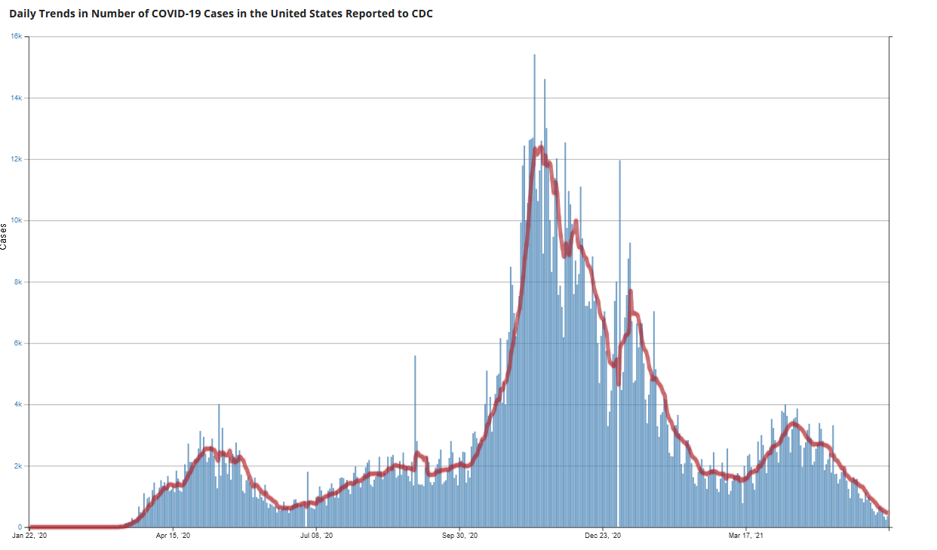
Illinois Data from CDC
Start of Illinois LTC Vaccination

Slide 11
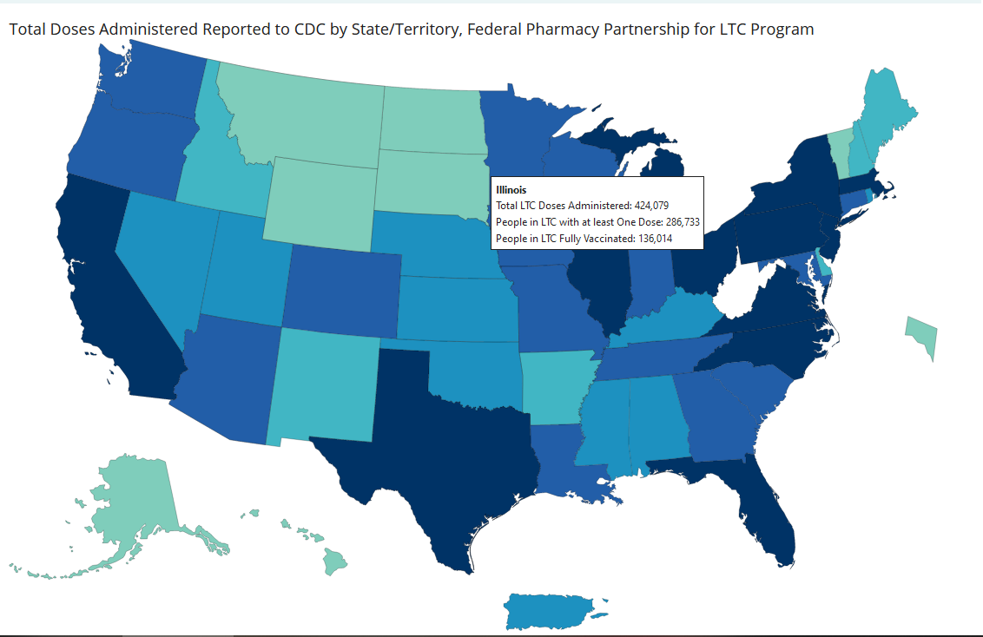

Slide 12
Illinois Opens in the General Population

Slide 13
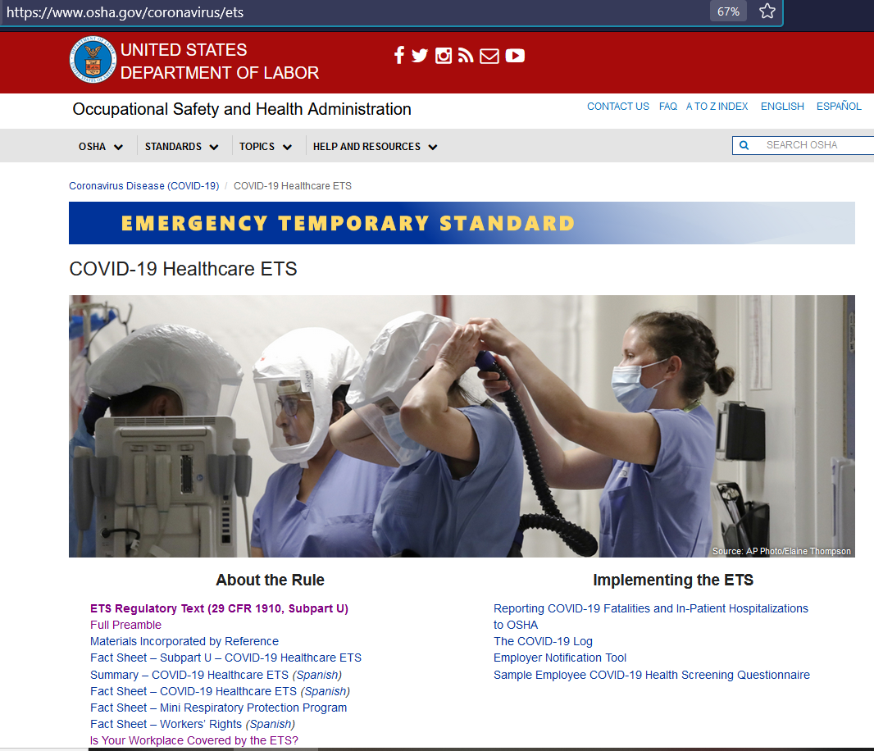
OSHA COVID-19 Healthcare Emergency Temporary Standard (ETS)

Slide 14
OSHA Emergency Temporary Standard (ETS)
OSHA will continue to monitor trends as more of the population becomes vaccinated and the post-vaccine evidence base continues to grow. If and when OSHA finds a grave danger from the virus no longer exists for covered healthcare workplaces (or some portion thereof), or new information necessitates a change in measures necessary to address the grave danger, OSHA will update the rule as appropriate.
The term Grave Danger is in the document 166 times

Slide 15
COVID-19 ETS
Emergency Temporary Standards are, by design, temporary in nature
IV. Rationale for the ETS A. Grave Danger
In summary, the availability and use of safe and effective vaccines for COVID-19 is a critical milestone that has led to a marked decrease in risk for healthcare employees generally,
but grave danger still remains for those whose jobs require them to work in settings where patients with suspected or confirmed COVID-19 receive care.
CDC has determined that the remaining risk for fully vaccinated persons outside of healthcare settings is low enough to justify foregoing other layers of controls for settings where all persons are fully vaccinated and asymptomatic (CDC, April 27, 2021),
but the CDC continues to recommend respirators and PPE for fully vaccinated healthcare employees in settings where patients with suspected or confirmed COVID-19 receive care.
Based on CDC guidance and the best available evidence, OSHA finds a grave danger in healthcare for vaccinated and unvaccinated HCP involved in the treatment of COVID-19 patients. (p.91)
https://www.osha.gov/sites/default/files/covid-19-healthcare-ets-preamble.pdf

Slide 16
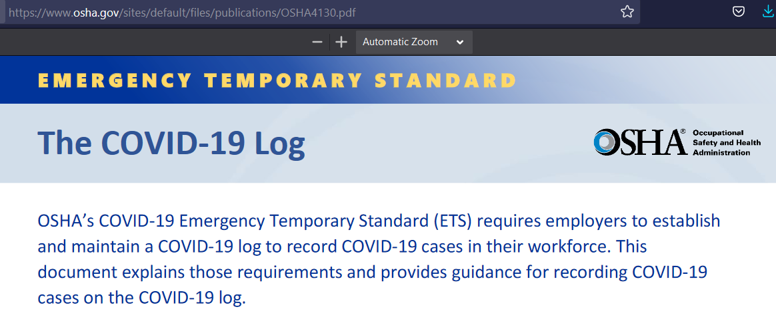
The log must include each confirmed case of COVID-19 even if the employee was asymptomatic (did not feel sick) and even if the case was not caused by an exposure in the workplace.
https://www.osha.gov/sites/default/files/publications/OSHA4130.pdf

Slide 17
https://www.osha.gov/sites/default/files/publications/OSHA4131.pdf

Slide 18
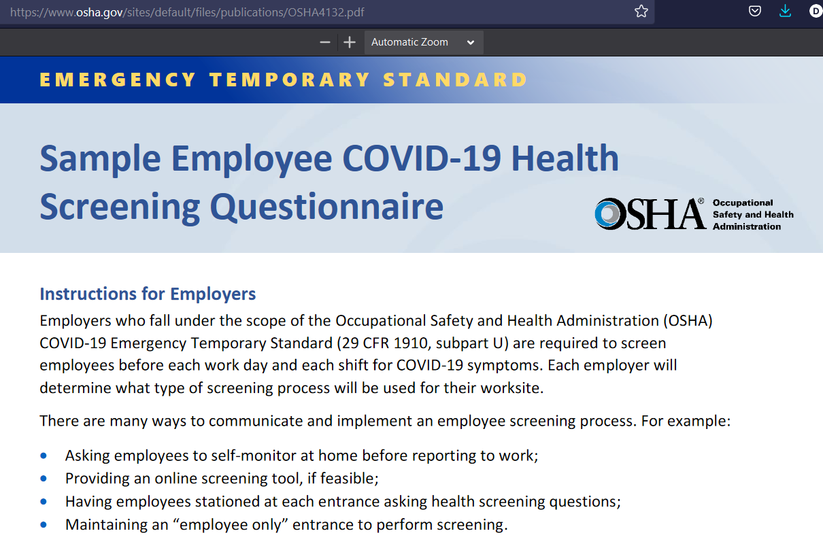
https://www.osha.gov/sites/default/files/publications/OSHA4132.pdf

Slide 20
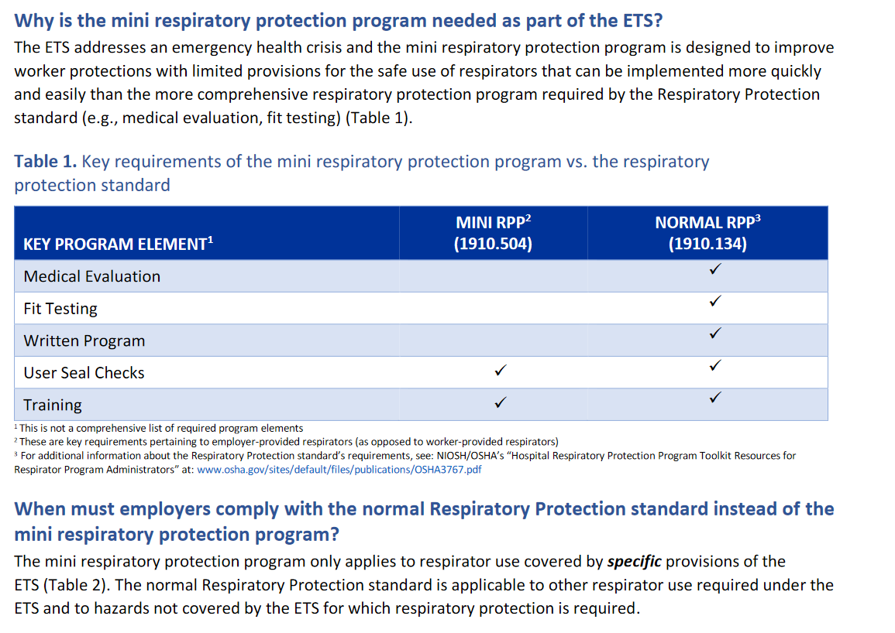
https://www.osha.gov/sites/default/files/publications/OSHA4121.pdf

Slide 21
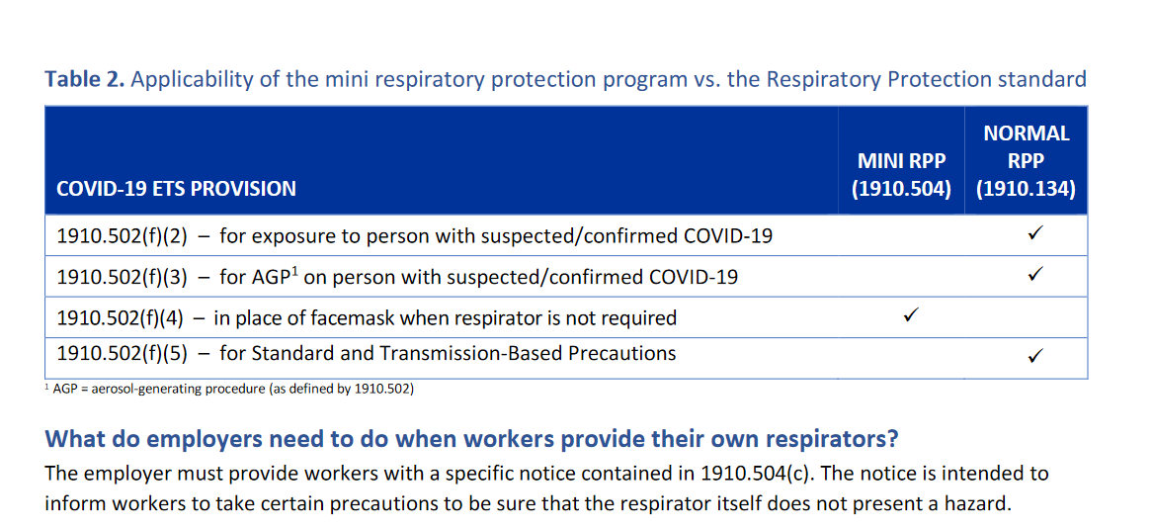
https://www.osha.gov/sites/default/files/publications/OSHA4121.pdf

Slide 22
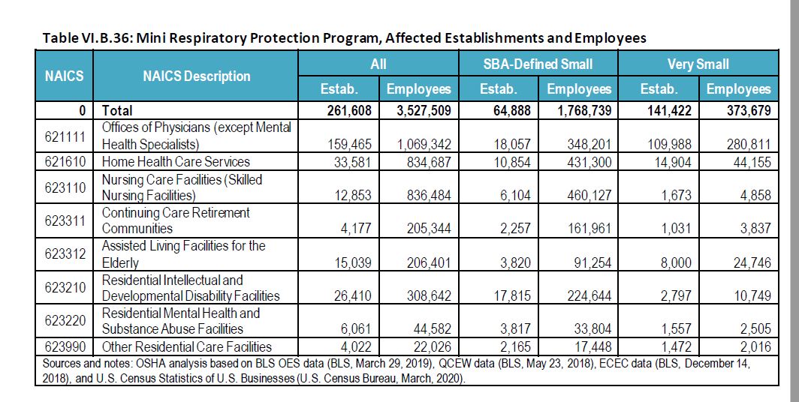
Who Does the Mini-Respiratory Protection Program Apply to?

Slide 23
https://www.osha.gov/coronavirus/ets/faqs

Slide 24
Deep Breath…. Going to Need Your IDT
Start with 44-page ETS Regulatory Text (29-CFR/1910-Subpart U) https://www.osha.gov/sites/default/files/covid-19-healthcare-ets-reg-text.pdf
The Preamble is 916 pages. https://www.osha.gov/sites/default/files/covid-19-healthcare-ets-preamble.pdf
Seems this is a ETS that has similar scope to the Bloodborne Pathogen Regs
Response to high morbidity and mortality among healthcare personnel
OSHA protects employees
Suggest breaking it up into sections
Start with Subpart U
We will take a deeper dive next time
Hang in there

Slide 25
Long-Term Care Guidance
June 11, 2021
Webstockreview.net

Slide 26
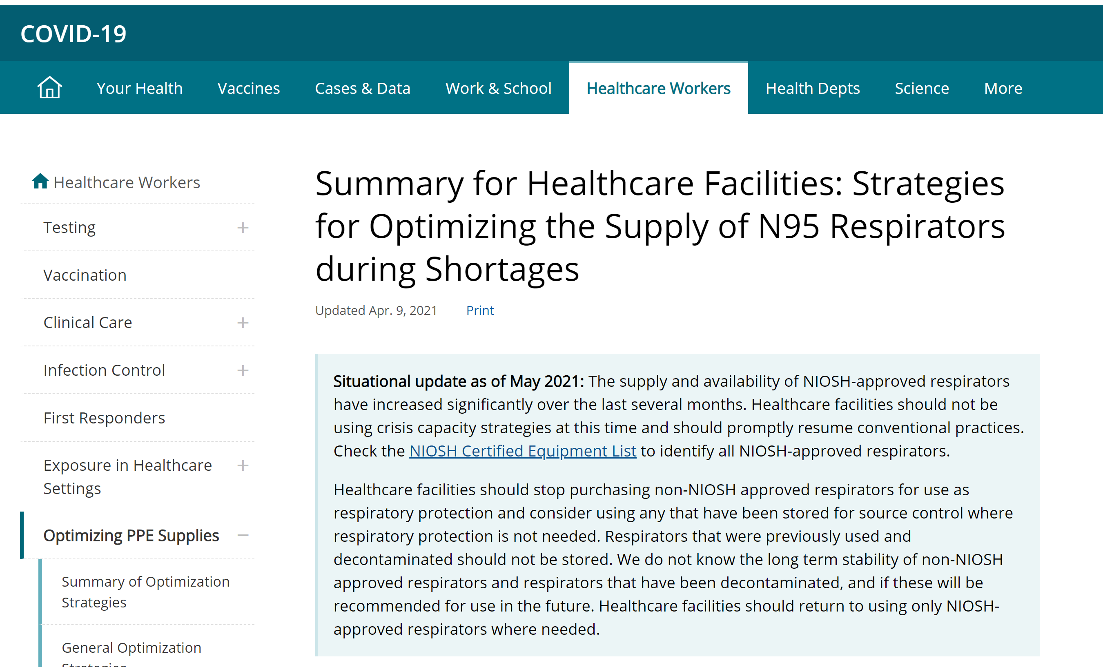

Slide 27
CDC Statement on use of Respirators
Situational update as of May 2021:
The supply and availability of NIOSH-approved respirators have increased significantly over the last several months.
Healthcare facilities should not be using crisis capacity strategies at this time and should promptly resume conventional practices.
Check the NIOSH Certified Equipment List to identify all NIOSH-approved respirators.
Strategies for Optimizing the Supply of N95 Respirators: COVID-19 | CDC

Slide 28
CDC Statement on use of Respirators
Healthcare facilities should stop purchasing non-NIOSH approved respirators for use as respiratory protection and
consider using any that have been stored for SOURCE CONTROL where respiratory protection is not needed.
Respirators that were previously used and decontaminated should not be stored. We do not know the long term stability of non-NIOSH approved respirators and respirators that have been decontaminated, and if these will be recommended for use in the future.
Healthcare facilities should return to using only NIOSH-approved respirators where needed.

Slide 29
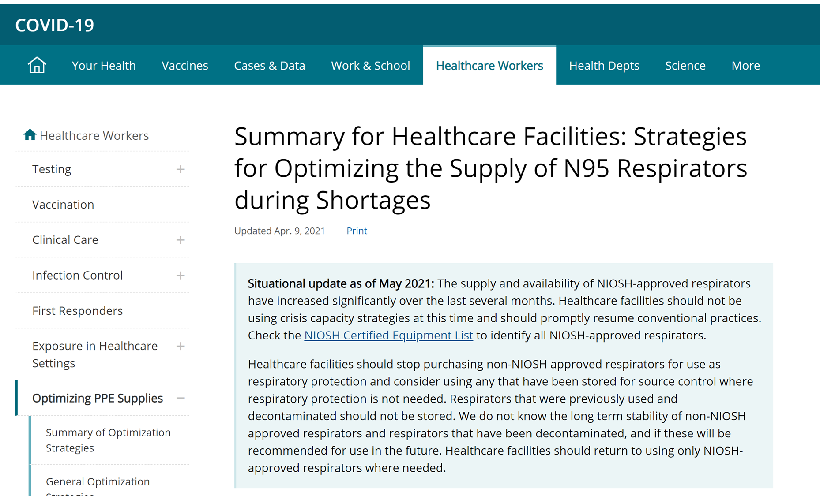
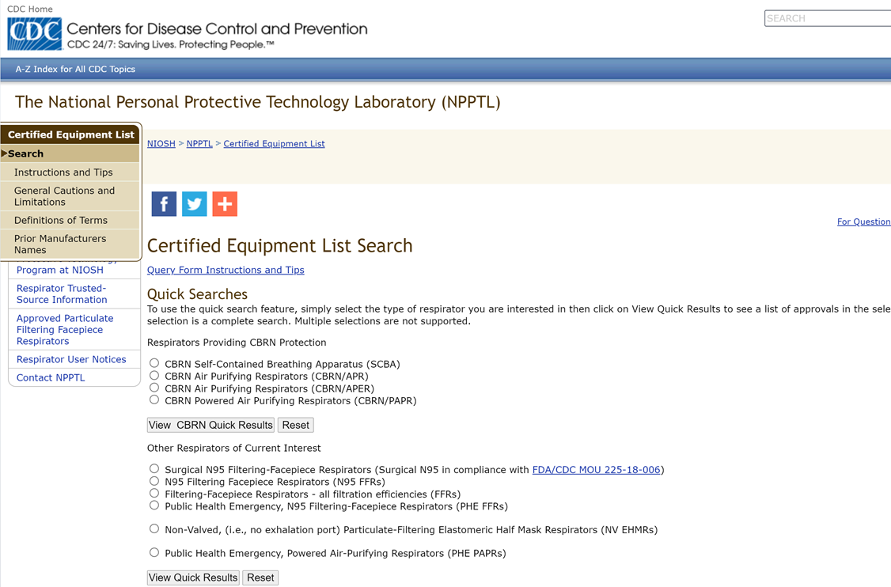

Slide 31
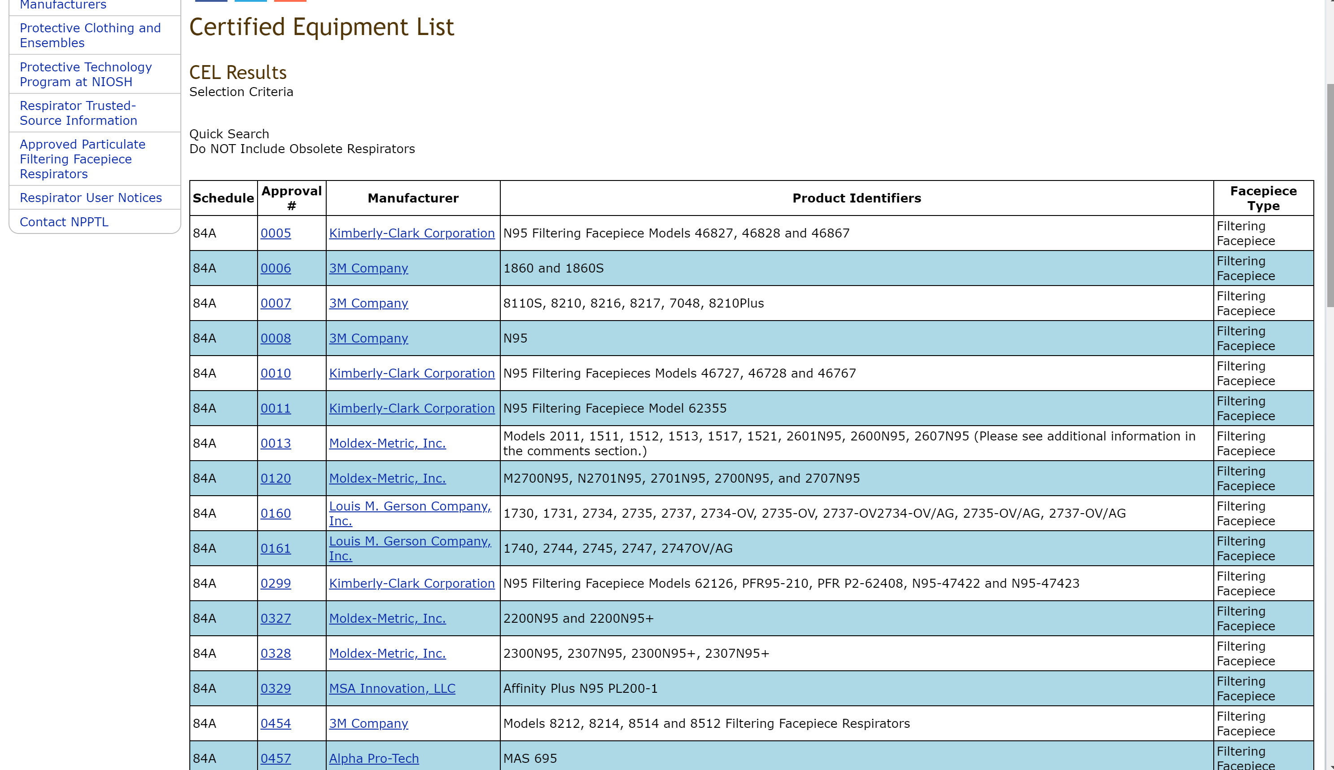
Scroll to find your
manufacturer and
Model #

Slide 32
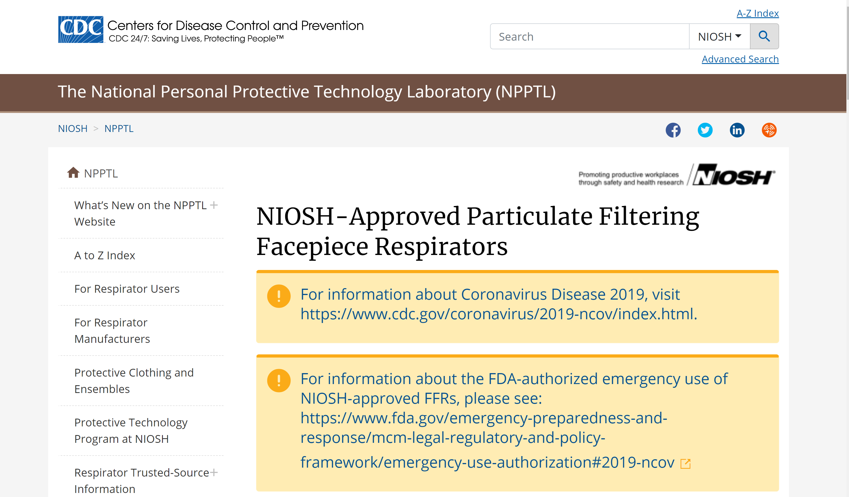
NIOSH-Approved Respirators
https://www.cdc.gov/niosh/npptl/topics/respirators/disp_part/default.html

Slide 33
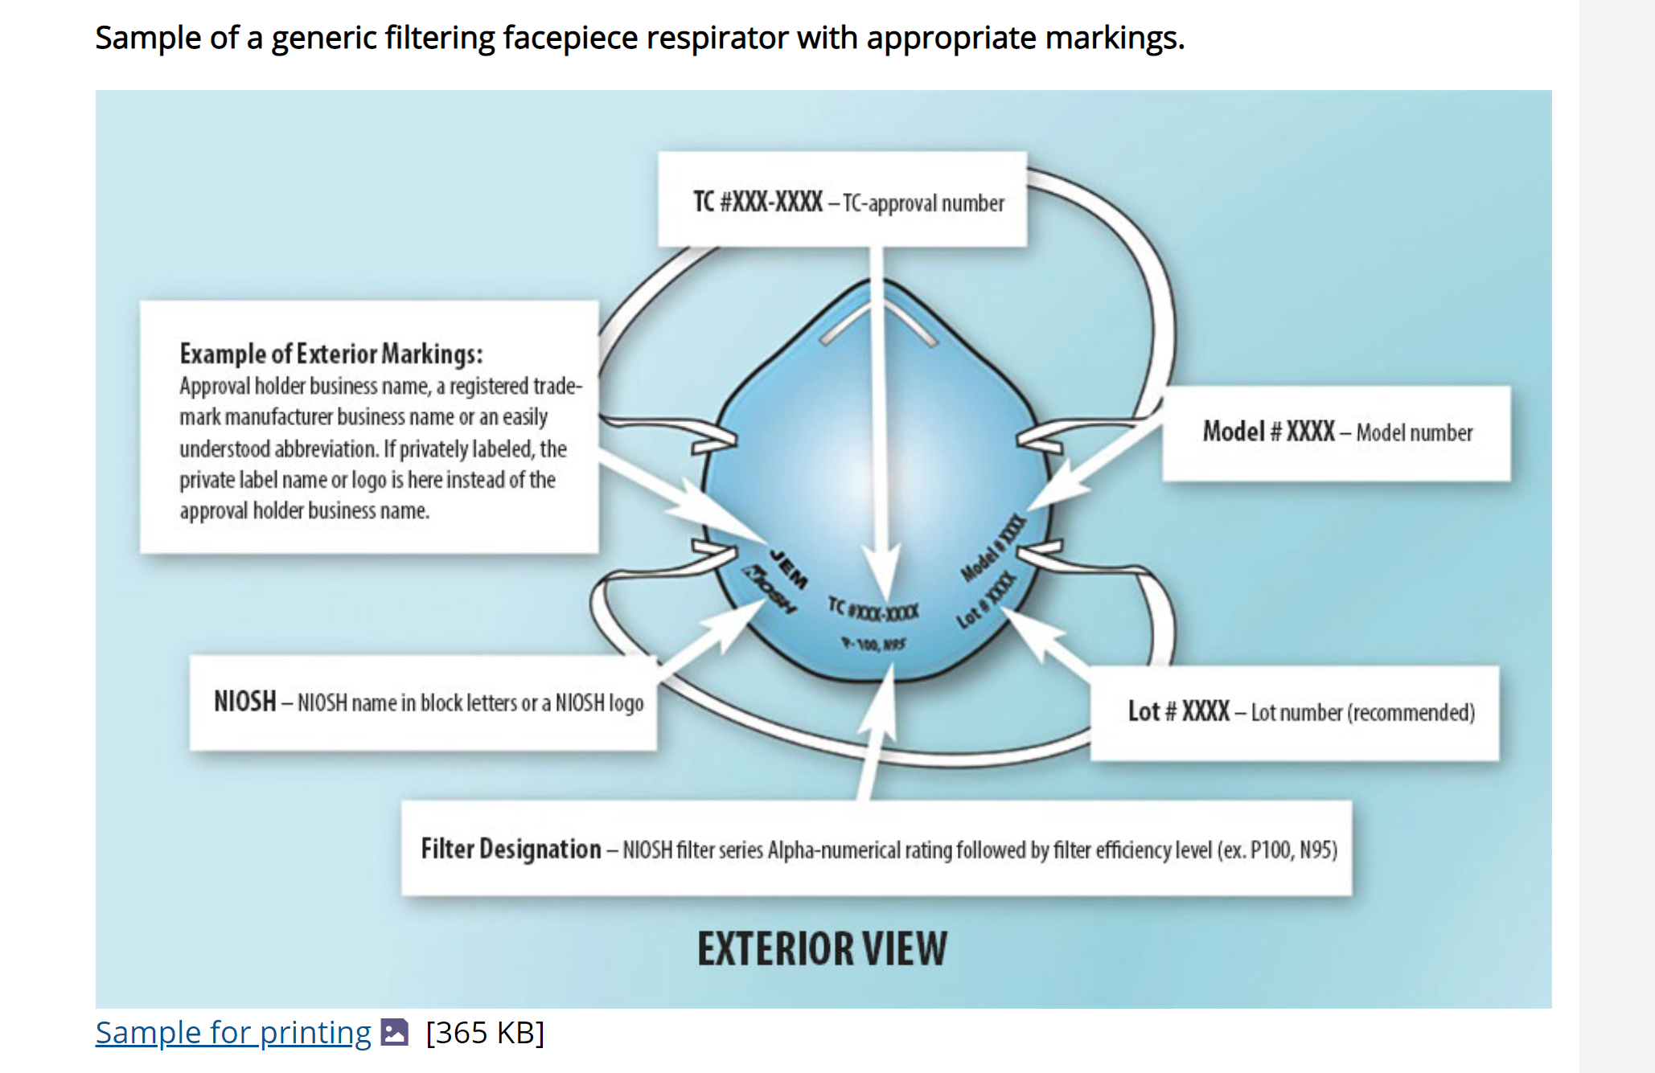

Slide 34
Contingency & Crisis Use of N95 Respirators
Healthcare facilities
should not be
using crisis capacity strategies
at this time and
should promptly resume conventional practices.
Strategies for Optimizing the Supply of N95 Respirators: COVID-19 | CDC
Use of N95 respirators
At start of shift obtain a new N95 respirator
May wear (leave on) between multiple residents unless soiled/damaged/hard to breathe through—(Extended wear is considered contingency use)
Remove for breaks and lunch and DISCARD (preferred by CDC)
If it becomes necessary to re-wear the N95, it must be stored properly between uses (paper bag, designated location) (Reuse is considered crisis use)
If Reusing N95 respirators:
Can only be reused 5 times (5 uses) then the N95 must be discarded
Must discard before 5 uses if soiled, damaged, or hard to breathe through
If the N95 is used 5 times (uses) during a shift of work, discard the respirator, and obtain a new N95 during the shift
The N95 respirator must be discarded at the end of the shift

Slide 35
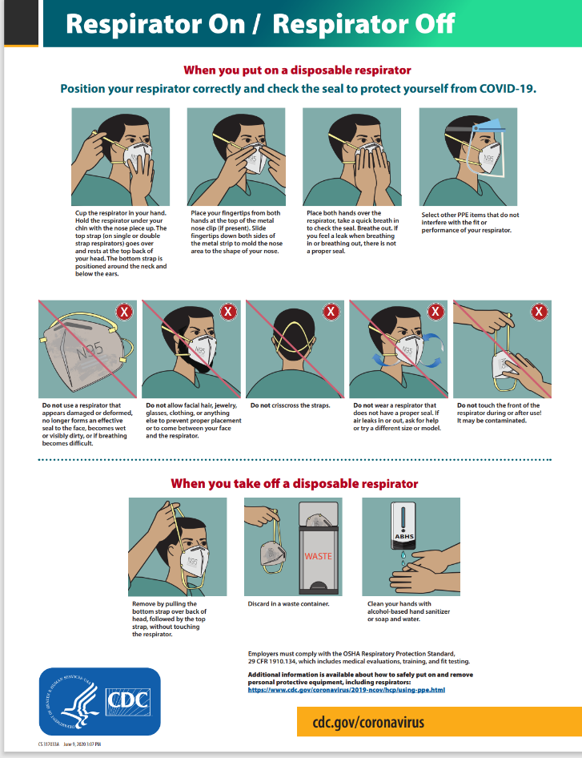
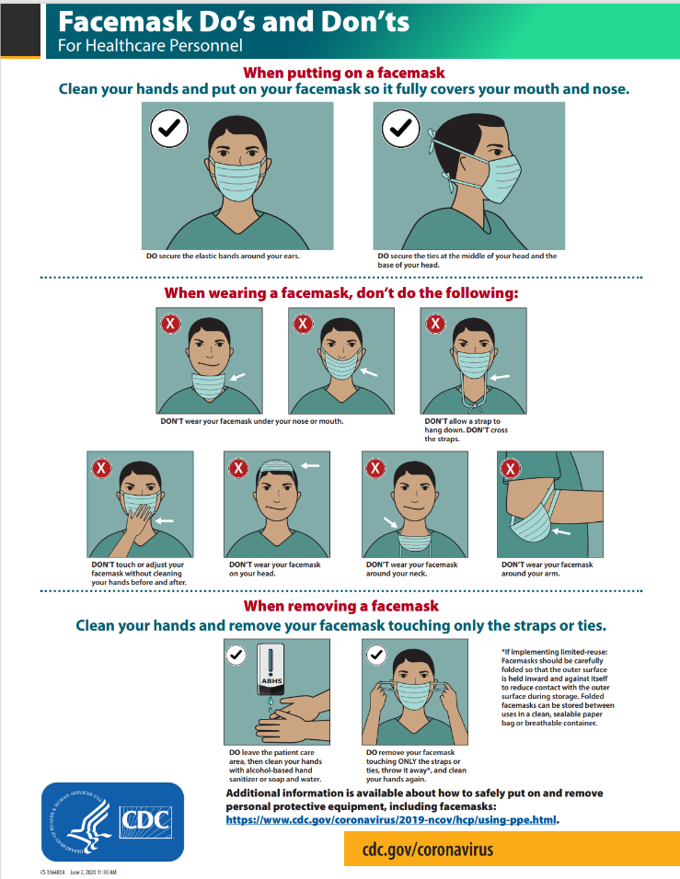
fs-respirator-on-off.pdf (cdc.gov)
fs-facemask-dos-donts.pdf (cdc.gov)

Slide 36
Use of Facemasks
Use of Facemasks
At start of shift obtain a new facemask
May wear (leave on) between multiple residents (unless soiled/damaged)—(Extended wear-contingency use)
Remove for breaks and lunch and DISCARD.
Do not reuse facemasks
Must discard if soiled, damaged, or hard to breathe through
The facemask must be discarded at the end of the shift
FACEMASKS SHOULD NOT BE REUSED
If your PPE supply is low and you are requiring the reuse of facemasks, attempt to secure additional product through other vendors, corporate offices, or your local health departments (emergency management divisions). If these attempts fail, reach out to your regional IDPH infection preventionist and we may be able to help.

Slide 37
Optimizing Use of PPE
Facilities understand their NIOSH-approved respirator inventory and supply chain
Facilities understand their NIOSH-approved respirator utilization rate (Burn rate calculator)
Facilities are in communication with local healthcare coalitions and federal, state, and local public health partners (e.g., public health emergency preparedness and response staff) to identify additional supplies
N95 respirators should be prioritized for those HCP who are recommended to wear them as PPE when caring for patients unless facility is in outbreak
Respirators should not be used by HCP who are only using them for source control.

Slide 38
Resident Placement
Confirmed COVID-19
Separate COVID positive residents from other residents
Single room, door closed
Dedicated bathroom (ideal)
Dedicated staff (ideal)
Determine how staffing needs will be met as the number of patients with suspected or confirmed SARS-CoV-2 infection decreases. Have a written plan.
Quarantine
May remain in current room without roommate (not required to have designated quarantine area)
Single room, door closed
Does not have to have dedicated staff BUT all infection prevention measures (droplet/contact precautions, hand hygiene, signage, full PPE) must be followed. Ensure hand hygiene is performed before providing care to the next resident.

Slide 39
Q&A
Question:
For PUI and confirmed cases, is the expectation going to be to wear a new N-95 each time a staff member enters a different resident’s room or can they wear same N-95 if on the designated wing?
Answer:
You can wear the same N95 between rooms BUT as soon as you take off the respirator for break or lunch….it gets discarded and a new N95 must be donned.

Slide 40
Q&A
Question:
Can the same mask be worn if working on PUI/COVID-19 wing and then return from lunch break? Or is the expectation going to be to dispose the mask prior to going to lunch and wear a new mask when returning to resident care?
Answer:
This question says “mask” but staff should be wearing N95 respirator if working on the COVID unit; however, once removed you should be donning a new N95 respirator.

Slide 41
Q&A
Question:
Can residents in long term care test out of quarantine?
Answer:
Fully vaccinated inpatients and residents in healthcare settings should continue to quarantine following prolonged close contact (within 6 feet for a cumulative total of 15 minutes or more over a 24-hour period) with someone with SARS-CoV-2 infection; outpatients should be cared for using recommended Transmission-Based Precautions.
Although not preferred, healthcare facilities could consider waiving quarantine for fully vaccinated patients and residents following prolonged close contact with someone with SARS-CoV-2 infection as a strategy to address critical issues (e.g., lack of space, staff, or PPE to safely care for exposed patients or residents) when other options are unsuccessful or unavailable. These decisions could be made in consultation with public health officials and infection control experts.

Slide 42
Q&A
Q: Is it still a requirement to rapid test transportation drivers and wipe down the seat, etc even if the resident is fully vaccinated?
A: It was never a requirement to do rapid tests on transport drivers. Cleaning and disinfection should still be done even if fully vaccinated. Core infection prevention measures must still be followed.

Slide 43
Q&A
Q: If someone tests positive. Can you do a POC and then the next day do PCR testing, does that show that you have done testing 2x per week or do you still have to do another one for the week?
A: No, that should not be the cycle you perform your testing.
Continue repeat viral testing of all previously negative residents and HCP, generally every 3 days to 7 days, until the testing identifies no new cases of SARS-CoV-2 infection among residents or HCP for a period of at least 14 days since the most recent positive result.

Slide 44
Open Q&A
Submit questions via Q&A pod to All Panelists
Please do not resubmit a single question multiple times
Slides and recording will be made available after the session.

Slide 45
Reminders
SIREN Registration
To receive situational awareness from IDPH, please use this link to guide you to the correct registration instructions for your public health related classification: http://www.dph.illinois.gov/siren
Project Firstline Learning Needs Assessment
English Version: https://redcap.link/firstlineLNA
Spanish Version: https://redcap.link/LNAespanol
NHSN Assistance:
Contact Telligen: nursinghome@telligen.com­
Extended Until 6/15

