Slide 1
COVID-19 Question and Answer Session for Long-Term Care and Congregate Residential Settings
August 19th, 2020

Slide 2
Housekeeping
All attendees in listen-only mode
Submit questions via Q&A pod to All Panelists
Slides and recording will be made available later

Slide 3
Agenda
Upcoming webinars
Region 4: Tiered mitigation
LTC testing flowchart
FAQ from last week
Open Q & A
Slides and recording will be made available after the session.

Slide 4
IDPH webinars
Friday Brief Updates and Open Q&A (1-2 pm):
​
Reopening Long-Term Care: Interim Guidance from IDPH (Recording):
​Friday, August 28 | ​https://illinois.webex.com/illinois/onstage/g.php?MTID=ec7830c54e232b98b51c7712eb567d015
Slides and recordings will be made available after the sessions.
Tuesday, August 11 | https://illinois.webex.com/illinois/lsr.php?RCID=aa4686fa239142b58e0313adff7551fd
Thursday, August 13 | https://illinois.webex.com/illinois/lsr.php?RCID=94e78fd2dfdd46d1ad1e7fe0ad3162cc
Notes:
HH webinar originally part of the monthly HAI series. Keeping this as a placeholder because it’s been scheduled. Most likely change to COVID-related topics and postpone HH for another time.

Slide 5
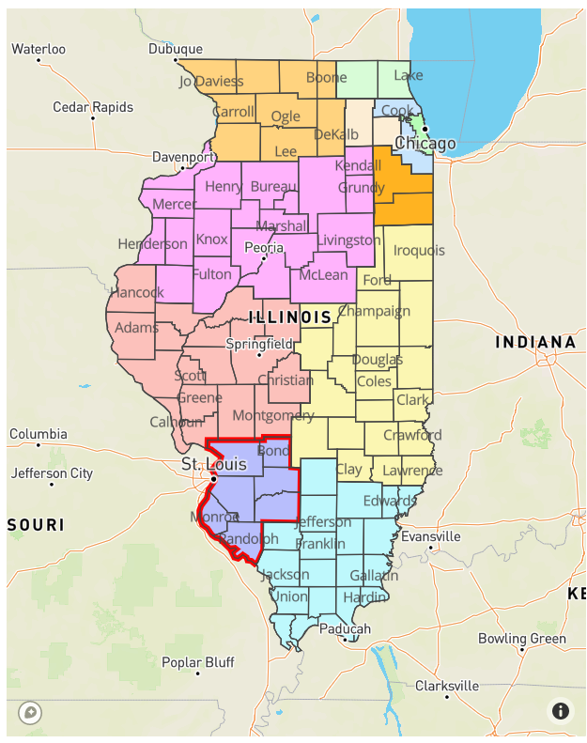
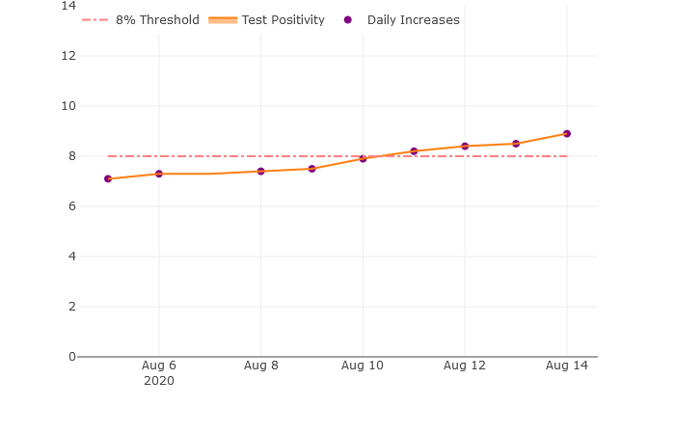
Region 4 Resurgence
Follow the latest regional metrics at: https://dph.illinois.gov/regionmetrics

Slide 6
Region 4: Tier 1 Mitigation Measures
LTC facilities in Region 4 that have already advanced to CMS Phase 3 must suspend indoor visitation and off-site outings
Indoor visitation and off-site outings can be resumed 14 days after tiered mitigation for the region is lifted
Outdoor visitation may continue
LTC facilities in Region 4 that have not yet advanced to CMS Phase 3 are not eligible to advance to CMS Phase 3 until 14 days after tiered mitigation in the region is lifted
Any plans to begin indoor visitation and off-site outings in association with phase advancement must be postponed until that time
Outdoor visitation may continue
Please direct any further questions to dph.ltcreopening@illinois.gov

Slide 7
LTCF Testing Flowchart
Organizes testing requirements or recommendations by outbreak status
May be updated as new CDC/CMS guidance is released or new testing initiatives come online
Available on IDPH website now, but planned to be sent out via SIREN with updated testing memo

Slide 8
LTCF testing – outbreak or one case
⁴ Some local health departments may choose to extend the period of testing to at least 28 days of no new cases.

Slide 9
LTCF testing – outbreak or one case
⁶ Facilities may also consider conducting periodic follow-up facility-wide testing of residents to identify asymptomatic and subclinical infections.

Slide 10
LTCF testing – no cases in last 28 days

Slide 11
LTCF testing – no cases in last 28 days
Identification of any new cases moves the facility over to the outbreak portion of the flowchart (orange arrows)

Slide 12
FAQ from last week
Q:­Are N95s required or just recommended? We cannot locate a company to assist with fit testing.­
Q:­If we are considered in Phase 2 can we attest to Phase 3 at this time?­
Q: ­If there is a facility acquired resident positive does outdoor visitation stop for all residents­

Slide 13
Open Q&A
Submit questions via Q&A pod to All Panelists
Slides and recording will be made available after the session.

Slide 14
Reminders
SIREN Registration
To receive situational awareness from IDPH, please use this link to guide you to the correct registration instructions for your public health related classification: http://www.dph.illinois.gov/siren
NHSN Data Assistance
Contact Telligen: nursinghome@telligen.com­

