Slide 1
Chicago VFC – Vaccine Return Form
How to submit expired vaccine to Chicago VFC
David Juen – Project Coordinator – Chicago VFC & I-CARE

Slide 2
Vaccine Return Form
When you have expired vaccine you must submit a Vaccine Return Form to Chicago VFC
Each line is intended for one vaccine lot
Ensure that you input correct PIN and contact information for you and your clinic
Write down the NDC from the box, not the vial/syringe
List the reason for the expiration; the codes are located on the return from in a box at the bottom right

Slide 3
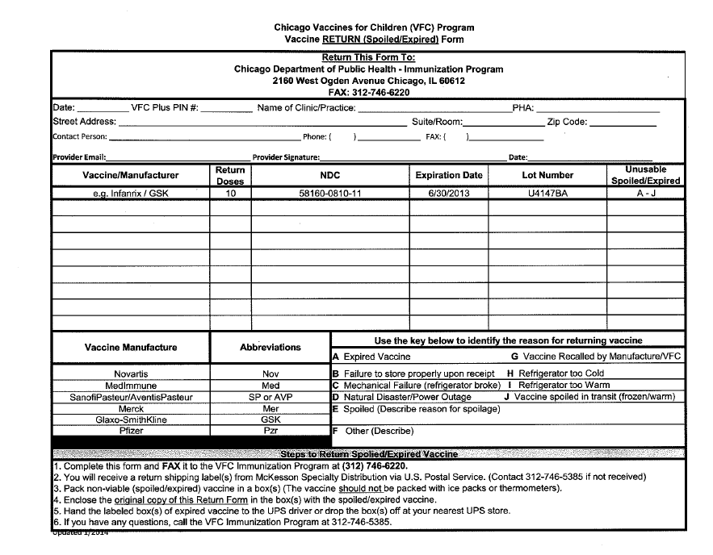
Vaccine Return Form
Start by inputting clinic details
Then, you must fill out all required fields for each expired vaccine

Slide 4
Vaccine Return Form
Once received, Chicago VFC will process the Vaccine Return Form
It can take 5-7 business days to process the form
Once the form is processed, you will receive a shipping label at the email listed on the form
Once you have received the shipping label you can pack up and send out the vaccine

Slide 5
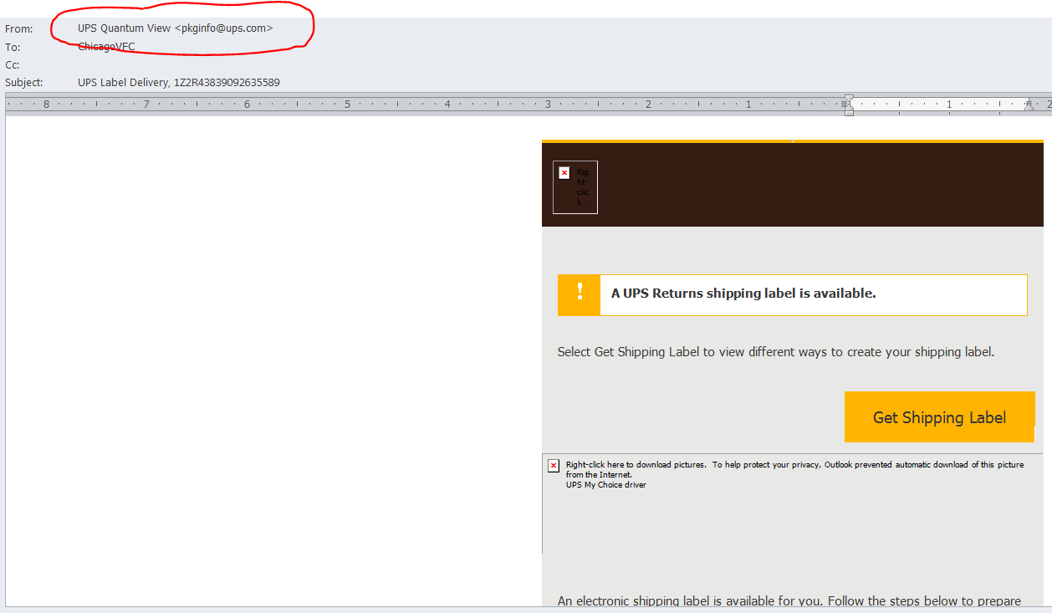
Shipping Label
Once processed you will receive a shipping label from UPS via email
You will need to print the shipping label and proceed to packing up the expired vaccine and shipping it out
Do not ship any broken or hazardous material

Slide 6
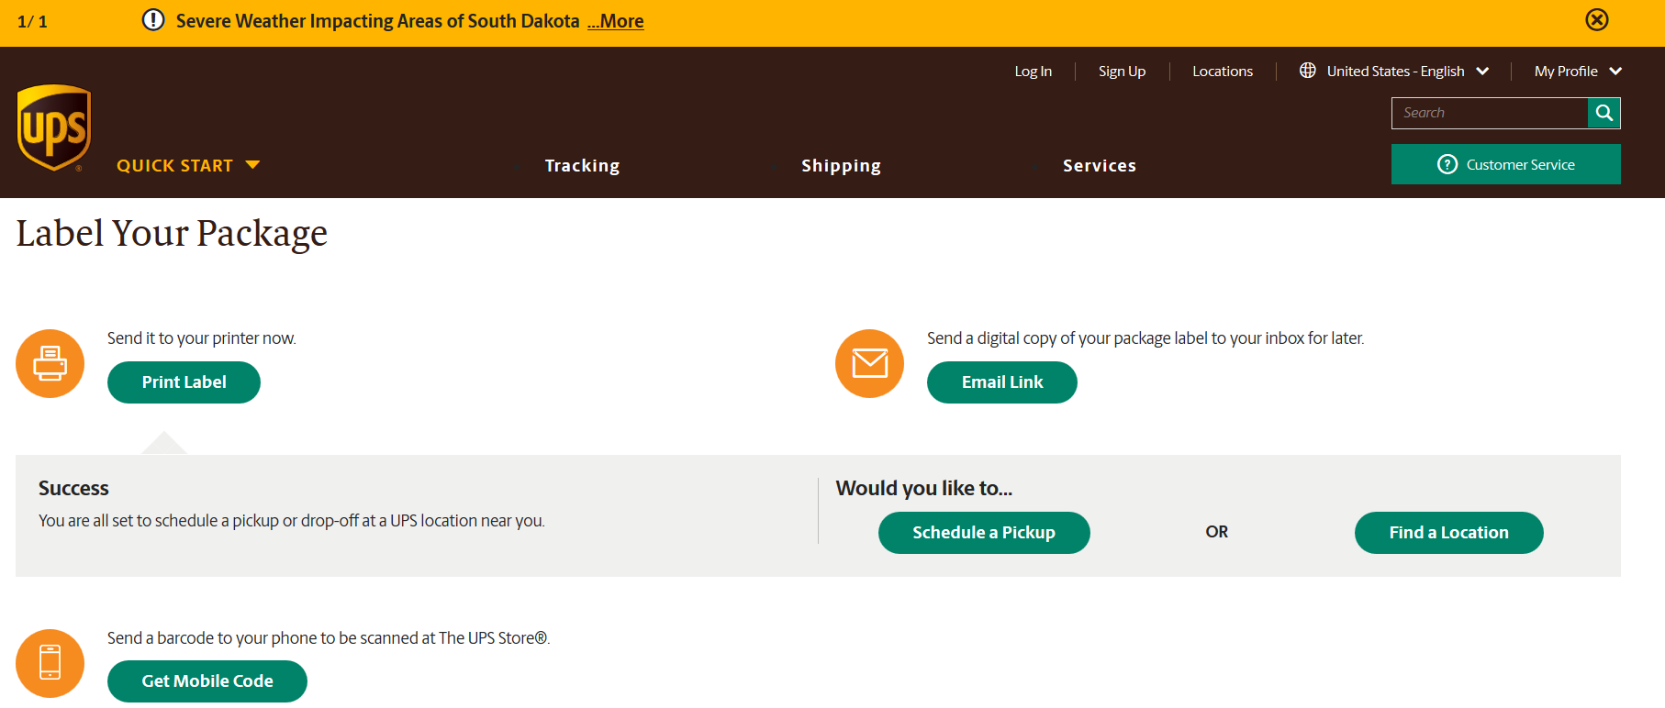
Print Shipping Label
Once you have followed the link select Print Label to generate and print the shipping label

Slide 7
Principle 3: Mark as expired in I-CARE

Slide 8
Mark as Expired
We are now going to mark the expired vaccine lot as expired in I-CARE
Then we are going to input any notes
Once the vaccine is at a zero balance we are going to mark it as out of stock

Slide 9
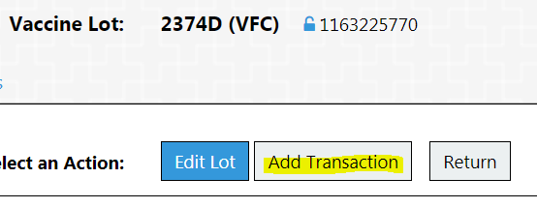
Mark Lot as expired in inventory
From the Vaccine list in I-CARE
Select the Lot
Click the Add transaction button
1.
2.

Slide 10
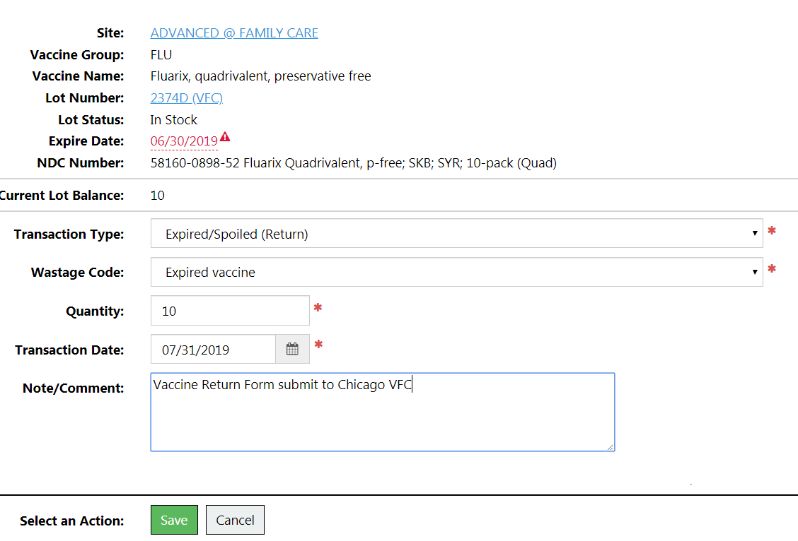
Mark Lot as expired in inventory
Add a Transaction
Expired/Spoiled
Expired vaccine
List the quantity expired
And the date you sent the form
Any notes for Chicago VFC
Click Save to save transaction
1.
2.
3.
4.
5.
6.

Slide 11
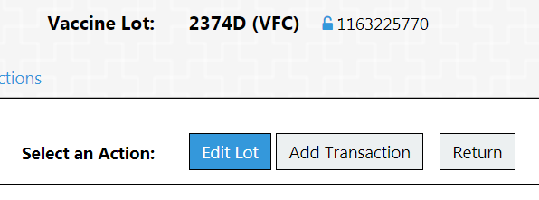
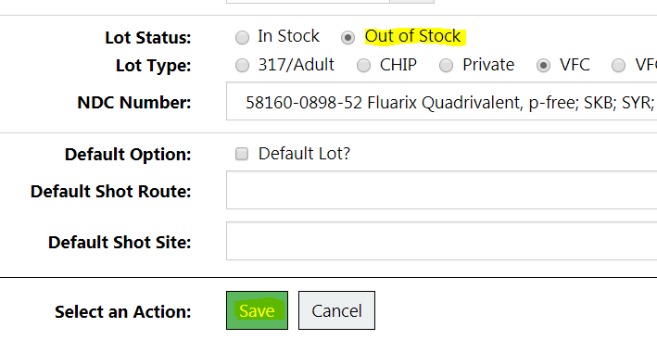
Mark Lot as out of stock
Once you have mark the vaccine as expired in I-CARE you can mark it as out of stock
2. Select Out of Stock
3. Click Save
1.
2.
1. Edit the expired lot
3.

Slide 12
90 days Notice
Hooray, you got all the expired vaccine out of your office!
Now, sort by expiration date in I-CARE again
Identify any lots which expire in the next 90 days
Send Chicago VFC an email alerting us to impending expired vaccine

Slide 13
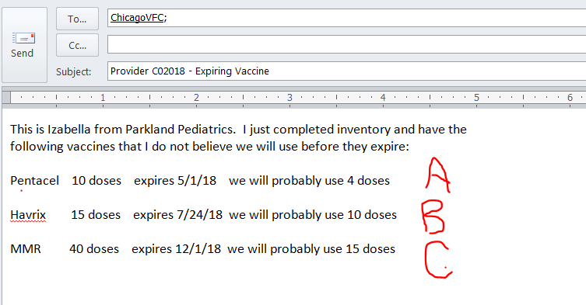
Example email - Soon to expire vaccine
By sending this email you:
Show VFC that you are managing your VFC vaccine inventory properly
Have written confirmation to avoid being charged for any expired vaccine doses

Slide 14
Questions?
Please reach out if you need further assistance or have any questions.
chicagovfc@cityofchicago.org
312.746.5385

