Slide 1
Central Intake for COVID-19 Isolation Housing
Referral Process & Best Practices

Slide 2
AGENDA
Welcome & Overview of Housing Options
Megan Cunningham, Managing Deputy Commissioner
Eligibility Criteria
Dr. Wilnise Jasmin, Medical Director
Central Intake Process & Roles
LaDonna Flanagan-Candia and Kevin Smith, Central Intake Team
Best Practices to Streamline Referrals
Dr. Wilnise Jasmin, Medical Director
Questions & Feedback from Participants

Slide 3
ISOLATION HOUSING OPTIONS
GOAL: Prevent transmission of COVID-19 by providing a range housing options, free of charge, to Chicago residents who are unable to safely isolate in their own homes.
General Isolation (Private Rooms)
for individuals who do not need additional medical and/or behavioral health support
Supported Isolation (Congregate Setting) for individuals who require additional support for other medical conditions and/or behavioral health needs

Slide 4
ELIGIBILITY CRITERIA: INCLUSION
Patient must have laboratory-confirmed COVID-19 diagnosis.
Less than 10 days from symptom onset or less than 3 days or more afebrile without antipyretics and improved symptoms, whichever is longer.*
Cannot safely isolate at home or in another setting.
*The required isolation period was recently updated based on CDC guidance, see https://www.cdc.gov/coronavirus/2019-ncov/hcp/disposition-hospitalized-patients.html.

Slide 5
ELIGIBILITY CRITERIA: EXCLUSIONS
Signs or symptoms of severe COVID-19 disease: e.g. temperature >103°F; Oxygen saturation <92% on room air; respiratory rate of >30 breaths per minute; difficulty breathing/respiratory distress.
Use of supplemental oxygen to maintain O2 saturation above 92% (one site)
Blood glucose readings >300 mg/dL
Uncontrolled and symptomatic hypertension
Pregnancy beyond 20.0 weeks gestational age
Receiving hemodialysis or chemotherapy (unless transfer has an established relationship with a dialysis facility)
Alcohol withdrawal risk (history of alcohol use disorder or alcohol dependence and recent last drink)
Opioid withdrawal AND disinterest in medications for opioid use disorder (MOUD)/medication assisted therapy (MAT)
Unable to perform activities of daily living (ADLs)
Severe uncontrolled psychosis (patients currently taking antipsychotic medications and stable are NOT excluded)
Disorientation
Active suicidal/homicidal ideation
Diagnosis of acute tuberculosis
Acute diarrheal illness, active XDRO, Candida auris colonization or infection
Current infestations such as scabies, bedbugs, or scabies (clients who completed treatment are NOT excluded)
Personality disorders that challenge the person’s ability to abide by facility rules
Unwillingness or inability to stay at the isolation facility through completion of the isolation period

Slide 6
WHAT IS CENTRAL INTAKE?
A support system that provides a single point of entry for assessment and referral to housing facilities.
Staffed by trained personnel who match referred clients with appropriate isolation housing to meet their needs.
ALL referrals for isolation housing from hospitals and outpatient clinics should be directed to central intake. Direct referrals to isolation facilities are not accepted.
Enables system-wide tracking of utilization and capacity.
Intake is available between 8 a.m. and 6 p.m. daily.

Slide 7
CENTRAL INTAKE PROCESS
General Isolation
Supported Isolation

Slide 8
ROLES & RESPONSIBILITIES
Client
Provide information to confirm eligibility.
Agree to abide by all rules of the designated isolation facility, including the expectation to stay for the duration of their isolation period.

Slide 9
ROLES & RESPONSIBILITIES
Referring Provider / Discharge Planner
Identify clients in need of isolation housing and collect all necessary information.
Complete and submit the COVID-19 Temporary Housing Intake Form.
Be available to answer follow up questions from the central intake team.

Slide 10
ROLES & RESPONSIBILITIES
Intake Social Worker
Review and assess intake forms to evaluate the nature and degree of clients’ needs.
Facilitate linkage to appropriate housing solutions based on eligibility criteria.

Slide 11
ROLES & RESPONSIBILITIES
Intake Medical Clinician
Perform chart reviews, evaluate clients and interpret lab data to determine eligibility for transfer to available isolation housing facilities.
Be available to the Social Work team members for consultation on referred clients.

Slide 12
ROLES & RESPONSIBILITIES
Client Transport
Pick up client at referring facility.
Provide transportation to the designated isolation housing location.

Slide 13
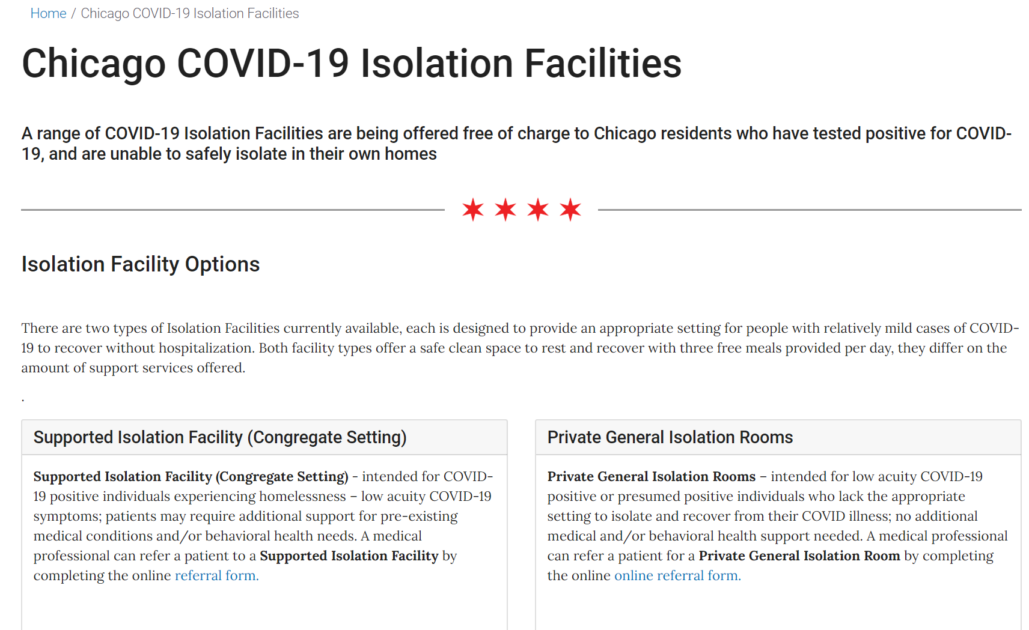
ISOLATION HOUSING WEBPAGE: https://www.chicago.gov/city/en/sites/health-care-workers/home/chicago-covid-19-isolation-facilities.html

Slide 14
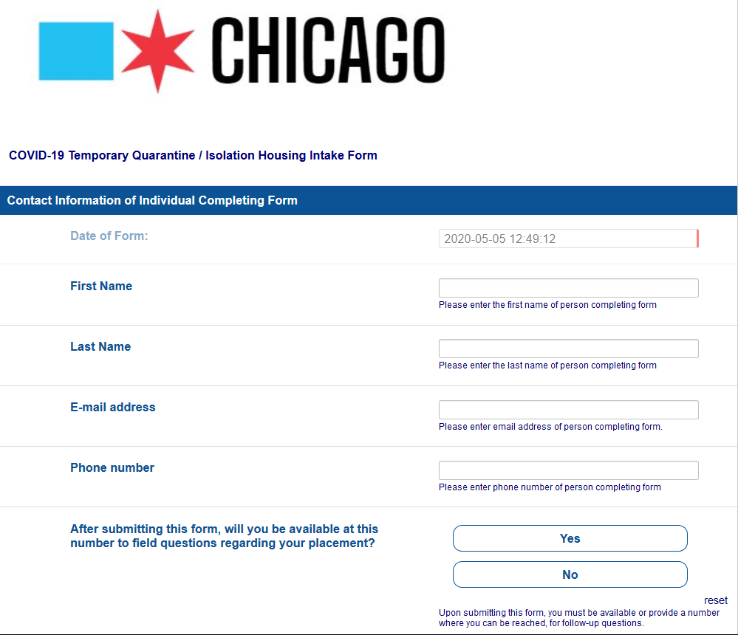
ISOLATION HOUSING INTAKE FORM: https://redcap.dph.illinois.gov/surveys/?s=NN8LH73WY7

Slide 15
BEST PRACTICES TO STREAMLINE REFERRALS
Designate a primary Isolation Housing Discharge Liaison who will make/support referrals from your hospital or clinic.
Fill out the intake form completely for each client.
Ensure that the Discharge Liaison is readily available to answer questions about referrals. Lag in providing necessary information will delay intake.
Ensure client is discharged with 2 weeks' worth of necessary medication.
Ensure the client is ready for pickup at the designated time and location.
Do not attempt to make direct referrals to isolation housing facilities.
Use the Comments section to request discussion of a possible exclusion criteria.
Isolation housing is only for people who have a confirmed case of COVID-19. To request a housing placement for someone who does NOT have COVID-19, call 311.
If you have questions about the central intake process, contact CoronavirusSocialWork@cityofchicago.org.

Slide 16
QUESTIONS OR FEEDBACK?

