Slide 1
COVID-19 Chicago Long Term Care Roundtable
04-29-2021

Slide 2
Objectives
Chicago COVID-19 Epidemiology
MMWR Report: Breakthrough Cases in Chicago SNFs
Reminders, Updates, and FAQs
NHSN Module Review
Q&A

Slide 3
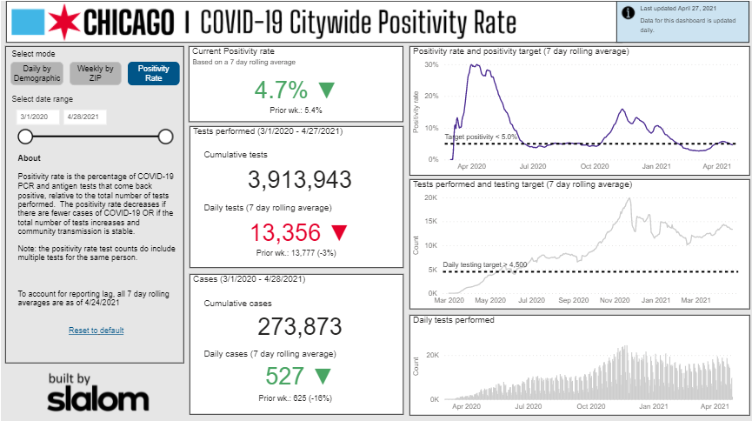
Chicago Dashboard
Source: https://www.chicago.gov/city/en/sites/covid-19/home/covid-dashboard.html

Slide 4
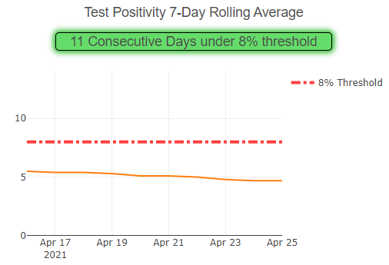
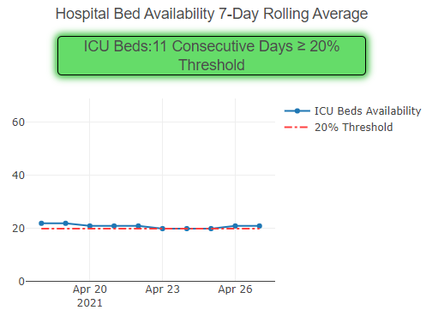
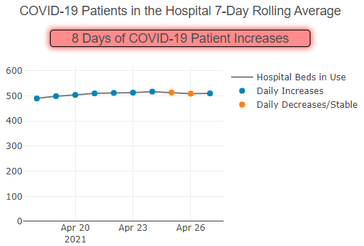
IDPH Regional Resurgence Metrics: Region 11
Source: https://www.dph.illinois.gov/regionmetrics?regionID=11

Slide 5
Skilled Nursing Facility COVID-19 Cases
38 (49%) SNFs have gone at least 28 days without a case
First round
vaccine clinics began
Role | Deaths | Mortality
Residents | 1,238 | 19.4%
HCWs/Staff | 17 | 0.5%
Total | 1,255 | 12.6%
Second round vaccine clinics began
*Epi curve only depicts lab-confirmed (PCR or antigen positive) cases since 9/1/2020
Third round vaccine clinics began
Data as of 4/27/21
Notes:
Data source: lab-confirmed (PCR or antigen) cases in INEDSS/RC

Slide 6
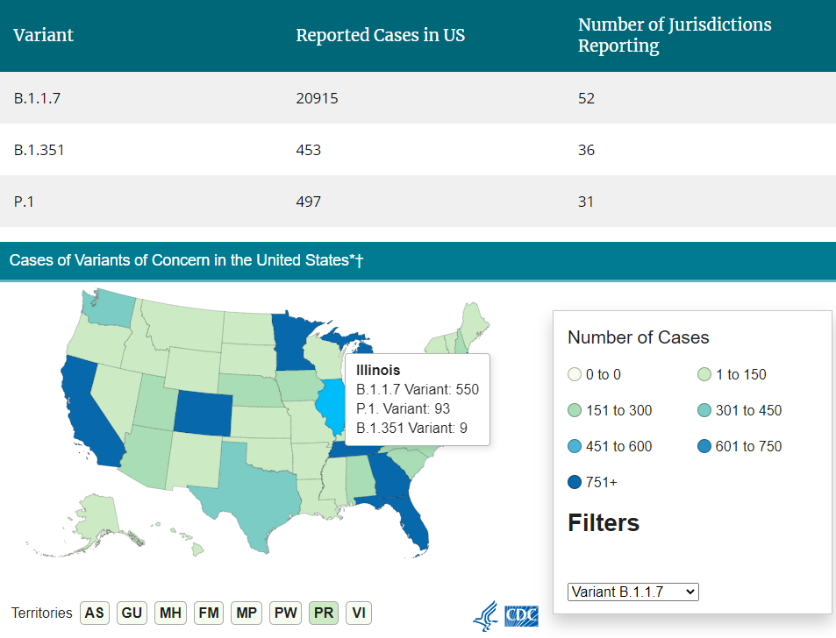
COVID Variants in the US & IL
Source: https://www.cdc.gov/coronavirus/2019-ncov/transmission/variant-cases.html

Slide 7
Notes:
Good afternoon everyone. My name is Kelly Walblay and I am the healthcare-associated infections epidemiologist at CDPH. Today, I am going to present on an MMWR we published last week on post-vaccination SARS-CoV-2 infections among skilled nursing facility (SNF) residents and staff in Chicago, Illinois.
In February 2021, after identifying a SARS-CoV-2 infection in a SNF resident who had received a second COVID-19 vaccine 16 days prior, CDPH initiated an investigation to quantify these breakthrough infections across all 78 SNFs, evaluate symptoms and clinical outcomes, and assess potential secondary transmission. Today I will review our investigation’s findings and public health recommendations.

Slide 8
CDPH skilled nursing facility COVID-19 case monitoring
Facility weekly summary reports
I-NEDSS
REDCap case report forms
RESULT: Weekly tracker of SNF-associated resident and staff COVID-19 cases and outbreaks
Notes:
First, I want to discuss a little bit about how we routinely track COVID-19 infections in our SNFs. CDPH has been monitoring these infections since the beginning of the pandemic using 3 main data sources and a complex data matching process. To enumerate the total number of COVID-19 cases occurring at each of Chicago’s 78 skilled nursing facilities, the facility weekly summary reports you send us each week along with the individual cases/cluster reports into REDCap get matching into INEDSS, which is out state surveillance system for tracking COVID-19. Most of the reports in INEDSS come in electronically through labs and have bare minimum information so we rely on the FSR and RC reports to identify these individuals as being associated with a SNF.
This data matching is conducted on a weekly basis to identify new COVID cases and also to monitor new and ongoing outbreaks across all facilities.

Slide 9
Investigation
INVESTIGATION PERIOD
PPP vaccination clinics begin
SNF team begins matching I-NEDSS and ICARE records
Second doses begin
First breakthrough case identified
Dec 28
Jan 25
Early Feb
Feb 24
Mar 31
Notes:
As we all know, skilled nursing facility residents and staff have been disproportionately affected by COVID-19 and were prioritized for COVID-19 vaccination during phase 1a. Vaccine administration at these facilities began on December 28th through the federal Pharmacy Partnership for Long-term Care Program (PPP). Pharmacies administered vaccines during 3 rounds of clinics. Second doses began to be administered through all the facilities beginning on January 25th.
At the end of January, CDC shared a definition for breakthrough infections with local and state health departments. In response, we began matching SNF-associated I-NEDSS records with the state's vaccination registry, ICARE
On February 24th, we identified our first breakthrough infection among a SNF resident. In response, our team designed an investigation to learn more about these breakthrough infections.
Our investigation began on December 28th, the date of the first PPP clinic and we followed facilities until March 31st.

Slide 10
Investigation objectives
Quantify breakthrough infections across all 78 facilities
Evaluate symptoms and clinical outcomes
Assess facility-associated secondary transmission due to the breakthrough infection
Notes:
The objectives of our investigation were to
Quantify the number of SARS-CoV-2 and breakthrough infections occurring across all 78 facilities during the investigation period
Evaluate symptoms and clinical outcomes of residents and staff who had a breakthrough infection
Assess facility-associated secondary transmission

Slide 11
Case definitions
SARS-CoV-2 infection
A positive SARS-CoV-2 NAAT (e.g., RT-PCR) or antigen test result from a respiratory specimen collected from a resident or staff member during the investigation period
Breakthrough infection
A positive SARS-CoV-2 NAAT or antigen test result from a respiratory specimen collected ≥14 days after completing the second dose of a two-dose COVID-19 vaccination series
Notes:
A SARS-CoV-2 infection was defined as a positive nucleic acid amplification or antigen test result from a respiratory specimen collected from a resident or staff member during the investigation period. A vaccine breakthrough infection was defined as a SARS-CoV-2 infection occurring ≥14 days after completing the 2-dose COVID-19 vaccination series.

Slide 12
Vaccination across all skilled nursing facilities
Received two doses of COVID-19 vaccine
7,931
6,834
Residents
Staff members
Notes:
During the investigation period, a total of 14,765 persons received two doses of COVID-19 vaccine through the PPP. This included close to 8K residents and 7K staff members

Slide 13
Round 1 Vaccinations
Round 2 Vaccinations
Round 3 Vaccinations
Notes:
On this slide we display an epi curve of all COVID-19 cases observed during the investigation period. For some additional context, the green represents when the different rounds of PPP clinics were happening. During the investigation period, 627 confirmed COVID-19 infections were identified across 75 of the 78 skilled nursing facilities, 56% among residents and 44% among staff members. Three facilities did not have any covid cases during the investigation period. We stratified persons with COVID infection into four groups based on vaccination status at the time of the positive result. These groups included: (a) unvaccinated persons (this included individuals who never received a COVID-19 vaccine dose); (b) partially vaccinated persons (including individuals who had received one dose of a two-dose series); (c) vaccinated but not immune persons (this included individuals who received both doses, but had a COVID infection during the 14 days post second dose); and (d) fully vaccinated persons (which included individuals who received both doses and were 14 days post second dose when they had a positive COVID result).

Slide 14
447 (71%) cases among unvaccinated
145 (23%) cases among partially vaccinated
13 (2%) cases among vaccinated, not immune
22 (4%) cases among fully vaccinated
Notes:
Of the 627 cases, 71% of SARS-CoV-2 infections occurred in unvaccinated persons, 23% in partially vaccinated persons, 2% in persons who completed the 2-dose vaccination series but were less than 14 days post second vaccination, and 4% in persons who had completed the 2-dose series ≥14 days post second vaccination.

Slide 15
Notes:
While breakthrough infections accounted for only 4% of all COVID infections during the investigation period, I think it is important to point out that many of these infections occurred during the initial half of the investigation, when breakthrough infections were not possible because individuals had not received two doses or were still within the 14 day period after second dose.

Slide 16
16% of SNF-associated cases were breakthrough infections
Notes:
If we focus on the time period when breakthrough infections were possible, breakthrough cases occurred among 16% of total cases identified 14 days after each facility’s second vaccination clinic date where second doses were administered, indicated in yellow in this figure.
Among the 22 persons with breakthrough infection, 18 individuals were identified via routine screenings and four residents were tested before a hospital admission or procedure. The median interval from second dose to positive specimen collection was 29 days.
Among 15 facilities with breakthrough cases, attack rates were lower for vaccinated individuals than unvaccinated individuals

Slide 17
22 / 14,765
0.15% of SNF residents and staff who received two doses of COVID-19 vaccine had a breakthrough infection during the investigation period
Notes:
The previous slides are looking at the % of cases that were breakthrough, however, I think one of the most important points to takeaway is that overall, breakthrough infections were identified among less than 1% of skilled nursing facility residents and staff who were fully vaccinated during the investigation period. This is equivalent to 3 breakthrough infections occurring among every 2000 individuals receiving both doses of vaccine at these facilities.

Slide 18
Summary of findings
= asymptomatic
= symptomatic
Residents
Staff
No symptoms | No hospitalizations | No deaths
4 Staff | 1 Resident
Residents
Resident
Resident
Mild symptoms
Diarrhea, fatigue, headache, nausea, sore throat, cough, new olfactory disorder
Non-COVID hospitalization
COVID
hospitalization
COVID
hospitalization and death
*** No known facility-associated secondary transmission
Notes:
Diving into some of the clinical presentations and outcomes of the 22 breakthrough cases we identified:
Almost two-thirds of breakthrough cases were asymptomatic
Five individuals had mild non-specific symptoms
2 individuals were hospitalized during the investigation period for non-COVID-related reasons. These individuals were tested before having a hospital procedure or upon hospital admission.
1 individual was hospitalized due to weakness and loss to appetite in association with pneumonia diagnosed at hospital admission
1 individual was hospitalized due to fatigue, cough, shortness of breath, and difficulty breathing. Individual has multiple infections, including COVID. Individual died 7 days after hospital admission. Their death certificate lists COVID-19 complications as primary cause of death. However, there were multiple contributing causes.
CDPH actively monitored facilities with these breakthrough infections for 28 days to identify whether any new cases occurred in close contacts of the person with the breakthrough infection. No known facility-associated secondary transmission was observed.

Slide 19
Key Messages
Most SNF resident and staff who received two doses of COVID-19 did not have SARS-CoV-2 infection
Among breakthrough infections, the majority were asymptomatic or had mild symptoms
No facility-associated secondary transmission observed
Facilities should continue to
Routine screening of residents and staff members, regardless of vaccination status
Maintain high vaccination coverage among SNF residents and staff members
Follow recommended infection prevention and control practices including work restrictions, isolation of confirmed cases, and use of personal protective equipment
Notes:
This study illustrates the importance of COVID-19 vaccination in high-risk congregate settings, as the majority of fully vaccinated persons were not infected and did not have COVID-19–like symptoms. Among breakthrough infections, the majority were asymptomatic or had mild symptoms. Additionally, no facility-associated secondary transmission was observed as a result of breakthrough infections.
SNFs should continue to follow recommended infection prevention and control practices -- including work restrictions for staff members who test positive for SARS-CoV-2, isolation of residents with SARS-CoV-2, quarantine of residents with close contact to a confirmed case, routine testing of residents and staff members, and use of personal protective equipment by staff members and masking of residents -- regardless of vaccination status. Maintaining high vaccination coverage among residents and staff members is also important, as it will reduce opportunities for transmission within facilities and exposure among persons who might not have achieved protective immunity after vaccination.

Slide 20
Thank you!
Co-authors
Richard Teran
Elizabeth Shane
Shannon Xydis
Stephanie Gretsch
Alexandra Gagner
Usha Samala
Hedy Choi
Christy Zelinski
Stephanie Black
CDPH Communicable diseases team
Administrative, medical, nursing, and infection prevention staff at all SNF facilities
Questions?
Email: Richard.Teran@cityofchicago.org
Email: Kelly.Walblay@cityofchicago.org
Notes:
I would like to thank the co-authors on this report – with special shoutouts to Richard Teran (corresponding and co-first author) and Liz Shane. The CDPH communicable disease team and the admin, medical, nursing and IP staff at all the SNFs.

Slide 21
MMWR Report: THANK YOU!!!!
Thank you to all the facilities with breakthrough cases for answering our countless questions and providing us with all requested information in a timely fashion!
Notes:
and OF COURSE special thanks to those facilities with breakthrough cases. Thank you for promptly responding to our relentless data requests. I know we ask a lot of you all in terms of reporting but know that your efforts are not in vain as this data is crucial to the COVID-19 response and for being able to publish investigations such as these.

Slide 22
Reminder: Breakthrough Case Survey
Moving forward, if you have a resident or staff member who tests positive for COVID >14 days after they received their 2nd dose of Moderna or Pfizer vaccine of 1st dose of J&J vaccine , please complete the Breakthrough Case Investigation Survey.
Only fill out the information you have available. If there is a mandatory field and you don’t know the answer (e.g., type of instrument used), just put “Unknown”.
Source: https://redcap.dph.illinois.gov/surveys/?s=HE49K7NDY3

Slide 23
Update: International Travel Guidance
Source: https://www.cdc.gov/coronavirus/2019-ncov/travelers/international-travel-during-covid19.html

Slide 24
FAQs
Question: If we have cases from multiple areas in our building, can our vaccinated residents go out on pass?
Answer: No. If there is more than one affected area, no residents should be going out on pass (except for medically necessary reasons) for at least 14 days from the most recent case. If there is only one affected area, then only the residents in that area need to be restricted from going out on pass for 14 days.

Slide 25
FAQs
Question: I see that the positivity rate is below 5%, does that mean we can go back to testing staff every other week?
Answer: No. We need to wait until CMS has Cook County in the “green” zone (i.e., positivity rate <5%) for two weeks before we can change the testing frequency. Right now, CMS still classifies Cook County as “yellow”.
Source: https://data.cms.gov/download/hsg2-yqzz/application%2Fzip; https://www.cms.gov/files/document/covid-nh-testing-faqs.pdf

Slide 26
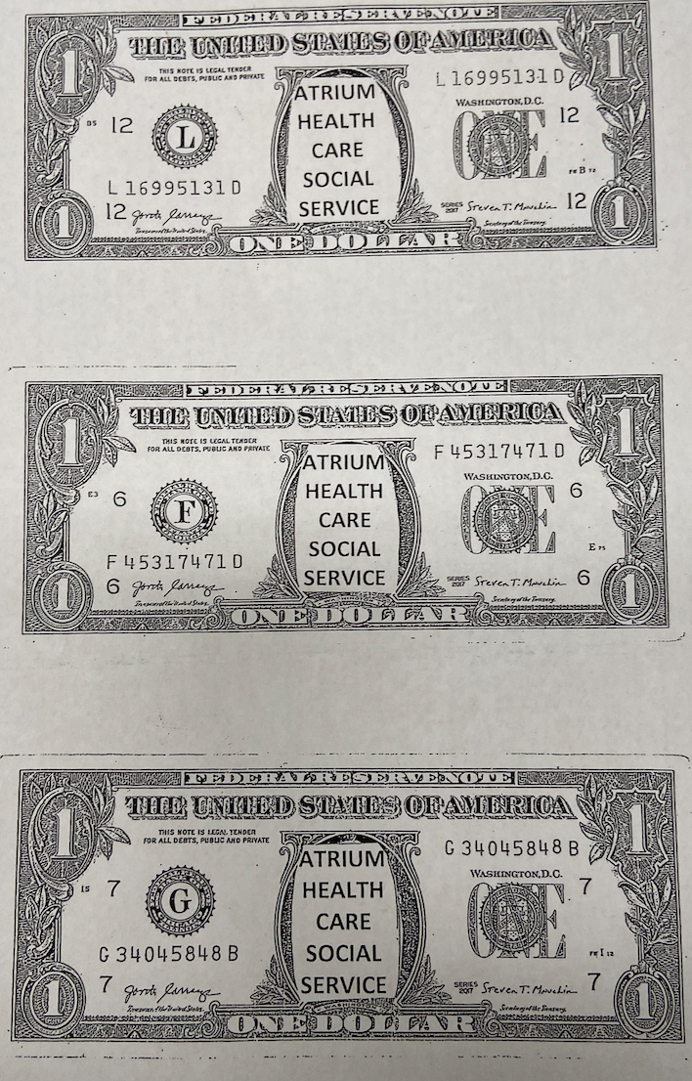
Facility Spotlight: Atrium
Residents can earn “Atrium bucks” by attending groups and following facility policies, including infection prevention and control policies
Can use the “money” to purchase personal hygiene items and snacks from the Activities department
Great way to incentivize proper distancing, masking, etc. in a fun way that is mutually beneficial
Source: Photo courtesy of Atrium

Slide 27
Update: New CDC Guidance for Vaccinated Individuals
New CDC/CMS guidance has been released which has updates on requirements for testing, group activities, and communal dining for vaccinated individuals in healthcare settings (including long-term care facilities)
Please attend the IDPH webinar tomorrow at 1 p.m. to hear more details about these updates and how they will impact your facility
The registration link for tomorrow’s webinar is on our HAN page
Please follow guidance as outlined by IDPH tomorrow
We will provide additional updates during our follow-up calls with your facilities and the next roundtable

Slide 28
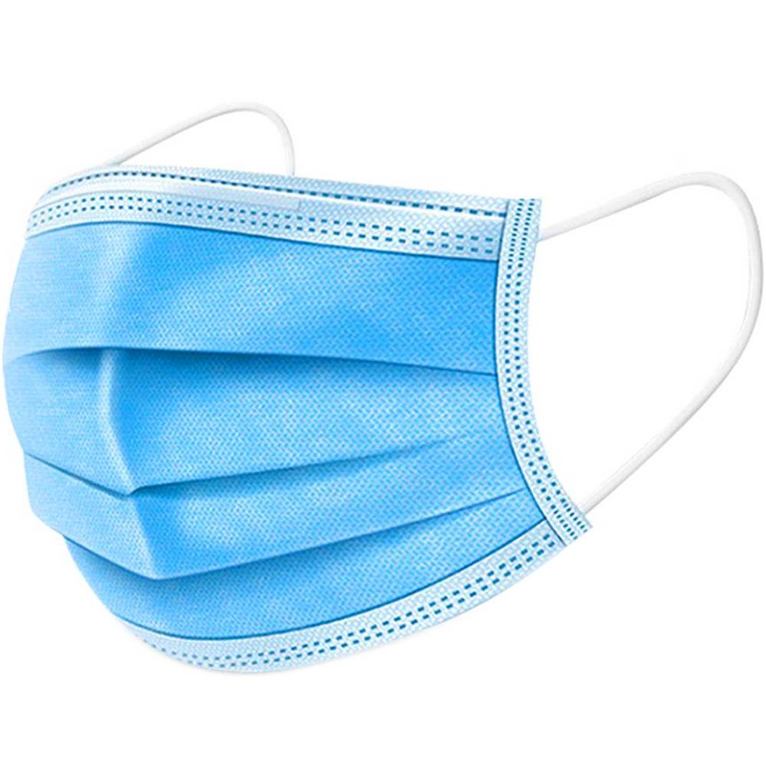
Reminder: Mask Optimization Strategies
Crisis capacity:
Mask re-use (i.e., re-donning a mask that was previously doffed)
Contingency capacity:
Extended use (e.g., wearing the same mask from room to room)
Discarding a mask anytime you doff (i.e., take it off) and putting on a new mask every time you don
Conventional capacity:
No reuse and no extended use
New mask for each resident encounter
Source: https://www.cdc.gov/coronavirus/2019-ncov/hcp/ppe-strategy/face-masks.html

Slide 29
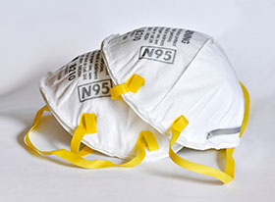
Reminder: N95 Optimization Strategies
Crisis capacity:
N95 re-use (i.e., re-donning a respirator that was previously doffed)
Contingency capacity:
Extended use (i.e., wearing the same respirator from room to room)
Discarding a respirator anytime you doff (i.e., take it off) and putting on a new respirator every time you don
Conventional capacity:
Single use (i.e., use one N95 for the care of one resident, discard that N95, and then get a new N95 for the care of the next resident)
Source: https://www.cdc.gov/coronavirus/2019-ncov/hcp/respirators-strategy/index.html

Slide 30
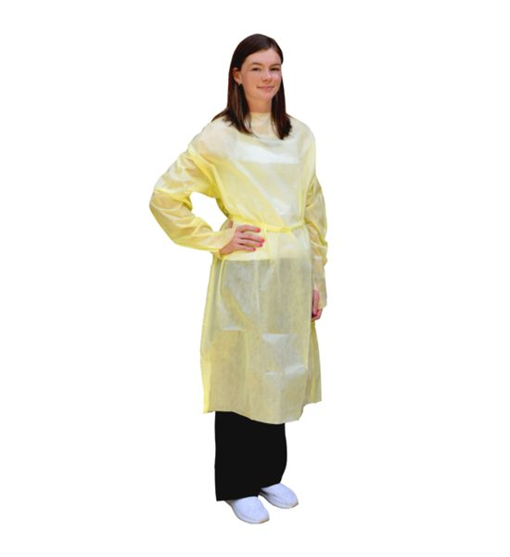
Reminder: Gown Optimization Strategies
Crisis capacity:
Extended gown use (e.g., wearing the same gown from room to room in the COVID unit)
Re-donning a previously used gown
Using gown alternatives (e.g., washable patient gowns or laboratory coats)
Contingency capacity:
Using coveralls (not recommended)
Conventional capacity:
Single-use disposable gowns (used for one resident and discarded after doffing)
Reusable (i.e., washable) gowns (used for one resident and laundered after doffing)
Source: https://www.cdc.gov/coronavirus/2019-ncov/hcp/ppe-strategy/isolation-gowns.html

Slide 31
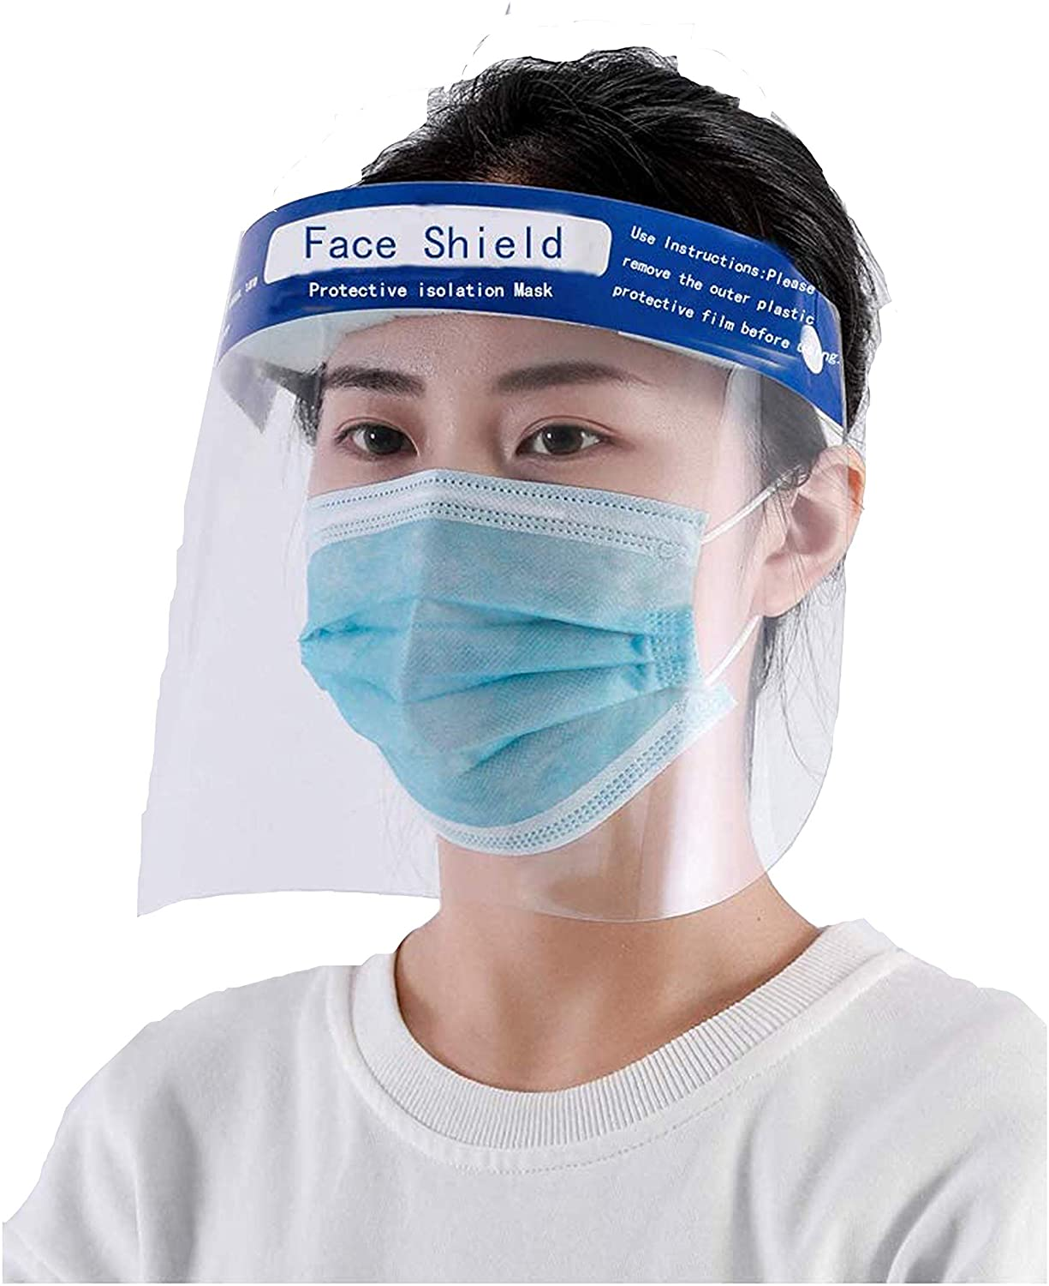
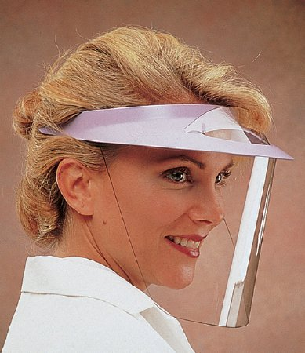
Reminder: Eye Protection Optimization Strategies
Crisis capacity:
Using safety glasses (e.g., trauma glasses) that cover the sides of the eyes
Using eye protection beyond their manufacturer-designated shelf life
Contingency capacity:
Extended use (i.e., wearing the same eye protection from room to room)
Using disposable eye protection more than once
Conventional capacity:
Using disposable eye protection and discarding after each resident encounter
Using reusable eye protection and disinfecting after each resident encounter
Example of a disposable face shield
Example of a reusable face shield
Source: https://www.cdc.gov/coronavirus/2019-ncov/hcp/ppe-strategy/eye-protection.html

Slide 32
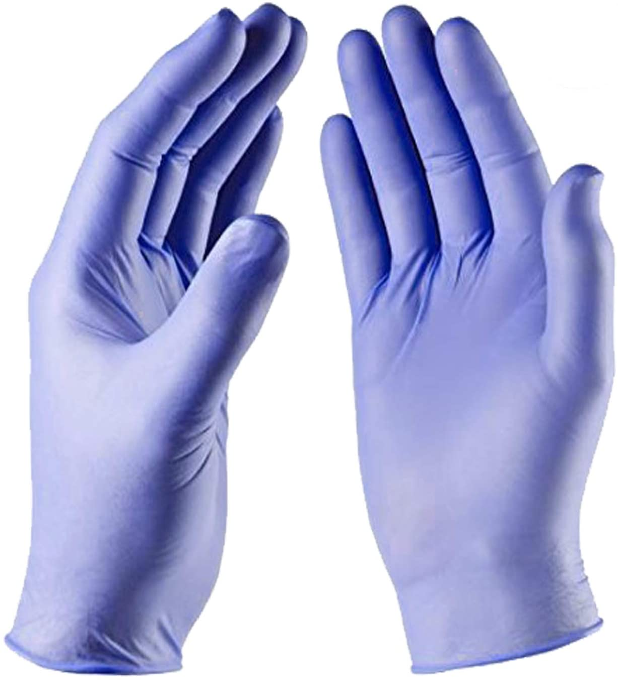
Reminder: Glove Optimization Strategies
Crisis capacity:
Using gloves past their manufacturer-designated shelf life
Consider non-healthcare glove alternatives
Extended use (i.e., using the same pair of gloves for the care of multiple residents). Must be sanitized in between residents
Contingency capacity:
Use disposable medical gloves conforming to other U.S. and international standards
Conventional capacity:
Use of “FDA-cleared” gloves
Single use (i.e., perform hand hygiene, don of a pair of gloves for the care of one resident, doff the gloves, perform hand hygiene)
Source: https://www.cdc.gov/coronavirus/2019-ncov/hcp/ppe-strategy/gloves.html

Slide 33
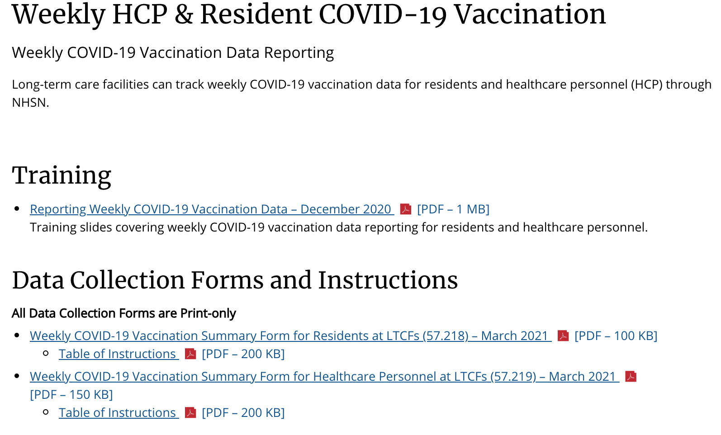
Update: NHSN Vaccine Module
Proposed rule from CMS that would mandate that SNFs report COVID-19 vaccination coverage into NHSN
Please begin reporting your facility’s data now so that you are well-versed in the process before it becomes mandatory
CDPH will be reaching out to facilities who have not yet reported into the module
If you need additional assistance or training, please visit https://www.cdc.gov/nhsn/ltc/weekly-covid-vac/index.html

Slide 34
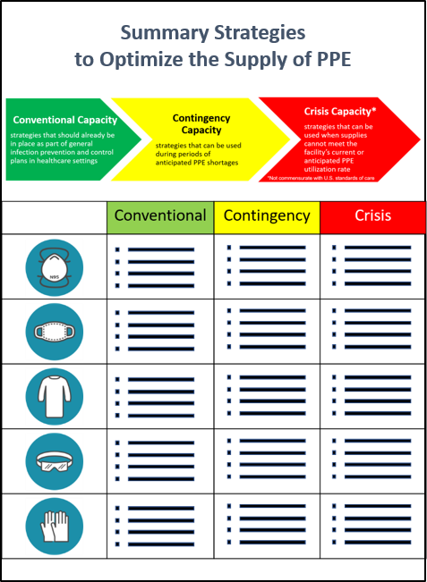
NHSN – PPE Supply Modules
Answers to NHSN module should match what you’re doing at your facility
For each type of PPE:
What optimization strategy are you using?
Conventional
Contingency
Crisis
Do you have an urgent need?
Yes
Your facility will no longer have this type of PPE in 7 days
Only say yes if you meet this criteria
No
All other situations
Examples:
One delayed PPE shipment
Switched from conventional to contingency
Source: https://www.cdc.gov/coronavirus/2019-ncov/hcp/ppe-strategy/general-optimization-strategies.html

Slide 35
NHSN – Need for Government Support or Assistance
Questions about facility shortages:
Staffing
Personal protective equipment
COVID-19 test supplies
Infection control / outbreak management
Staff training
CDC defines “need” of government support very specifically
Providing this information does not guarantee resources can be provided as local, state, and federal resources are allocated based on supply and priority of need.

Slide 36
NHSN – Staffing Shortages
Examples of Staff include, but are not limited to:
Nursing Staff: registered nurse, licensed practical nurse, or vocational nurse.
Clinical Staff: physician, physician assistant, or advanced practice nurse.
Aide: certified nursing assistant, nurse aide, medication aide, or medication technician.
Other staff or facility personnel that are not included in the above categories, regardless of clinical responsibility or resident contact.
For example, dietary, environmental services, cook, pharmacists, pharmacy tech, activities director, care givers, wound care, physical therapy, shared staff, physical therapy.

Slide 37
NHSN – Staffing Shortages
Would your facility like outreach by CDPH/IDPH with staffing shortages?
Examples for when a facility might select “YES” include:
The facility has exhausted other staffing options, such as temporary staffing (for example, travel staff)
The facility has exhausted staffing options using mechanisms available internally or through the facility corporate structure.
Note:
Select “NO” if facility adequately staffed with credential and/or skilled workers, including agency and/or temporary workers

Slide 38
NHSN – Staffing Shortages
Example:
On the date the facility is entering data into NHSN:
The facility has 7 nursing vacancies that it has not been able to fill through hiring actions or contracts with staffing agencies

Slide 39
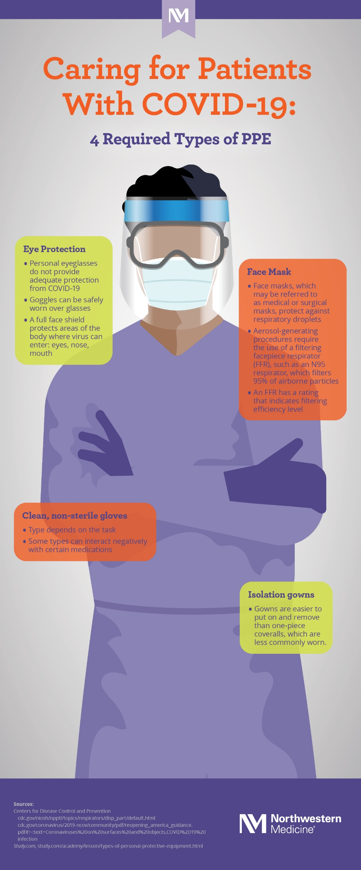
NHSN – PPE Shortages
Examples of PPE include:
N95 Respirators
Gowns
Gloves
Eye Protection (such as face shields)
Facemasks
Source: https://www.nm.org/healthbeat/covid-19/advances-in-care/anatomy-of-ppe

Slide 40
NHSN – PPE Shortages
Would your facility like outreach by CDPH/IDPH for assistance with PPE shortages?
Examples for when a facility might select “YES” include:
The facility is using crisis optimization strategies for supplies and personal protective equipment according to CDC guidance
CDC’s Optimizing Personal Protective Equipment (PPE) and Supplies.
The facility will no longer have one or more of the listed PPE supply item in the next 7 days
reporting “YES” to “urgent need” and currently using crisis or contingency optimization strategies
Note:
A facility should only select “YES” if they have exhausted other potential sources, such as commercial distributors and corporate stockpiles.
Facility’s answer to this question should match their answer in the previous NHSN PPE supply section
 | 4/3/2021
PPE | Available/Strategy | Need (Y/N)
Alcohol-Base Hand Rub | Y | N
N95 Respirator | CONTINGENCY | N
Face Mask | CONTINGENCY | N
Eye Protection | CONVENTIONAL | N
Gowns | CONVENTIONAL | N
Gloves | CONVENTIONAL | N

Slide 41
NHSN – PPE Shortages
Example:
On the date the facility is entering data into NHSN, it is already employing limited reuse of N95 respirators and, despite this strategy, will exhaust its supply of respirators in 7 days.
The facility would select “yes” to state/local outreach for PPE assistance if it does not anticipate receiving another shipment of N95 respirators from its supplier for approximately 2 weeks, and its corporate parent has exhausted its own stockpile of N95 respirators.
The same facility might select “no” to state/local outreach for PPE assistance if it expects a large shipment of N95 respirators from its supplier in the next two days.

Slide 42
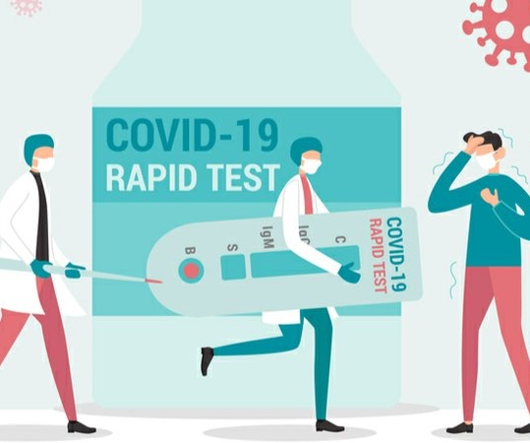
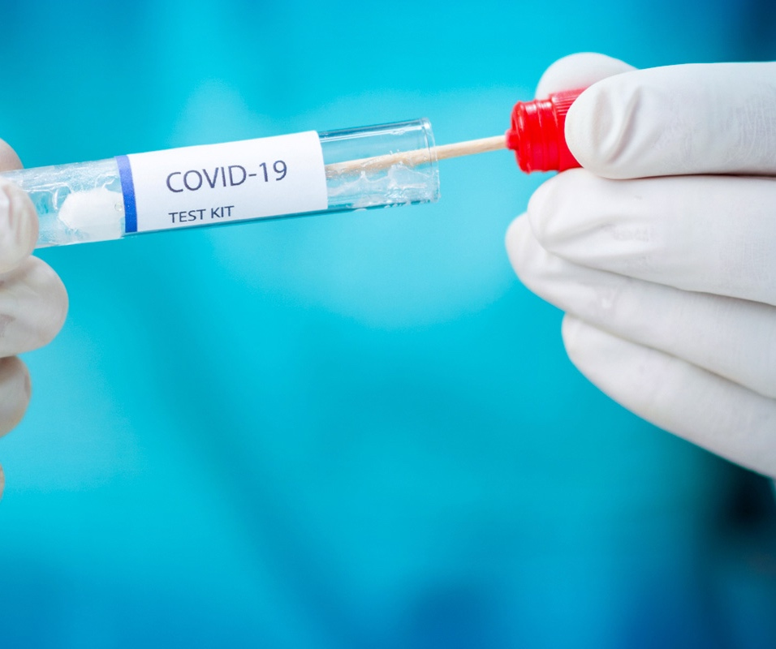
NHSN – Testing Supply Shortages
Testing supply focuses on access to testing.
Does your facility have:
The ability to test:
Either at point of care or using a commercial lab
One of these types of tests:
Either PCR (through a commercial lab) or Antigen (BinaxNow, BD Veritor, Sofia)
If using PCR, do you have access to resources to test:
Swabs
Media
Tubes

Slide 43
NHSN – Testing Supply Shortages
Would your facility like outreach by CDPH/IDPH for assistance with testing supply shortages?
Examples for when a facility might select “YES” include:
The facility does NOT have the ability to perform or to obtain resources for performing COVID -19 testing on all staff and facility personnel within the next 7 days, if needed.
The facility does not have access to or the ability to receive test results within 72 hours of sample collection.
Note:
Facilities should only select “YES” if they have exhausted other potential options, such as commercial distributors, corporate stockpiles, and alternative contract laboratories.

Slide 44
NHSN – Testing Supply Shortages
Example:
On the date the facility is entering data into NHSN:
The facility does do not have sufficient resources, either on site or through a contract with an external laboratory, to initiate outbreak testing for all residents and staff (including temporary, contract staff, if applicable) following a resident newly positive for SARS-CoV-2 (COVID-19) through viral testing.
Or the facility’s turnaround times for resident and/or staff testing results are greater than 3 days.
Can’t procure BinaxNow cards AND
Can’t find a new commercial lab with less than 72 hour turnaround

Slide 45
NHSN – Infection Control and Outbreak Management
Would your facility like outreach by CDPH/IDPH for assistance with infection control and outbreak management?
Examples for when a facility might select “YES” include:
Facility needs technical assistance with:
Assessing and strengthening infection prevention and control practices OR
Actively responding to and effectively containing the spread of COVID-19
Note:
A facility can request additional outreach for outbreak assistance even if the facility has consulted with IDPH/CDPH in the recent past.
If the facility is already actively working with IDPH/CDPH to address their current outbreak, select “NO”
A facility should not use this question as a substitute for regular case and/or outbreak reporting; facilities should contact their health department directly to address urgent questions or needs related to Infection Control or Outbreak Management

Slide 46
NHSN – Infection Control and Outbreak Management
Example:
On the date the facility is entering data into NHSN:
The facility has non-urgent questions about performing internal audits of staff hand hygiene or the implementation of testing and cohorting strategies.

Slide 47
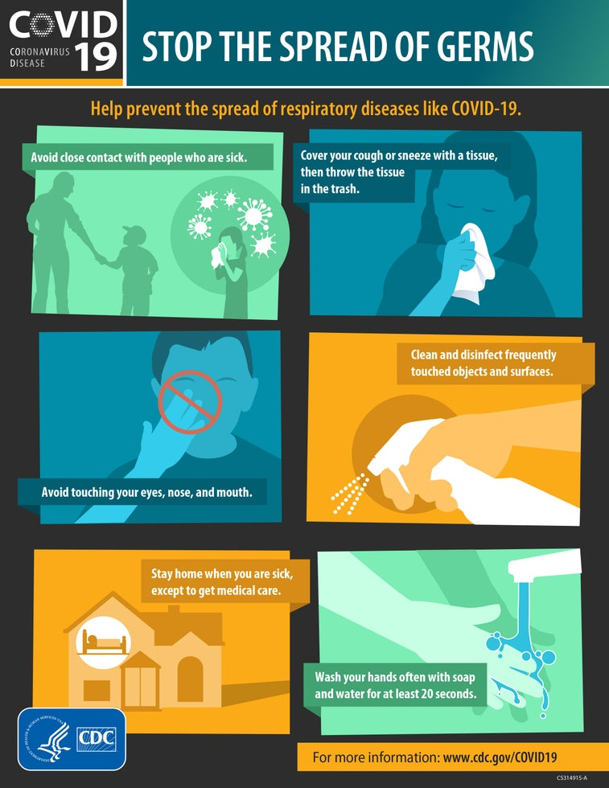
NHSN – Staff Training
Examples of staff training include:
Infection prevention and control
Surveillance and reporting
Testing
Cohorting strategies
Environmental cleaning
PPE use (such as optimization strategies, donning and doffing, etc.)
Source: https://www.cdc.gov/coronavirus/2019-ncov/downloads/stop-the-spread-of-germs.pdf

Slide 48
NHSN – Staff Training
Would your facility like outreach by CDPH/IDPH for assistance with staff training?
Examples for when a facility might select “YES” include:
Facility needs technical assistance or resource materials to train staff and/or leadership on infection control topics.
Note:
CDPH will connect you with resource materials for assist facility leadership in conducting staff trainings
CDPH won’t send a team out for individual facility frontline trainings

Slide 49
NHSN – Staff Training
Example:
On the date the facility is entering data into NHSN:
The facility had determined during a recent internal audit that many leaders and staff did not understand, and were not adhering to, guidelines for PPE use and optimization.
Or during a recent COVID-19 Infection Control Survey, the facility had been cited for deficiencies in its implementation of standard and transmission based precautions during resident care—and some of these deficiencies could be addressed through staff training.

Slide 50
NHSN – Staff Training
CDPH can send resource materials, but you don’t have to wait!
Facilities may take advantage of the following federal training resources:
CDC’s Project Firstline, which includes resources for nursing homes
https://www.cdc.gov/infectioncontrol/projectfirstline/index.html
CMS’s Targeted COVID-19 Training for Nursing Homes
https://qsep.cms.gov/COVID-TrainingInstructions.aspx
AHRQ’s ECHO National Nursing Home COVID-19 Action Network
https://hsc.unm.edu/echo/instituteprograms/nursing-home/pages/

Slide 51
NHSN – COVID-19 Vaccine Management
Would your facility like outreach by CDPH/IDPH for assistance with COVID-19 vaccine access?
Examples for when a facility might select “YES” include:
Facility does NOT have arrangements in place to receive COVID-19 doses from a vaccine provider for all residents and staff on a periodic basis.
Note:
Select “NO” if your facility is currently partnered with a COVID-19 vaccine provider (typically your contracted LTC pharmacy) to receive regular COVID-19 doses
Select “YES” if your facility is no longer partnered with a COVID-19 vaccine provider and your previous provider will not be scheduling clinics or sending vaccine in the future

Slide 52
NHSN – COVID-19 Vaccine Management
Example:
On the date the facility is entering data into NHSN:
The facility has completed all three clinics under the federal Pharmacy Partnership for LTC Program (PPP) and does not have access to sufficient vaccine (either on site or through a contract with an external pharmacy) to vaccinate newly admitted residents.
The facility does not have access to sufficient vaccine (either on site or through a contract with an external pharmacy) to offer a second dose to staff who received their first dose of a two dose COVID-19 vaccine during the third PPP clinic.

Slide 53
Questions & Answers
A special thanks to:
CDPH HAI Team: Hira Adil
Dr. Stephanie Black
Dan Galanto
Dr. Amy Hanson
Adebola Hassan
Liz Shane
Winter Viverette
Kelly Walblay
Shannon Xydis
Shane Zelencik
Christy Zelinski
For additional resources and upcoming events, please visit the CDPH LTCF HAN page at: https://www.chicagohan.org/covid-19/LTCF

