Slide 1


Slide 2
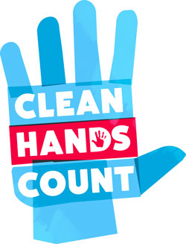
Improving Hand Hygiene at
Insert Facility Name
Hand Hygiene Education Program
Clean In Clean Out Method

Slide 3
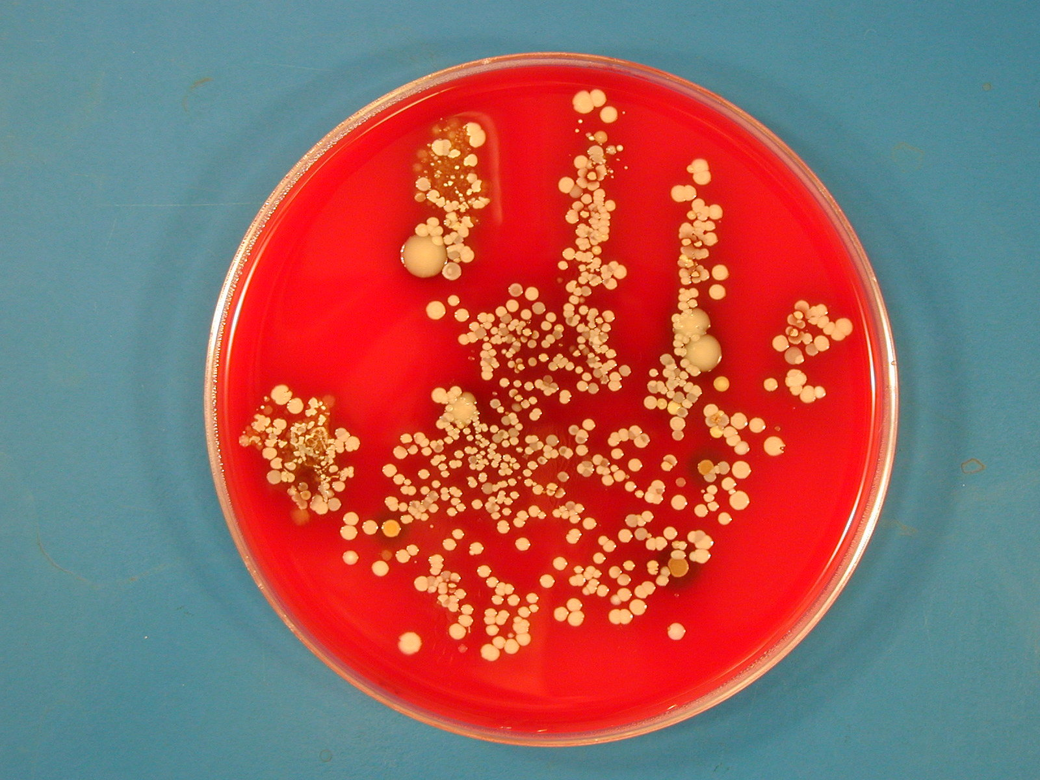
Why is hand hygiene important?
Hands are the number one way germs are transmitted.
The lack of hand hygiene contributes to the spread of resistant microorganisms.
It supports safe resident care.
Notes:
We all have common germs. Some residents have unusual and/or resistant germs. It can be difficult to know when common germs are transferred from one resident to the next because many residents have the common germs. When uncommon and/or resistant germs are found in more than one resident it often suggests that transmission has occurred. The lack of hand hygiene is one of the ways germs can be transferred or spread from one resident to the another.

Slide 4
Make Cleaning Your Hands A Habit
Clean In
Clean Out
Clean when entering a resident room or care space
Clean upon exiting a resident room or care space
Why should we Clean In, Clean out?
  Most of the time when a provider enters a patient room, they make contact with the environment or the patient¹:
    92.6 % of the time the environment will be touched.
    57.4% of the time the patient will be touched.
  Consistent with leading hand hygiene practice^{2.}
¹ Infect Control Hosp Epidemiol 2007; 28:341-345;
²http://www.centerfortransforminghealthcare.org/projects/detail.aspx?Project=3
Notes:
Hand hygiene is a safety measure similar to wearing a seat belt. You put on a seat belt because you can’t predict when an accident might occur. In the same way, you can’t anticipate what you will have contact with when entering the room. So to be safe, your hands should be cleaned upon entering and cleaned upon exiting.
It’s also important to consider each bed space as a separate room. Hands should be cleaned when moving from one bed space to the next.

Slide 5

The Facts: Gloves and Hand Hygiene
Gloves reduce hand contamination by as much as 70-80%
Gloves prevent cross-infection and protect from infection
Gloves need to be changed between residents
and
Hands should be cleansed IMMEDIATELY after glove removal!
Notes:
Gloves are a good thing, but not a replacement for hand hygiene. Gloves may have small holes or tears. Additionally, it can be difficult to remove gloves without exposing your hands to the contaminated gloves.
Gloves can protect you by creating a barrier, but can put residents at risk if the same pair is used from resident to resident.

Slide 6

More Facts: Gloves and Hand Hygiene
Wear gloves when contact with blood or other potentially infectious materials is anticipated.¹
Perform hand hygiene before the use of gloves.
  Two studies illustrated that exam gloves from boxes in use were contaminated 55%² and 75%³ of the time. Unopened boxes were not contaminated. This finding suggests that staff contaminated the gloves in the open boxes when removing a pair.
Perform hand hygiene after the use of gloves.
  Two studies demonstrated that gloves were highly protective, but hand contamination still occurred 13%⁴ and 5%⁵ of the time.
Do not wear gloves in the hallway.
Do not wear the same pair of gloves for the care of more than one resident.
¹Guideline for Hand Hygiene in Health-care Settings. MMWR 2002; vol. 51, no. RR-16. ² Infect Control Hosp Epidemiol 2008 Jan;29(1):63-5. ³Am J Med 1993 Jun;94(6):602-7. ⁴JAMA 1993 Jul 21;270(3):350-3 . ⁵Infect Control Hosp Epidemiol 2008 Feb ;29(2):149-154 .
Notes:
Residents should have on clean clothes, clean hands (they can use the alcohol based handrub), and wounds/drainage should be contained when they are in common areas. This should limit the risk of healthcare worker exposure to potentially infectious materials.
Therapists can place a pair of gloves in their pockets if they are uncomfortable ambulating a resident without access to gloves.
For activities like carrying a trash or linen bag to the soiled utility room or chute, some staff prefer to have on gloves. The outside of the bags should be visibly clean, so gloves are not necessary. If staff press on the issue, they can be instructed to wear a glove on the hand that is carrying the bag. The other non-gloved hand should be used to open doors, etc. The glove should be removed and hand hygiene performed as soon as the bag is in the appropriate receptacle.

Slide 7
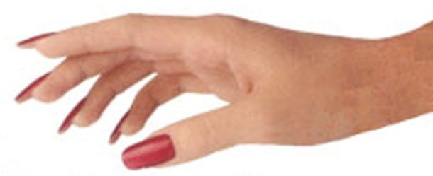
Artificial and Polished Natural Nails Put Residents at Risk
Artificial Nails
Outbreak of Pseudomonas aeruginosa in a Neonatal ICU resulted in 16 Deaths and was associated with a RN wearing artificial nails.¹
3 people suffered Candida bone infections after spine surgery. The infection was associated with an OR Tech wearing artificial nails. ²
Natural Nails
Polished nails are more likely to harbor bacteria than natural nails.
Polish should be free of chips.
ARTIFICIAL
NATURAL
POLISHED
Artificial nails are prohibited in direct patient care providers, food handlers and those handling sterile supplies.
Keep natural nails <1/4 inch if caring for patients.
¹ Outbreak of Pseudomonas aeruginosa in a neonatal intensive care unit - Moolenaar RL et al, Infect Control Hosp Epidemiol 21(2):80, 2000; ² Candida Osteomyelitis and Diskitis after Spinal Surgery – Parry et al, Clinical Infectious Diseases 32:352-7, 2001; ³ Larson, Nursing Research 1998; 47:54
Notes:
While not long term care related outbreaks, these outbreaks provide scientific evidence that artificial nails can lead to adverse patient outcomes.

Slide 8
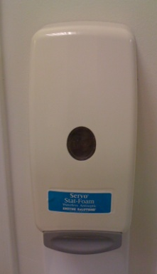
Hand Rub vs. Soap and Water
HAND RUB (foam and gel)
Pros:
Takes less time
Contains moisturizers
Readily accessible
Cons:
Can’t be used for situations with gross contamination
Technique:
Apply to palm of one hand (the amount used depends on specific hand rub product and the size of your hands).
Rub hands together, covering all surfaces, focusing in particular on the fingertips and fingernails, until dry.
HANDWASHING (soap and water)
Pros:
Effective for all situations.
Cons:
Takes more time
Can be more drying than foam/gel
Sink and soap not always nearby
Technique:
Wet hands with water.
Apply soap.
Rub hands together for at least (insert facility time) seconds, covering all surfaces, focusing on fingertips and fingernails.
Rinse under running water and dry with disposable towel.
Use the towel to turn off the faucet.
Notes:
There have been several recent changes related to the use of ABHR in long term care. In the past CMS, and therefore the state surveyors, did not necessarily support the use of ABHR in long term care facilities. Now CMS is strongly supporting the use including for residents with C. difficile and norovirus unless there is an outbreak or high baseline levels. From CMS State Operations Manual:
For example: o Hand hygiene (HH) (e.g., hand washing and/or ABHR): consistent with accepted standards of practice such as the use of ABHR instead of soap and water in all clinical situations except when hands are visibly soiled (e.g., blood, body fluids), or after caring for a resident with known or suspected Clostridium (C.) difficile or norovirus infection during an outbreak, or if infection rates of C. difficile infection (CDI) are high; in these circumstances, soap and water should be used;47 NOTE: According to the CDC, strict adherence to glove use is the most effective means of preventing hand contamination with C. difficile spores as spores are not killed by ABHR and may be difficult to remove even with thorough hand washing. For further information on appropriate hand hygiene practices see the following CDC website: http://www.cdc.gov/handhygiene/providers/index.html
The other thing to note is the urban myth that healthcare workers have to wash with soap and water after using ABHR a set number of times. We have not found any ABHR product that requires handwashing after a set number of uses. Some products tend to build up and get gritty and staff may want to wash, but it is not required.

Slide 9
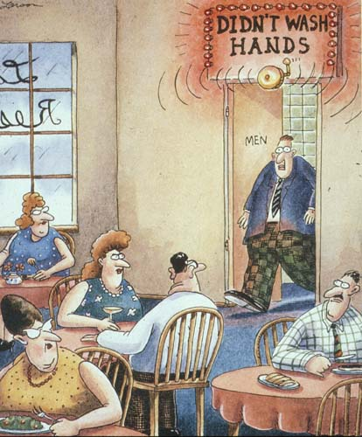
Speak Up for Resident Safety
Resident safety is a team effort.
Be empowered to speak up and remind a colleague if they forget to perform hand hygiene.
Lead by example.
9
Notes:
Staff should be empowered to speak up with a respectful gentile reminder if you they are comfortable.
Studies have shown that if a provider enters the room and does not clean their hands, others following behind likely will not either. BUT, if the provider cleans their hands on entry, those following behind are more likely to perform hand hygiene.

Slide 10
In Conclusion
Clean In, Clean Out.
Clean hands before and after the use of gloves.
Speak up for clean hands.
Notes:
Remove gloves and clean hands between resident encounters in the same room.

