Slide 1
COVID-19 Chicago Long Term Care Roundtable
07-27-2023

Slide 2
Agenda
COVID-19 Epidemiology & Updates
Transmission Based Precautions
Shingles
Bed Bugs
iHealth Rapid Test Expiration Dates
COVID-19 Reporting
Project Firstline
Increasing Vaccine Uptake
CDPH Emergency Preparedness Liaison

Slide 3
Chicago Dashboard
Source: https://www.chicago.gov/city/en/sites/covid-19/home/covid-dashboard.html

Slide 4
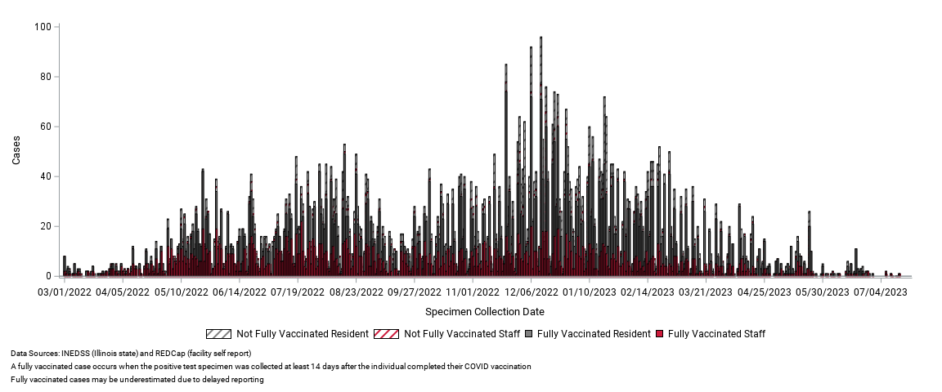
SNF COVID-19 Cases (Mar. 1, 2022 – July 19, 2023)
Data as of 07/19/2023
3 (4%) SNFs have active outbreaks
Notes:
Data source: lab-confirmed (PCR or antigen) cases in INEDSS/RC matched to ICARE

Slide 5
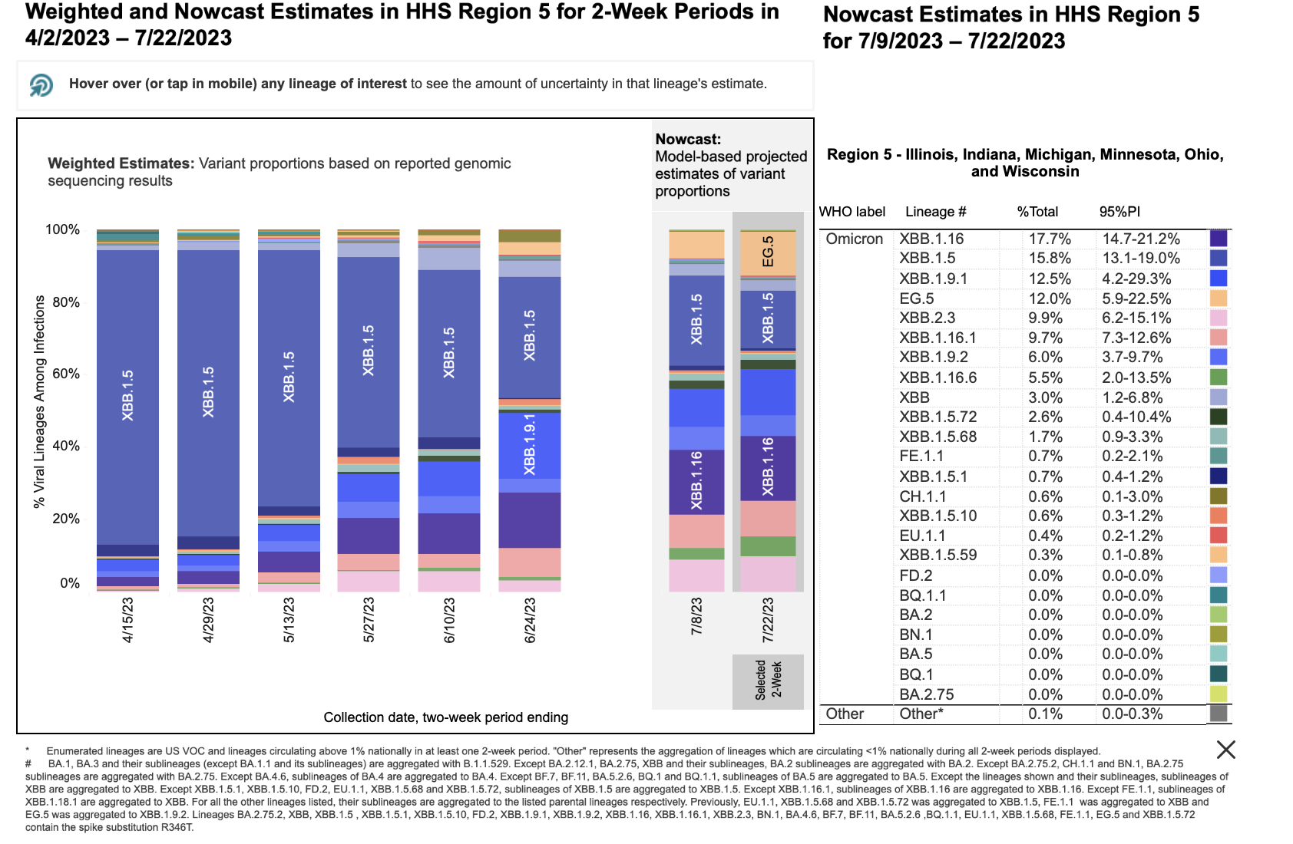
COVID-19 Variant Proportions
Source: https://covid.cdc.gov/covid-data-tracker/#variant-proportions
Notes:
Region 5 screenshot

Slide 6
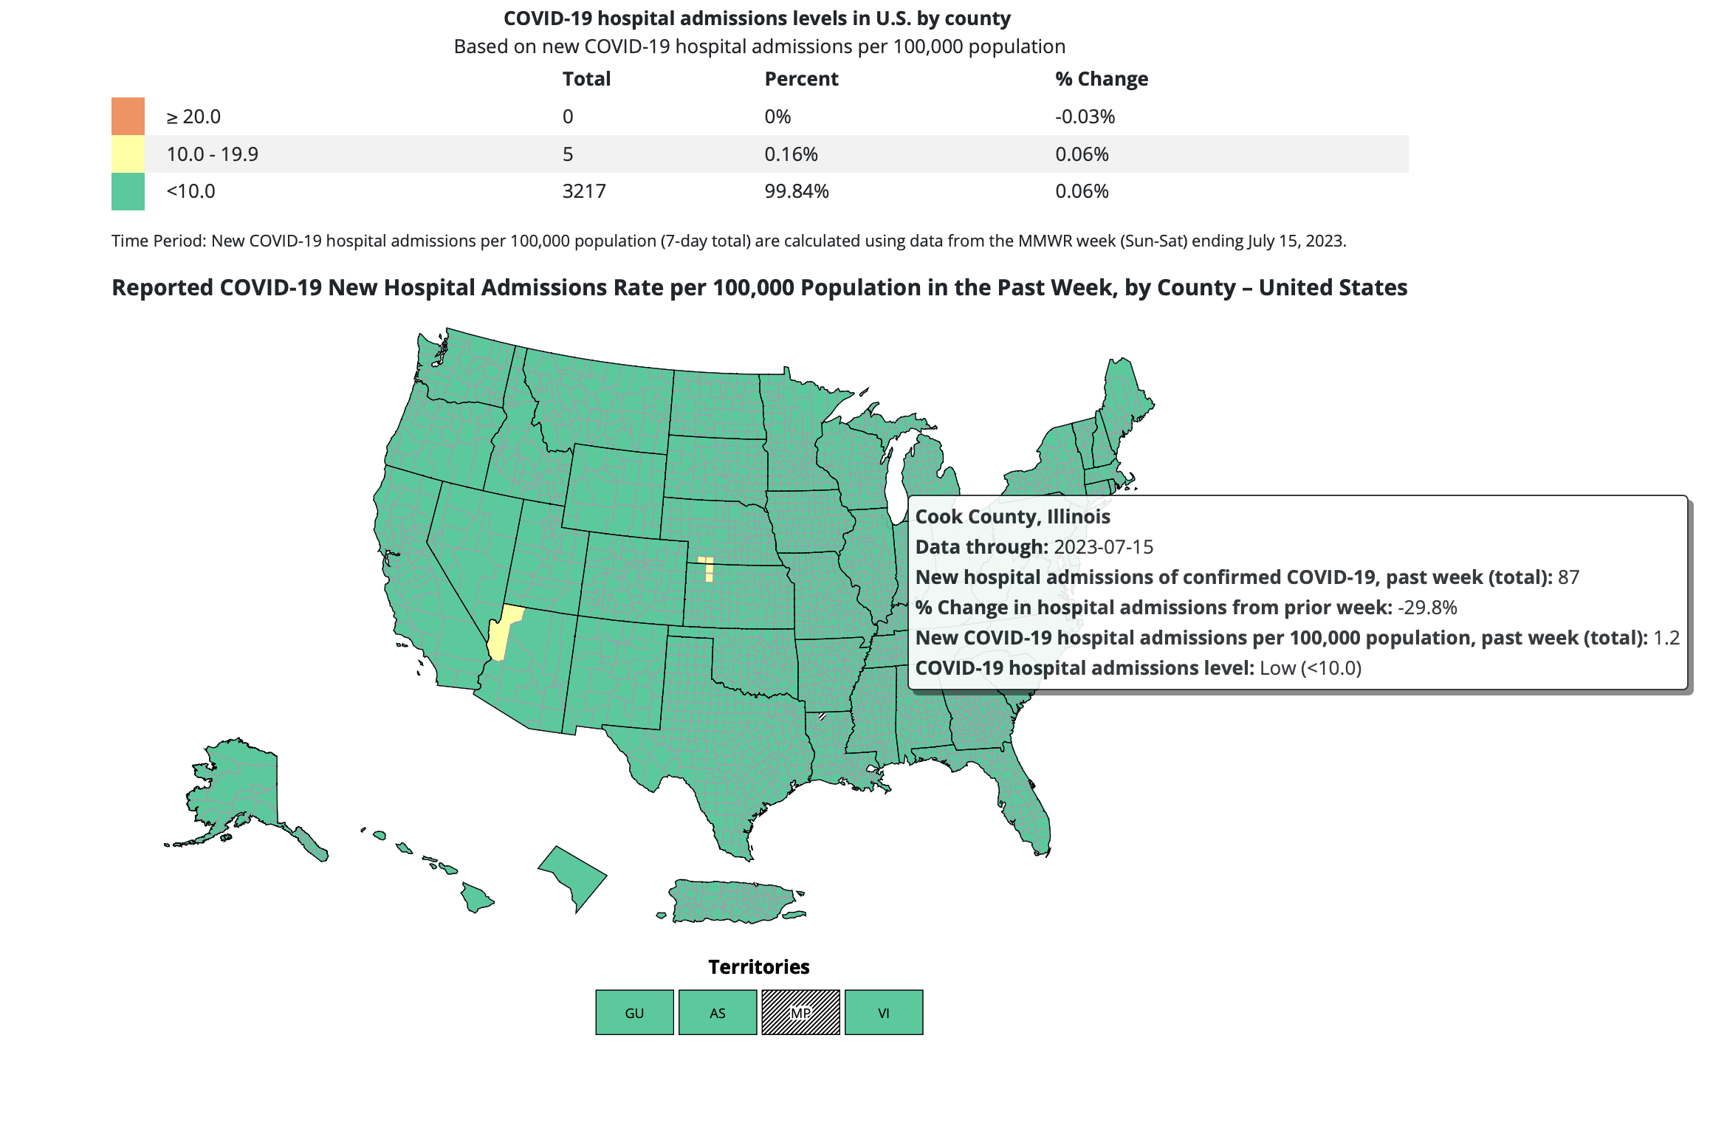
CDC COVID Data Tracker: Cook County
Source: https://covid.cdc.gov/covid-data-tracker/#cases_new-admissions-rate-county
Notes:
This is the CDC Covid Data Tracker for Cook County we will be utilizing. This tracker monitors Covid-19 hospital admissions levels by county per 100, 000 population. We are still in low at this time.

Slide 7
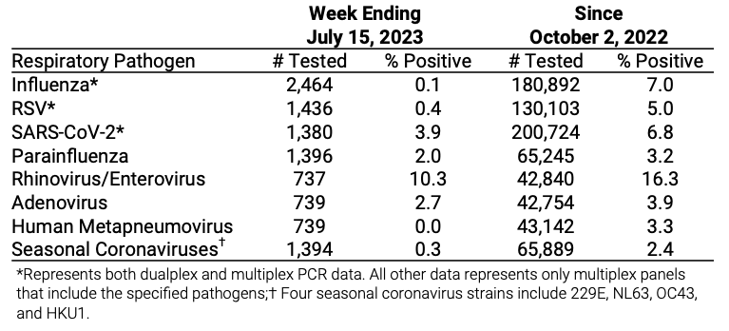
Chicago Respiratory Virus Surveillance Report – Current Week & Cumulative
Notes:
Report for week ending July 15
Table shows the number of respiratory viral PCR test performed by several hospital laboratories in Chicago
The risk of influenza infection is low.
Two of 2,464 (<1%) reported specimens tested for influenza were positive. Since October 2, 2022, 12,643 of 180,892 (7.0%) reported specimens tested for influenza were positive.
The proportion of emergency department visits for influenza-like illness (ILI) and the proportion of outpatient visits for ILI are below local thresholds.

Slide 8
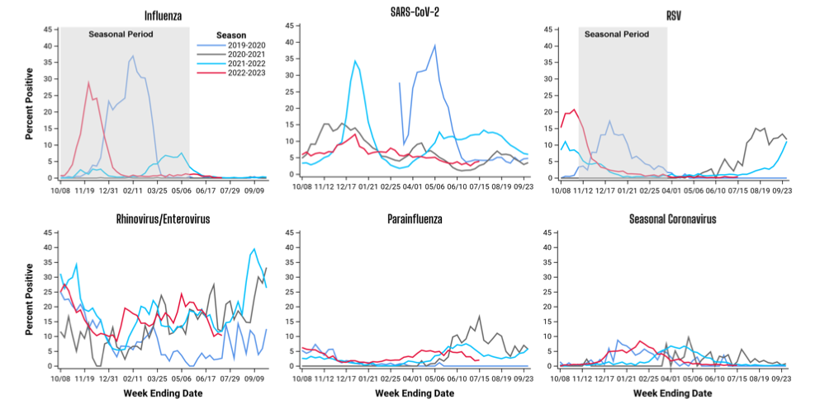
Chicago Respiratory Virus Surveillance Report – Seasonal Trends
Notes:
Graphs showing the seasonal trends of respiratory virus testing. Shaded grey areas indicate seasonal periods when activity tends to increase for influenza and RSV.
Other Respiratory viruses:
The test positivity for SARS-CoV-2 has increased from 3.6% to 3.9%.
The test positivity for RSV remains at <1%.
The test positivity for parainfluenza has increased from 1.8% to 2.0%.
The test positivity for rhinovirus/enterovirus has decreased from 11.0% to 10.3%.

Slide 9
Reminder: Minimum Routine Staff Testing Frequency
Vaccination Status | Hospital Admission Level | Testing Frequency
Not up to date | All | No required routine testing*
Up to date** | All | No required routine testing*
* Unless symptomatic, had a high-risk exposure, or your facility is in outbreak and performing unit/broad-based testing.
** An individual has received all COVID-19 vaccinations for which they are eligible
Source: IDPH Updated Interim Guidance for Nursing Homes Following the End of the Public Health Emergency

Slide 10
Reminder: Minimum Routine Resident Testing Frequency
Vaccination Status | Hospital Admission Level | Routine Testing Frequency
Not up to date | All | No required routine testing*
Up to date | All | No required routine testing*
New and readmissions, regardless of vaccination status | Low, Moderate, Substantial | No required routine testing*
New and readmissions, regardless of vaccination status | High | Facility discretion*
*Unless symptomatic, following a high-risk exposure, or your facility is in outbreak and performing broad-based testing.
Source: IDPH Updated Interim Guidance for Nursing Homes Following the End of the Public Health Emergency

Slide 11
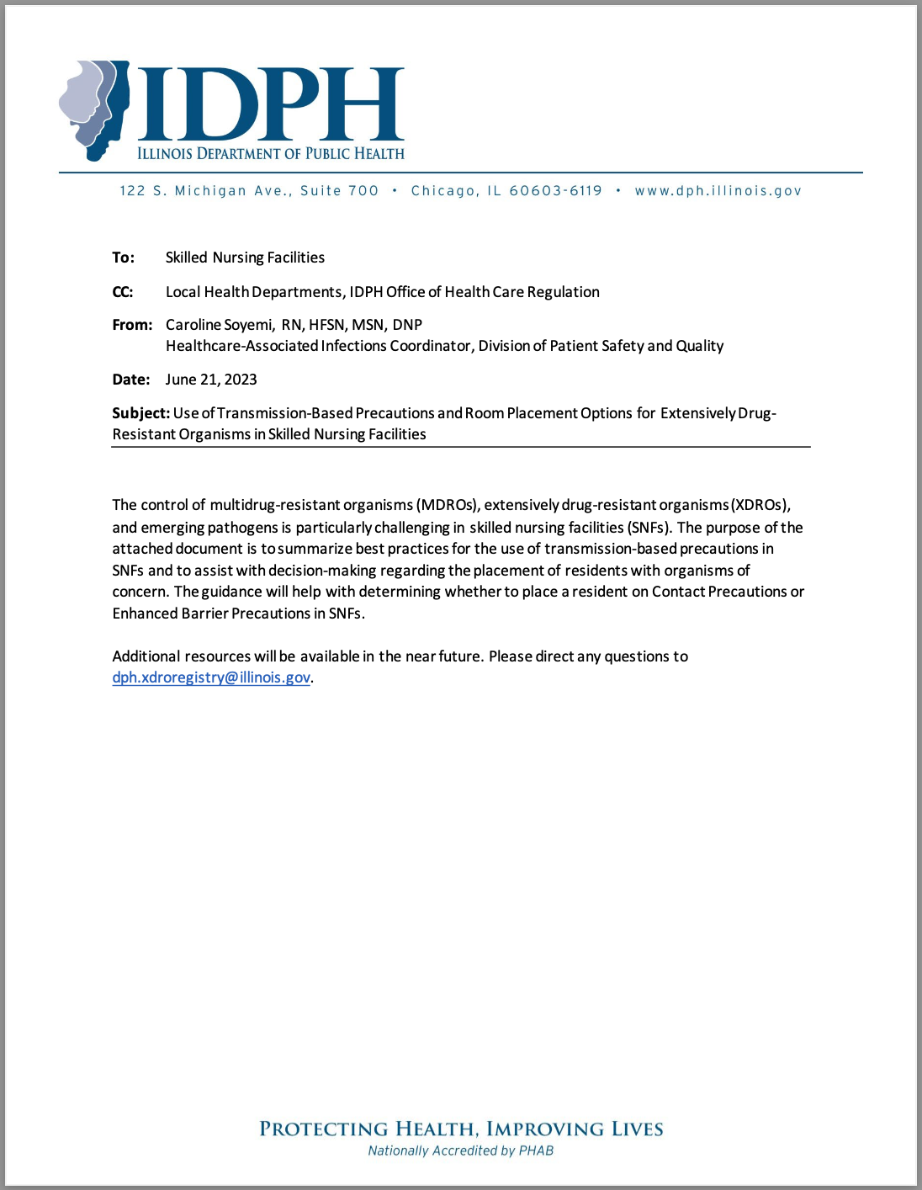
New IDPH TBP Guidance Document
New guidance document released on June 21, 2023
Best Practices for the use of transmission-based precautions in SNFs
Guidance with placing a resident on Contact Precautions or Enhanced Barrier Precautions
Assist with decision-making regarding the placement of residents with organism of concern

Slide 12
Definitions
MDROs: multidrug resistant organisms
Methicillin-resistant Staphylococcus aureus (MRSA)
ESBL-producing Enterobacterales
Vancomycin-resistant Enterococci (VRE)
multidrug-resistant Pseudomonas aeruginosa
multidrug-resistant Streptococcus pneumoniae
XDROs: extensively drug-resistant organisms entered in the XDRO registry
Candida auris
Carbapenem-resistant Enterobacterales (CRE)
Carbapenem-resistant Acinetobacter baumannii (CRAB)
Carbapenem-producing organisms (CPOs)
Endemic CPOs: CRE-KPC, CRAB OXA 23, CRAB OXA 24/40, or unknown mechanisms
Rare or low prevalence CPOs: CRE-NDM or CRE-VIM
Notes:
Enterobacterales (order) e. coli and k. pneumonaie
Enterococcus (genus) e. faecalis and e. faecium

Slide 13
Facility-level Approaches
Pathogen-based
XDROs: EBP for residents with an XDRO
MDROs: use a risk-based approach to determine what type of precautions are warranted for residents colonized or infected with MDROs.
Risk-based
EBP for residents with wounds requiring dressing (e.g. pressure ulcers, diabetic foot ulcers, unhealed surgical wounds, and chronic venous stasis ulcers)
EBP for residents with any indwelling devices (e.g. central lines, urinary catheters, feeding tubes, hemodialysis catheters, tracheostomies, and ventilators)
Notes:
When implementing TBP among residents in long-term care facilities, consider using one or more of the following facility-level approaches, keeping in mind that standard precautions should be used on all residents during all care

Slide 14
Enhanced Barrier Precautions (EBP)
Single or private rooms are not required
Don PPE during high-contact resident care activities (e.g. dressing, bathing, transferring, providing hygiene, changing linens, changing briefs, or assisting with toileting, care or use of indwelling devices, wound care requiring a dressing)
Resident is NOT restricted to their room
Resident is allowed to participate in communal dining and group activities
EBP does not impose the same restrictions as contact precautions, EBP is intended to be in place for the duration of a resident’s stay or until resolution of wound or discontinuation of indwelling device

Slide 15
Contact Precautions
Single room is preferred
Don PPE upon room entry and discard PPE before exiting the patient room
Resident is restricted to their room except for medically necessary care
Resident should not participate in communal dining or group activities
Intended to be time limited, plan for discontinuation or de-escalation
Use disposable patient-care equipment or implement patient-dedicated use
Use contact precautions for residents with:
Draining wounds that cannot be contained and/or diarrhea
Other infections/conditions listed in CDC’s Appendix A
C. difficile
Scabies
Norovirus

Slide 16
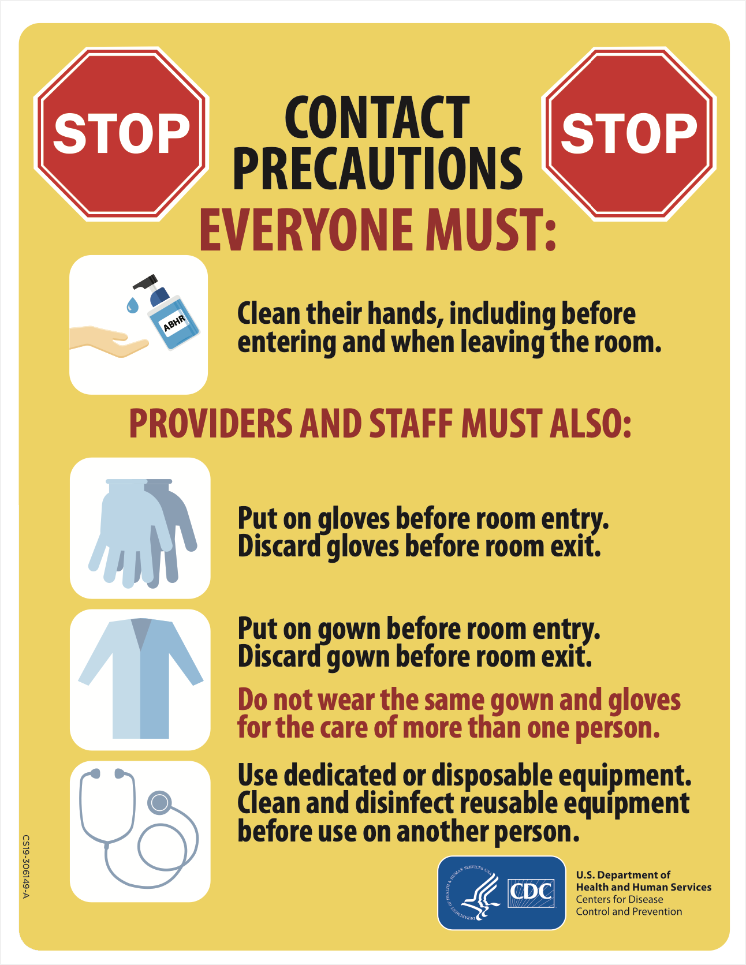
Signage

Slide 17
TBP Scenarios

Slide 18
TBP Question 1
A resident is admitted with a diabetic ulcer that requires dressing. The ulcer was cultured at a previous facility and the lab results show no growth.
What type of precautions are indicated?
Enhanced barrier precautions
Contact precautions
Standard precautions

Slide 19
Answer
Enhanced barrier precautions
Enhanced Barrier Precautions are recommended for residents with indwelling medical devices or wounds, even if they have no history of MDRO colonization or infection and regardless of whether others in the facility are known to have MDRO colonization. This is because devices and wounds are risk factors that place these residents at higher risk for carrying or acquiring a MDRO and many residents colonized with a MDRO are asymptomatic or not presently known to be colonized.
Source: https://www.cdc.gov/hai/containment/faqs.html

Slide 20
TBP Question 2
A resident on enhanced barrier precautions (for XDRO infection) is now experiencing loose stools and has tested positive for C. difficile.
Should the resident remain on enhanced barrier precautions?
Yes, continue with enhanced barrier precautions
No, change to contact precautions

Slide 21
Answer
b) No, change to contact precautions
Residents with C. difficile should be placed under contact precautions. Continue contact precautions for the duration of the C. difficile infection.
Enhanced Barrier Precautions do not replace existing guidance regarding use of Contact Precautions for other pathogens and conditions in nursing homes. Refer to Appendix A – Type and Duration of Precautions Recommended for Selected Infections and Conditions of the CDC Guideline for Isolation Precautions.
Source: https://www.cdc.gov/hai/containment/faqs.html

Slide 22
TBP Question 3
A resident who does not have an indwelling device or wound has tested positive for MRSA colonization.
What type of precautions are indicated?
Enhanced barrier precautions
Contact precautions
Use a risk-based approach to determine precautions needed

Slide 23
Answer
c) Use a risk-based approach to determine precautions needed
A facility should use a risk-based approach to determine what type of precautions (contact or EBP), if any, are warranted for a resident colonized or infected with MDROs. A risk-based approach takes into consideration the resident’s clinical situation and the prevalence or incidence of MDROs in the facility. Consider this approach for residents with organisms not previously encountered in the facility.

Slide 24
Shingles (Herpes Zoster)
Reactivation of varicella-zoster virus, the same virus that causes chickenpox
You cannot get shingles from someone with shingles or chicken pox
You can get chicken pox from someone with shingles, if you have never had chickenpox or the chickenpox vaccine
A rash most commonly appears on the trunk along a thoracic dermatome or on the face and it usually does not cross the body’s midline.
The rash develops into clusters of vesicles. New vesicles continue to form over 3 to 5 days, and the rash progressively dries and scabs over. The rash usually heals in 2 to 4 weeks.
Susceptible HCWs should not provide direct resident care if immune caregivers are available
Infection control measures depends on the resident’s immune status and rash presentation
Source: https://www.cdc.gov/shingles/hcp/clinical-overview.html

Slide 25
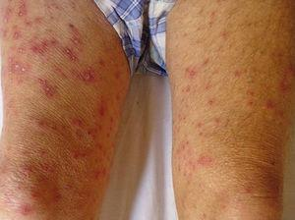
Shingles (Herpes Zoster)
Localized Shingles
Source: https://myvision.org/eye-conditions/shingles-on-face/
Disseminated Shingles
Source: https://www.actasdermo.org/en-clinical-characteristics-outcomes-in-population-articulo-S1578219016303638

Slide 26
Shingles (Herpes Zoster) Precautions
Source: https://www.cdc.gov/shingles/hcp/hc-settings.html

Slide 27
Shingles (Herpes Zoster) Management of Staff
For localized shingles in immunocompetent staff:
Cover lesions and restrict from care of high-risk residents until all lesions are dry and scabbed
If lesions cannot be completely covered, exclude from from work until all lesions are dry and scabbed
For disseminated shingles exclude from work until all lesions are dry and scabbed
For localized shingles in immunocompromised staff exclude from work until disseminated infection is ruled out
Source: https://www.cdc.gov/shingles/hcp/hc-settings.html

Slide 28
Shingles (Herpes Zoster) Vaccine
CDC recommends adults 50 years and older get two doses of the recombinant zoster vaccine (Shingrix)to prevent shingles and related complications in adults 50 years and older.
Two doses separated by 2 to 6 months.
You can get Shingrix even if in the past you:
Had shingles
Received Zostavax
Received varicella (chickenpox) vaccine
Source: https://www.cdc.gov/vaccines/vpd/shingles/hcp/shingrix/recommendations.html
Notes:
Zoster vaccine live (Zostavax) is no longer available for use in the United States, as of November 18, 2020.

Slide 29
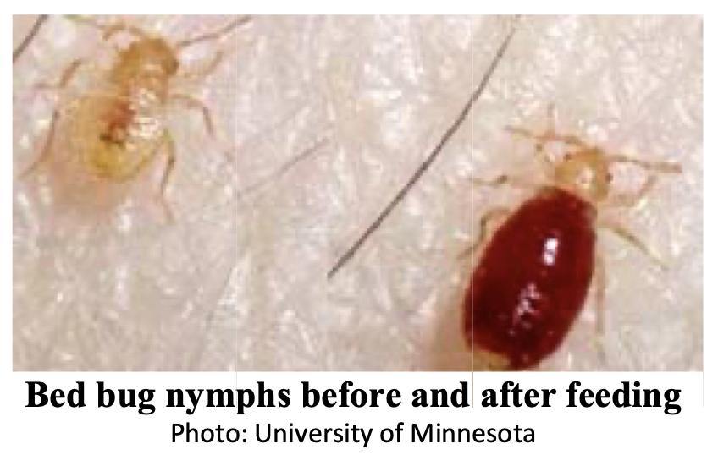
Bed Bugs
Health care facilities experience a constant inflow of people and their belongings; and can expect bed bugs to be introduced from time to time.
Signs can include:
Bite marks often circular, inflamed and somewhat linear in arrangement
Shed exoskeletons usually an amber color
Bed bugs in the fold of mattresses and sheets
Rusty–colored blood spots due to their blood-filled fecal material
Sweet musty odor if heavily infested
Source: https://www.cdc.gov/parasites/bedbugs/faqs.html
Notes:
Bite pictures

Slide 30
Bed Bug Identification
When bed bugs are suspected, specimens should be collected and submitted to entomologists or pest management professionals qualified to identify them.
Without specimens identified as bed bugs, a report of suspected bites does not necessarily mean a facility is bed bug infested.
Skin markings may be consistent with bed bug bites, however other biting arthropods and environmental and medical conditions can produce similar markings.
Visible reactions may not appear for two weeks after the bites or bites may not appear at all.
An experienced pest management professional should inspect and treat as needed all areas where bed bugs are suspected, as well as all rooms adjacent, above and below.
Source: http://www.idph.state.il.us/envhealth/BedBugs_HealthCareFacilities.pdf

Slide 31
Bed Bug Management
When bed bugs are discovered in a resident room, the resident should be bathed or showered, clothes changed, and transferred to another room.
Resident belongings, equipment and furnishings including beds, should not leave the room until thorough inspection finds them bed bug free.
Linen should be carefully removed, tightly sealed in bags, put directly into a washer or dryer and dried on the hot setting for at least 20 minutes to kill all stages of bed bugs.
Seal potential bed bug access points to adjacent rooms, by filling gaps that occur where plumbing penetrates common walls and around electrical, cable and phone outlets.
Waiting rooms, visitor lounges, common areas, laundry rooms, and equipment such as wheelchairs and food carts, should be regularly inspected for bed bugs.
Source: http://www.idph.state.il.us/envhealth/BedBugs_HealthCareFacilities.pdf

Slide 32
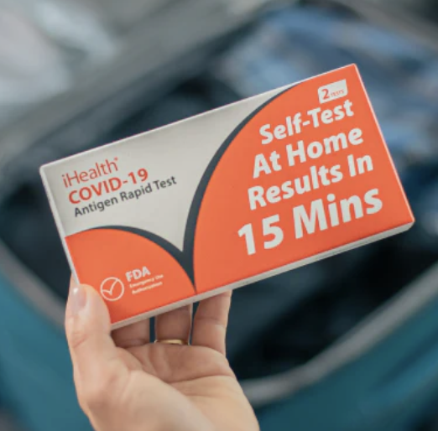
Expiration Dates for Rapid Tests
On Jan 11, 2023, the FDA granted another three-month shelf-life extension for the iHealth COVID-19 Antigen Rapid Test, which extended the shelf-life of all iHealth tests from 6 months to 15 months
Use the link below to check the most updated expiration date of your kit: https://ihealthlabs.com/pages/news#expiration
Notes:
CDPH sent test

Slide 33
COVID-19 Reporting
Continue reporting positive cases to the redcap SNF COVID-19 Case Report Form
Complete the COVID-19 Therapeutics Utilization form on a weekly basis
If no therapeutics were administered, select “Did NOT administer therapeutics”

Slide 34
Project Firstline
Gus E. Turner, MPH​ Project Firstline​ Project Manager, CDPH

Slide 35
Project Firstline Overview
Project Firstline is the Center for Disease Control’s (CDC) National Training Collaborative for Healthcare Infection Control education​
Project Firstline (PFL) brings together more than 75 healthcare, academic, and public health partners to reach healthcare workers across the country​
PFL offers educational resources in a variety of formats to meet the diverse learning needs and preferences of the healthcare workforce

Slide 36
Available Resources
Learn about Infection Control in Health Care: CDC’s Project Firstline provides innovative and accessible resources so all healthcare workers can learn about infection control in health care. ​
Topics include 14+ foundational IP&C (e.g., hand hygiene, environmental services, ventilation, PPE, how viruses spread, etc.), Recognizing Risk using Reservoirs, Where Germs Live training toolkits, and more interactive resources. ​
Lead an Infection Control Training: Our facilitator toolkit is designed to work with your team’s learning styles and busy schedules (10-, 20-, and 60-minute scripted sessions).​
Access Infection Control Educational Materials: Find short videos, fact sheets, job aids, infographics, posters, printed materials, interactive computer lock screens, and social media graphics to utilize at your facility on foundational IPC topics.​
Earn Continuing Education: Earn CEU’s on CDC Train for PFL content.​
Translated Resources: IPC materials translated into Spanish & additional languages.

Slide 37
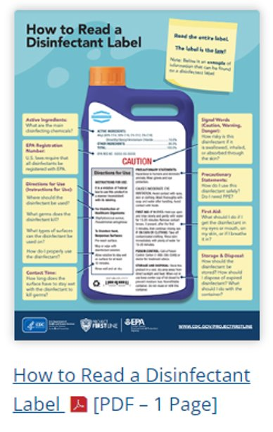
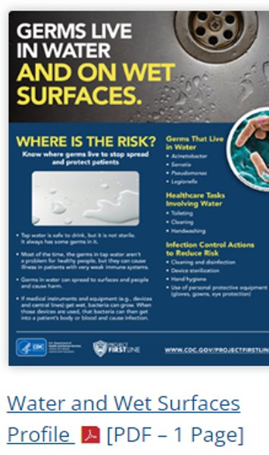
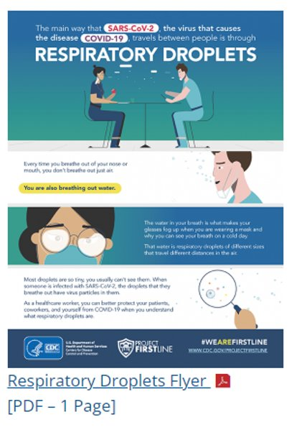
Print Materials & Job Aids​
Several print materials and job aids available on foundational IP&C topics.​
Available for free download on CDC's website. ​
Including lock screens for staff computers.​
We are happy to offer professional printing support for poster requests!​
Please see our team after the presentation to request print materials.​
For remote guests, please email: projectfirstline@cityofchicago.org

Slide 39
2023 Learning Needs Assessment
Thank you to our respondents thus far!​
Primary workplace:​
31.0% Acute care hospital​
13.8% Outpatient healthcare facility​
1.7 % Long-term acute care hospital​
Primary professional roles:​
24.1% Infection preventionists​
24.1% Registered nurses​
10.3% Healthcare administrators
Topics of interest for NEW Trainings for frontline staff:​
Transmission-based precautions/enhanced-barrier precautions (73.7%)​
Bugs in healthcare settings (63.2%)​
e.g., maggots, bed bugs, scabies, etc.​
Vaccines and Vaccination (57.9%)​
Antibiotic resistance/MDRO basics (57.9%)​
Early identification & patient screening, with case studies (56.1%)​
Sterilization and high-level disinfection basics (49.1%)​
e.g., how to know if something is sterile, sterile supply storage, transport soiled and clean instruments/devices, etc.

Slide 40
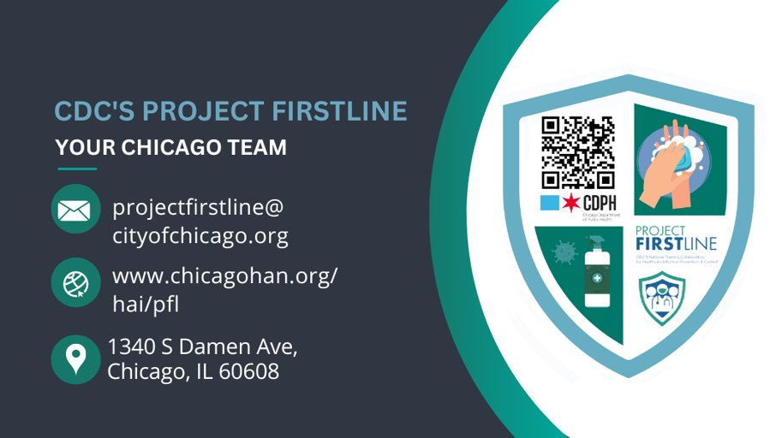
Your Chicago Project Firstline Team
​CDPH Infection Preventionist: Your facility's main contact for all infection prevention and control questions
General contact information: cdphhaiar@cityofchicago.org​
PFL-Chicago Education Specialists: Contact our team to hear more about specific Chicago-based educational opportunities! ​
We offer many resources including virtual or onsite trainings, webinars, and helpful newsletters. ​
CDPH Project Firstline email:​ projectfirstline@cityofchicago.org
Visit our Chicago Health Alert Network (HAN) page for recorded webinars, newsletter information, and upcoming events. Stay up to date on exciting new resources!

Slide 41
Increasing Vaccine Uptake: COVID-19 Vaccine Posters & Education Sessions
Leirah Jordan TREAT COVID-19 Program Project Manager, Contractor

Slide 42
Updated Covid-19 Vaccine
On average, 45% of all staff, and 70% of residents in our Chicago-based skilled nursing facilities have received at least one dose of the updated COVID-19 vaccine. However, there are many SNFs with lower than average vaccine coverage​
Staying up to date with recommended COVID-19 vaccines still remains the safest and most effective way of protecting yourself from serious illness, hospitalization, and death from COVID-19​
CDC currently recommends adults get the updated Pfizer or Moderna COVID-19 vaccine, regardless of whether they’ve received any original COVID-19 vaccines. ​
People ages 65 years and older have the option to receive 1 additional bivalent vaccine dose

Slide 43
NEW! COVID-19 Vaccine Poster for Residents’ Families
New family posters discuss the benefits of the updated COVID-19 vaccine, especially for those at high-risk​
Providing families of SNF residents with valuable vaccine information may encourage them to discuss staying up to date with routine vaccinations with their loved ones​
Family Posters will be mailed to each skilled nursing facility along with additional staff and resident vaccine posters

Slide 44
NEW! Resident & Family Vaccine Education Sessions, Schedule Today!
To help increase vaccine uptake, CDPH is partnering with CIMPAR through The Rapid Response Evaluation And Treatment of COVID-19 (TREAT COVID-19) program to offer Resident and Family Vaccine Education Sessions! ​
The TREAT Program invites facility residents and their families to attend an on-site session to discuss: ​
Questions and concerns about COVID-19 vaccines​
The importance of staying up to date with recommended respiratory vaccines (covid, flu, and rsv)​
Why updated covid-19 vaccines offer better protection than those previous ​
What to expect this fall​
Updated covid-19 vaccines will be available, at no cost, for all interested facility residents and family members​
Contact Leirah.jordan@cityofchicago.org to learn more or schedule

Slide 45
I am the CDPH Emergency Preparedness Liaison to Long Term Care and Assisted Living Facilities. Although CDPH is not a regulatory agency, I am happy to help build your response capacity through preparedness efforts as required by your regulatory agencies such as CMS. I can assist with the development and/or review of:
Emergency Operations Plan (EOP)
Exercise programs
Incident Command System
Staff training
Mark McCarville Senior Emergency Management Coordinator mark.mccarville@cityofchicago.org o. 312/747-9581 c. 312/350-0940

Slide 46
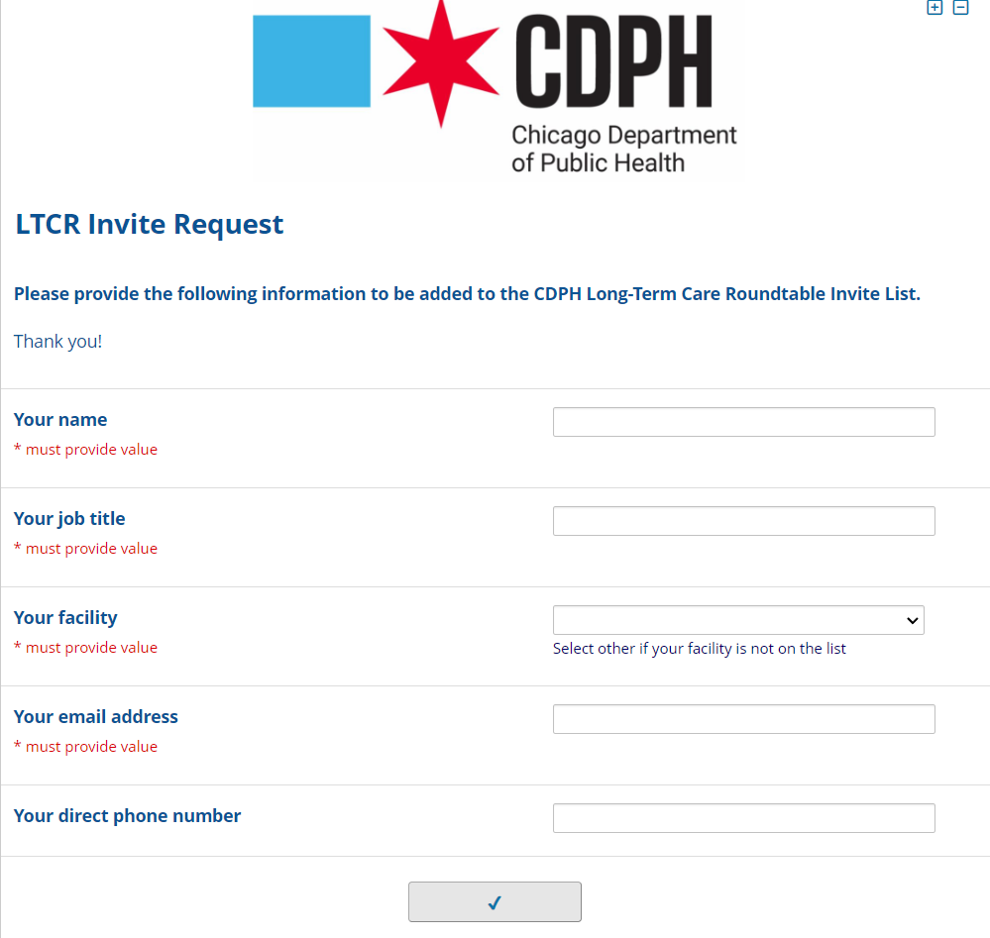
LTCR Invite Request Form
Next roundtable August 24
If you do not receive calendar invitations to the roundtable webinars and/or have a new staff member that you would like to attend, please complete this brief survey
Notes:
Before this slide, put Gus and then Mark slides

Slide 47
Questions & Answers
For additional resources and upcoming events, please visit the CDPH LTCF HAN page at: https://www.chicagohan.org/covid-19/LTCF

