Slide 1
COVID-19 and HAI Updates and Q&A Webinars for Long-Term Care and Congregate Residential Settings
December 9th, 2022

Slide 2
Housekeeping
All attendees in listen-only mode
Submit questions via Q&A pod to All Panelists
Slides and recording will be made available later

Slide 3
Agenda
Upcoming Webinars
Navigating Project Firstline
Project Firstline Landscape Assessment
COVID-19 Outbreak Testing: Strategies from the Updated Interim Guidance for Nursing Homes and other Licensed LTCFs
Civil Money Penalties for In-Person Visitation Aids
COVID-19 Therapeutics and Influenza Testing
Open Q & A
Slides and recording will be made available after the session.

Slide 4
Upcoming Infection Prevention and Control Updates
1:00 pm - 2:00 pm
​
Date | Infection Control Topic | Registration Link
Friday, December 16th | CAUTI/CLABSI | https://illinois.webex.com/illinois/onstage/g.php?MTID=e00594f71075334ee88516dec33c0042c
Notes:
Add – NEED TO BE REGISTERED TO Receive CE, if watching as part of a group recommend registering separately anyway so that you can receive credit
Deadline for Survey
Separate Slide in the beginning

Slide 5
Navigating Project Firstline

Slide 6
Project Firstline
Listens to healthcare workers
Appreciates the value of every healthcare worker
Recognizes that bandwidth is low due to burnout and trauma
Meets healthcare workers where they are

Slide 7
CDC’s Project Firstline
Interactive Resources
Videos and Social Media Graphics
Print Materials and Job Aids
Training Toolkits

Slide 8
https://www.cdc.gov/infectioncontrol/projectfirstline/index.html

Slide 9
https://www.cdc.gov/infectioncontrol/projectfirstline/healthcare/educational-materials.html

Slide 10
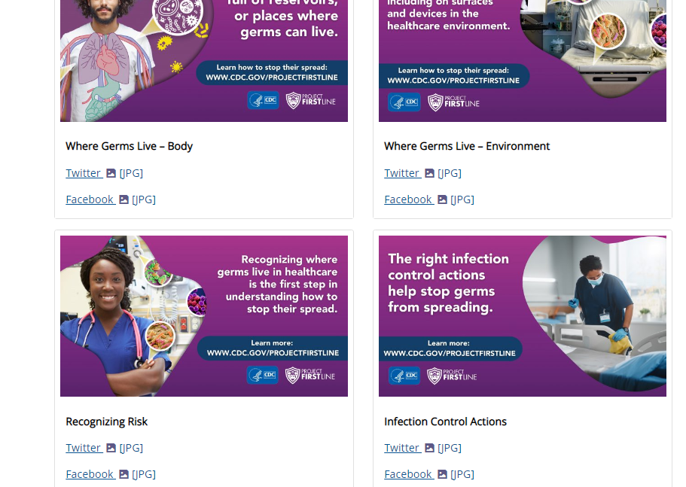
Videos and Social Media
https://www.cdc.gov/infectioncontrol/projectfirstline/healthcare/videos-graphics.html
https://www.cdc.gov/infectioncontrol/projectfirstline/resources/videos.html

Slide 11
https://www.cdc.gov/infectioncontrol/projectfirstline/healthcare/educational-materials.html

Slide 12
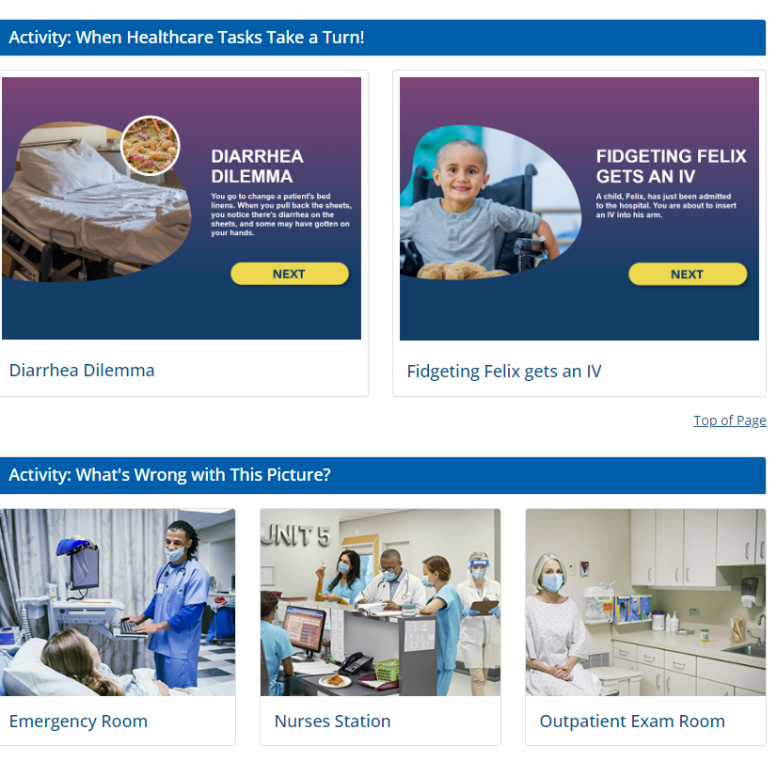
Interactive Resources
https://www.cdc.gov/infectioncontrol/projectfirstline/healthcare/interactive.html

Slide 13
https://www.cdc.gov/infectioncontrol/projectfirstline/healthcare/educational-materials.html

Slide 14
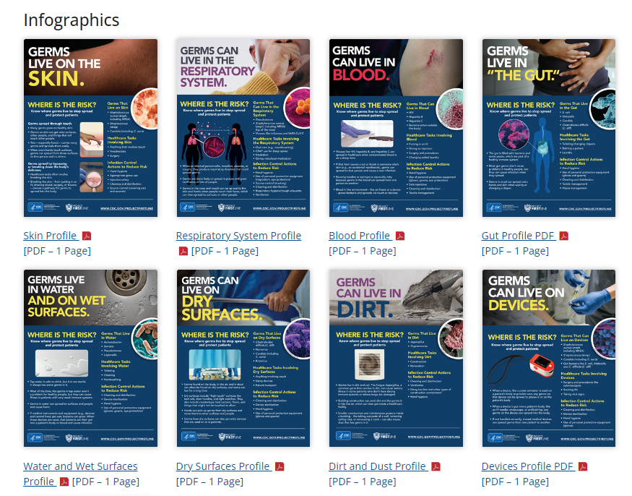
Print Materials and Job Aids
https://www.cdc.gov/infectioncontrol/projectfirstline/healthcare/print.html

Slide 15
https://www.cdc.gov/infectioncontrol/projectfirstline/healthcare/educational-materials.html

Slide 16
General Infection Control Training Toolkits

Slide 17
https://www.youtube.com/watch?v=DTaelg1Ogb0&feature=youtu.be

Slide 18
https://www.cdc.gov/infectioncontrol/projectfirstline/index.html

Slide 19
https://www.cdc.gov/infectioncontrol/projectfirstline/resources.html

Slide 20
https://www.cdc.gov/infectioncontrol/projectfirstline/resources/videos.html

Slide 21
https://www.cdc.gov/infectioncontrol/projectfirstline/resources/videos.html

Slide 22
https://www.cdc.gov/infectioncontrol/projectfirstline/resources.html

Slide 23
COVID-19 Training Toolkits
https://www.cdc.gov/infectioncontrol/projectfirstline/resources/facilitator-toolkit.html

Slide 24
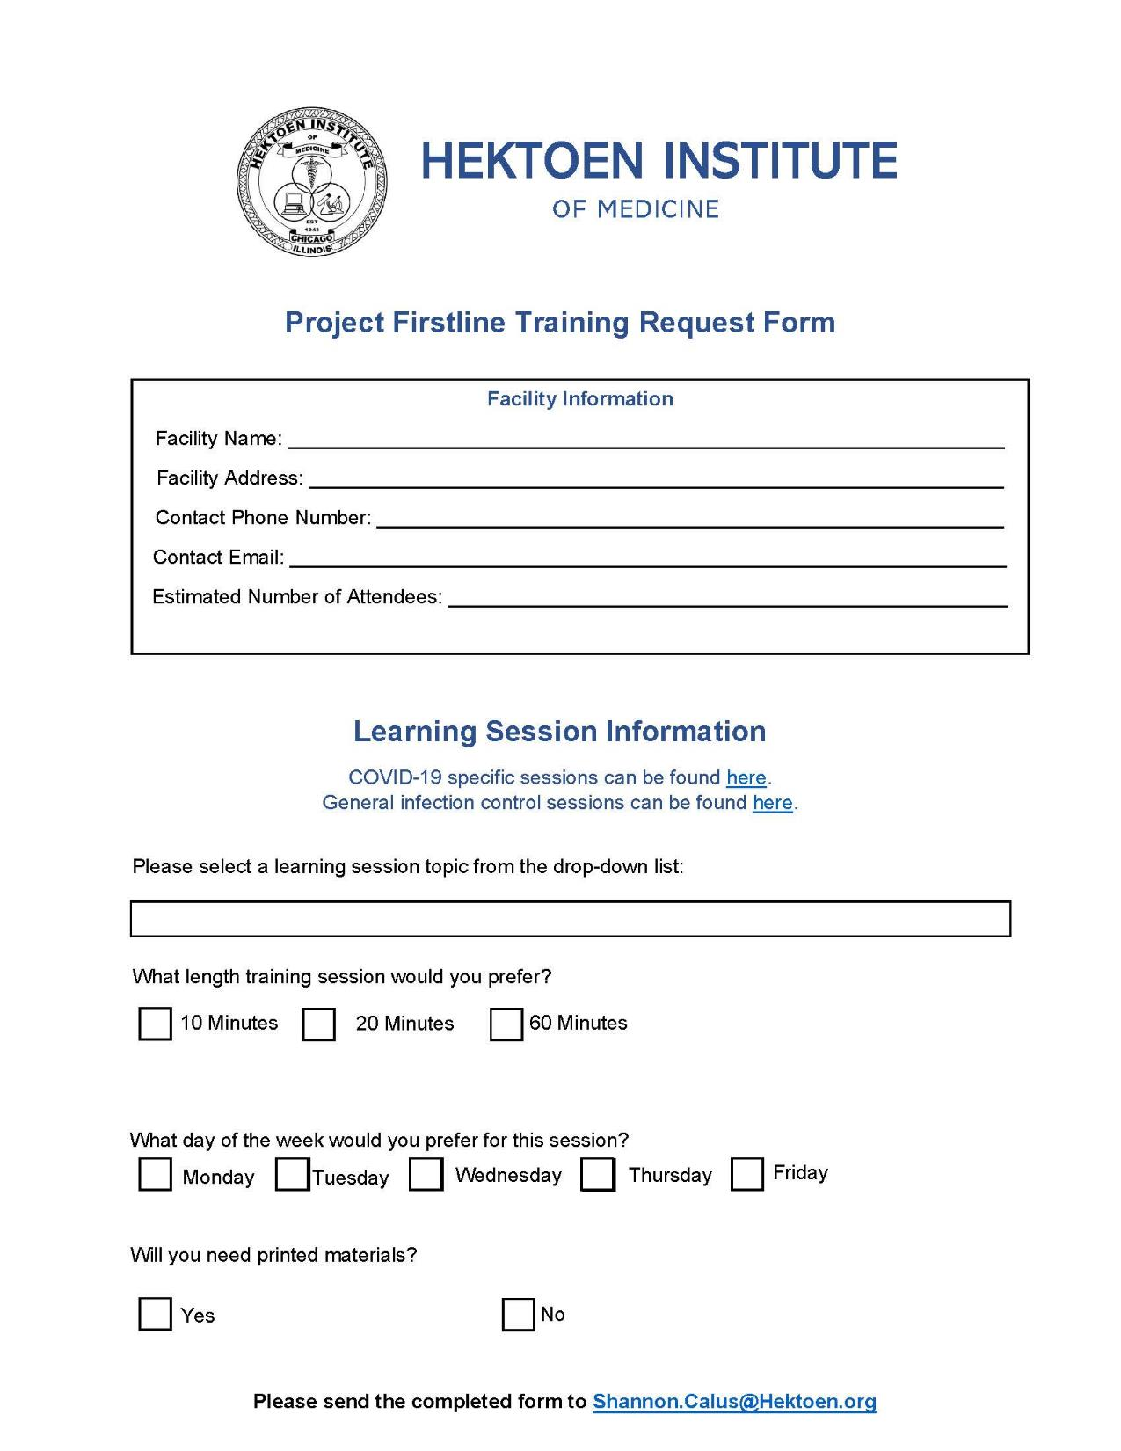
Hektoen’s Project Firstline Program
You pick the lesson!
Project Firstline offers COVID-19 specific & general infection control curriculum
Request a Project Firstline training by completing a PFL request form
Request form included on attendee flash drives
Send to Shannon.Calus@Hektoen.org
Hektoen will provide an instructor and all required materials

Slide 25
Free!!! Non-regulatory!!! Infection Control Assessment and Response (ICAR)!

Slide 26
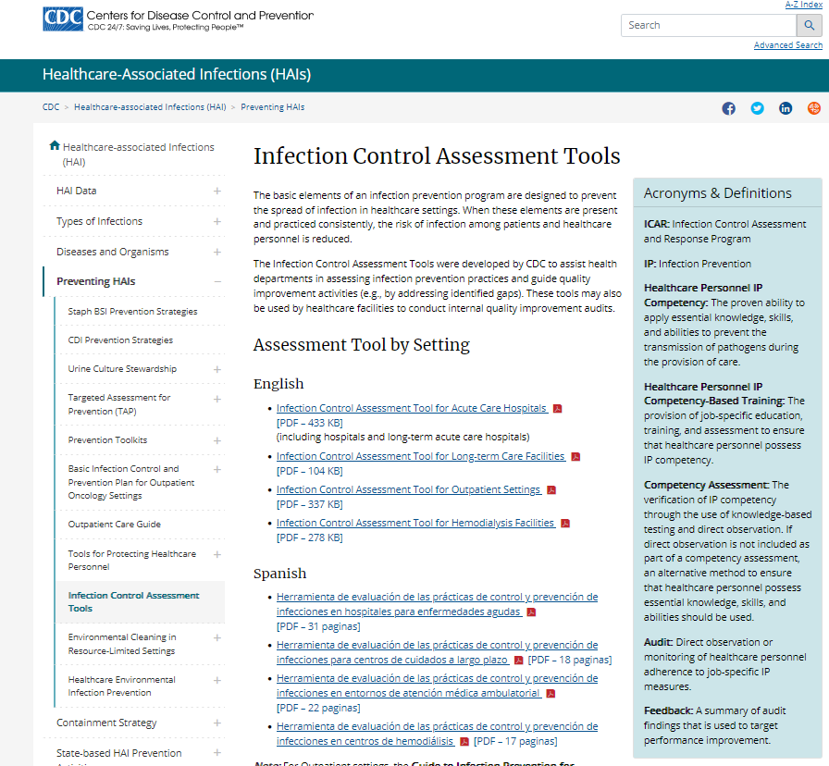
Comprehensive Infection Control Assessment and Response (ICAR)
Newer versions of the original ICAR
Looks at the entire infection prevention and control program
Consultation free of charge, non-regulatory and interdisciplinary
Contact Shannon.calus@hektoen.org

Slide 27
Project Firstline’s Illinois Landscape Assessment Results
Jessica Ledesma MEd MPH
Notes:
tagline to reflect the value of public health

Slide 28
What is Project Firstline?
Empowering
Core Training
Practical Tools
Immersive
Engagement
Mentorship
Lasting
Public Health Capacity
Innovation
Diverse collaborative designed to provide engaging, innovative, and effective infection control training to more than 6 million healthcare personnel (HCP) in the United States
Notes:
Project Firstline is an infection prevention and control training initiative started by the CDC in response to what they were seeing on the ground while visiting facilities battling COVID-19. As we all know, proper infection control protocols are crucial to limiting the spread of COVID-19, especially among the already vulnerable populations often found in healthcare settings. Unfortunately, the pandemic really brought to light a lot of fundamental knowledge gaps about infection control among the frontline healthcare personnel. These knowledge gaps lead to lapses in infection control that put both healthcare personnel and patients at risk. In response, CDC created Project Firstline, a diverse collaborative designed to provide engaging, innovative, and effective infection control training to more than 6 million HCP in the US.
This program is designed to empower healthcare personnel, who may have never received a training specific for infection control to understand the basics of how microbes are spread and what they can do to stop transmission. The education will immerse HCP in a culture of infection control to have a lasting effect on healthcare as a whole. Lets watch a short promotional video

Slide 29
Who is Project Firstline for?
All HCP in all settings:
Hospitals
Outpatient clinics
Dialysis centers
Nursing homes
For all education levels
Notes:
What makes project first line stand out amongst other infection control training is that it is truly designed to be for everyone, regardless of your level of education. This curriculum focuses on breaking down the basics of infection prevention in a very general way so that HCP from all settings can understand the reasoning behind the practices and then apply it to their own daily life, both at work and at home.

Slide 30
IDPH Role in Project Firstline
Distribute Learning Needs Assessment
Promote Project Firstline Curriculum
Track Participation
Evaluate Impact
Prevent Further Spread of infection
Notes:
CDC has reached out to state health departments across the country to assist with making project Firstline a success. One of the first things they asked each state health department to do was to conduct a learning needs assessment to determine what specific infection control gaps are present in each state and in all healthcare positions. We will talk more about our learning needs assessment in the next slide. CDC also asks that each state promote the project Firstline curriculum, promote understanding of local HAI/AR threats in our various jurisdictions to prevent further spread of infection, which we plan on doing by making HAI/AR data more accessible to LHDs, and finally to track participation throughout the state. Finally, IDPH will assist CDC with evaluating the impact of the program in Illinois.

Slide 31
Project Firstline Curriculum
Project Firstline curriculum is expanding everyday
Results of LNA are incorporated
IDPH will offer a variety of IC training to supplement curriculum:
In-person
Self-paced/on demand
Team based
Webinars
This Photo by Unknown Author is licensed under CC BY-NC
Notes:
The Project Firstline program and curriculum continues to evolve, and new materials are continuously being added. As the project grows and CDC continues to hear the feedback from partners, the curriculum will be tailored to address the learning needs of the HCP that responded to the learning needs assessment and participate in PFL office hours and state workgroups.
In addition to the curriculum provided by CDC, and as stated before, IDPH will also take the results of the learning needs assessment to inform our training initiatives to supplement the CDC curriculum.

Slide 32
Illinois Landscape Assessment
Purpose:
Learn IPC training initiatives currently being carried out in Illinois
Identify opportunities to better support healthcare worker IPC training
Develop a resource directory
Completed via REDCap
Approximately 10-15 minutes
Open for 15 days
Only 1 survey should be completed per organization.
Notes:
Another way to inform our training initiatives is to identify key infection prevention and
control (IPC) training initiatives currently being carried out in Illinois.
This information will be used to (1) Learn what IPC training initiatives currently being carried out in Illinois
Identify (2) opportunities to better support healthcare worker Infection Prevention and Control training and (2) develop a resource directory of project Firstline activities in Illinois.

Slide 33
Who responded to our survey?
19 Local Health Departments
Medical practice group
Hospital
LTAC hospital
Rehab center
Professional organization
2 assisted living facilities
Notes:
We had a total of 29 completed surveys
19 of which were local health departments, and the rest were comprised of
A Medical practice group
Hospital
LTAC hospital
Rehab center
Professional organization AND
2 assisted living facilities

Slide 34
Does your organization plan to promote or host Project Firstline trainings?
Notes:
We began by asking them if they planned to promote PFL trainings.
7 organizations responded: that Yes, we have already started
3 Responded they will start in the next 6 months
and 19 do not have any current plans to host Project Firstline trainings.

Slide 35
Briefly describe your organization’s Project Firstline plans or activities
We participate in Project Firstline trainings for our staff and encourage long term care facilities to attend trainings when possible.
We organized a team of COVID-19 investigators who specialize in long-term care facility outbreaks.
Funded by national AAP for past two years to do trainings and promote on our social media
Discuss with every LTCF ICAR and provide link for access.
We attend the Project Firstline zoom series
Notes:
Of those that answered yes, we asked them to describe their current activities or plans:
These include:
-participating in PFL trainings and encouraging LTC facilities to do the same
-organizing covid investigators who specialize in LTCF outbreaks
-Promote PFL on social media
-Provide links for access and attend PFL zoom series
--------------------------------------------------------------------------
Our activities to date include: 1. Conducted a PFL Learning Needs Assessment among various healthcare facility types and professional roles across the City of Chicago We received responses from 410 healthcare providers. We subsequently compiled the learnings and used them to inform the development of two PFL webinar series (April-June 2022 and September - October 2022). Happy to share the report if you would like. 2. Conducted an 8-part PFL Infection Prevention Essentials Spring Webinar series which kicked off in mid-April 2022 and commenced in early June. This webinar series consisted of live interactive webinar sessions with facilitated breakout sessions using the PFL core curriculum training materials and videos. Topics included the concept of infection control, environmental cleaning and disinfection, how respiratory droplets spread, source control, how COVID-19 spreads, ventilation, asymptomatic spread of COVID-19, and outbreak management. A total of 726 individuals attended across all sessions. These individuals consisted of frontline healthcare providers from various settings including acute care hospitals, nursing homes, LTACHs, outpatient clinics, dialysis centers, home health agencies, SNFs and LHDs (to name a few). Recordings to the the spring webinars are posted to the CDPH webpage at https://www.youtube.com/playlist?list=PL1en-Rg_ete_ujx0EX5mniEA816oKek_5 3. Between June and September, we distributed a total of 11 PFL newsletters highlighting the various topics and resources addressed during the spring PFL webinar series. These communications were distributed on a weekly basis, reaching a total of 862 frontline healthcare workers across the City of Chicago. 3. Beginning in early September 2022, we launched our 7-part PFL Infection Prevention Essentials Fall Webinar series which will commence at the end of October. This webinar series consists of live interactive webinar sessions with facilitated breakout sessions using the newly released PFL "Recognizing Infection Risks in Healthcare" training materials and videos. Topics include the concept of infection control, risk recognition in healthcare, how germs make people sick, recognizing risk using reservoirs, where germs live - body reservoirs, and where germs live - healthcare environment reservoirs. Additionally, as part of this fall PFL series, we worked with CDPH to develop a special CDC-approved "Monkeypox Virus Infection Control Basics" on September 27. To date, we have held 3/7 webinars with a total of 361 individuals in attendance across these 3 sessions. These individuals consisted of frontline healthcare providers from various settings including acute care hospitals, nursing homes, LTACHs, outpatient clinics, dialysis centers, home health agencies, SNFs and LHDs (to name a few). Recordings to the fall webinars will be posted to the CDPH webpage listed above.

Slide 36
Briefly describe your organization’s Project Firstline plans or activities
We currently have a contract with the Chicago Department of Public Health to administer the Project Firstline trainings and curriculum on behalf of frontline healthcare workers in the City of Chicago
Another group was funded by the national AAP for past two years to do trainings and promote on our social media
To educate and promote the importance of infection control in LTC setting and reduce rate of transmission.
Notes:
Of those that answered yes, we asked them to describe their current activities or plans:
Our activities to date include: 1. Conducted a PFL Learning Needs Assessment among various healthcare facility types and professional roles across the City.
AND then compiled the learnings and used them to inform the development of two PFL webinar series.
Another group was funded by national American Academy of Pediatrics for past two years to conduct trainings and promote PFL on their social media

Slide 37
Project Firstline has three main intentions, which intention is your organization targeting?
Notes:
10 Empowerment - incorporates Core Training and Practical Tools
7 Lasting results - addresses Public Health Capacity and Science to Practice
Collaboration - focuses on Partner Engagement and Mentorship

Slide 38
What setting is your organization’s Project Firstline activities serving/targeting?
Notes:
Top 3 responses were
LTC skilled nursing facilities
LTCF other and
Acute care hospitals respectively

Slide 39
What setting is your organization’s Project Firstline activities serving/targeting?
Assisted living facilities, home health agencies, hospice providers, local health department staff, mental/behavioral health facilities, laboratories, EMS providers, pharmacies, and FQHCs.
Pediatricians
Initially focused on SNFs, will expand to: SMHRF, Group Homes, Assisted Living, Memory Care, Shelters
Notes:
Other setting that were not captured by the last question include (pfl_settings_other)
Assisted living facilities, home health agencies,
hospice providers, local health department staff,
mental/behavioral health facilities, laboratories,
EMS providers, pharmacies, and Federally Qualified Health Center (FQHC).
Pediatricians
Initially focused on SNFs, will expand to: Specialized Mental Health Rehabilitation Facilities (SMHRF), Group Homes, Assisted Living, Memory Care, Shelters

Slide 40
What groups of workers is your organization targeting through its Project Firstline activities?
Options included:
Administrators
Environmental Service Workers
Nurses
Nursing Assistants
Physician Assistants
Prescribers (Physicians, Advance Practice Nurses)
Other (please specify)
Notes:
None of the respondents answered this question. I don’t know what it means and I only mention it because I find it interesting

Slide 41
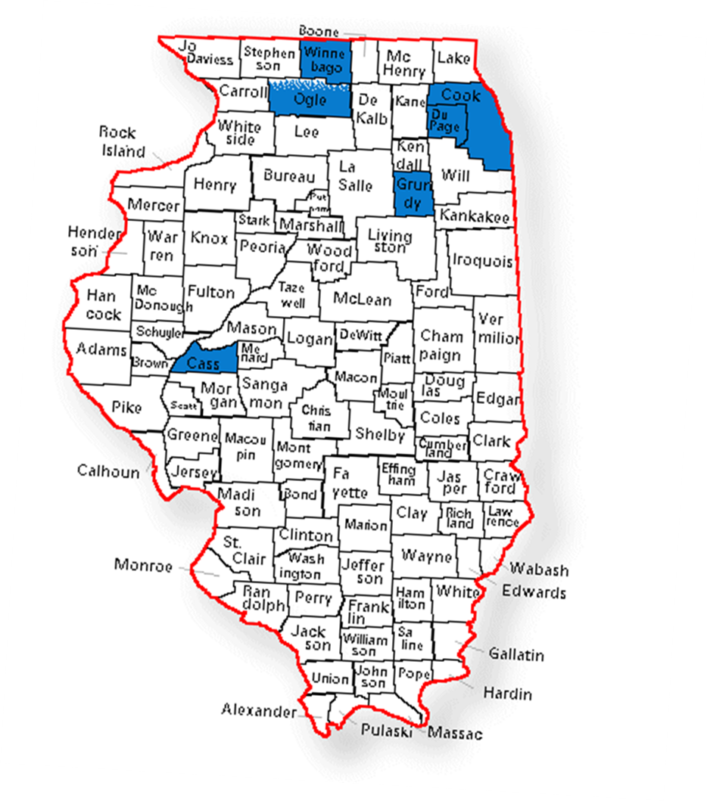
Geographic Locations
Notes:
Primary Geographic Locations where the organizations are targeting their efforts for their PFL activities.
As we can see we have only one are that is not focusing in the northern Illinois area and that is Cass County

Slide 42
Will your organization collect data or review data collected by others?
Notes:
As part of your organization's Project Firstline efforts, will your organization collect data or review data collected by others?
We had 7 respondents indicating they will either collect data or review data collected by others.
Some will be collecting data multiple categories, looks like we have an even distribution of data collected across the 3 categories.

Slide 43
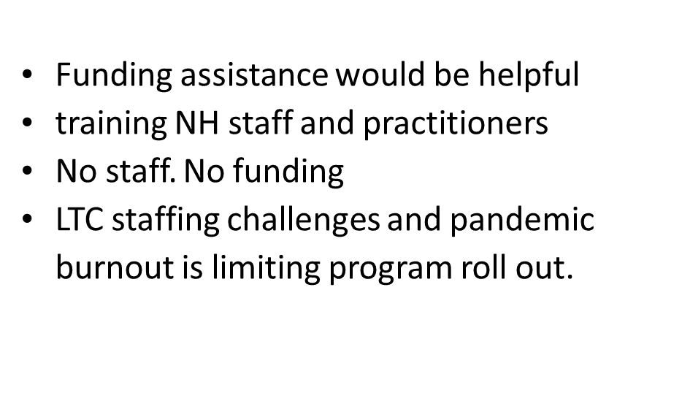
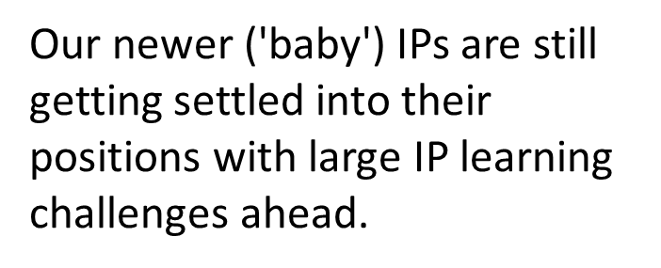
Please identify any challenges your organization has identified associated with utilizing or promoting Project Firstline

Slide 44
Other initiatives your organization is implementing
Notes:
Other_ipc
Other initiatives your organization is implementing related to building healthcare worker knowledge and skills for infection prevention and control.

Slide 45
Notes:
(other_orgs_pfl)
All but 2 responses indicated they were NOT aware of any groups

Slide 46
Summary/Next Steps
Interested in Data
Receptive to training
Engage with LHD
Notes:
What would you say are the most important points for moving forward?
The key take aways at this point are knowing where current Project Firstline trainings are being conducted.
Understanding that we have an interest
And NEXT we’ll meet with LHD who received NACCHO the National Association of County and City Health Officials
Funding, through the grant entitled BLOC COVID-19+ to go beyond COVID-19 response and address other HAIs and AR pathogens.
To promote PFL in their counties.

Slide 47
THANK YOU
jessica.ledesma@illinois.gov
IDPH DPSQ website
Notes:
Thank you for your time and attention.
I’ve included my email for questions as well as our division of patient safety and quality website linked here.

Slide 48
COVID-19 Outbreak Testing:
12/09/2022
Strategies from the Updated Interim Guidance for Nursing Homes and other Licensed LTCFs
Thomas C. Roome, MPH, EMT,
IDPH Regional Infection Prevention Specialist,
Office of Policy, Planning, and Statistics,
Division of Patient Safety and Quality,
Tom.Roome@Illinois.gov

Slide 49
Trigger for Action: Outbreak
Trigger for outbreak investigation:
“A new facility-associated case of COVID-19 infection in any healthcare personnel (HCP) or any nursing home-onset COVID-19 infection in a resident.”
Facility-Associated is defined as:
For residents: “a COVID-19 case that originated in the facility; a COVID-19 case with a confirmed diagnosis 14 days or more after admission for a non-COVID condition, without an exposure during the previous 14 days to another setting where an outbreak was known or suspected to be occurring.”
For staff: “ a COVID-19 case in an individual (staff member) who worked at the facility for any length of time two calendar days before the onset of symptoms (for a symptomatic person) or two calendar days before the positive sample was obtained (for an asymptomatic person) until the day that the positive staff member was excluded from work.”

Slide 50
Outbreak Testing Approaches
There are two approaches you can choose from:
Contact-tracing approach
Broad approach
The contact tracing approach involves identifying and testing all the close contacts of an initial case.
The broad approach involves testing all residents and staff [on a unit, floor, or even the whole building] based on the areas involved.

Slide 51
Contact Tracing Approach
When to use the Contract Tracing Approach:
When you can identify all the close contacts of your initial case.
When you don’t have any cases that contact tracing can’t account for.
When only one unit/floor/area is involved.
Identify all the close contacts of the initial case/cases.
Test close contacts on days 1, 3, and 5 after exposure.
If these contacts are negative on all 3 tests, and no other cases are identified, no further testing is needed.
Close contacts at high risk of developing COVID-19 should be quarantined.

Slide 52
Broad Approach
The broad approach involves testing everyone [in the affected area] every 3-7 days until no new cases are identified for 14 days.
This doesn’t necessarily mean testing the whole facility;
If there are cases on two units on the same floor, but no cases on other floors, you might choose to just test that floor.
Or if you can’t identify all contacts on a unit, you could only test that unit.
However, if you have cases on multiple units, cases you can’t account for, or mitigation efforts aren’t effective; consider testing the whole facility.

Slide 53
Deciding on an Approach
Consider a broad approach:
If you CAN’T contact trace (unable to identify all contacts)
There are exposures across several units.
If you have new cases that contact tracing can’t account for OR
You have new cases appear on other units
These indicate the outbreak is more widespread
If you’ve chosen not to quarantine close contacts and they test positive, then a broad approach may be best.

Slide 54
Other Considerations
Remember: vaccination status no longer affects how or who we test.
The outbreak testing approach may need to change during a single outbreak.
Those who have recovered from COVID within 30 days do not need to be tested.
For those who have recovered 31-90 days ago, you may consider testing them using an antigen test (not PCR).
PCR may detect genetic material after there is no longer replication-competent virus present.

Slide 55
Example № 1:
Your facility identifies a staff member who has COVID-19. There were 4 residents exposed, all on the same unit. What approach should you take?
Contact tracing
These contacts are tested on days 1, 3, & 5. Per the guidance, you elect not to quarantine the close contacts. On day 3, one of the residents tests positive. Should you stick with contact tracing or change to a broad approach?
Broad based approach.
While looking into what areas to include in testing, you realize that the resident who tested positive took part in communal dining and group activities with residents from all other units. Where should you test?
It may be wise to test the whole facility at this point.

Slide 56
Example № 2:
A resident develops COVID-19 after a trip (<24h) to visit family. You identify all their close contacts, and they are on the same unit. Which approach would be best?
Contact tracing
There are 4 close contacts on the unit, you test them on days 1, 3, & 5. all 4 contacts test negative on all tests. What would you do now?
You don’t need to do any further outbreak testing right now!
Close contacts should still mask for a full 10 days.
Then, 2 days after the last exposure tested negative on their 3rd test, a resident who was NOT identified as a close contact develops symptoms, and tests positive. What would you do now?
You should switch to a broad approach.

Slide 57
Example № 3:
A staff member becomes positive and is put on work restriction. You identify all contacts; 3 staff were exposed but no residents. The staff all work on different units. What approach would you take?
Contact tracing
All exposed staff members are asymptomatic. How would you manage these staff members?
They would be tested on days 1, 3, & 5
If one of the staff members recovered from COVID ≥ 31 days ago, do they need to be tested?
No, but you can if you feel it’s a good idea
You choose to test them; what kind of test would you use?
An antigen test; PCR/NAAT could yield false positives in such situations.

Slide 58
Thank You
If you have further questions, please reach out to your local health department or our team.

Slide 59
Civil Money Penalties for In-Person Visitation Aids
Mary Alice Lavin

Slide 60
Civil Money Penalty Reinvestment Funds
Centers for Medicare & Medicaid Services (CMS) developed an application process to use the Civil Money Penalty (CMP) Reinvestment funds for in-person visitation aids.
Up to $3000.00 can be used for in-person outdoor visitation aids.
Can include the cost of installation, installation materials, and shipping costs.
For expenses after QSO 20-39-NH (September 17, 2020).
Up to $3000.00 can be used for in-person visitation aids to improve indoor air quality.
Can include the cost of portable fans, air cleaners with H-13 or H-14 filters, and shipping costs.
For expenses after QSO 20-39-NH FAQ Revised (February 2, 2022).

Slide 61
CMP Application Process
COVID-19 In-Person Visitation Aid Application Template
Required elements:
Name of facility and CMS Certification Number (CCN)
Number of certified beds
Types of visitation aids
Cost per visitation aid
Total number of visitation aids requested
Total funds requested.
Application FAQ and application template sent with webinar slides
Questions: dph.hcr.cmpgrant@illinois.gov

Slide 62
IDPH LTC Q & A COVID-19 Therapeutics and Influenza Testing
Catherine A. Counard, MD, MPH
State Medical Officer/ODC
12/09/22

Slide 63
LTC COVID-19 Hospitalizations

Slide 64
LTC COVID-19 hospitalizations July – October 2022
Data as for July-October, 2022
During this time period there were 348 LTC COVID-19 Deaths
236
13
201
8
127
136
4
7
July
August
September
October
Resident
Employee
Source: INEDSS

Slide 65
COVID-19 Treatment Update

Slide 66
On Wednesday, November 30, 2022, the FDA announced:
Bebtelovimab is not authorized for emergency use in the U.S. because it is not expected to neutralize Omicron subvariants BQ.1 and BQ.1.1,
These sub–variants are the majority of all circulating SARS–CoV–2 viruses.
Bebtelovimab Health Care Provider Fact Sheet 11042022 (fda.gov)

Slide 67
https://www.covid19treatmentguidelines.nih.gov/tables/management-of-nonhospitalized-adults-summary/

Slide 68
https://aspr.hhs.gov/COVID-19/Therapeutics/Documents/COVID-Therapeutics-Decision-Aid.pdf

Slide 69
Influenza Testing

Slide 71
Influenza Testing Recommendations
If influenza is suspected in any resident, influenza testing should be performed promptly.
LTC facilities should develop a plan for collecting respiratory specimens and performing influenza testing when influenza is suspected in a resident (e.g., RT-PCR, and rapid molecular or nucleic acid based diagnostic test)
LTC facilities should work with their laboratory providers to identify a facility that can perform influenza testing.
For more information regarding influenza testing, please visit Information for Clinicians on Influenza Virus Testing | CDC.

Slide 72
Influenza Testing During Outbreaks
If your facility is experiencing an outbreak, institute the facility’s plan for collection and handling of specimens to identify influenza virus as the causal agent early in the outbreak (within one to two days of symptom onset)
Perform rapid influenza virus testing of multiple residents with recent onset of symptoms suggestive of influenza.
If your facility has a CLIA waiver for COVID-19 testing, that will apply to rapid flu tests as well.
Rapid antigen tests are not as sensitive in detecting influenza and a negative test may warrant confirmation with PCR/NAAT testing.

Slide 73
Outbreak Samples For IDPH Lab
If possible, a few RT-PCR samples from any LTC influenza outbreak should be sent to the IDPH laboratory to determine the influenza virus type and subtype.
The IDPH laboratory does not perform routine diagnostic testing for influenza.
For collection, shipping, and submission details, please contact your LHD.

Slide 74
COVID-19 testing and Respiratory Viral Panels (RVP) during outbreaks
When SARS-CoV-2 and influenza are found to be co-circulating, test any resident with symptoms of COVID-19 or influenza for both viruses.
A positive influenza test result without SARS-CoV-2 testing does not exclude SARS-CoV-2 infection, and a positive SARS-CoV-2 test result without influenza testing does not exclude influenza virus infection.
Respiratory viral panels (RVP) are used to determine the cause of respiratory illness when influenza and COVID-19 are either not suspected or have been ruled out, when there are concerns about co-infection, or when multiple viruses are circulating.

Slide 75
Open Q&A
Submit questions via Q&A pod to All Panelists
Please do not resubmit a single question multiple times
Slides and recording will be made available after the session.

Slide 76
Reminders
SIREN Registration
To receive situational awareness from IDPH, please use this link to guide you to the correct registration instructions for your public health related classification: http://www.dph.illinois.gov/siren
NHSN Assistance:
Contact Telligen: nursinghome@telligen.com­

