Slide 1
COVID-19 and HAI Updates and Q&A Webinars for Long-Term Care and Congregate Residential Settings
October 14th, 2022

Slide 2
Housekeeping
All attendees in listen-only mode
Submit questions via Q&A pod to All Panelists
Slides and recording will be made available later
For continuing education credit, complete evaluation at https://redcap.dph.illinois.gov/surveys/?s=LJKK339YHJTCNW8P by October 28th, 2022
Credit only available for the live session
Must be registered individually to receive credit

Slide 3
Agenda
Upcoming Webinars
CDC & CMS Updates
Creating a Safe Environment of Care
Open Q & A
Slides and recording will be made available after the session.

Slide 4
Upcoming COVID-19 and Infection Prevention and Control Updates
1:00 pm - 2:00 pm
​
Date | Infection Control Topic | Registration Link
Friday, October 28th | MDROs: Lab Results, Interpretation, and Response | https://illinois.webex.com/illinois/onstage/g.php?MTID=e17814ed8fc09addc0adfdc28defb874b
Previously recorded webinars can be viewed on the IDPH Portal
Continued Education will be offered. It will only be for the live presentation. Please ensure when registering that your name and email are correctly spelled. To receive the continued education, you must complete a training survey, which will be provided with the link to the recording.
Notes:
Add – NEED TO BE REGISTERED TO Receive CE, if watching as part of a group recommend registering separately anyway so that you can receive credit
Deadline for Survey
Separate Slide in the beginning

Slide 5
Suggestions
Keep doing what you are doing for the time being
All of IDPH/Hektoen are working hard to make changes
Need to consider Executive Orders and Emergency Rules
Infection Preventionist work with your Interdisciplinary Team
Start to compare your existing policies and procedures with new CDC guidance and CMS rules

Slide 6
CDC Updates Infection Prevention and Control Guidance for U.S. Healthcare Settings
Interim Infection Prevention and Control Recommendations for Healthcare Personnel During the Coronavirus Disease 2019 (COVID-19) Pandemic
Updated Sept. 23, 2022
https://www.cdc.gov/coronavirus/2019-ncov/hcp/infection-control-recommendations.html
Interim Guidance for Managing Healthcare Personnel with SARS-CoV-2 Infection or Exposure to SARS-CoV-2
Updated Sept. 23, 2022
https://www.cdc.gov/coronavirus/2019-ncov/hcp/guidance-risk-assesment-hcp.html
Strategies to Mitigate Healthcare Personnel Staffing Shortages
Updated Sept. 23, 2022
https://www.cdc.gov/coronavirus/2019-ncov/hcp/mitigating-staff-shortages.html

Slide 7
CMS Updated Rules Sept 23, 2023
QSO-20-38-NH Interim Final Rule (IFC), CMS-3401-IFC, Additional Policy and Regulatory Revisions in Response to the COVID-19 Public Health Emergency related to Long-Term Care (LTC) Facility Testing Requirements
https://www.cms.gov/files/document/qso-20-38-nh-revised.pdf
QSO-20-39-NH Nursing Home Visitation - COVID-19 (REVISED)
https://www.cms.gov/files/document/qso-20-39-nh-revised.pdf
QSO-22-25-CLIA CMS Rescinds December 7, 2020, Enforcement Discretion for the Use of SARS-CoV-2 Tests on Asymptomatic Individuals Outside of the Test’s Instructions for Use
https://www.cms.gov/files/document/qso-22-25-clia.pdf

Slide 8
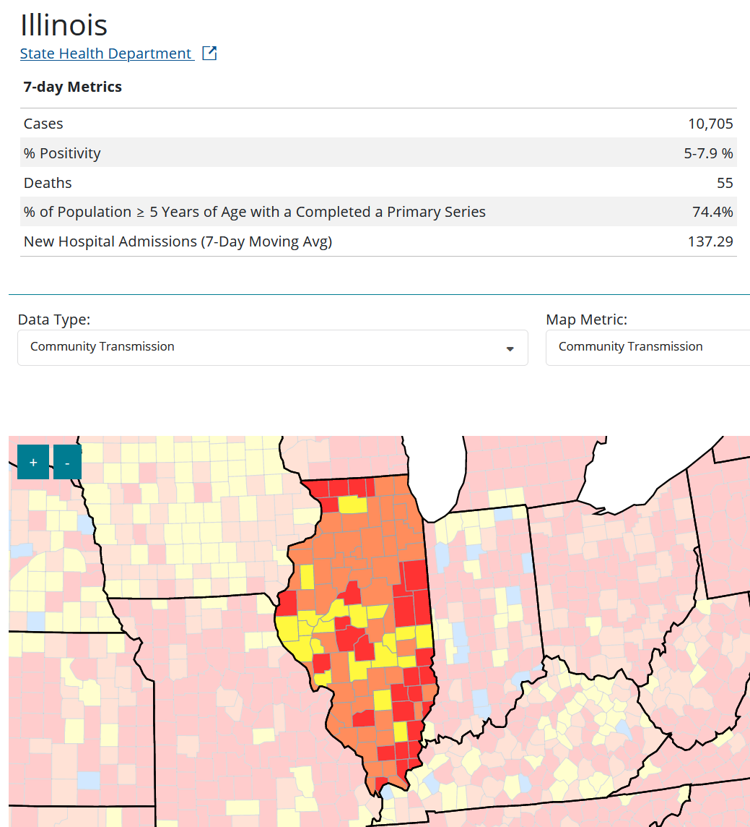
No Blue this week! Still over 10,000 cases 137 hospitalizations 55 deaths in Illinois 7 day moving average Not over yet… But getting better
https://covid.cdc.gov/covid-data-tracker/#county-view?list_select_state=Illinois&data-type=Risk

Slide 9
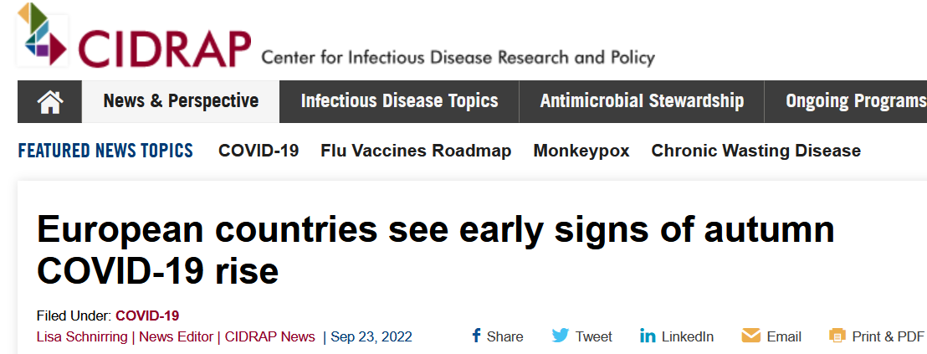
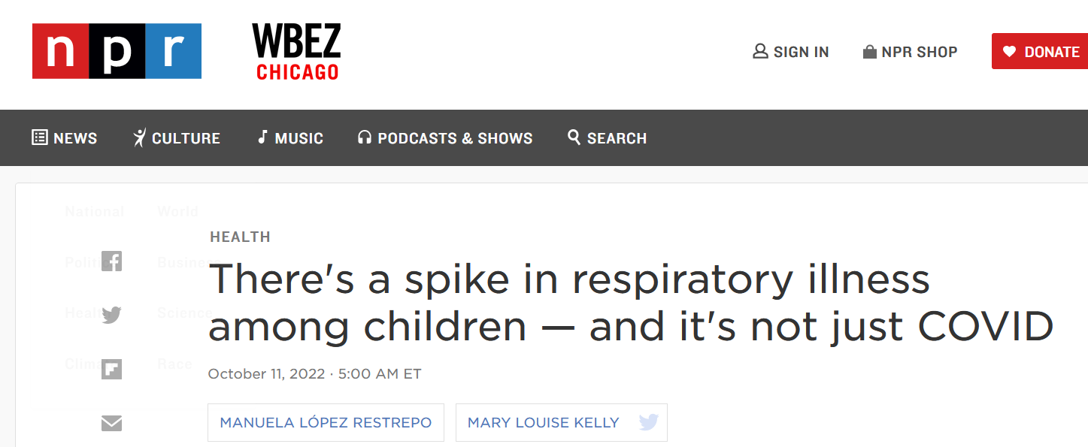
Will the Assisted Living Smartsheet be updated to report up to date vaccination status including bivalent boosters?
Working on adding a question on bivalent boosters to the Smartsheet soon
Bivalent vaccines have been shown to be very effective in preventing severe illness and hospitalizations
Reminder that cases are increasing
https://www.cidrap.umn.edu/news-perspective/2022/09/european-countries-see-early-signs-autumn-covid-19-rise
https://www.npr.org/2022/10/11/1127873967/respiratory-illness-covid-children-hospitalizations-health

Slide 10
Creating a Safe Environment of Care A Focus on Water
Mary Alice Lavin
October 14, 2022

Slide 11
Disclosure
Mary Alice Lavin has no relevant financial relationship(s) to disclose with ineligible companies whose primary business is producing, marketing, selling, re-selling, or distributing healthcare products used by or on patients.

Slide 12
Objectives
Recognize the risks water can pose in a healthcare setting.
Identify waterborne pathogens, the mechanisms of transmission, and the sources of exposure.
Apply risk mitigation and reduction measures to create a safe environment of care.

Slide 13
Why the Focus on Water?
Recent estimates indicate 7.15 million waterborne infections occur annually in the United States
Healthcare facilities have complex water systems
Complex water systems are at greater risk for harboring waterborne pathogens
Safe water is a part of preventing infection through a safe and sanitary environment
Risk for healthcare-associated waterborne infections
Emerg Infect Dis. 2021;27(1):140-149
https://www.cms.gov/Medicare/Provider-Enrollment-and-Certification/SurveyCertificationGenInfo/Downloads/Survey-and-Cert-Letter-17-30.pdf
https://www.ncbi.nlm.nih.gov/pmc/articles/PMC7883772/pdf/nihms-1669733.pdf
Notes:
You may be wondering why the focus on water?
Recent research by the Centers for Disease Control and Prevention estimates that more than 7 million waterborne infections occur annually in the United States. The work highlighted the increase in environmental pathogens in water distribution systems and systems such as cooling towers. It is important to note that not all of the infections were healthcare associated and many were acquired outside of the healthcare setting.
Healthcare facilities have complex water systems. The systems include a significant amount of piping, large hot water heaters, holding tanks as well as other system components, and in some cases hydrotherapy tanks. The more complex the water distribution system, the greater the risk is for waterborne pathogens.
Because of their age and/or underlying medical conditions, such as being a current or former smoker, requiring respiratory therapy, or feeding tubes, long term care facility residents are more vulnerable to infections including those caused by waterborne pathogens.
Safe water is one component of creating a safe and sanitary environment of care.
Investigators from the Centers for Disease Control and Prevention reviewed consultations conducted by their teams from 2014 through 2017 to determine how many of the investigations were related to waterborne pathogen transmission. They found that 21.6% of the investigations resulted in the potential for a waterborne healthcare associated infection. Keeping in mind that not every healthcare facility asks for help when they are investigating a potential waterborne related healthcare associated infection, the percent of waterborne related healthcare associated infections is likely higher.
Of the waterborne pathogens, only legionella is a nationally reportable disease. There are many other waterborne pathogens that may be equally important and that can cause infection and outbreaks.

Slide 14
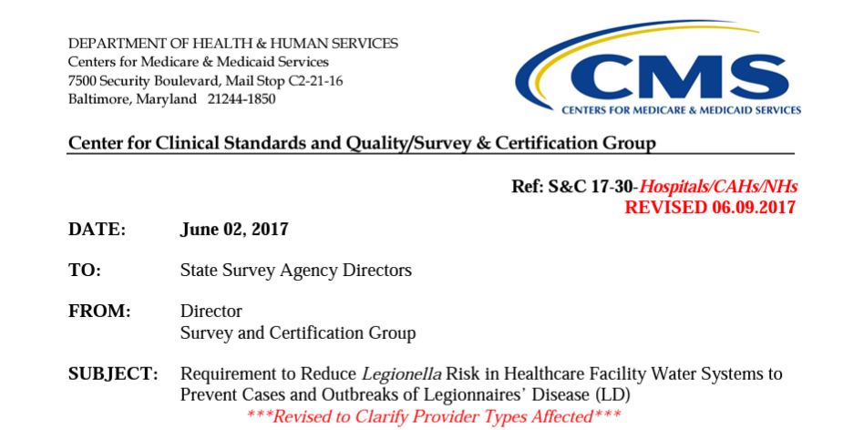
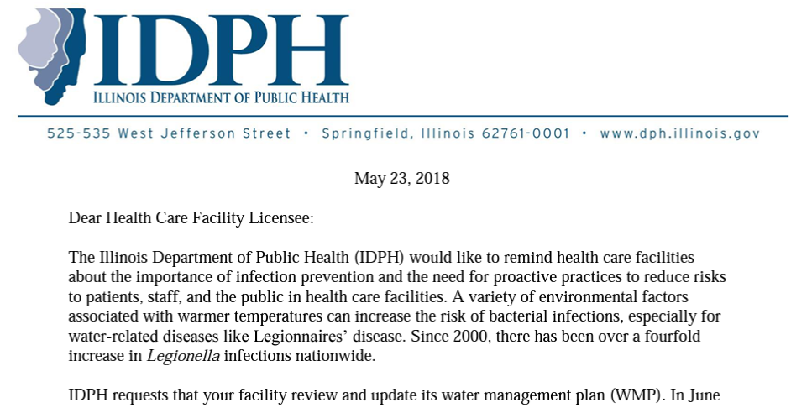
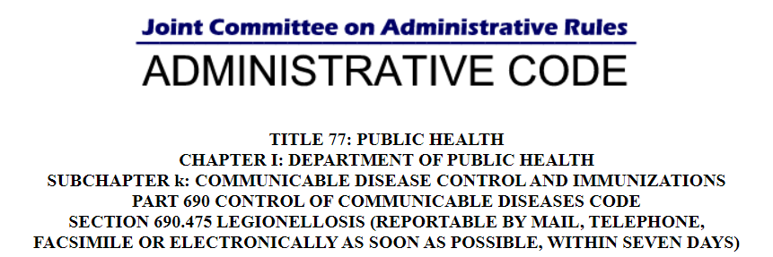
Regulatory Compliance
https://www.cms.gov/Medicare/Provider-Enrollment-and-Certification/SurveyCertificationGenInfo/Downloads/Survey-and-Cert-Letter-17-30.pdf
https://dph.illinois.gov/content/dam/soi/en/web/idph/files/publications/letter-hcfs-wmp-060618.pdf
https://www.ilga.gov/commission/jcar/admincode/077/077006900D04750R.html
Notes:
Here are some of the regulatory requirements related to legionella and water management plans.
The CMS Survey and Certification memo, now called Quality, Safety & Oversight, from June 2017 cites the Conditions of Participation at 42 CFR §483.80 for skilled nursing facilities and nursing facilities: “The facility must establish and maintain an infection prevention and control program designed to provide a safe, sanitary, and comfortable environment and to help prevent the development and transmission of communicable diseases and infections.”
The 2018 IDPH memo was to remind facilities that water management plans are required by CMS. There was also an IDPH Health Alert issued in July 2021 due to an increase in legionella cases in Illinois. There were concerns that buildings and systems that had not been occupied during the pandemic, where water might have been stagnant, might be contributing to the increase.
Legionella is reportable as soon as possible but within 7 days.

Slide 15
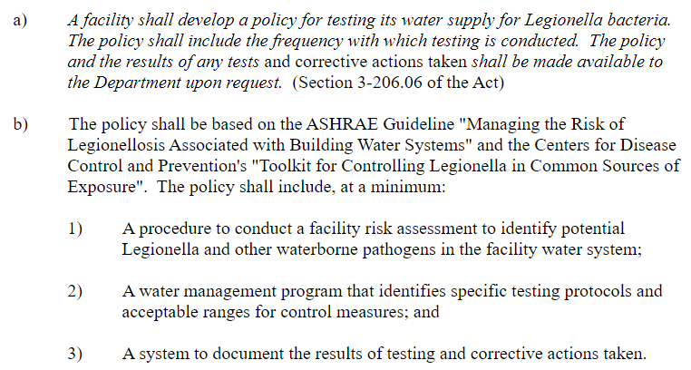
Regulatory Compliance
Section 300.700 Effective May 31, 2022
Section 330.792 Effective June 2, 2022
Section 340.1337 Effective June 2, 2022
Notes:
As of May and June of this year Sections 300, Skilled and Intermediate Care; 330, Sheltered Care; and 340, Illinois Veterans’ Homes all contain a requirement for testing the water supply for legionella. The regulation states that the facility policies should be based on the American Society of Heating, Refrigerating, and Air Conditioning Engineers or ASHRAE Guideline and the Centers for Disease Control and Prevention Toolkit for Controlling Legionella in Common Sources of Exposure.

Slide 16
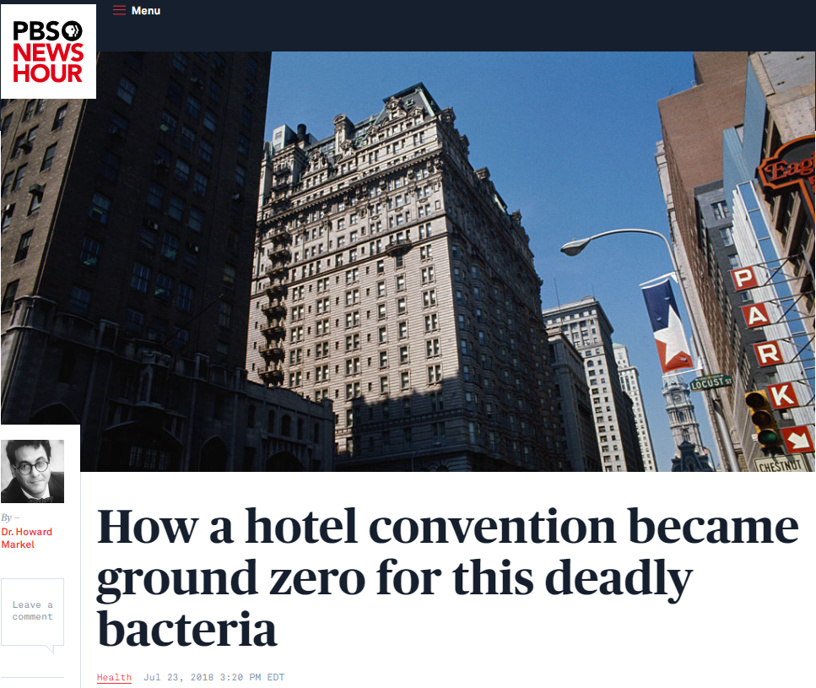
Waterborne Pathogens of Importance
Legionella pneumophila
Pseudomonas aeruginosa
Acinetobacter baumannii
Stenotrophomonas maltophilia
Nontuberculous mycobacteria
Elizabethkingia anophelis, Elizabethkingia meningosepticum
https://www.pbs.org/newshour/health/how-a-hotel-convention-became-ground-zero-for-this-deadly-bacteria
Notes:
These are some of the waterborne pathogens you may be familiar with. Legionella is likely the waterborne pathogen that has gotten the most press. There are many species and subgroups, but Legionella pneumophila is most often associated with diseases. It can cause Legionnaires Disease and Pontiac Fever. It became famous when it caused pneumonia in attendees at a Philadelphia convention of the American Legion in 1976 and the disease became known as Legionnaires Disease. This is a picture of the Bellevue Stratford Hotel where the convention was held in Philadelphia. It was later determined that eight years before, individuals working in Pontiac, Michigan had become less sick with the same bacteria. Hence the second illness, Pontiac Fever. Legionella has caused a rapidly increasing number of infections in the United States since 2000. It is important to note that legionella does not spread from person to person.
Pseudomonas aeruginosa is a gram-negative pathogen found in the environment including in water. It is often resistant to antibiotics commonly used to treat infection making it more difficult to treat. It can also cause pneumonia.
Acinetobacter baumannii can persist in the environment for up to five months and rarely causes infection in individuals in the community. It is primarily a healthcare-associated pathogen that can cause infection or colonization and is transmitted through surfaces and or reusable equipment that is not adequately or properly cleaned and disinfected.
Stenotrophomonas maltophilia is an environmental gram-negative pathogen primarily causing respiratory infections. It is particularly problematic as it is often multi-drug resistant. Among the many places it has been isolated, sink drains, ice machines, nebulizers, and water treatment and distribution systems are just a few. It can adhere to plastics and has the ability to form biofilms.
Nontuberculous mycobacteria or NTM, also known as environmental mycobacteria, are opportunistic pathogens. There are over 180 species. When cultured, some grew in 7 to 10 days and others take longer to grow needing more than 14 days.
Like many of the other waterborne pathogens Elizabethkingia anophelis can be found in the environment. However, unlike the other pathogens it infrequently causes disease. The Centers for Disease Control and Prevention report that fewer than five to ten cases occur per year per state. If this pathogen sounds familiar, it may be because there was a large outbreak in Wisconsin in 2016. Cases were also identified in Illinois and Michigan. The primary type of infection was bacteremia, but respiratory and joint infections also occurred. It was determined that the Illinois cases were not related to the Wisconsin cases. Reports from investigation of the Illinois cases suggested that there likely was ongoing sporadic infection in critically ill nursing home residents. In the Illinois cases, environmental samples matched some of the clinical samples.
So, how is this information relevant? Contamination from and exposure to water creates the risk for infection.

Slide 17
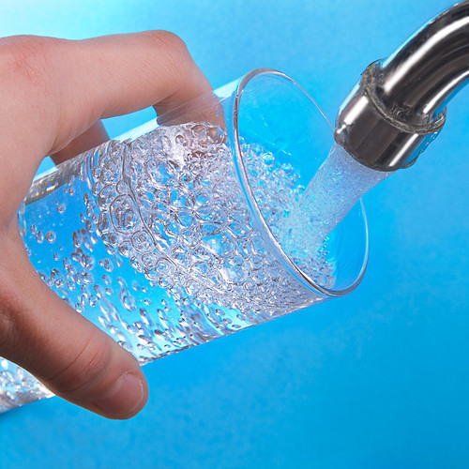
Sources of Exposure
Acceptable Uses of Tap Water
Imperfect Uses of Tap Water
Drinking
Handwashing
Cooking
Dishwashing
Flushing feeding tubes
Rinsing some medical devices including CPAP machines and nebulizers
Filling nebulizers
J Parenter Enteral Nutr. 2017;41:15-103
https://www.cdc.gov/infectioncontrol/pdf/guidelines/healthcare-associated-pneumonia-H.pdf
Notes:
Now that the we have discussed the risks water can pose, and the pathogens of importance, we will focus on how patients can be exposed.
Tap water is not sterile. In most communities, water is supplied from the municipality and the water has been treated to make it safe for drinking. Tap water can safely be used for drinking, handwashing, cooking, and dishwashing.
There are other uses of tap water that are not recommended, particularly among immunocompromised individuals.
Recommendations for the flush solution for feeding tubes vary. The American Society for Parenteral and Enteral Nutrition recommend the use of purified water for flushing feeding tubes, particularly when the individual is critically ill or immunocompromised when the tap water microbial and chemical safety is unknown. Utilize your annual infection prevention and control risk assessment to guide the decision on the best solution for flushing feeding tubes based on your resident population. Document your decision process and discuss it at the Infection Prevention and Control Committee meeting. It can also be a discussion for the water management committee.
Because they are difficult to completely dry, the CDC recommends the preferential use of sterile water for rinsing reusable respiratory devices including CPAP machines and nebulizers.
Only sterile fluids should be used in nebulizers and care should be taken to use aseptic technique when filling the reservoir.

Slide 18
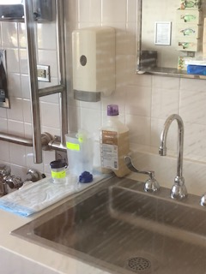
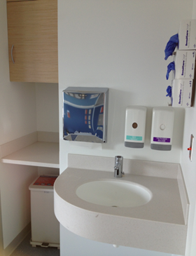
Sources of Exposure
Sinks
Design
Depth
Fixtures and faucets
Placement
Uses
FGI. Guidelines for Design and Construction of Residential Health, Care and Support Facilities. 2022 Edition. 2.1-8.4.3.2 Handwashing station sink.
Infect Control Hosp Epidemiol. 2018 Dec;39(12):1467-1469.
Infect Control Hosp Epidemiol. 2009;30(1):25-33
Notes:
In addition to using tap water correctly, it is important to have an understanding of how the sink itself may introduce risk.
The design of sinks is an important consideration. They should be designed to prevent splashing.
In the Guidelines for Design and Construction of Residential Health, Care, and Support Facilities of the Facilities Guidelines Institute or FGI, guidance is provided that the point of water discharge for handwashing sinks should be at least 8.5 inches above the bottom of the sink in resident rooms and bathrooms and 10 inches from the bottom for all other locations. In research using fluorescent gel inoculated just below the sink strainer completed at four Ohio hospitals, shallow sink bowls were more likely to disperse the fluorescent gel outside the sink bowl. The researchers determined that if the water flow was decreased it decreased or eliminated dispersal.
For staff, residents and the public, handwashing fixtures should allow for hands-free operation. The use of wrist blades are allowed. If sensor-regulated devices are utilized, they should be adjustable for both water temperature as well as the length of time the water flows. The sink must be able to operate if there is a loss of normal power. Many sensor-regulated devices are either battery operated or have a battery back up.
Placement of the sink is equally important, and placement can create risk that is likely linked to the dispersal from splash. With the intent of ensuring handwashing compliance, sinks were placed at the head of the bed in an intensive care unit. During the investigation of an outbreak of multidrug-resistant Pseudomonas aeruginosa in the intensive care unit, it was determined that biofilms in the sink drain were linked to the outbreak. The investigators determined that a shallow sink and gooseneck faucet created splash that traveled one meter or more than three feet from the sink. Researchers at the University of Virginia Health System recommended strategic design to ensure sinks are not within one meter or three feet from patient care areas.
In all cases, resident care items should never be placed on the counter next to any sink. In the top photo enteral feeding and a flush syringe are stored just in front of the hand soap dispenser and on the edge of the sink bowl. Not only is there risk for splash, but also dripping water from wet hands accessing the soap. In the bottom photo is an ideal sink design. There is limited counter space around the sink bowl. Counterspace is recessed outside of the splash zone close to the sink. This allows for the safe preparation of medications, enteral feeding, and other resident care supplies.
Ideally there are separate sinks for staff handwashing, resident use and for cleaning resident care equipment. Additionally, nutritional supplements, intravenous fluids, medications, dialysate, and body fluids should not be discarded in a handwashing sink. If a clinical sink or hopper is not available for discarding wastes, the toilet should be utilized. Emptying any of those items into a handwashing sink can act as nutrients and support the growth of waterborne pathogens.
While design and placement of sinks are not always modifiable in existing buildings, physical separation of sinks and clean work areas should be included in the design of any renovation or new construction.

Slide 19
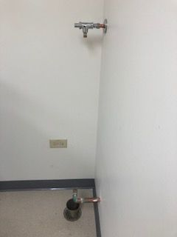
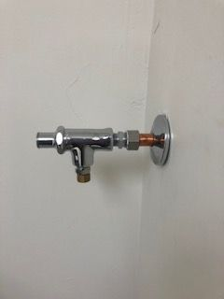
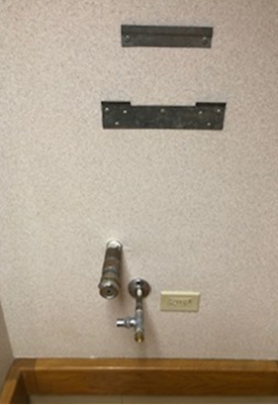
Sources of Exposure
Dead Legs
Often difficult to identify
The result of equipment being removed and or construction
Create a space where water can remain stagnant at room temperature
Notes:
Dead legs are sections of pipes that create a dead end. No water flows through them. Just like the air, if the water is not flowing through the pipes the potential pathogens can not be eliminated or reduced.
Dead legs result when equipment utilizing water is removed. Pictured are examples of deadlegs. In the photo on the left, a wall mounted handwashing sink was removed from the corridor and in the photos on the right, an ice machine was removed. These dead legs are visible, so they are easier to remove once it is realized. Dead legs can also be left in a wall. In those cases, the equipment or device is removed, but the unused portion of the pipe is left behind in the wall. This condition often results when renovation or construction occurs, and space is repurposed or reconfigured.
It is important to specify in your construction Infection Control Risk Assessment (ICRA) to remove any dead legs created or discovered. The pipe should be removed back to the location where the pipe branches and should be capped off.
A dead leg is a potential problem because it creates a space where water can remain stagnant at room temperature. The hot water gets cooler and the cold water gets hotter. In those conditions, any pathogens present can multiply and eventually spread to the main supply pipes. Additionally, if the water pressure drops, the stagnant water can mix with the circulating water and introduce the pathogens into the general water circulation. During construction, vibration can also disturb water in the deadleg.

Slide 20
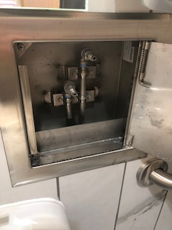
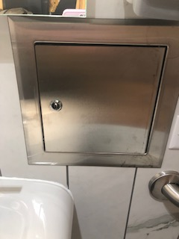
Sources of Exposure
Additional Sources
Showers
Decorative water features
Cooling towers
Ice machines
Dialysis Box
AJIC: American Journal of Infection Control (2022), doi: https://doi.org/10.1016/j.ajic.2022.08.007
Notes:
There are other potential sources of waterborne pathogens in the environment. Showers particularly if they haven’t been used for extended periods of time, decorative water features (both inside and outside), cooling towers, and ice machines are some of the locations. Exposure risk from showers, water features, and cooling towers is related to droplet or aerosolization, while exposure from the ice machine is related to aspiration. Note that if included in the design in congregate care, indoor water features should have a special ventilation feature above them.
An in press article in the American Journal of Infection Control describes an outbreak with Delftia acidovorans, an emergent opportunistic pathogen that demonstrates antibiotic resistance, related to the dialysis wall boxes and prime buckets. Water cultures were negative. They concluded that the outbreak “was most likely due to indirect exposures to contaminated wall boxes and possibly saline prime buckets due to poor hand hygiene and station disinfection.” The investigation highlighted the association of hands and the environment in the transmission of pathogens. If you aren’t familiar with the dialysis boxes, they have a connection for the water source and in some cases the bicarbonate and acid solutions, as well as a drain. They eliminate the need to connect the water source at the handwashing sink and run a hose to the toilet. It will be important to assign the responsibility for disinfecting the box and maintaining the area.
When reviewing construction or renovation plans ask if dialysis boxes will be utilized and ensure the placement doesn’t add to a splash risk.

Slide 21
Water Management Program
Components
Water management team
Describe the water system
Identify the areas for growth and spread
Decide control measures and monitoring
Establish interventions
Verification and validation
Documentation and communication
www.cdc.gov/hai/prevent/water-management.html
https://www.cdc.gov/nceh/ehs/elearn/prevent-LD-training.html
https://www.cdc.gov/legionella/wmp/toolkit/index.html
Infectious Disease Reports. 2022; 14(3):341-359. https://doi.org/10.3390/idr14030039
https://www.cdc.gov/legionella/health-depts/healthcare-resources/cases-outbreaks.html
Notes:
The next step in creating a safe environment is to develop a Water Management Program.
The first link on this page is a CDC checklist that can be used to establish the water management program as well as evaluate it once established. The second link takes you to free training to assist with development of your water management program.
The Water Management Program has seven components.
Developing a water management team.
Describing the building water system in text and through a diagram.
Identifying the areas where waterborne pathogens can grow and spread as well as the control measures and corrective actions.
Deciding where the control measures will be implemented and how they will be monitored.
Establishing interventions if the control measures are not met.
Ensuring the Water Management Program is working as designed and is effective through verification and validation.
Documenting and communicating all aspects of the water management program.
The program should be reviewed annually as well as when any water systems, components or products change. As mentioned, construction can create deadlegs and often results in water shutdowns. Be sure to complete a construction Infection Control Risk Assessment or ICRA and include risk mitigation measures related to water if plumbing systems are impacted during the construction project. The fourth link is a recent article that describes a Water Management for Construction—Infection Control Risk Assessment (WMC-ICRA) tool, which may be a helpful add on to the standard construction ICRA.
CDC recommends a full investigation for 1 or more cases of presumptive healthcare-associated Legionnaires’ disease at any time and for 2 or more cases of possible healthcare-associated Legionnaires’ disease within 12 months of each other. The local health department will likely contact you if you report a case.
Since one case of legionella is considered an outbreak, it will likely warrant mitigation measures, which may result in a change to your water management program. As scientific information about waterborne pathogens advances, there may be changes to guidelines, best practices, and regulations that also warrant a revision of your Water Management Plan. It is a living document.

Slide 22
Water Management Program
Water Management Team
Building administrator or manager
Facility maintenance/engineering staff
Water management suppliers and/or experts
Laboratorian/industrial hygienist
Quality/regulatory/risk
Infection Preventionist
Infectious Disease Consultant/Laboratorian
https://www.cdc.gov/legionella/wmp/toolkit/index.htm
l
Notes:
As with many aspects of creating a safe environment, managing the Water Management Program will be a team effort. The water management team will be a diverse group of both clinical and non-clinical team members. Consider members from outside of the facility that can provide expertise that you may not have.
The diverse group of disciplines should include someone from the administrative team such as administrator or manager. Because much of the plan specifically involves the infrastructure of the water systems, an individual from the maintenance or engineering staff must be included. A facility may choose to bring in a water management company to provide subject matter expertise and advise on the interventions. Even if they are not a standing member of the team, having an expert available on an ad hoc basis can be beneficial to problem solving. A team member who can represent the quality, regulatory, and risk aspects of the water management plan will keep the team on task as it relates to compliance issues. And last but not least, you should have access to an infectious disease consultant who can help manage a resident should they develop a waterborne infection. The infectious disease consultant can also provide guidance if waterborne pathogens are found in the environment.
A team leader should be identified; however, they should not be the only member of the team that has responsibilities and should delegate to other members of the team. For instance, there may be a team member who is more expert at maintaining databases who could manage the documentation.
Because having a Water Management Plan is a relatively new requirement, many facilities are just learning how to develop a program. Building a diverse team with shared responsibilities will help with development of the plan and program. Remember that this was a CMS directive from 2017 aimed at creating a safe environment.

Slide 23
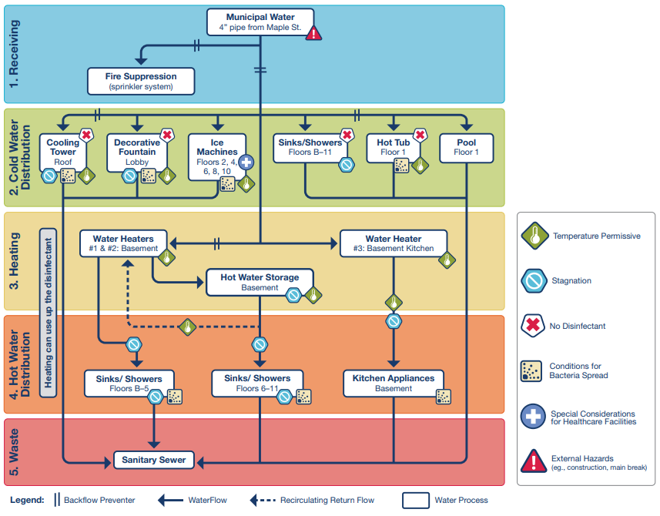
Water Management Program
Water Management Plan
Written description
Building flow diagram
Risk points in the flow
https://www.cdc.gov/legionella/wmp/toolkit/index.html
Notes:
To establish the facility specific Water Management Plan, the team will need a description of how the water enters the building and all the paths it can take before exiting the building. It may be helpful to break up the description into sections such as: where the water enters, the cold water distribution, the components of heating and storing the water, how the hot water is distributed, and where the water is discharged.
To make it easier to understand and visualize, the plan’s narrative language will also need to be converted to a building water flow diagram. Describing the water system and creating a flow diagram is one of the seven elements of the CDC water management program, so all facilities should be working towards creating those components. If you have a contract with a water management company, they can be instrumental in creating the flow diagram. The description and flow diagram will be especially important in facilities that have had facility onset cases of Legionella or other waterborne pathogens such as Elizabethkingia. Once the basic flow diagram is established, the hazardous conditions should be added. This example with the hazards identified is from the CDC. Note that the hazards help to identify the risk points in the flow. Points where stagnation is a risk, such as infrequently used showers may require risk mitigation measures such as flushing to remove the stagnant water. Also, old pipes with biofilm as well as areas where there are disruptions in the water system caused by construction are points of risk that may need to be addressed. A tour of the building can help to identify the risk points. In facilities that are just beginning to establish a program, mitigation measures can be implemented to address those risk points before you have fully developed the written description and flow diagram.
It is important to keep the unintended consequences of control measures in mind as well. Raising the water in the hot water heater to greater than or equal to 124℉ will prevent the growth of legionella but will also put residents, staff, and visitors at risk for scalding if point of use mixing valves are not in place. IDPH regulations for hot water at shower, bathing, and hand-washing facilities establish the do not exceed temperature of 110º at the point of discharge.
As you can see once again, having a diverse team will help to ensure all aspects of water management are addressed.

Slide 24
Water Management Program
Control Measures
Visual inspection
Disinfectant level check
Temperature check
Start up
Notes:
Base the control measures on what you learned about the facility design, water system components, and equipment while establishing the flow diagram.
Establish where the control measures will be applied based on the hazards you identified. In general, there are three types of ongoing control measures: visual, disinfectant level check, and temperature check.
For some hazards, you will be able to visually identify when control measures are not adequate. Decorative water features may have a slime or odor developing indicating that the chemical treatment has not been maintained appropriately. Ice machines may have a build up of calcium in the drain or mold build up around the dispenser indicating that preventive maintenance has not been completed . Visual inspections are easy for anyone to perform but should be regularly assigned to an individual to ensure they are consistently performed.
Checks on the disinfectant level will require some technical expertise and monitoring know how. Devices like a handheld chlorimeter can be utilized to measure the chloride ion content in water.
The disinfectant will decay over time based on many of the facility systems and water qualities, so you cannot just rely on the fact that the municipality has treated the water. Some facilities may opt to add disinfectant as a control measure. It can be important in both cases to verify the disinfectant levels in the facility water supply. Additionally, high levels of the disinfectant can damage pipes and fixtures and/or harm building occupants. If chlorine is used as the disinfectant, it may be important to monitor the pH of the water because the pH can impact the effectiveness of the chlorine.
Monitoring the temperature can serve at least two purposes: ensuring safety at the point of use and confirming that the chlorine is not impacted by the temperature. By knowing the temperature of building water, you will be able to gauge the risk for waterborne pathogens and the potential need for risk mitigation measures.
In addition to the routine inspections and monitoring, do not lose sight of initial start up measures that are required at the beginning of the cooling season and/or as new systems are brought on line. Having a checklist for the annual start up of the cooling towers will help ensure compliance. Manufacturer’s will provide guidance that should be followed when commissioning new equipment.

Slide 25
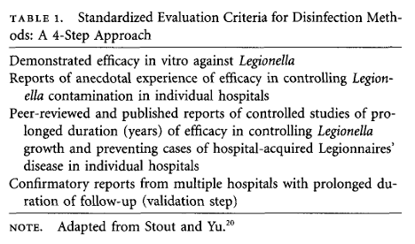
Water Disinfection Methods
Infect Control Hosp Epidemiol 2011;32(2):166-173
Notes:
This is an older review article, but still relevant. It suggests evaluation criteria for water treatment disinfection methods.
When evaluating methods, ask the companies for facilities in your region that utilize the system and contact them to discuss their experiences.

Slide 26
Water Management Program
Plan Effectiveness
Verification
Confirmation of design implementation
Cross check
Validation
Cultures
Disinfectant
https://www.cdc.gov/legionella/downloads/wmp-data-template.xlsx
Notes:
The Water Management Plan will only be as good as its implementation. To ensure its effectiveness, the plan must be verified and validated.
Verification is proving that you are doing what you said you would do, that you are implementing the plan as designed. To provide an unbiased assessment, assign team members who are not routinely responsible for that component of the plan to cross check the elements. Think of it as an extra set of eyes attesting to the implementation.
Validation is the confirmation. The validation will rely heavily on the documentation. It ensures the hazards have been controlled. The validation will include culture results if your plan includes cultures. CDC has developed an Excel spreadsheet for documenting water culture results. Visual, disinfectant, and temperature checks are also validation measures but must be documented.
Verification and validation should be part of each water management team meeting and should be reflected in the meeting minutes.

Slide 27
Water Management Program
Plan Package
Document
Team membership
Facility characteristics
Water system description and flow diagram
Control measures and limits
Verification and validation
Communicate
Facility
Consultants
Health Department
Notes:
The comprehensive Water Management Plan relies heavily on the documentation and communication of all the elements. The package is not complete until it is codified into the facility infection prevention and control and environment of care program processes in a written document that includes the program elements, but also the compliance monitoring.
List the water management team member names and roles in the plan.
Mention the population at risk for waterborne pathogens in your annual risk assessment and refer to the risk assessment in the Water Management Plan. This will indicate a well thought out and comprehensive Infection Prevention and Control Program.
Keep the written description and process flow diagram of the facility water systems up to date. A water management plan is not a one and done document.
Establish the control measures and limits in the plan and maintain records of documentation. Indicate the actions necessary if the limits are not met or they are exceeded.
As with any process, and a water management plan is a process, verify and validate that the process is meeting the intent.
While it is great to have perfect documentation, the information is not valuable unless it is shared with others. Having a perfect binder in a locked office will not meet the intent. Share the high-level aspects of the plan at appropriate meetings. Provide the why. For example: “We have decided to remove the indoor decorative water feature because we felt it was a risk we may not be able to adequately control for.” Sharing that type of information will indicate the emphasis on creating a safe environment.
Include consultants when communicating monitoring results, sharing water management meeting minutes, and when updating the water management plan. To provide the best guidance, consultants need complete information, both on the control measures, but also the clinical outcomes.
As previously mentioned, one case of healthcare onset legionella is considered an outbreak and must be reported to the health department. The health department can act as a resource. They would much rather provide guidance on the front end than they would like to manage a large outbreak investigation.

Slide 28
Risk Mitigation Measures
Risk Mitigation | Limitation/Failure | Compliance
Corporate water management plan | Plan not specific to the local facility/building | Adopt corporate plan to the specific building
Water containing equipment is inspected on a quarterly basis | Quarterly equipment inspection not performed | Establish preventive maintenance schedules
Process flow diagram | Therapy pool not included | All fixtures and equipment must be included in the flow diagram
Temperature, pH, chemical monitoring | No documentation | Audit
Decorative water feature maintenance | Manufacturer’s instructions not followed | Ensure manufacturer’s instructions for use are available and followed
Ice machine filters | Filters not changed | Follow manufacturer’s frequency for changing
Contracted service maintains cooling towers | Biocides were not added | Include contracted services timelines in the facility maintenance schedules
Notes:
Risk mitigation measures are both proactive and reactive. They will depend on the facility systems and equipment. The control measures, as defined by the water management plan, must be implemented. Failure to do so may put residents, team members, and visitors at risk.
This table is an example of some, but certainly not all, of the possible risk mitigation measures, the limitations and/or possible failures associated with the mitigation measure, as well as the ways to ensure compliance.
Just like policies, the water management plan must be specific to each individual facility. A plan developed at the corporate level can be a starting point but is not precise enough for the specific facility risks.
Establish the frequency and sample size for the risk mitigation measures. Include the frequency and sample size in the preventive maintenance schedules and then stick to them.
The process flow diagram should include a list of all water containing equipment. Walk the building with the facilities team to ensure all fixtures and equipment are included. Missing a component could lead to a control failure and result in an outbreak.
As with most of what we do in healthcare, if it is not documented it was not done. To ensure documentation is adequate and accurate, perform quality checks or audits on the documentation.
Always follow the manufacturer’s instructions for use in operating and maintaining equipment. Failure to do so with water containing equipment can result in conditions that will support the growth and spread of waterborne pathogens.
If you contract with a third party to manage and/or maintain your water management plan and/or systems, do not assume that no news is good news. Ensure the third party is in compliance with all aspects of the contract. Request and maintain copies of service visits. Include the timelines for the contracted service activities on the facility preventive maintenance schedules so that they are not overlooked.
As mentioned earlier, the water management program is a team effort, so assign the responsibility for ensuring compliance with the mitigation measures to members of the water management team.

Slide 29
Reducing the Risk from Water
Recognizing that water is ever present in healthcare facilities and can create a risk is one of the first steps to recognizing the need for a water management plan
Developing a water management team and utilizing the CDC’s water management toolkit will support the development of the water management program
Establishing the expectations of the program and compliance measures should facilitate the plan implementation
https://www.cdc.gov/niosh/topics/hierarchy/
Notes:
Water is a necessary component in healthcare, but it can also create great risk. You may recognize the OSHA Hierarchy of Controls we have referenced before. The water management plan is aimed at eliminating the risk, implementing engineering controls, and ensuring administrative controls.
Using resources available from the CDC will support the development of the water management program.
To fully implement the program, the expectations and compliance measures must be clearly spelled out in the water management plan.

Slide 30
Summary
When an unusual gram-negative organism causes infection, think water.
Take a walk for safety.
Verify and validate the water management plan components.
Notes:
If an unusual and/or highly resistant gram-negative organism is identified, think water. Consider the following questions: How is water used for resident care? Is the resident care provided close to a water source? It may help guide interventions to prevent additional cases.
Take a walk for safety. Walking with the facilities team will help to identify all potential sources of water to include in the water management plan. They are most familiar with the building infrastructure, and you are most familiar with how equipment and devices interface with water. Keep your eyes open for water related risk from splash/spray when on rounds.
The water management plan will not prevent harm if it is not implemented as designed. Verify and validate. Ensure quality controls are completed and documentation is complete.

Slide 31
Questions
Mary Alice Lavin, MJ, BSN, RN, CIC, FAPIC
Infection Control Consultant
Hektoen Institute/Illinois Department of Public Health
mary.lavin@illinois.gov
847-910-8222

Slide 32
Open Q&A
Submit questions via Q&A pod to All Panelists
Please do not resubmit a single question multiple times
Slides and recording will be made available after the session.

Slide 33
Reminders
For continuing education credit, please fill out the following evaluation by October 28th, 2022:
For continuing education credit, complete evaluation at https://redcap.dph.illinois.gov/surveys/?s=LJKK339YHJTCNW8P
SIREN Registration
To receive situational awareness from IDPH, please use this link to guide you to the correct registration instructions for your public health related classification: http://www.dph.illinois.gov/siren
NHSN Assistance:
Contact Telligen: nursinghome@telligen.com­

