Slide 1

Infection Prevention and Control Roundtable​ with Acute Care ​Facilities
10-17-24
Notes:
Welcome everyone!

Slide 2
Agenda
Important Updates
  Situation Awareness: Marburg Virus Outbreak in Rwanda, Dr. Michelle Funk, Medical Director, CDPH
Special Topics
  IDSS and Recent Communicable Disease Rule Changes, Judy Kauerauf, Communicable Disease Section Chief, and Dr. Hillary Spencer, Infection Prevention Medical Advisor, Illinois Department of Public Health
Discussion and Q&A
Notes:
A lot of this information presented today has been previously presented by our team at CDPH. So apologies if some of this is a repeat. We will move quickly so we can get to the discussion part.

Slide 3

2024 International Infection Prevention Week: October 13 – 19, 2024
Monday, October 14 – Theme: “Moving the Needle on the Profession’s Development”
Tuesday, October 15 – Theme: “Moving the Needle on Healthcare Worker Safety”
Wednesday, October 16 – Theme: “Moving the Needle on Patient Safety”
Thursday, October 17 – Theme: “Moving the Needle on Public Health Preparedness”
Friday, October 18 – Theme: “Moving the Needle Across the Continuum of Care
  Celebrate Clean Hospital Day!

Slide 4
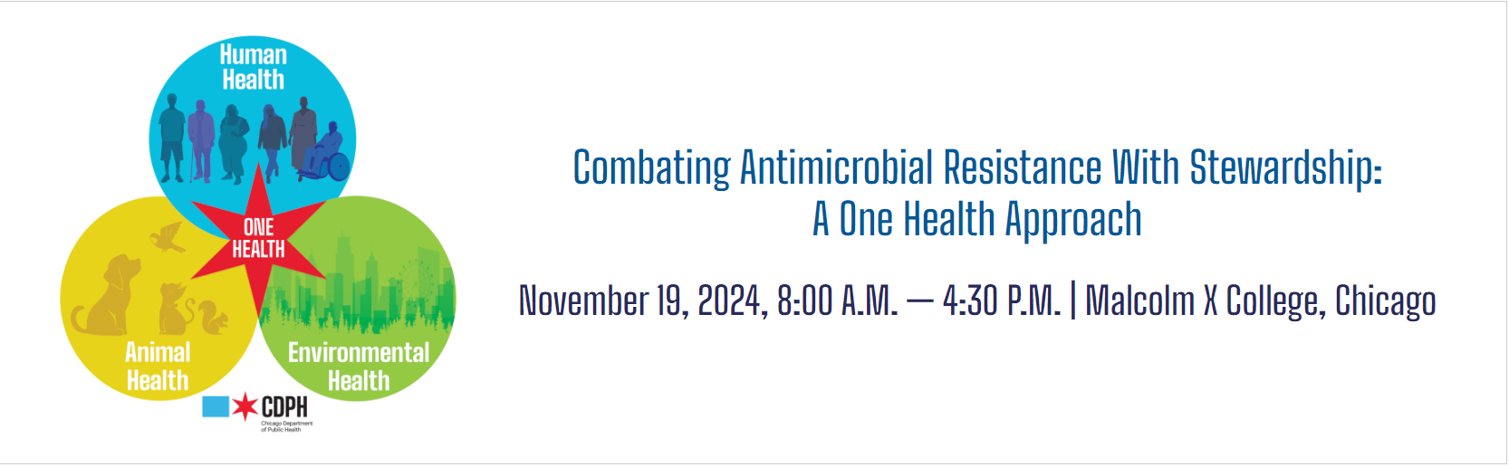
Registration is now open!
Our team will be attending, and we’d love to connect with you.
If you’re interested, join us in the main conference room during the lunch break for networking and the opportunity to meet fellow infection preventionists.
Register here: https://www.chicago.gov/city/en/depts/cdph/supp_info/infectious/one-health-conference-home.html
Notes:
The Chicago Department of Public Health will be hosting a free one-day continuing education event. Attendees across a spectrum of settings will learn how to maximize their organization’s capacity to take actionable steps and combat the problem of antimicrobial resistance. Local and national leaders in antimicrobial stewardship will guide participants on how they can use limited resources to have the biggest impact, how they can use their facility’s data to prioritize activities, and how they can motivate patients/clients and colleagues to invest in antimicrobial stewardship. Target Audience Chicago healthcare providers (physicians, veterinarians, pharmacists, nurses, infection preventionists, and administrators) Elizabeth Dodds Ashley, PharmD, MHS, FCCP, FIDP, BCIDP. Liaison Pharmacist at Duke Antimicrobial Stewardship Outreach Network (DASON) • Julia Szymczak, PhD. Associate Professor in the Division of Epidemiology and Department of Internal Medicine at The University of Utah School of Medicine

Slide 5
Marburg Virus Disease
10.17.2024
*Information provided is preliminary; additional guidance expected in coming days

Slide 6
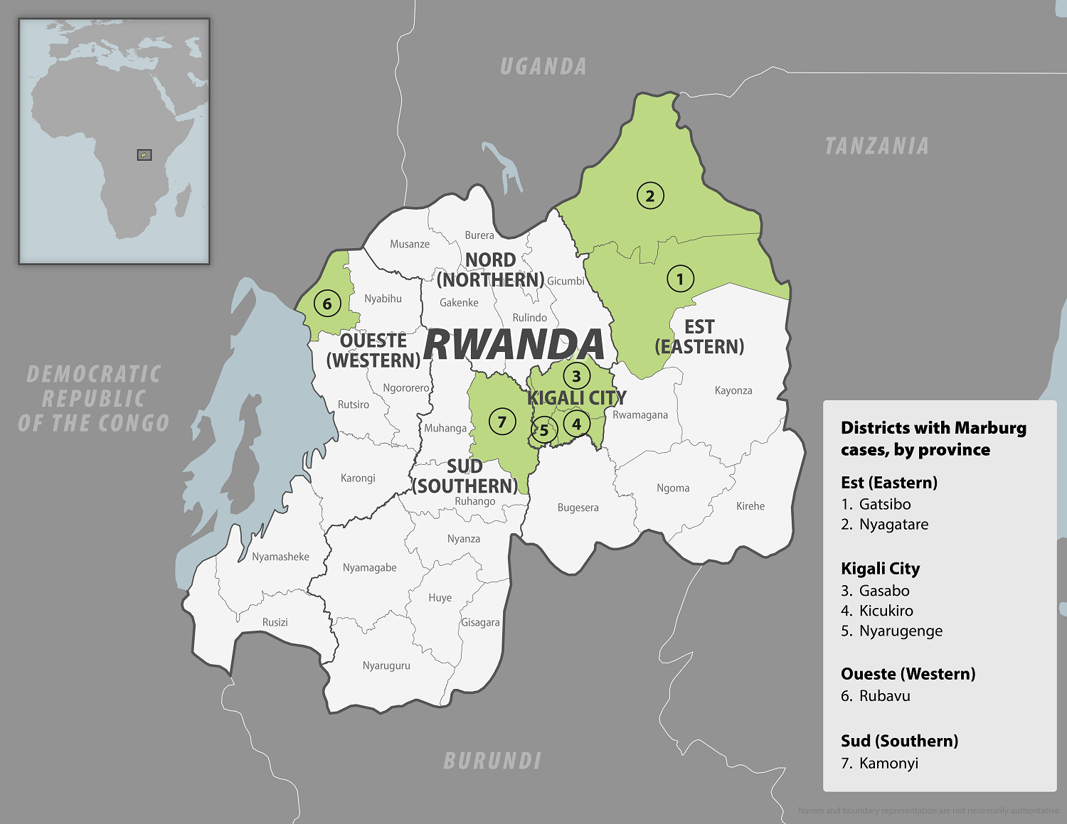
Outbreak
Since September 27, 2024, Rwanda Ministry of Health has reported:
  62 cases of Marburg Virus Disease (10/15/24)
    15 Deaths
    17 in Treatment
    30 Recovered
  ~80% of cases are healthcare workers, particularly those working in ICUs.
  No community transmission identified at this time.
  rbc.gov.rw/marburg/
Notes:
Photo: https://wwwnc.cdc.gov/travel/notices/level2/marburg-rwanda

Slide 7
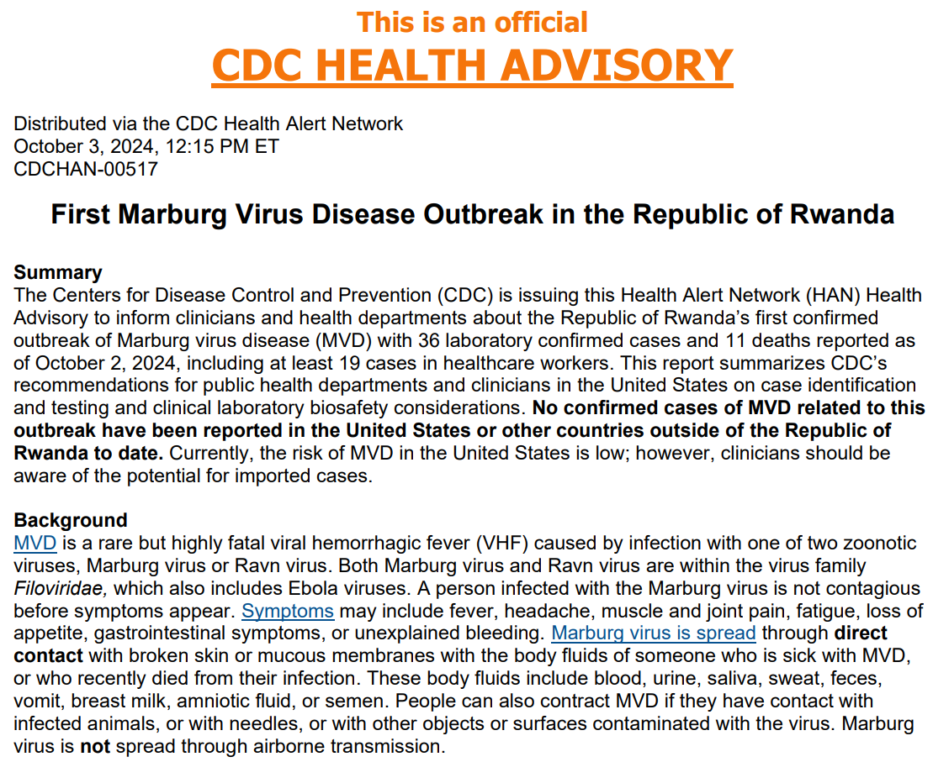

Slide 8
CDC Interim Recommendations
October 11:
  Interim Recommendations for Public Health Management of U.S.-based Healthcare Personnel Returning from Rwanda | Marburg | CDC
October 15:
  Interim Recommendations for Post-Arrival Public Health Management of Travelers from Rwanda | Marburg | CDC
Infection Prevention and Control Guidance:
  Infection Prevention and Control Recommendations for Patients in U.S. Hospitals who are Suspected or Confirmed to have Selected Viral Hemorrhagic Fevers (VHF) | Viral Hemorrhagic Fevers (VHFs) | CDC
PPE:
  PPE: Confirmed Patients and Clinically Unstable Patients Suspected to have VHF
  PPE: Clinically Stable Patients Suspected to have VHF

Slide 9

Local Implications of Outbreak
Threat to the U.S. and Chicago remains low currently.
Chicago Department of Public Health (CPDH) will monitor returned HCWs/Travelers with Medium-High Risk for 21 days
  Healthcare workers will be excluded from patient care.
  Avoid nonessential visits (e.g., elective surgeries) to U.S. healthcare facilities.
Department of Homeland Security (DHS) will begin redirecting air travelers from Rwanda to Chicago O'Hare airport starting 10/16/24.
  All travelers from Rwanda will be screened at the airport.
  ~100-120 travelers per day arrive to the U.S. from Rwanda.
Level 3 Travel Advisory – avoid non-essential travel/reconsider travel

Slide 10
Local Implications of Outbreak
ORD Port of Entry (POE) Division of Global Migration Health (DGMH) screening to begin Wednesday 10/16/24 for all travelers returning from Rwanda:
  Primary screener:
    Low-risk asymptomatic will continue their journey and self-monitor.
  Secondary screener: Risk Assessment. CDPH will be notified and monitor these individuals.
    Health/Symptom Assessment
    Healthcare Facility and Role
    MVD Exposure Assessment
    Funeral/Mortuary Attendance
  CDC will coordinate with CDPH on any individual that requires action at POE.
    Isolation, quarantine, no-onward travel, testing, medical care.

Slide 11
IDSS and Recent Communicable Disease Rule Changes
Illinois Department of Public Health
10.17.2024

Slide 12
IDSS Review

Slide 13
IDSS Work
Release 2
  All remaining diseases
  Initial Electronic Case Reporting
  Addressing bugs with providers not seeing reports from others within the org.
  LHD ability to merge info all provider info into IDSS
  Immunization (ICARE) integration so LHD will have this info, as well as APORS, REDCap and IVRS
  Address match to assist with identifying persons in congregate settings
  Still working on flow
Notes:
Cautious – Dejan pilot with TEFCA to use FIRE. Allows you to ping for certain info and get that back; not passive.

Slide 14
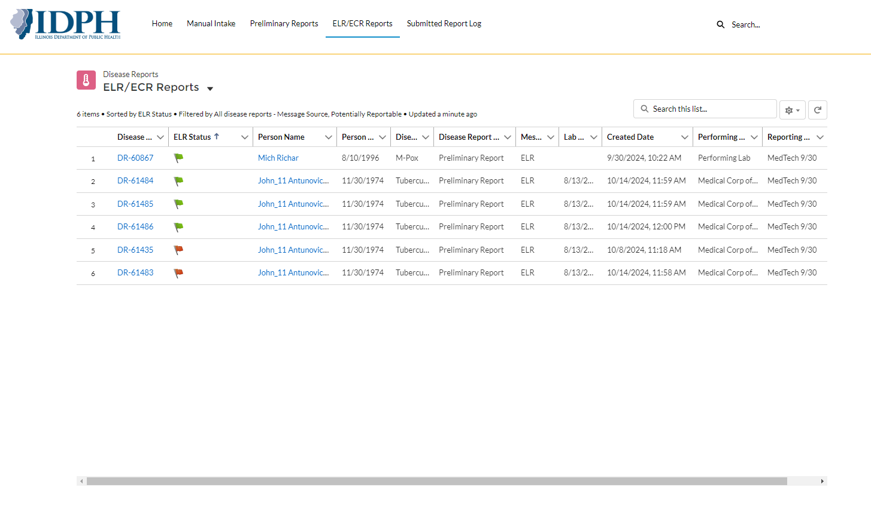
ELR/ECR Viewing in Provider Portal
New tab will be available for providers to view ELRs and ECRs that were submitted for their organization
Notes:
Would like feedback on this setup.
Flags show ones that have been completed
Removing from view Disease Report type and Reporting Org (will be the same as the lab)
Can set your filter to display but default will be based on created date

Slide 15
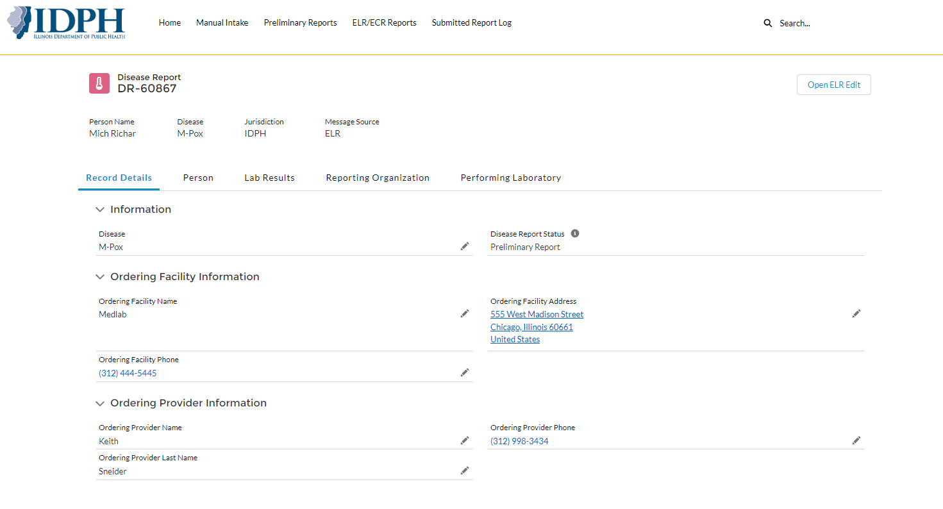
ELR/ECR Viewing in Provider Portal
After opening the ELR record, providers can view data that was submitted via ELR. If they wish to add additional details for this ELR, they can click on button “Open ELR Edit”
Placeholder
Notes:
Rename Open ELR Edit (since you can’t edit an ELR) to
“Amend with Provider Report”

Slide 16
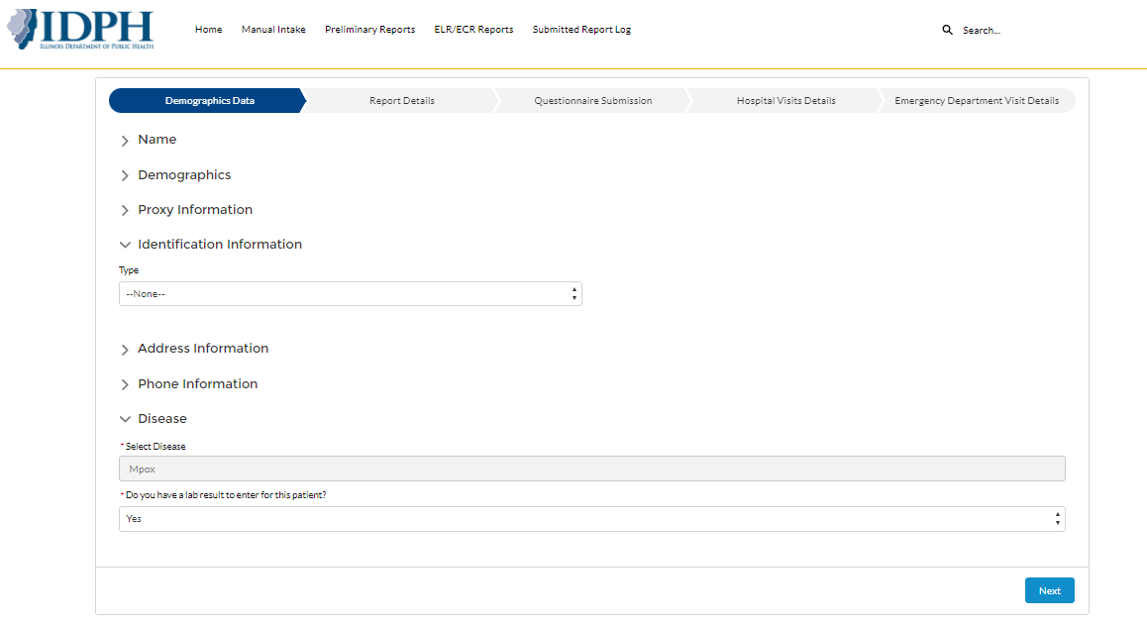
ELR/ECR Viewing in Provider Portal
Providers will be able to update demographics data of the person linked to the ELR which can later be merged onto the person record by LHDs

Slide 17
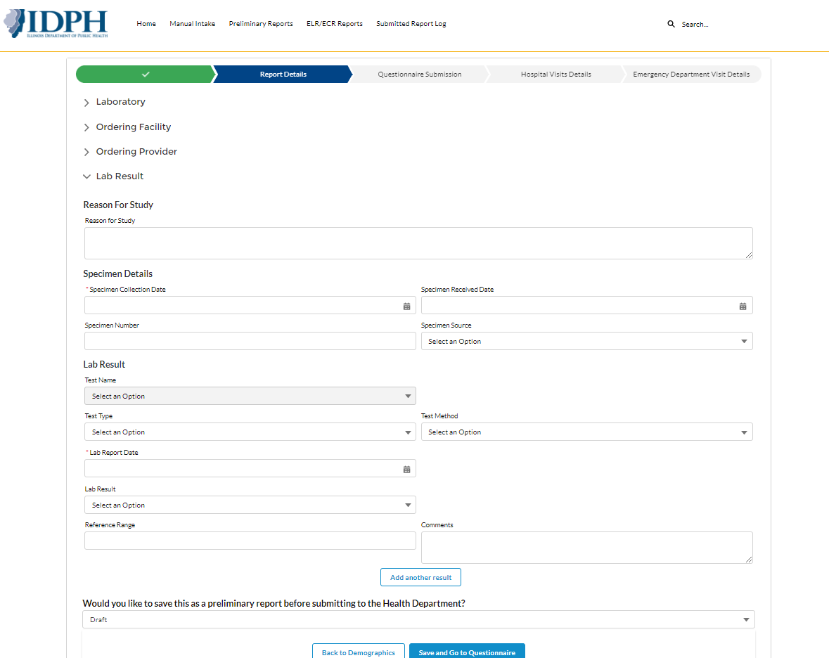
ELR/ECR Viewing in Provider Portal
Providers will be able to add additional lab results in the next step of the flow
Notes:
Rename this tab “add Additional Lab Results” e.g., reference lab testing.
I’ve asked to prepopulate Ording Facility with the Hospitals Name.
Issues with this draft saving part. Not anything we asked for and very confusing.

Slide 18
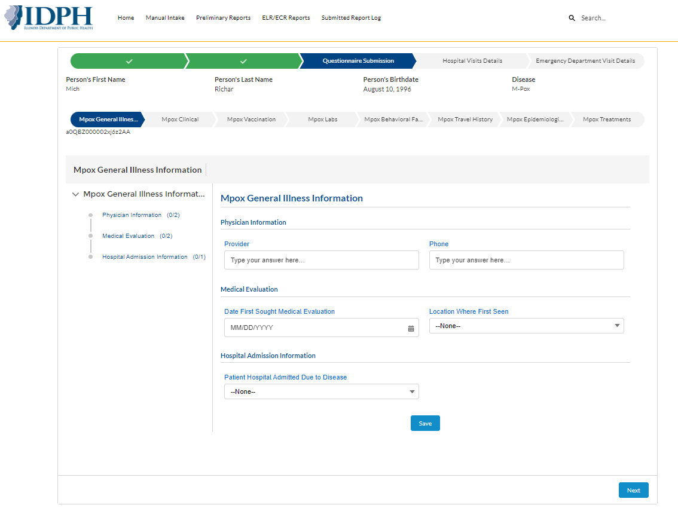
ELR/ECR Viewing in Provider Portal
Providers can add questionnaire information for a previously submitted ELR which can later be merged into a case by LHDs
Placeholder
Notes:
Questionnaire submission: Asked to rename Epi and Clinical data

Slide 19
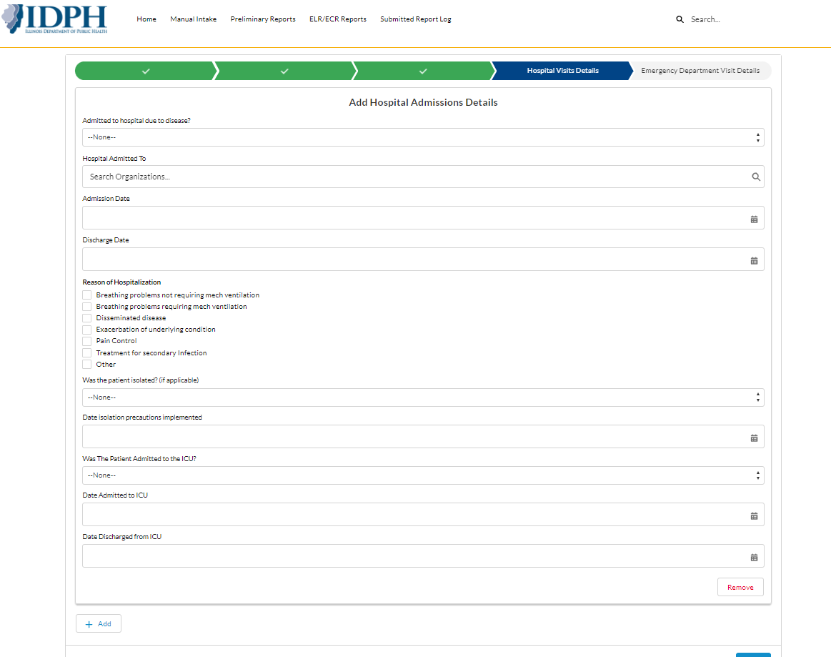
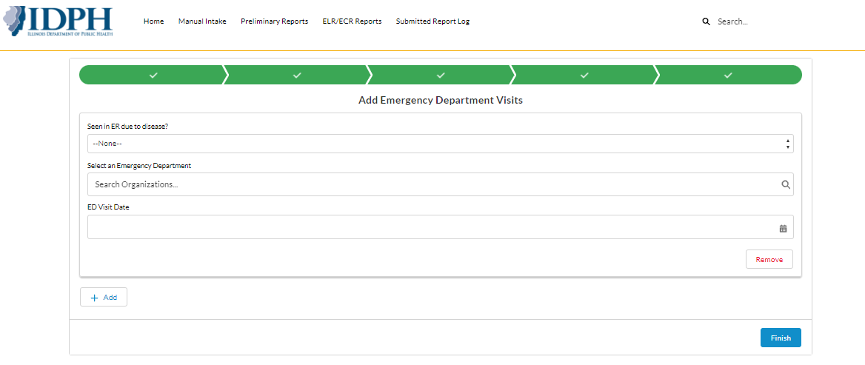
ELR/ECR Viewing in Provider Portal
Providers can add hospital admission & ER visit information for a previously submitted ELR which can later be merged into a case by LHDs
Notes:
Asked them to put ED first then Hospitalization and prepopulate with name of hospital of Provider.

Slide 20
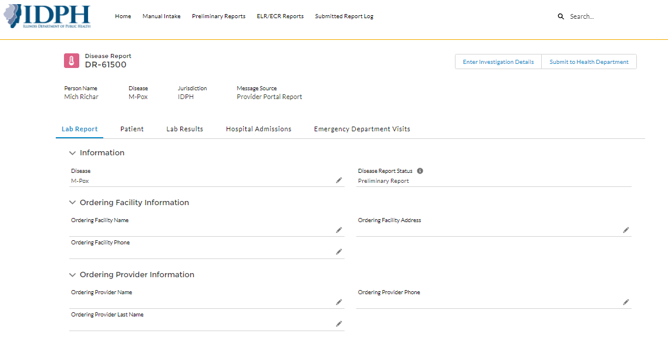
ELR/ECR Viewing in Provider Portal
Notes:
Still working on this page. Not sure what the difference is. But in order to go to the LHD, you hit Submit to LHD. Would prefer this we part of the flow so the step is not missed.

Slide 21
IDSS & Communicable Disease Rule Changes
October 17, 2024
Notes:
tagline to reflect the value of public health

Slide 22
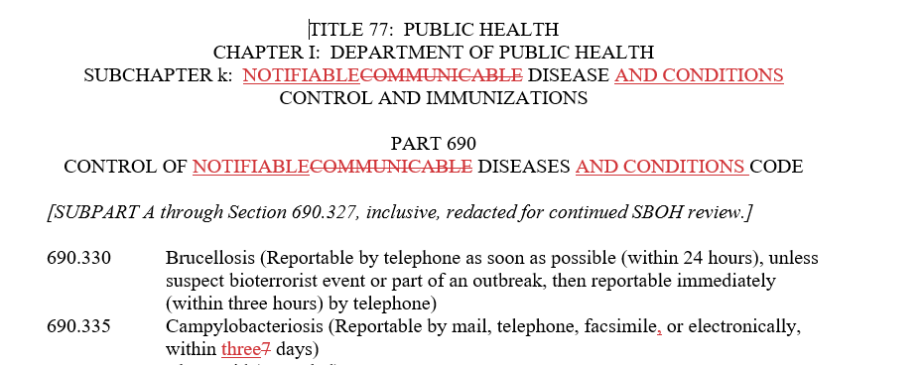
Overall Name Change and Timeframe Change for Class 2 Diseases
Notes:
The definition of infectious and communicable are not the same. Not all infectious diseases are communicable. So Notifiable was a nice compromise, consistent with CDC and other states. And not all infectious diseases are reportable under this code.
By adding conditions, it allows us to use the rules for non-infectious conditions, e.g., EVALI.
"Notifiable disease or condition" – A disease or condition that, when diagnosed, requires health providers (usually by law) to report to state or local public health officials. Notifiable diseases are of public interest by reason of their contagiousness, severity, or frequency.

Slide 23
Revised Definitions
"Food Handler: Any person who has the potential to transmit foodborne pathogens to others from working with unpackaged food, food equipment, clean utensils, oral medications, or food-contact surfaces; any person who has the potential to transmit foodborne pathogens to others by directly preparing or handling food, drinks, or providing oral medication or oral care. Food handler does not include individuals in private homes preparing or serving food for individual family consumption.
Health Care Provider; certified midwives added
Health Care Facility: School nurse office added
Health Care Worker: “or learning in a student or trainee role at” added
"Outbreak" – The occurrence in a community, facility, workplace or region of a case or cases of an illness in excess of the number usually expected. The number of cases indicating an outbreak or cluster will vary according to the agent, disease, or condition, the site conditions/hazards, size and type of population exposed, previous experience or lack of exposure to the disease, and time and place of occurrence
"Restrict from Work" – For food handlers, this means to limit the activity of a food handler so that there is no risk of transmitting a disease by making sure that the food handler does not work with food, cleaning equipment, clean utensils, clean dishes, clean linens or unwrapped single service or single use articles or in the preparation of food.
"Sensitive Occupation" − An occupation, excluding health care workers

Slide 24
Section 690.30 General Procedures for the Control of Notifiable Diseases and Conditions, Including Outbreaks
a. Investigation
  2) The Department shall make investigations and inquiries with respect to the causes of disease, health conditions, and death; investigate the effect of environment, including conditions of employment and other conditions that may affect health; and to make other investigations that it may deem necessary for the preservation and improvement of health. (Section 510 of the Public Health Powers and Duties Law)
  6) When two or more cases of a suspected or notifiable disease or condition, including, but not limited to confirmed health care associated infection or colonization, or single case with public health significance occur in any business, organization, institution, health care facility or private home, the business owner, the person in charge of the establishment or the event, or the homeowner shall cooperate with public health authorities in the investigation of cases, suspect cases, outbreaks and suspect outbreaks. This includes, but is not limited to, release of utilization information about a product used to mitigate spread, including therapeutics; shopper card records; credit card receipts, food preparation methods; menus; environmental specimens; food specimens; clinical specimens, invoices, employee work schedules and work logs, including logs of employee illness or absences; lists of customers, attendees, residents or patients; utilization information about a product used to mitigate spread, including therapeutics, vaccinations or prophylactics; and the name and other pertinent information about employees, guests, members or residents diagnosed with a communicable disease or condition, including infection or colonization as the information relates to the investigation…

Slide 25
Section 690.30 General Procedures for the Control of Notifiable Diseases and Conditions, Including Outbreaks
Investigation
14) Investigations conducted by the Department or local health authority may include, but are not limited to:
  Review of pertinent, relevant medical records by authorized personnel, if necessary to confirm the diagnosis; investigation of causes; identification of other cases related to the outbreak or the reported disease (including colonization) or condition in a region, community, or workplace; to conduct epidemiologic studies; to determine whether a patient with a notifiable disease or condition has received adequate treatment to render the patient non-infectious, whether a person exposed to a case has received vaccination or prophylaxis, if appropriate, or infection or environmental control measures have been implemented, if appropriate.

Slide 26
Section 690.30 General Procedures for the Control of Notifiable Diseases and Conditions, Including Outbreaks
d) Release of specimen
A local health authority may disclose to and require a food service business owner or the owner’s designee that an employee with a disease that can be transmitted through food cannot return to work until the local health authority lets the business owner know that the employee can return to work.
g) Persons with jaundice and the onset of jaundice within seven calendar days shall not work as health care workers, food handlers or in sensitive occupations until seven days after the jaundice ceases, unless the employee provides written documentation from a health care provider that the jaundice is not caused by the hepatitis A virus or other fecal-orally transmitted infection. If the case is confirmed as hepatitis A and jaundice is not present, the health care worker, food handler or person in a sensitive occupation shall be restricted from work for two weeks from the start of the clinical symptoms.

Slide 27
690.100 Disease and Conditions
Added to the opening paragraph as general guidance for control of case and contacts was removed.
  Appropriate infection prevention and control standards shall be implemented for cases and contacts per existing infection prevention and control standard precautions and transmission-based protocols.
  a) Control of Case
Standard precautions shall be followed. Contact precautions shall be followed for care of persons with cutaneous anthrax when dressing does not adequately contain drainage.

Slide 28
690.200: a) Reporting
1) Reporting Entities and Manner of Reporting
  Added Infection preventionist, pharmacy technicians, animal control or animal shelter employees,
Laboratories shall report certain positive test results and provide clinical materials as specified in Subpart D or if requested. Upon request of the local health authority, laboratories shall submit a copy of a laboratory report by facsimile or electronically. If a medical laboratory forwards clinical materials out of the State for testing, the originating medical laboratory shall comply with this requirement by either reporting the results and submitting clinical materials to the Department or ensuring that the results are reported, and materials are submitted to the Department. Laboratories shall report negative or indeterminate test results as requested by the Department, when necessary for the investigation, monitoring, control and prevention of diseases dangerous to the public health.

Slide 29
690.200: Reporting
5) Report shall be submitted electronically or by fax, mail….
Providers shall establish a data linkage and submit electronic case report data through the Association of Public Health Laboratories Informatics Messaging Service (AIMS) platform in accordance with CMS Promoting Interoperability standards.
The reporter shall provide, when available, disease or condition, name, age, date of birth, sex, race, ethnicity, address (including zip code), email address and telephone number (if available) of the case, and name and telephone number of the attending medical provider. When requested, on paper forms provided by the Department or electronically through EDSS or AIMS, clinical and laboratory findings in support of the diagnosis, epidemiological facts relevant to the source of the infection or condition, and possible hazard of transmission of the infection or condition shall also be reported.
8) Veterinarians, animal control officials, animal holding facility personnel, retail stores selling animals and wildlife professionals shall report any zoonotic disease outbreak in persons including location and contact information for the owner of the animals suspected of causing the outbreak, as well as any new or emerging zoonotic disease illness in a single person or any human contacts to the infected animals.

Slide 30
690.200: d) Confidentiality
8) To prevent the spread of a disease or condition, the Department, local boards of health, local health authorities, and other state agencies involved with direct care and service provisions to individuals shall have emergency access to medical or health information or records or data upon the condition that the Department, local boards of health, and local health authorities …
9) The Department will provide information pertaining to human or animal cases of zoonotic disease to another State or federal agency, including but not limited to the Centers for Disease Control and Prevention, Federal Drug Administration and U.S. Department of Agriculture, Illinois Department of Agriculture, and Illinois Department of Natural Resources.

Slide 31
690.295 Unusual Disease
b) Control of Contacts
Contacts shall be evaluated to determine the need for quarantine and/or for symptom monitoring follow-up for a period of time following exposure.
e) Laboratories
2) Laboratories shall retain specimens or isolates for a minimum of 30 days and submit to the Department upon request.

Slide 32
Timeframe Changes
Class 2 disease changed from 7 days to 3 days
Measles made reportable within 3 hours (from 24 hours)
Influenza, (Laboratory Confirmed Deaths in persons less than 18 years of age) reportable within 3 days from 7 days)

Slide 33
New Disease Added/Removed
Acute Flaccid Myelitis (AFM)
Cronobacter, including C. sakazakii and C. malonaticus, in infants younger than 12 months of age
Melioidosis due to Burkholderia pseudomallei
Multi-drug resistant organisms (in addition to CRE and C. auris)
RSV
COVID-19 (separate from novel coronavirus)
SARS was removed as a separate disease and added to Novel Coronavirus
Hep D removed from Hep B category
Notes:
Other than Hep D removed

Slide 34
Disease Name Changes
Any Unusual Case of a Disease or Condition Caused by an Infectious Agent Not Listed in this Part that is of Urgent Public Health Significance
Haemophilus Influenzae, Meningitis and Other Invasive Disease
Influenza, (Laboratory Confirmed Deaths in persons youngerDeath (in persons less than 18 years of age)
Listeriosis (When Both Mother and Newborn are Positive, Report Mother Only)
Measles, Suspect, Probable or Confirmed (Reportable by telephone immediately, within three hours, upon initial clinical suspicion or laboratory test
Neisseria meningitidis, Meningitis and Invasive Disease and Purpura Fulminans
Any Suspected or Confirmed Outbreak of Public Health Significance a Disease of Known or Unknown Etiology that may be a Danger to the Public Health, Whether the Disease, Infection, Microorganism, or Condition is specified in the Rule Outbreaks of Public Health Significance (Including, but Not Limited to, Foodborne, Healthcare-associated, Zoonotic Disease or Waterborne Outbreaks)
Salmonellosis, Including Paratyphi B var. L(+) tartrate+ (Other than S. Typhi, S. Paratyphi A, S. Paratyphi B (tartrate negative) and S. Paratyphi C cases) (Other than Typhoid Fever)
Streptococcal Infections, Group A, Invasive Disease (Including Streptococcal Toxic Shock Syndrome and Necrotizing fasciitis) In Persons in Hospitals or Residing in a Residential Facility, including antibiotic susceptibility test results.
Tickborne Infections Disease (Includes African Tick Bite Fever, Anaplasmosis, Babesiosis, Bourbon Virus, Ehrlichiosis, Heartland Virus Anaplasmosis, Lyme Disease and Spotted Fever Rickettsiosis)
Trichinosis (Trichinellosis) due to Trichinella spiralis

Slide 35
Section 690.468 Influenza (Laboratory Confirmed and Intensive Care Unit Admissions
c) Laboratory Reporting
1) Laboratories shall report all positive laboratory results for influenza to the Department via the Department's electronic lab reporting (ELR) system in a manner and on a schedule prescribed by the Department. Laboratories unable to submit results to the Department via the Department's ELR shall contact the Department for instructions on how to submit results.
Notes:
Influenza cases that were admitted to the ICU have been reportable to IDPH per our CD code since 2014, however this addition to the rules for influenza mandates all positive laboratory tests (not just labs for ICU cases or ped flu deaths, to be reported to IDPH via ELR). We are only requesting influenza positives tests reported by ELR, we do NOT want providers reporting influenza positive tests on person's who haven't been admitted to the ICU or are a pediatric influenza-related death.

Slide 36
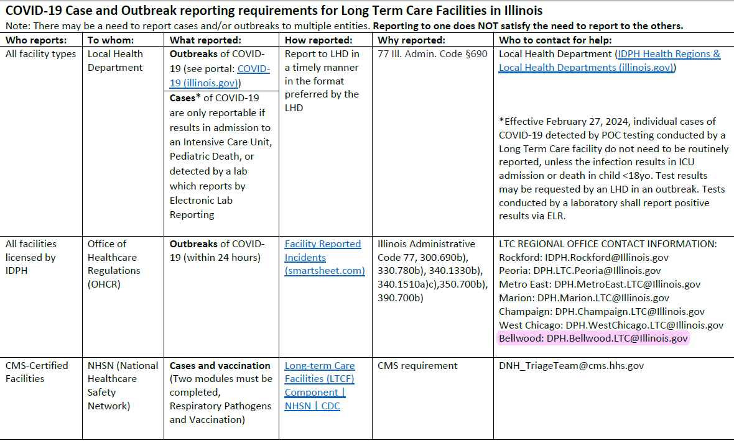
Notes:
Not for Hospitals – refer to Hillary

Slide 37
Section 690.360: Cholera
Control of Case
Food Handlers or Persons in Sensitive Occupations, Not Including Health Care Workers. Cases with cholera shall not work as food handlers or in sensitive occupations until diarrhea has ceased for at least 4824 hours and three consecutive negative stool specimens are obtained. Specimens shall be obtained following clinical recovery of the patient, at least 24 hours apart and not sooner than 48 hours after the last dose of antimicrobials, if administered. Specimens shall be submitted within one week after notification.
Health Care Workers or Those Who Work in Occupations Requiring Standard Precautions. Local health departments may require specimens from health care workers or those who work in occupations requiring standard precautions if there is reason to believe that specimen testing is necessary (e.g., the nature of the work, including feeding patients, assisting patients with eating, providing or preparing meals for patients, denture or oral care, hygienic practices of the worker, dispensing or administering oral medications, or as part of an investigation of a cluster). Specimens shall be obtained following clinical recovery of the patient, at least 24 hours apart and not sooner than 48 hours after the last dose of antimicrobials, if administered. Specimens shall begin to be submitted within one week after notification, or the individual shall be restricted from patient care. When specimen submission is required, health care workers who feed patients or assist patients with eating, meals, provide denture or oral care or dispense or administer oral medications, shall be restricted from these duties until three negative stool specimens are obtained or the public health authority determines that monitoring is no longer warranted.
Persons shall be excluded from school or childcare facilities until vomiting and diarrhea has resolved for at least 24 hours without the use of antidiarrheal medication.
Notes:
Discuss why we used this language instead of setting an arbitrary number of days.
#2) also the same edits for HCWs who are close contacts with or without sx

Slide 38
Section 690.400 Escherichia coli Infections (E. coli 0157:H7 and other Shiga Toxin-producing E. coli)
b) Control of Contacts
Same edits to HCWs as with Cholera
2) Contacts Who Currently Have Diarrhea or Have Had Diarrhea During the Previous Four Weeks
C) Day Care Attendees
  Contacts to cases of E. coli O157 or other Shiga toxin-producing E. coli strains who currently have or have had diarrhea during the previous four weeks who attend a childcare facility, an adult day care facility or a facility for the developmentally disabled and are below the age of five years or incontinent of stool shall submit two consecutive negative stool specimens. Specimens shall be obtained following clinical recovery of the patient, at least 24 hours apart, and not sooner than 48 hours after the last dose of antimicrobials, if administered. Release specimens shall be submitted within one week after notification, or the individual shall be restricted from attendance. If either of the two specimens is positive for E. coli infection caused by O157 or other Shiga toxin producing E. coli strains, contacts shall be considered cases and shall comply with subsection (a)(3). If noncompliant with stool testing, the day care attendee is eligible to return to day care 30 days after the date diarrhea has ceased.
D) Day Care Staff
  Contacts to cases of E. coli O157:H7 or other Shiga toxin producing E. Coli who currently have or have had diarrhea during the previous four weeks who work in a childcare facility or an adult day care facility and directly care for attendees or handle food shall submit two consecutive negative stool specimens. Specimens shall be obtained following clinical recovery of the patient, at least 24 hours apart, and not sooner than 48 hours after the last dose of antimicrobials, if administered. Specimens shall be submitted beginning within one week after notification, or the individual shall be restricted from working. If either of the two specimens is positive for E. coli infection caused by O157:H7 or other Shiga toxin producing strains, contacts shall be considered cases and shall comply with subsection (a)(4). If noncompliant with stool testing, the day care staff is eligible to return to work 30 days after the date diarrhea has ceased.

Slide 39
Section 690.565: Any Suspected or Confirmed Outbreak of a Disease of Known or Unknown Etiology that may be a Danger to the Public Health, Whether the Disease, Infection, Microorganism, or Condition is specified in the Rule Outbreaks of Public Health Significance (Including, but Not Limited to, Foodborne, Healthcare-associated, Zoonotic Disease or Waterborne Outbreaks)
a) Investigation of Outbreaks
Any pattern of cases, or increased incidence of any illness beyond the expected number of cases in a given period, that may indicate an outbreak, including but not limited to suspected or confirmed outbreaks of foodborne or waterborne disease, or outbreaks transmitted by laboratory acquisition, animal contact, person-to-person contact, inhalation or other transmission method, or in healthcare settings due to breaches in infection control practices shall be reported to the local health authority within 24 hours. Outbreaks should be reported if there is a public health significance to the event, including, but not limited to, evidence of severe illness (deaths or hospitalizations), institutional outbreaks, or involving a population at increased risk for severe complications, outbreaks of reportable diseases or conditions, outbreaks of unknown etiology, outbreaks with a controllable source, or outbreaks which are very large or rapidly progressing or if there is the possibility of transmission to humans from animal.
3) If the investigation determines that an outbreak has occurred, the jurisdiction in charge of the investigation shall enter the outbreak within 24 hours into the Department's ORS. Within 30 days of the end of the outbreak investigation, the final information should be entered into ORSsubmit a final report to the Department, using the most current outbreak reporting form available from the Department, within four weeks following the completion of the epidemiologic investigation.

Slide 40
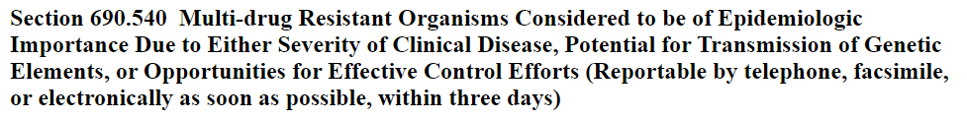
*NEW* Section for XDROs
Currently applies to Candida auris and CRE (carbapenem-resistant Enterobacterales) only
Allows us to make other emerging XDROs reportable under this section & provide instructions for control of cases/contacts
Notes:
Brings XDROs in line with other reportable conditions.

Slide 41
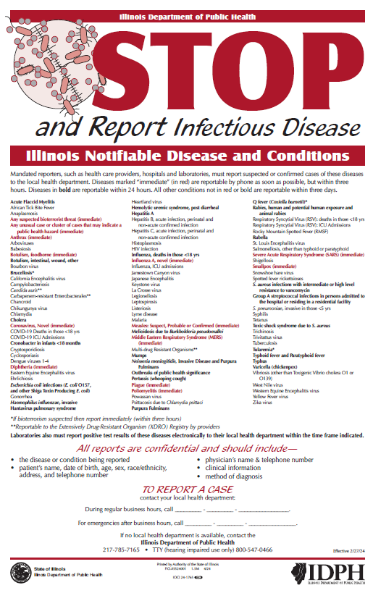

Updated Reportables Poster
=
**Reportable to the Extensively Drug-Resistant Organism (XDRO) Registry by providers
https://dph.illinois.gov/content/dam/soi/en/web/idph/files/publications/ReportDisease.pdf

Slide 42
XDRO Reporting Requirements in Illinois
Disease | Mandatory Reportable? | How?
Carbapenem-resistant Enterobacterales (CRE) | Yes | Labs/facilities report directly to XDRO registry. LTCFs/others may arrange to have their labs report on their behalf. LHDs may request that case investigation data be submitted via INEDSS for rare CRE types (e.g., NDM, VIM).
Candida auris (C. auris) | Yes | Labs/facilities report directly to XDRO registry as of 7/1/24. LHDs may request that case investigation data be submitted via INEDSS.

Slide 43
Voluntary XDRO Reporting in Illinois
Disease | Mandatory Reportable? | How?
Carbapenem-resistant Acinetobacter baumannii (CRAB) | No* | Voluntary reporting: Labs/facilities can report directly to XDRO registry as of 7/1/24. IDPH also enters into XDRO.
Carbapenemase-producing Pseudomonas aeruginosa (CP-CRPA) | No* | Voluntary reporting: Labs/facilities notify IDPH/CDPH, IDPH/CDPH enters into XDRO registry. Note: must have carbapenemase gene identified (e.g., VIM) or positive phenotypic test for carbapenemase production (e.g., CarbaNP or mCIM).
*Will eventually include under new 690.540 section. Memo would be sent out to notify facilities/labs.

Slide 44
*NEW* Requirement to Query or Get Automated Alerts
Section 690.1510 Entities Required to Submit and Query Information
b) The Department requires the following health care facilities to query or implement alert notification with the XDRO Registry in order to identify new admissions with XDROs:
1) Hospitals;
2) Long-term acute care hospitals;
3) Skilled nursing and intermediate care facilities; and
4) Dialysis centers.
(Source: Amended at 48 Ill. Reg. 4098, effective February 27, 2024)

Slide 45
THANK YOU
PRESENTER’S CONTACT INFO
IDPH website

Slide 46


Thank you for participating!
Next Meeting (on Teams): Thursday, November 21, 2:00 PM
Notes:
And on behalf of all of us at CDPH, a Big Thanks to all of you for making healthcare safer in Chicago!

Slide 47
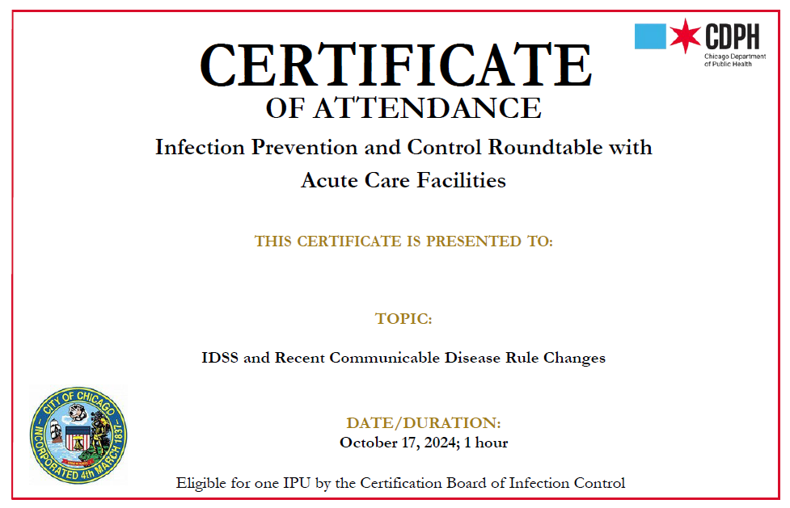
Certificate of Attendance

Slide 48
Additional Slides/Resources
(not presented during the meeting)

Slide 49



Reach out to us!
ACHOO TEAM
Our team:
  Deputy Commissioner: Stephanie Black
  Medical Director: Stephanie Black
  Michelle Funk
  Projects Administrator: Shane Zelencik
  Project Manager: Maria Bovee
  Infection Preventionist (IP):
    Andrea Castillo
    Karen Branch-Crawford
    Kim Goitia (Dialysis, Outpatient, FQHCs)
  Public Health Administrator (PHA):
    Romualdo Chavez
    Maggie Li
Major role: Build infection control capacity across healthcare facilities in Chicago
ACHOO Email: cdphhaiar@cityofchicago.org
ACHOO Phone: 312-744-1100
NEW: ACHOO HAN page

Slide 50
Our Services
Our team consists of Infection Prevention Specialists, Epidemiologists, Project Managers, Projects Administrators, and Medical Directors who provide the following assistance:
IP&C Guidance and Training
Infection Control Assessments and Responses (ICARs)
Epidemiology Support
IP&C Roundtable
Our partnerships and site visits are meant to be educational, constructive, non-regulatory, and non-punitive
  We work with you to resolve any identified issues
  These services are not in response to citations or complaints
Notes:
The tools that we use are publicly available on the Centers for Disease Control and Prevention (CDC) website (link) and can be reviewed prior to any visit.
Infection Prevention Training: Our experienced Infection Preventionists (IPs) can help train new infection control staff or front line staff on a variety of topics: basic infection control best practices, management of multi-drug resistant organisms (MDROs), prevention of healthcare associated infections, mandatory National Healthcare Safety Network (NHSN) and Illinois National Electronic Disease Surveillance System (INEDSS) reporting, surveillance, environmental rounds, outbreak management, and more.
Infection Control Assessments and Responses (ICARs): Standardized, CDC approved assessments with your team. Currently, the modules that are available are: Training, audits, feedback; Hand Hygiene; Transmission Based Precautions; Environmental Services. We can come on site to do these with our staff as a training opportunity or as a second set of eyes.
Epidemiology Support : Our epidemiologists can assist with outbreak investigations and summarizing facility-level data. This may include data collection, analysis, and/or data visualization support.
IP&C Roundtable: You are here!!! Thanks so much for participating. We want this to be a community of practice, and a place where you can ask any questions you might have and learn from your peers. We will do our best to bring anything you need to know (e.g., changes, updates, outbreaks, etc.) to this meeting. Even if you are familiar with a topic we are presenting, we encourage you to attend to share your knowledge and experience with folks that are not as familiar.

Slide 51
Case Report Forms (CRFs)
CDPH requires additional epidemiological information for specific cases, in addition to the standard reporting requirement. Providing this information to CDPH allows us to have a better understanding of individual case and aids in limiting the transmission of certain multi-drug resistant organisms.
For MDRO Reporting training (whether you have a new IP or need a refresher) and for questions regarding CRF completion requirements, please contact Cecilia Pigozzi at cecilia.pigozzi@cityofchicago.org
Notes:
The tools that we use are publicly available on the Centers for Disease Control and Prevention (CDC) website (link) and can be reviewed prior to any visit.
Infection Prevention Training: Our experienced Infection Preventionists (IPs) can help train new infection control staff or front line staff on a variety of topics: basic infection control best practices, management of multi-drug resistant organisms (MDROs), prevention of healthcare associated infections, mandatory National Healthcare Safety Network (NHSN) and Illinois National Electronic Disease Surveillance System (INEDSS) reporting, surveillance, environmental rounds, outbreak management, and more.
Infection Control Assessments and Responses (ICARs): Standardized, CDC approved assessments with your team. Currently, the modules that are available are: Training, audits, feedback; Hand Hygiene; Transmission Based Precautions; Environmental Services. We can come on site to do these with our staff as a training opportunity or as a second set of eyes.
Epidemiology Support : Our epidemiologists can assist with outbreak investigations and summarizing facility-level data. This may include data collection, analysis, and/or data visualization support.
IP&C Roundtable: You are here!!! Thanks so much for participating. We want this to be a community of practice, and a place where you can ask any questions you might have and learn from your peers. We will do our best to bring anything you need to know (e.g., changes, updates, outbreaks, etc.) to this meeting. Even if you are familiar with a topic we are presenting, we encourage you to attend to share your knowledge and experience with folks that are not as familiar.

Slide 52


Slide 53
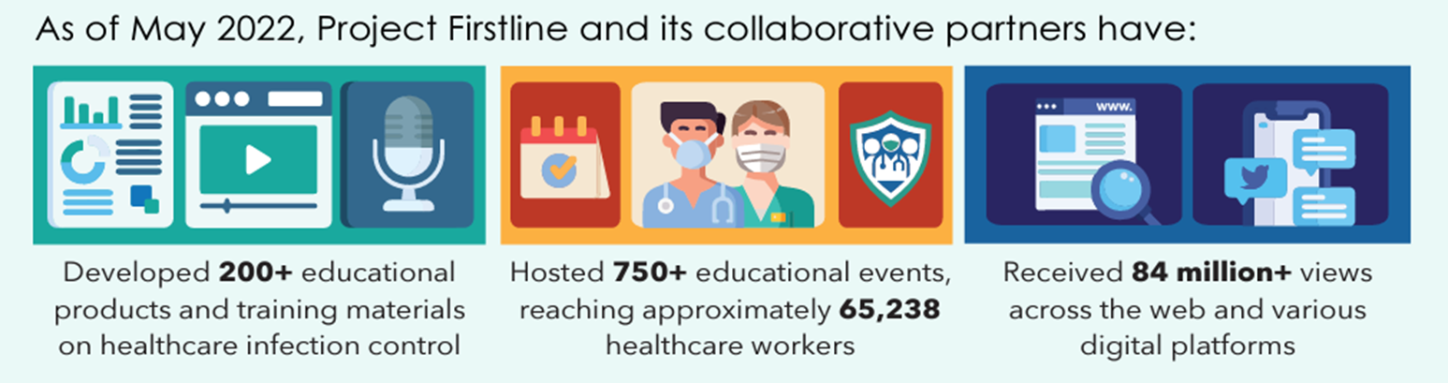
Project Firstline Overview
Project Firstline is the Center for Disease Control’s (CDC) National Training Collaborative for Healthcare Infection Control education
Project Firstline (PFL) brings together more than 75 healthcare, academic, and public health partners to reach healthcare workers across the country
PFL offers educational resources in a variety of formats to meet the diverse learning needs and preferences of the healthcare workforce

Slide 54
Available Resources
Learn about Infection Control in Health Care: CDC’s Project Firstline provides innovative and accessible resources so all healthcare workers can learn about infection control in health care.
  Topics include 14+ foundational IP&C (e.g., hand hygiene, environmental services, ventilation, PPE, how viruses spread, etc.), Recognizing Risk using Reservoirs, Where Germs Live training toolkits, and more interactive resources.
Lead an Infection Control Training: Our facilitator toolkit is designed to work with your team’s learning styles and busy schedules (10-, 20-, and 60-minute scripted sessions).
Access Infection Control Educational Materials: Find short videos, fact sheets, job aids, infographics, posters, printed materials, interactive computer lock screens, and social media graphics to utilize at your facility on foundational IPC topics.
Earn Continuing Education: Earn CEU’s on CDC Train for PFL content.
Translated Resources: IPC materials translated into Spanish & additional languages.

Slide 55
Infection Control Training Topics (Onsite/Virtual with IDPH CEU/CEC)
The Concept of Infection Control
The Basic Science of Viruses
How Respiratory Droplets Spread COVID-19
How Viruses Spread from Surfaces to People
How COVID-19 Spreads - A Review
Multi-Dose Vials
PPE Part 1 - Eye Protection
PPE Part 2 - Gloves & Gowns
Hand Hygiene
Virus Strains
PPE Part 3 - Respirators
EVS (Enviro Cleaning & Disinfection)
Source Control
Asymptomatic Spread of COVID-19
Ventilation

Slide 56
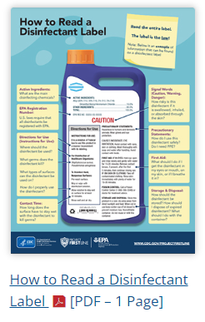
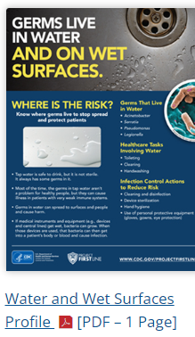
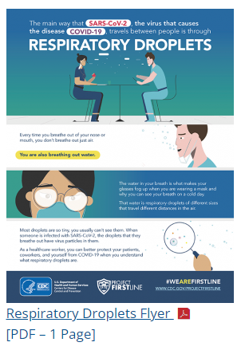

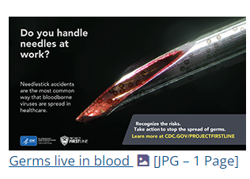
Print Materials & Job Aids
Several print materials and job aids available on foundational IP&C topics.
  Available for free download on CDC's website.
  Including lock screens for staff computers.
We are happy to offer professional printing support for poster requests!
  Please see our team after the presentation to request print materials.
  For remote guests, please email: projectfirstline@cityofchicago.org.

Slide 57
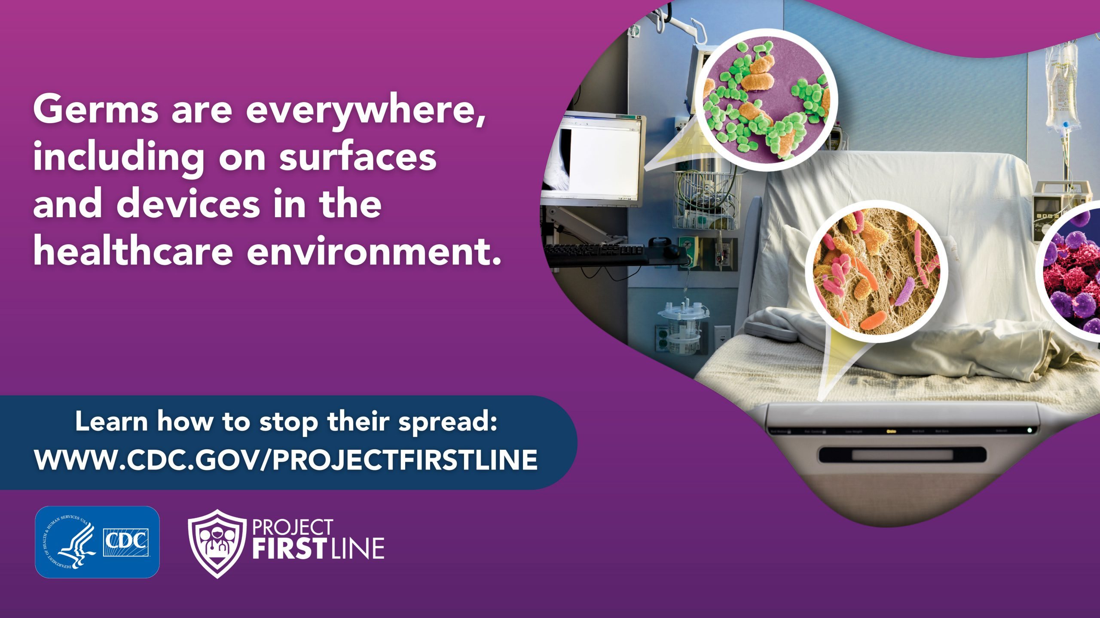

Slide 58
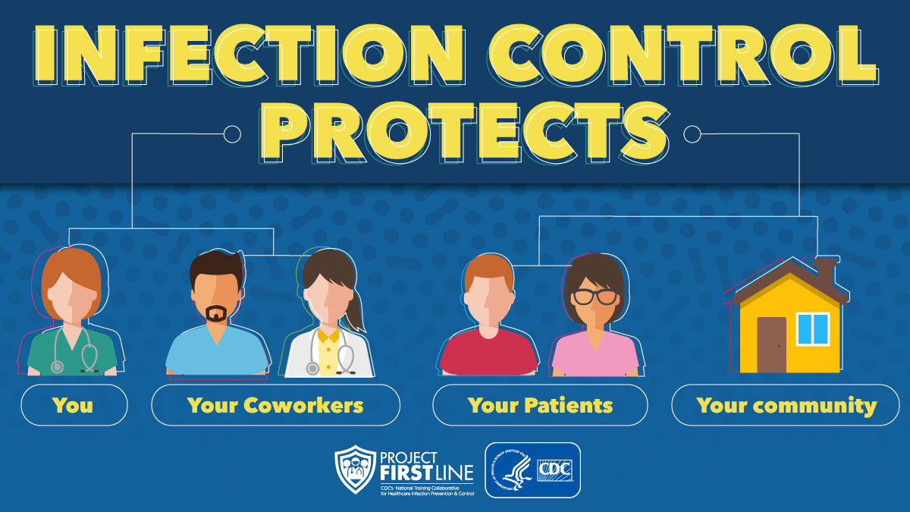

Slide 59


Slide 60


Slide 61


Your Chicago Project Firstline Team
CDPH Infection Preventionist: Your facility's main contact for all infection prevention and control questions.
  General contact information: cdphhaiar@cityofchicago.org
PFL-CDPH Team: Contact our team to learn about specific Chicago-based educational opportunities!
  We offer many resources including virtual or onsite trainings, webinars, and job aides.
  CDPH Project Firstline email:
  projectfirstline@cityofchicago.org
Visit our Chicago Health Alert Network (HAN) page by scanning the QR code in the shield logo above to access resources and sign up for the newsletter to stay up to date on exciting new IPC resources!

Slide 62
Infection Control Assessment Tools | HAI | CDC
Click on each module below to open the tool in a fillable PDF document.
Module 1 – Training, Audits, Feedback
Module 2 – Hand Hygiene
Module 3 – Transmission-Based Precautions (TBP)
Module 4 – Environmental Services (EVS)
Module 5 – High-level Disinfection and Sterilization
Module 6 – Injection Safety
Module 7 – Point of Care (POC) Blood Testing
Module 8 – Wound Care
Module 9 – Healthcare Laundry
Module 10 – Antibiotic Stewardship
Module 11 – Water Exposure
ICARs
Are non-regulatory and non-punitive
Facilitate collaboration among facility departments
Provide learning opportunities in critical areas
Help facilities prepare for Joint Commission surveys
Increase involvement of facility leaders in infection prevention work
Notes:
Don’t work with IDPH or CMS

