Slide 1
Applying for an Individual I-CARE User Account
December 2023

Slide 2
Individual I-CARE Access
Navigate to the Site:
I-CARE Enrollment - Smartsheet.com
Select Individual I-CARE Access

Slide 3
Step 1:
Register for the Web Portal

Slide 4
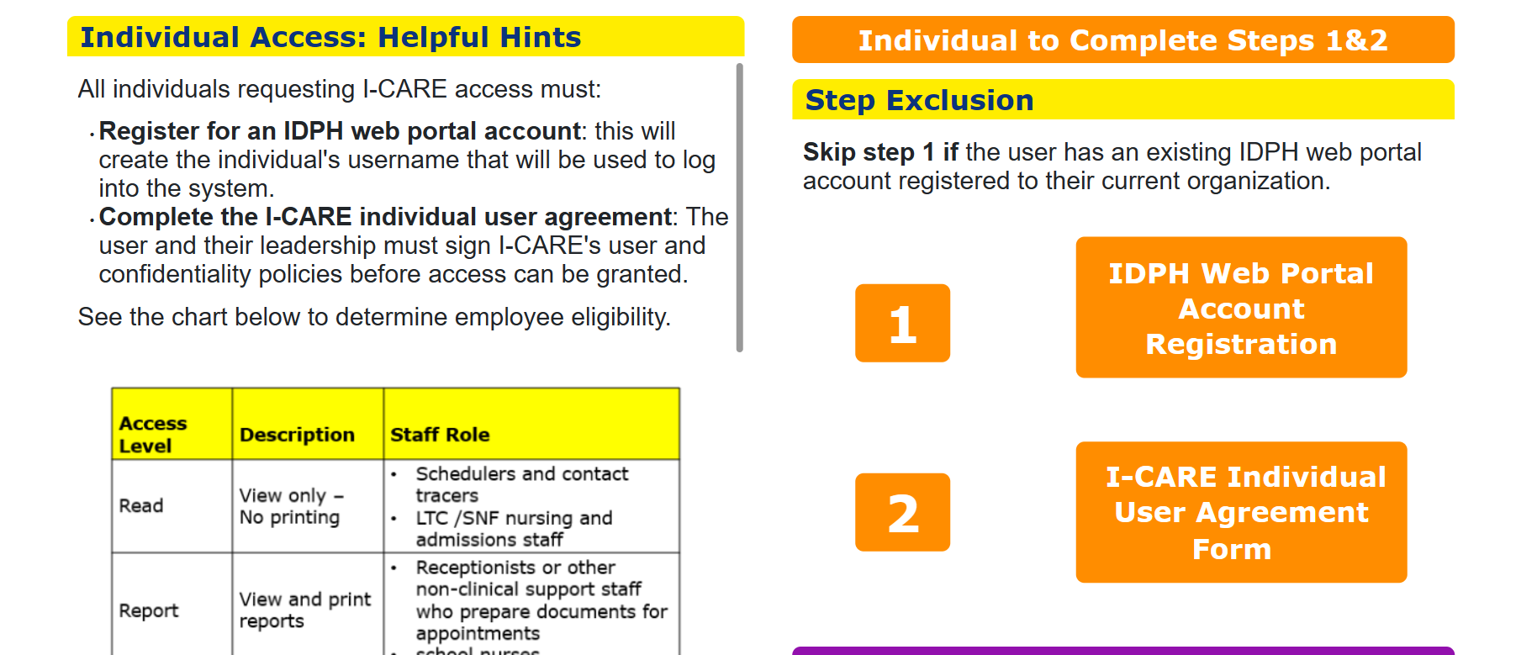
Step 1: Register for the Web Portal
Select IDPH Web portal account registration
Launch the IDPH Web portal account
All individuals requesting I-CARE access must register for an IDPH web portal AND complete the I-CARE Individual User Agreement.

Slide 5
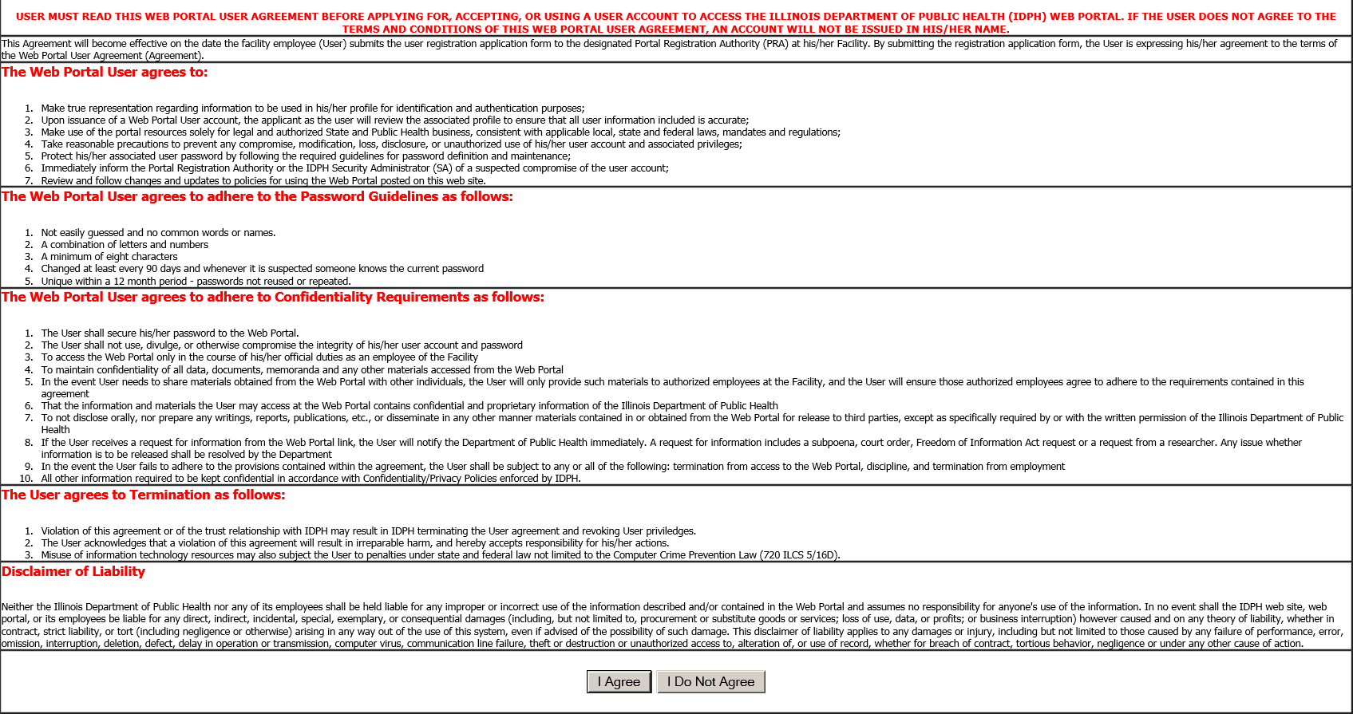
Web Portal Agreement
This agreement reviews the general user guidelines and password and confidentiality guidelines.
Read the Web Portal Agreement.
Select "I Agree" to continue
or
"I Do Not Agree" to go back.

Slide 6
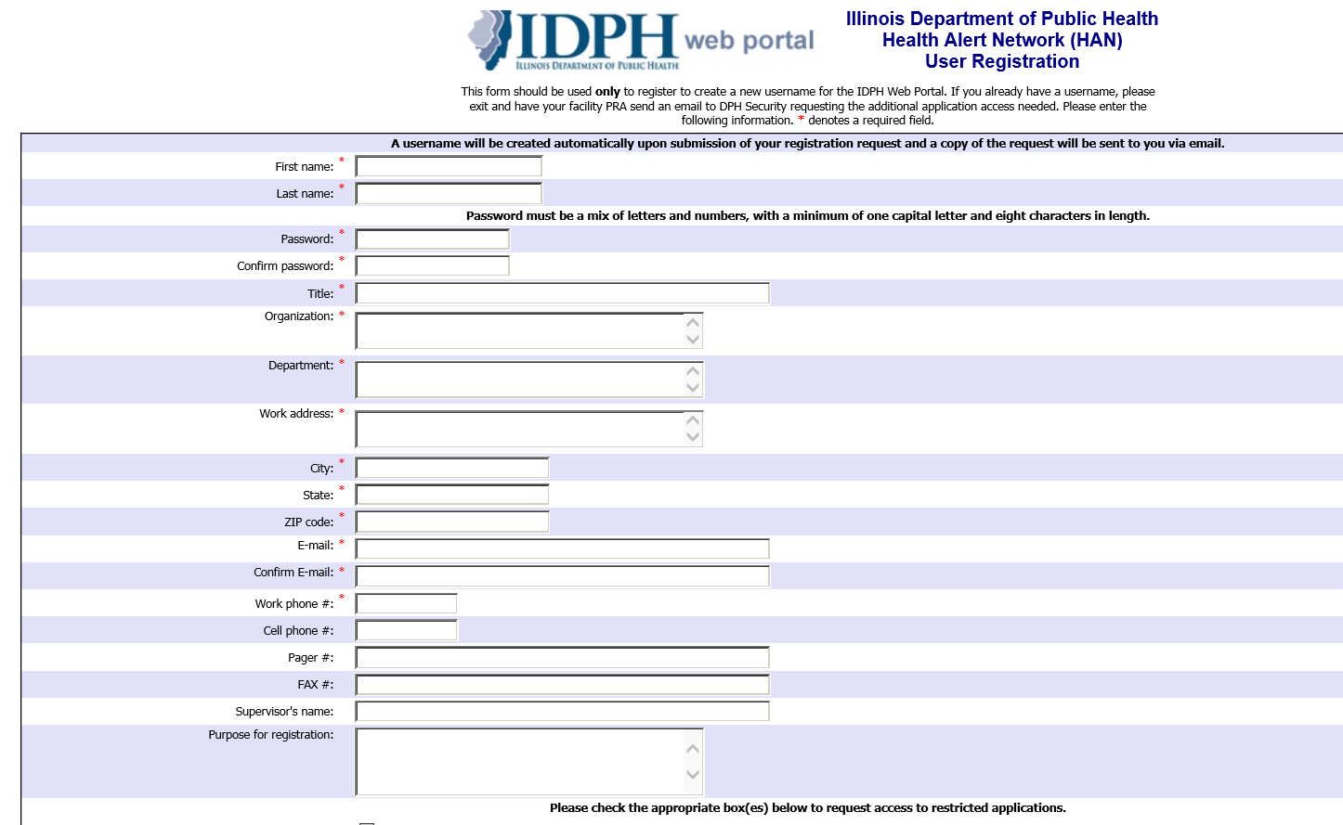
Complete IDPH Web Portal Registration
Complete all necessary fields
indicated with a red asterisks
Provide information related to your current site
Title = Current Job Title
Provide individual work email used by the applicant (group emails are not permitted)

Slide 7
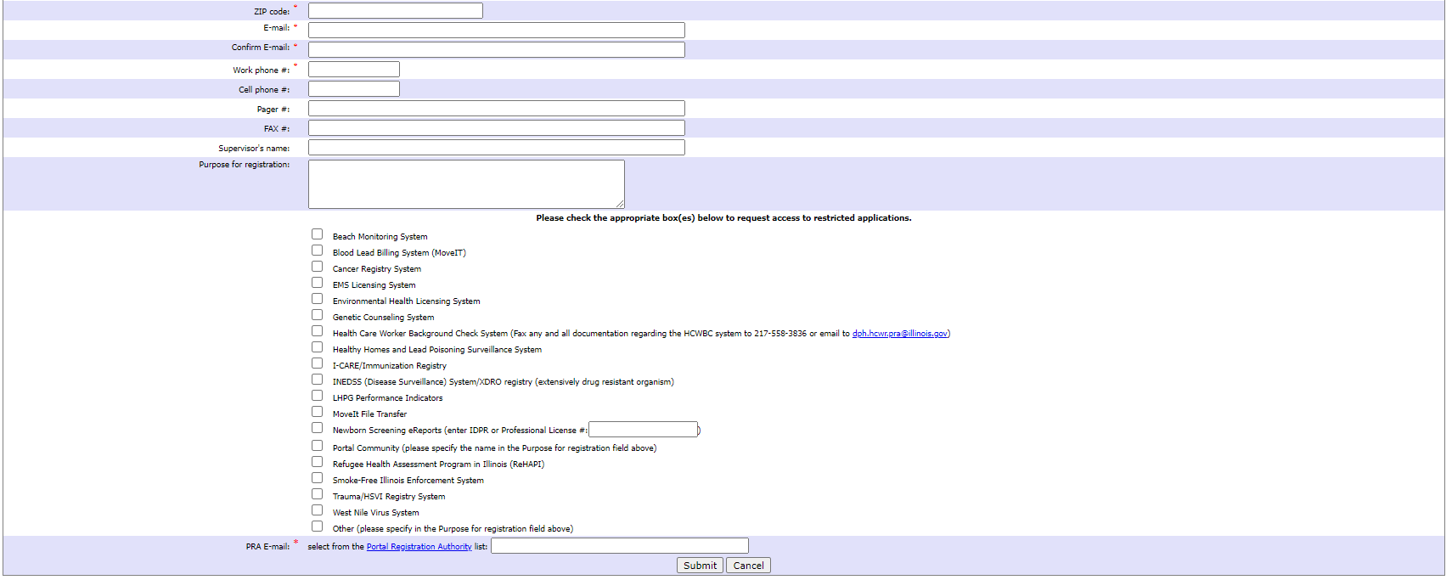
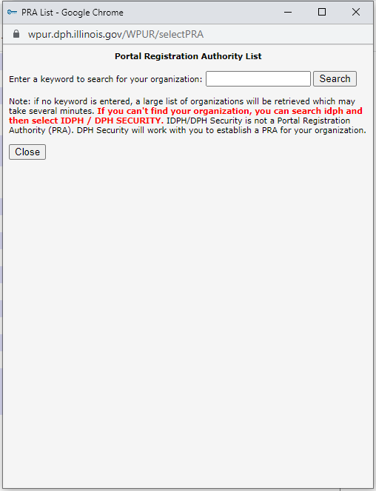
Complete IDPH Web Portal Registration
Select I-CARE from the application options
PRA E-mail: Select Portal Registration Authority to pull up the search bar.

Slide 8
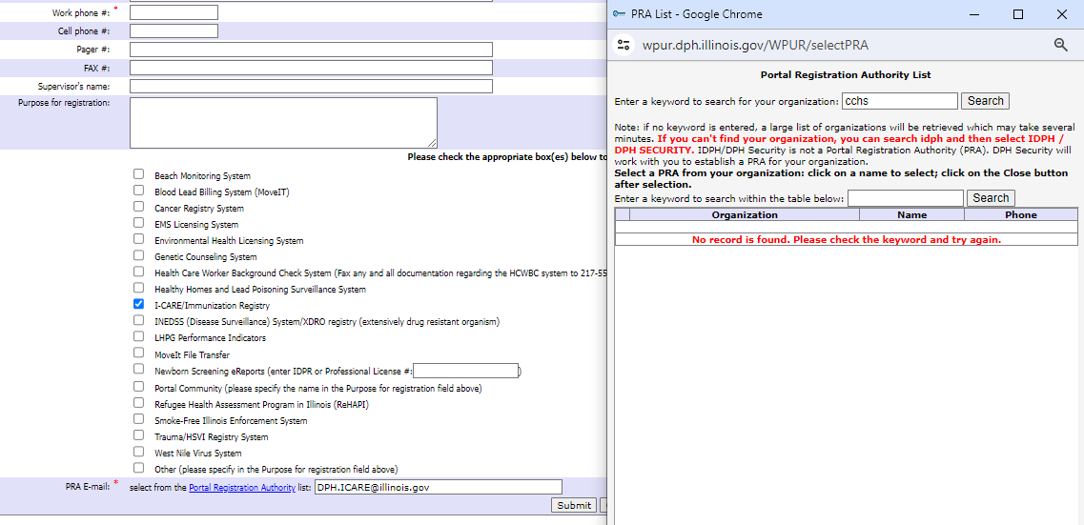
Select Portal Registration Authority (PRA)
Site Name
Site Name
PRA Name
Input the site name into the search bar in the PRA list window and select current PRA.
If you are unable to locate your PRA, use IDPH to search and use DPH I-CARE.

Slide 9
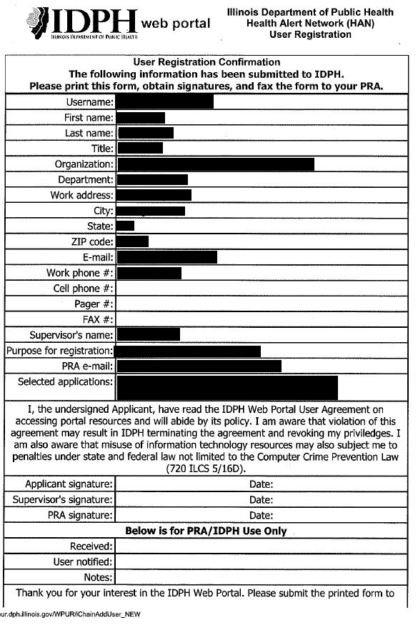
Save Web Portal Agreement
You will need your username and password when completing the individual user agreement in the next step.
Please store your username and password securely.

Slide 10
Step 2:
Individual User Agreement

Slide 11
Step 2: Individual User Agreement (IUA)
Select I-CARE Individual User Agreement Form.

Slide 12
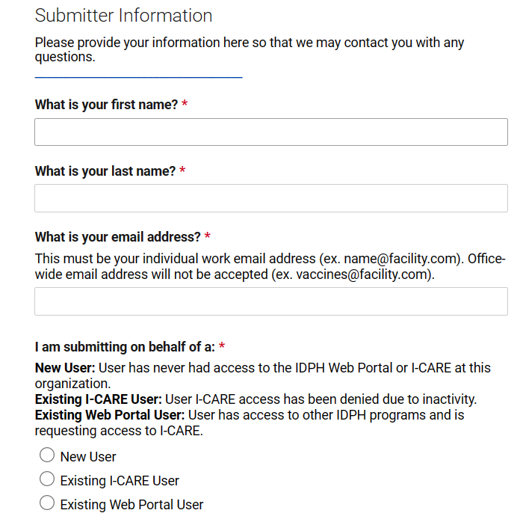
Submitter Information
*Complete all fields with red asterisks.
If submitting for someone else, provide their first and last name, work email address, web portal username, phone number, and role.

Slide 13
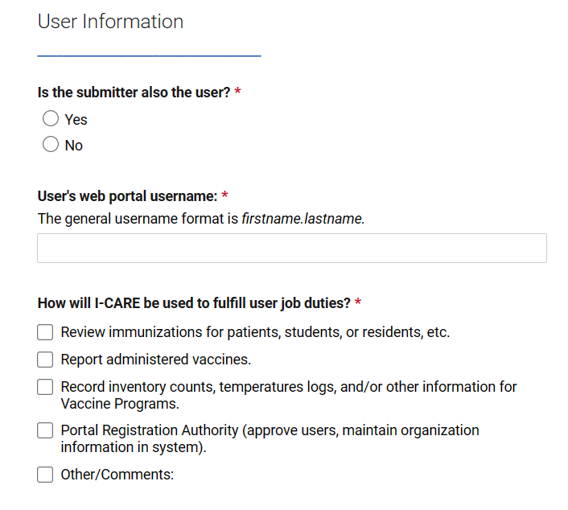
User Information
*Complete all fields with red asterisks.

Slide 14
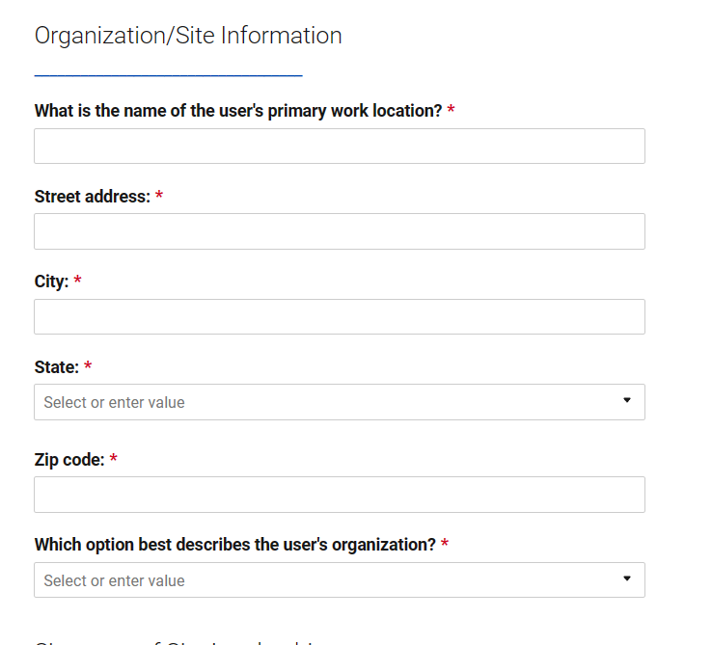
Organization/Site Information
*Complete all fields with red asterisks.

Slide 15
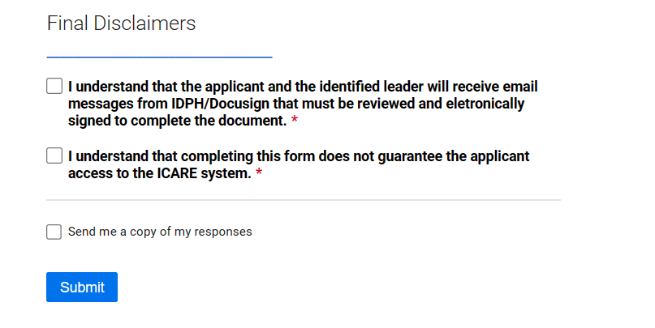
Final Disclaimers
Final Disclaimers: Review the disclaimers, check the boxes to indicate that you understand, and click Submit.

Slide 16
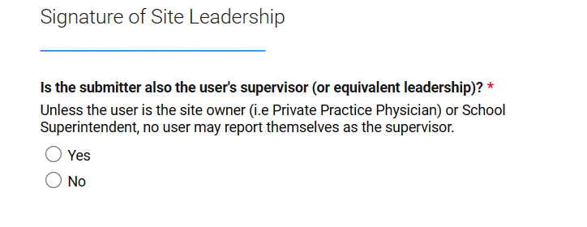
Signature of Site Leadership
*Complete all fields with red asterisks.
Confirm if the submitter is the user’s supervisor. If not, provide the supervisor’s name, email, and title.

Slide 17
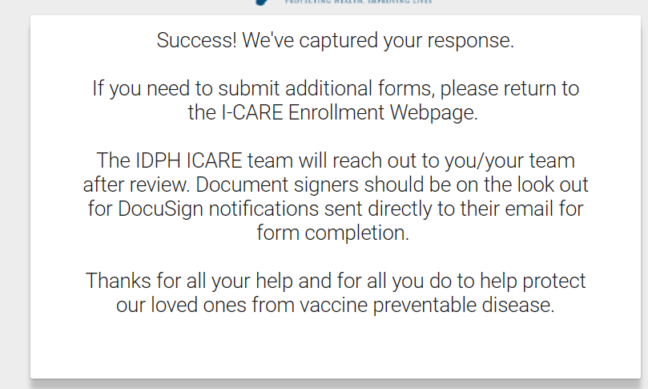
Application Submitted
After applying, both the applicant and the supervisor will receive an email from IDPH/DocuSign containing documents that require electronic review and signature.
Please monitor incoming emails from IDPH and reply within the same email thread. If there is any missing information, both the Applicant and Supervisor may receive a follow-up email. Failure to respond to these email requests may result in a delay in the application process.

Slide 18
Signature Process

Slide 19
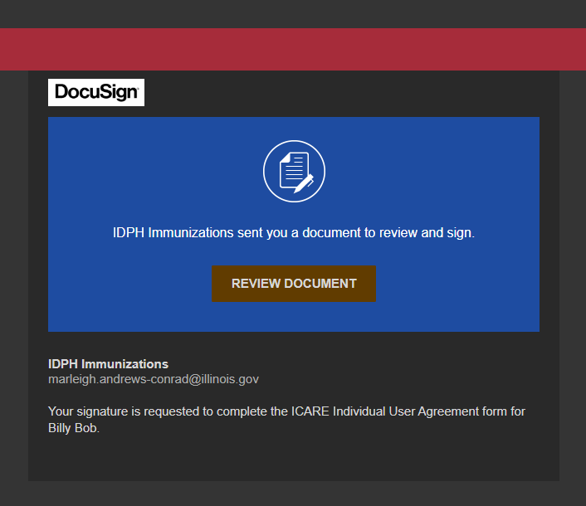
Signatures
Once the application is submitted and approved an email from IDPH/DocuSign will be sent.
Signatures will be required from the user, supervisor, and PRA.
Click on "Review Document“.

Slide 20
Signatures
Once application is submitted and approved you will need to complete signatures via DocuSign
Read the disclosure. If you agree, select the box with "I agree" and click Continue

Slide 21
Signatures
Select the “Start” button to review and sign the Docusign.

Slide 22
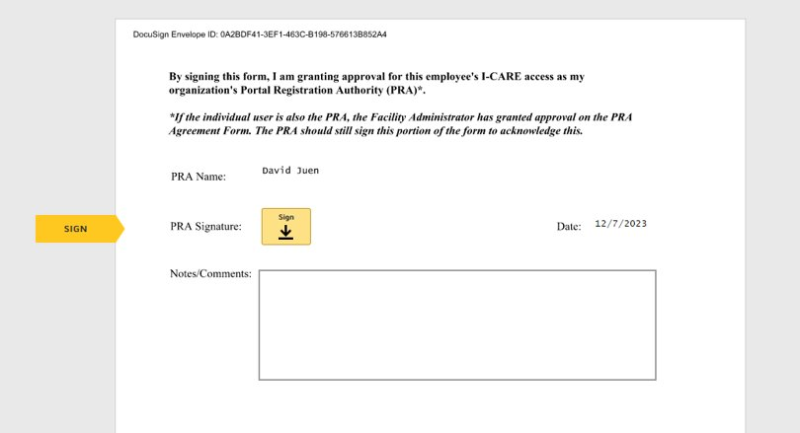
Signatures
Select the “Sign” button to sign the DocuSign.

Slide 23
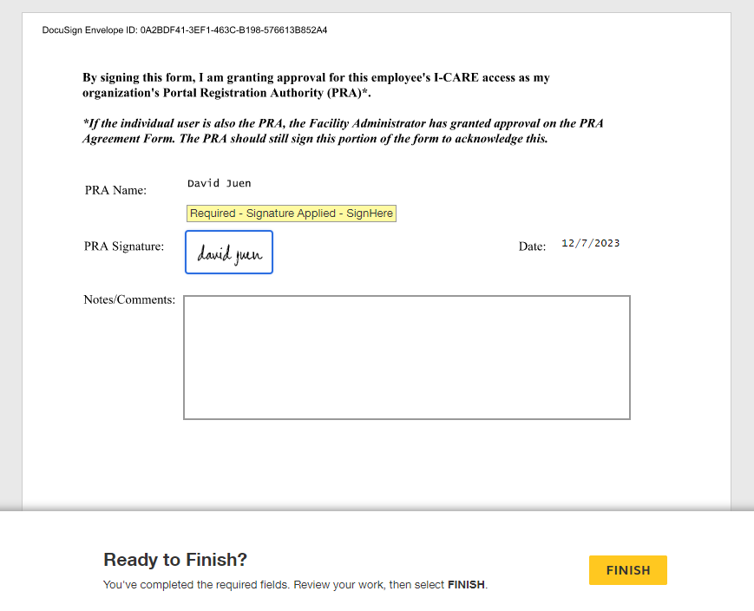
Signatures
Only the PRA will have the option to provide any notes or comments they wish to communicate to IDPH staff on the form.
Select Finish to submit.

Slide 24
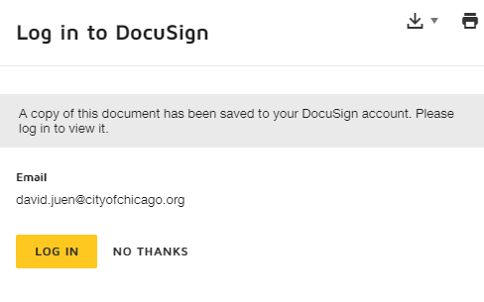
Signatures
You will receive an email confirmation once completed.
You have the option to download or print a copy of the form.
You can also log in to your DocuSign account to retrieve a copy.

Slide 25
Congratulations!
Your Individual I-CARE Account Has Been Submitted
For help, questions, or feedback please contact:
IDPH Immunization Section at dph.icare@illinois.gov or
call 217-785-1455 and select option 1.
Provider offices within the City of Chicago can also reach out to:
dominique.chandler@cityofchicago.org
Office Number: 312-744-0300
Cell Number: 312-502-6442

