Slide 1
Applying for an Individual I-CARE user Account
Kristin Elich – Public Health Associate – CDPH

Slide 2
Register for Web Portal
Complete Individual User Agreement
Complete the SmartSheet application
  Upload all pertinent signed document:
  I-CARE web portal registration AND an individual user agreement
  2) Do not Fax or Email information to IDPH
  Note: CDPH does not have control over I-CARE approval

Slide 3
Portal Registration Authority(PRA)
Each site must elect a Portal Registration Authority (PRA) - See Slide 4
This individual will approve any new accounts that come into their clinical site
Before applying for I-CARE Access you should ask your supervisor who your PRA is. Contact ChicagoVFC@cityofchicago.org if you need assistance.
You must select them during the individual I-CARE application process, and they must sign off on your account approval prior to uploading in the smartsheet
If you are unable to find your PRA in your Portal Registration Authority List on Slide 13 please select input DPH and select DPH.ICARE to complete the Web Portal Agreement.
Once all documents have been signed by applicant, manager and PRA, the PRA submits the required documents to the smartsheet for approval (slide 16) from IDPH

Slide 4
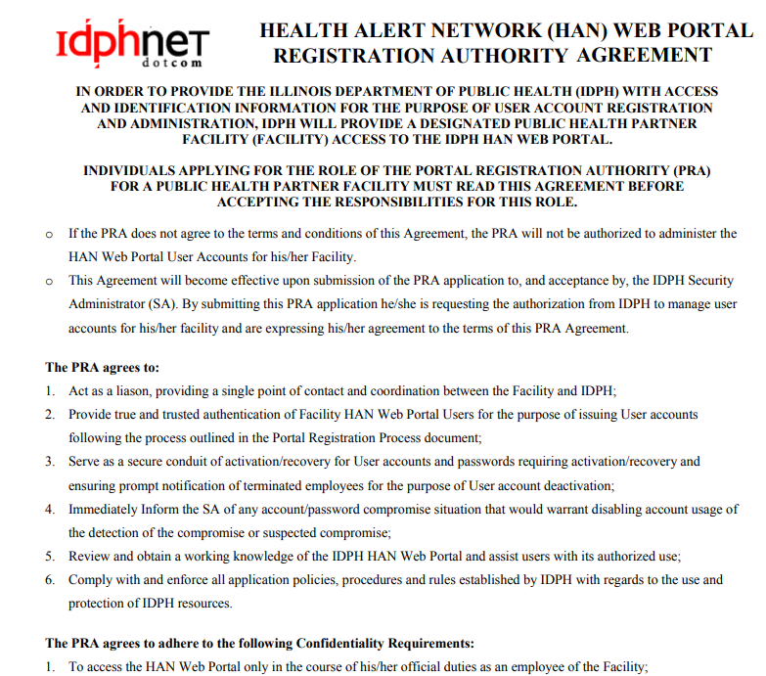
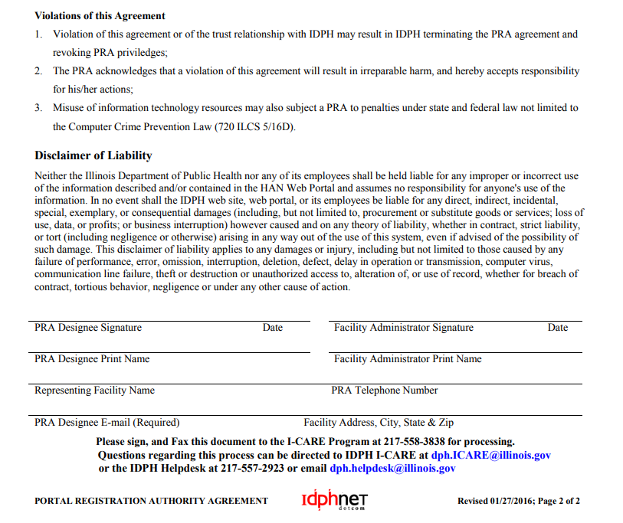
PRA Application
*** If you have a PRA, skip this step to slide 5 ***
If you site has no PRA, select your PRA and submit the PRA Agreement in the below link to the smartsheet
PRA Agreement - I-CARE.pdf

Slide 5
Register for Web Portal

Slide 6
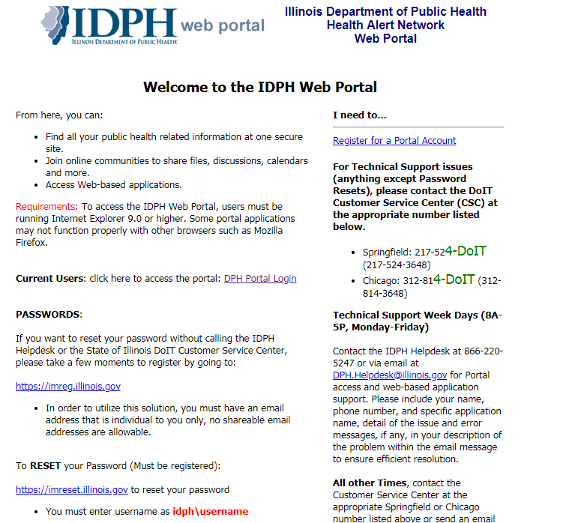
The application process is online through IDPH
Navigate to: http://portalhome.dph.illinois.gov/
Select Register for Portal Account

Slide 7
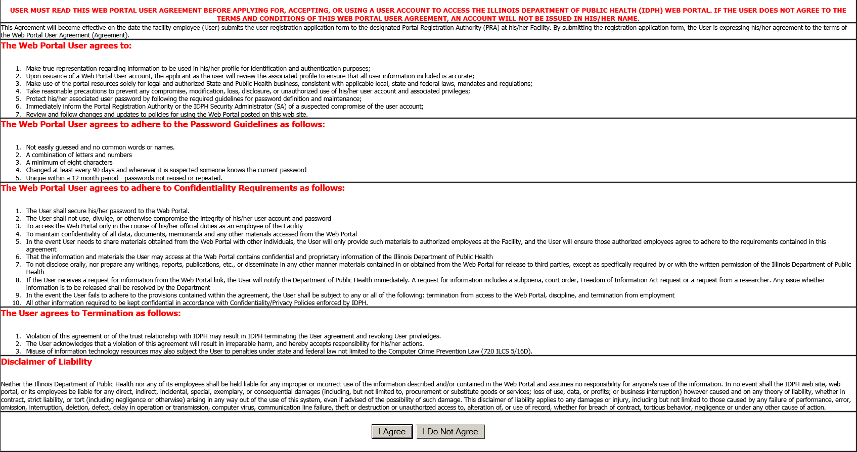
Agree to Terms of ICARE Application
This agreement goes over the general user guidelines, password guidelines, and confidentiality
Select ‘I Agree’ to continue

Slide 8
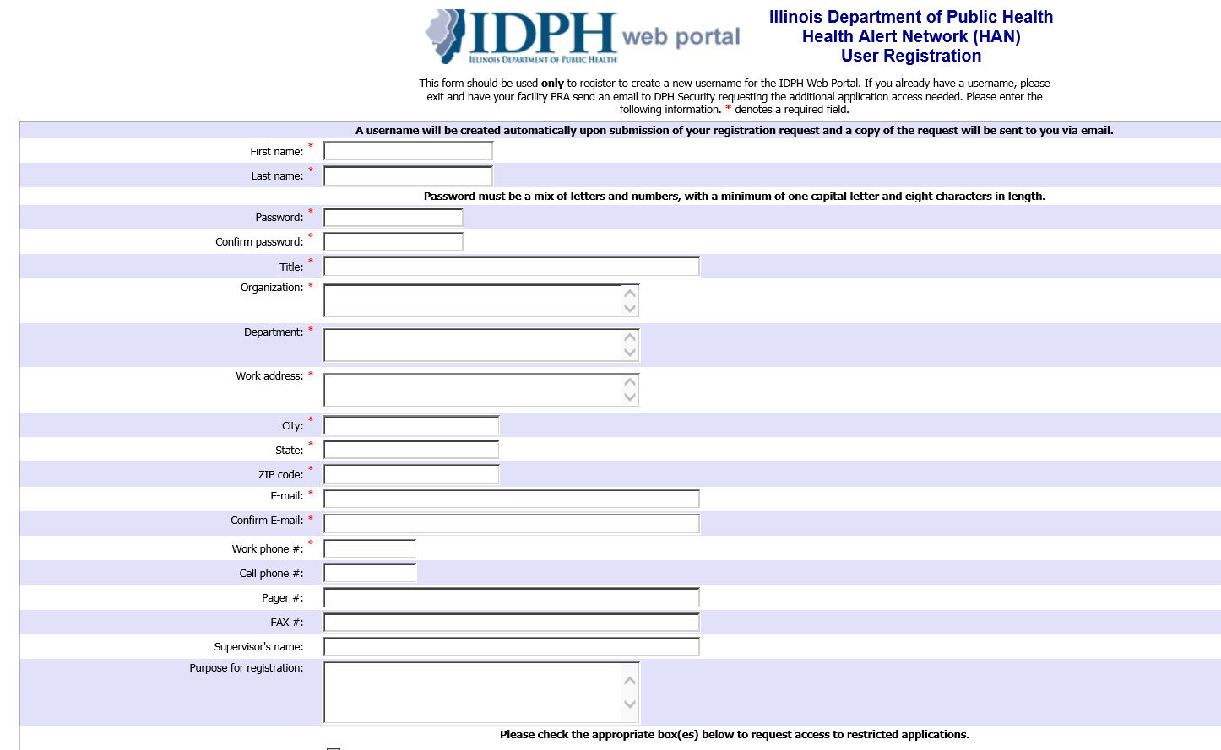
Complete Online Application
Complete all necessary fields
indicated with a red asterisks
You should provide all pertinent information related to your current clinical site
Provide individual work email used by the applicant

Slide 9
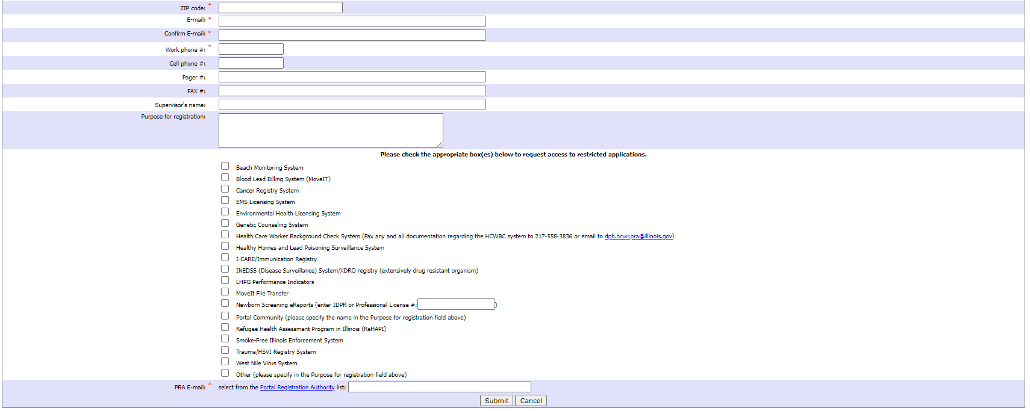
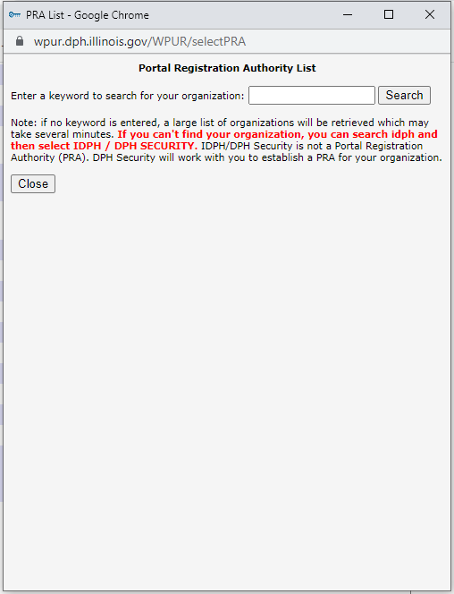





Complete Online Application Cont’
2
After filling out your information, select the box(es) below request restricted application access
1) Select the Portal Registration Authority button (1) to pull up the search bar (2)
1

Slide 10
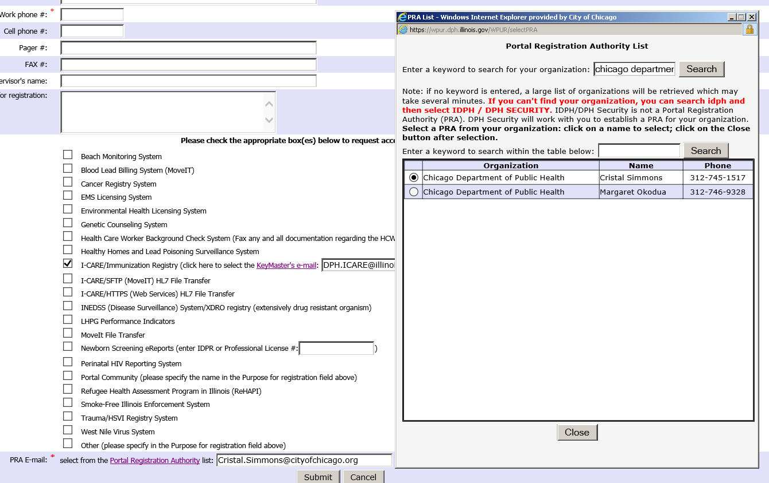
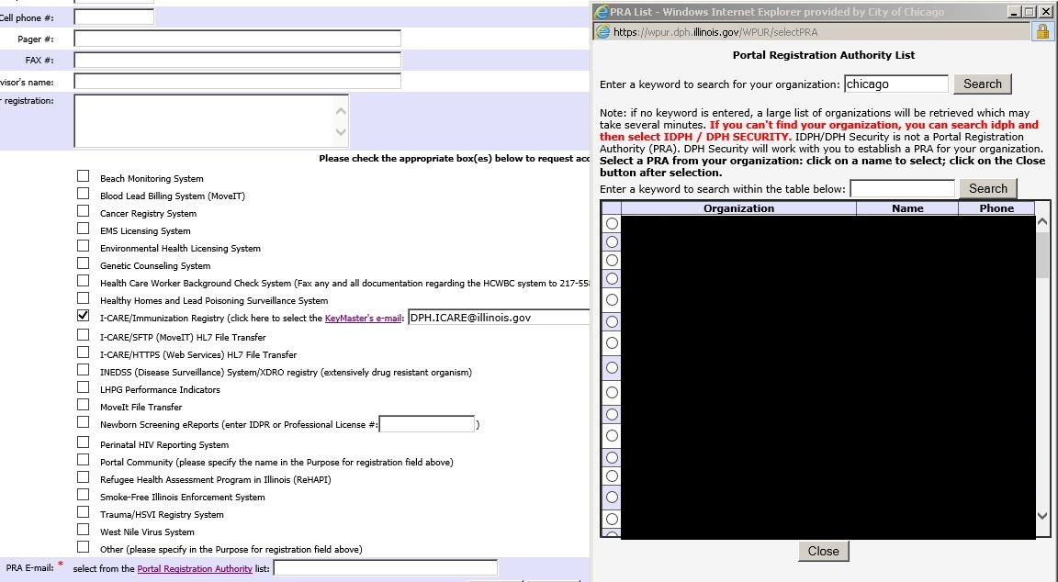
Select Portal Registration Authority
Site Name
2
Site Name
PRA Name
3
2) Input site name into search bar in PRA list window
3) Select current PRA to send application
* PRA is the Portal Registration Authority (see slide 3)
* This individual will approve I-CARE access for any application at your specific provider.
1

Slide 11
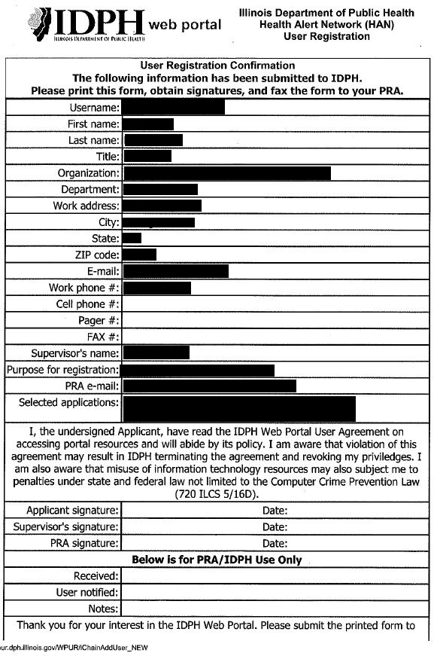
Print > Sign > Send
After you submit the application online, save a digital copy then print for signatures
The below listed individuals will need to sign and date printed document
* Applicant Signature
* Supervisor Signature
* PRA Signature
If supervisor and PRA are the same person, have them sign both lines

Slide 12
Individual User Agreement

Slide 13
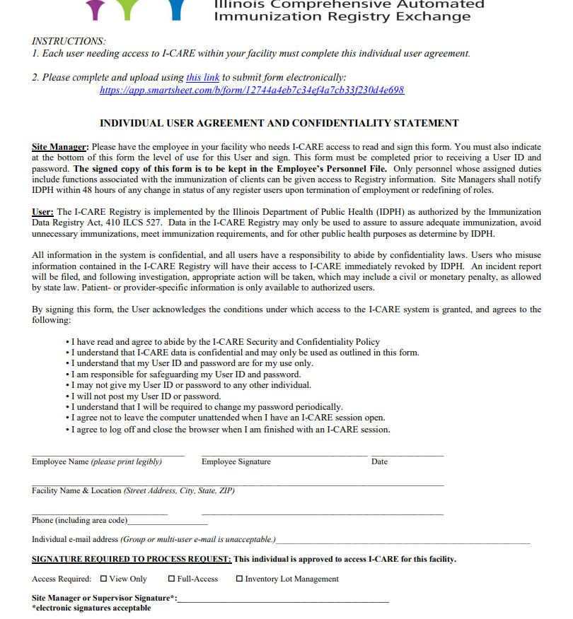




Individual User Agreement (IUA)
You will need to print, sign and submit an I-CARE Individual User Agreement with your Web Portal Application
* Applicant must fill out and sign document
* Site manager or supervisor must sign document
Link to IUA:
https://dph.illinois.gov/content/dam/soi/en/web/idph/files/publications/icare-individual-user-final-072512-102016.pdf

Slide 14
SmartSheet Process

Slide 15
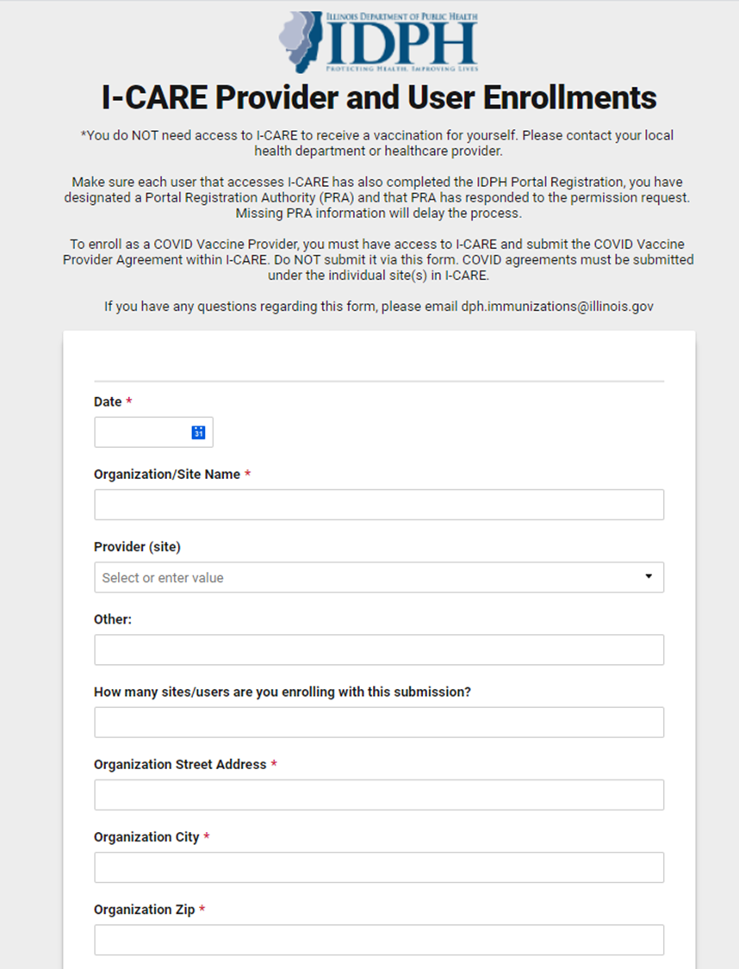
SmartSheet
Here is the link to the SmartSheet, where you can begin your application process:
https://app.smartsheet.com/b/form/12744a4eb7c34ef4a7cb33f230d4e698
* Please Complete all required fields as indicated by the red asterisks

Slide 16
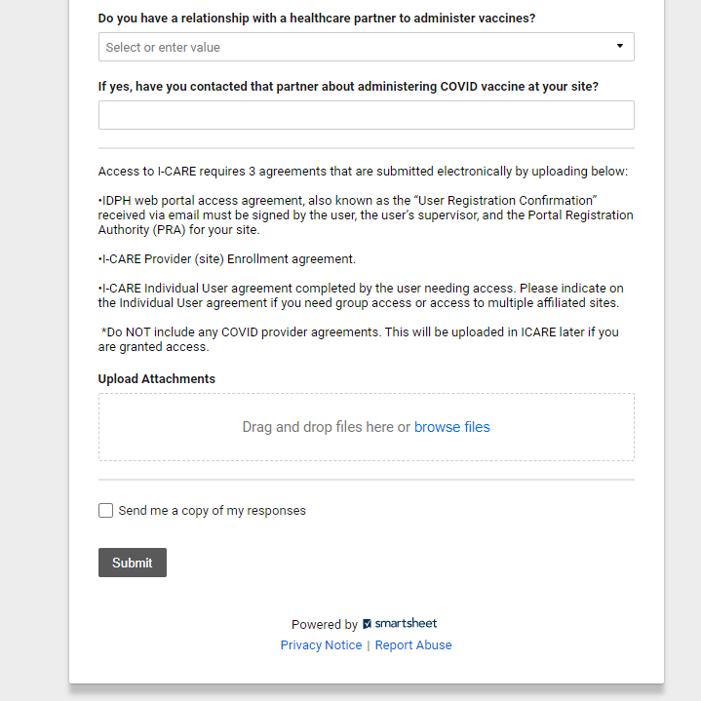
SmartSheet
PRA must upload 2 Agreements here for applicant:
1) IDPH Web Portal
2) I-CARE Individual
*Please ensure that you do not click submit before uploading these requirements

Slide 17
What Comes Next
PRA will receive an email from DPH to confirm if they approve the applicant to have I-CARE access to the site. Please keep an eye out for all emails from DPH and respond to the same email chain.
Applicant, PRA and Supervisors must pay attention to all emails from DPH in the event there are missing requirements. Not responding to these email requests accordingly will delay the application process.

Slide 18

Your I-CARE account is now setup!
Please reach out if you need further assistance or have any questions.
Chicagovfc@cityofchicago.org
Office Number:
312-744-0300

